Slide 1

ESA Third Party Missions & Copernicus Contributing Missions – Commercialisation through data procurement
© image acquired by GEOSAT-2, Geosat, 2024
Peggy Fischer, ESA EO Third Party Missions Manager
Kap Europe,
Frankfurt am Main
ESA as Anchor Customer
THE 2nd EO COMMERCIALISATION FORUM
27/28th October 2024

Slide 2






ESA procures EO data (and associated services) for its own purpose or on behalf of other institutions
→ ESA Third Party Missions and Copernicus Contributing Missions
Earthnet Third Party Missions
Copernicus Contributing Missions
EO data for R&D and science needs
EO data (and associated delivery services) for operational public needs
Initial data assessment
(mainly for commercial EO data)
Growing data portfolio including
emerging data domains
Operational data delivery:
from established data suppliers
from emerging data suppliers
→ includes some coordination with NASA
ESA as Anchor Customer

Slide 3
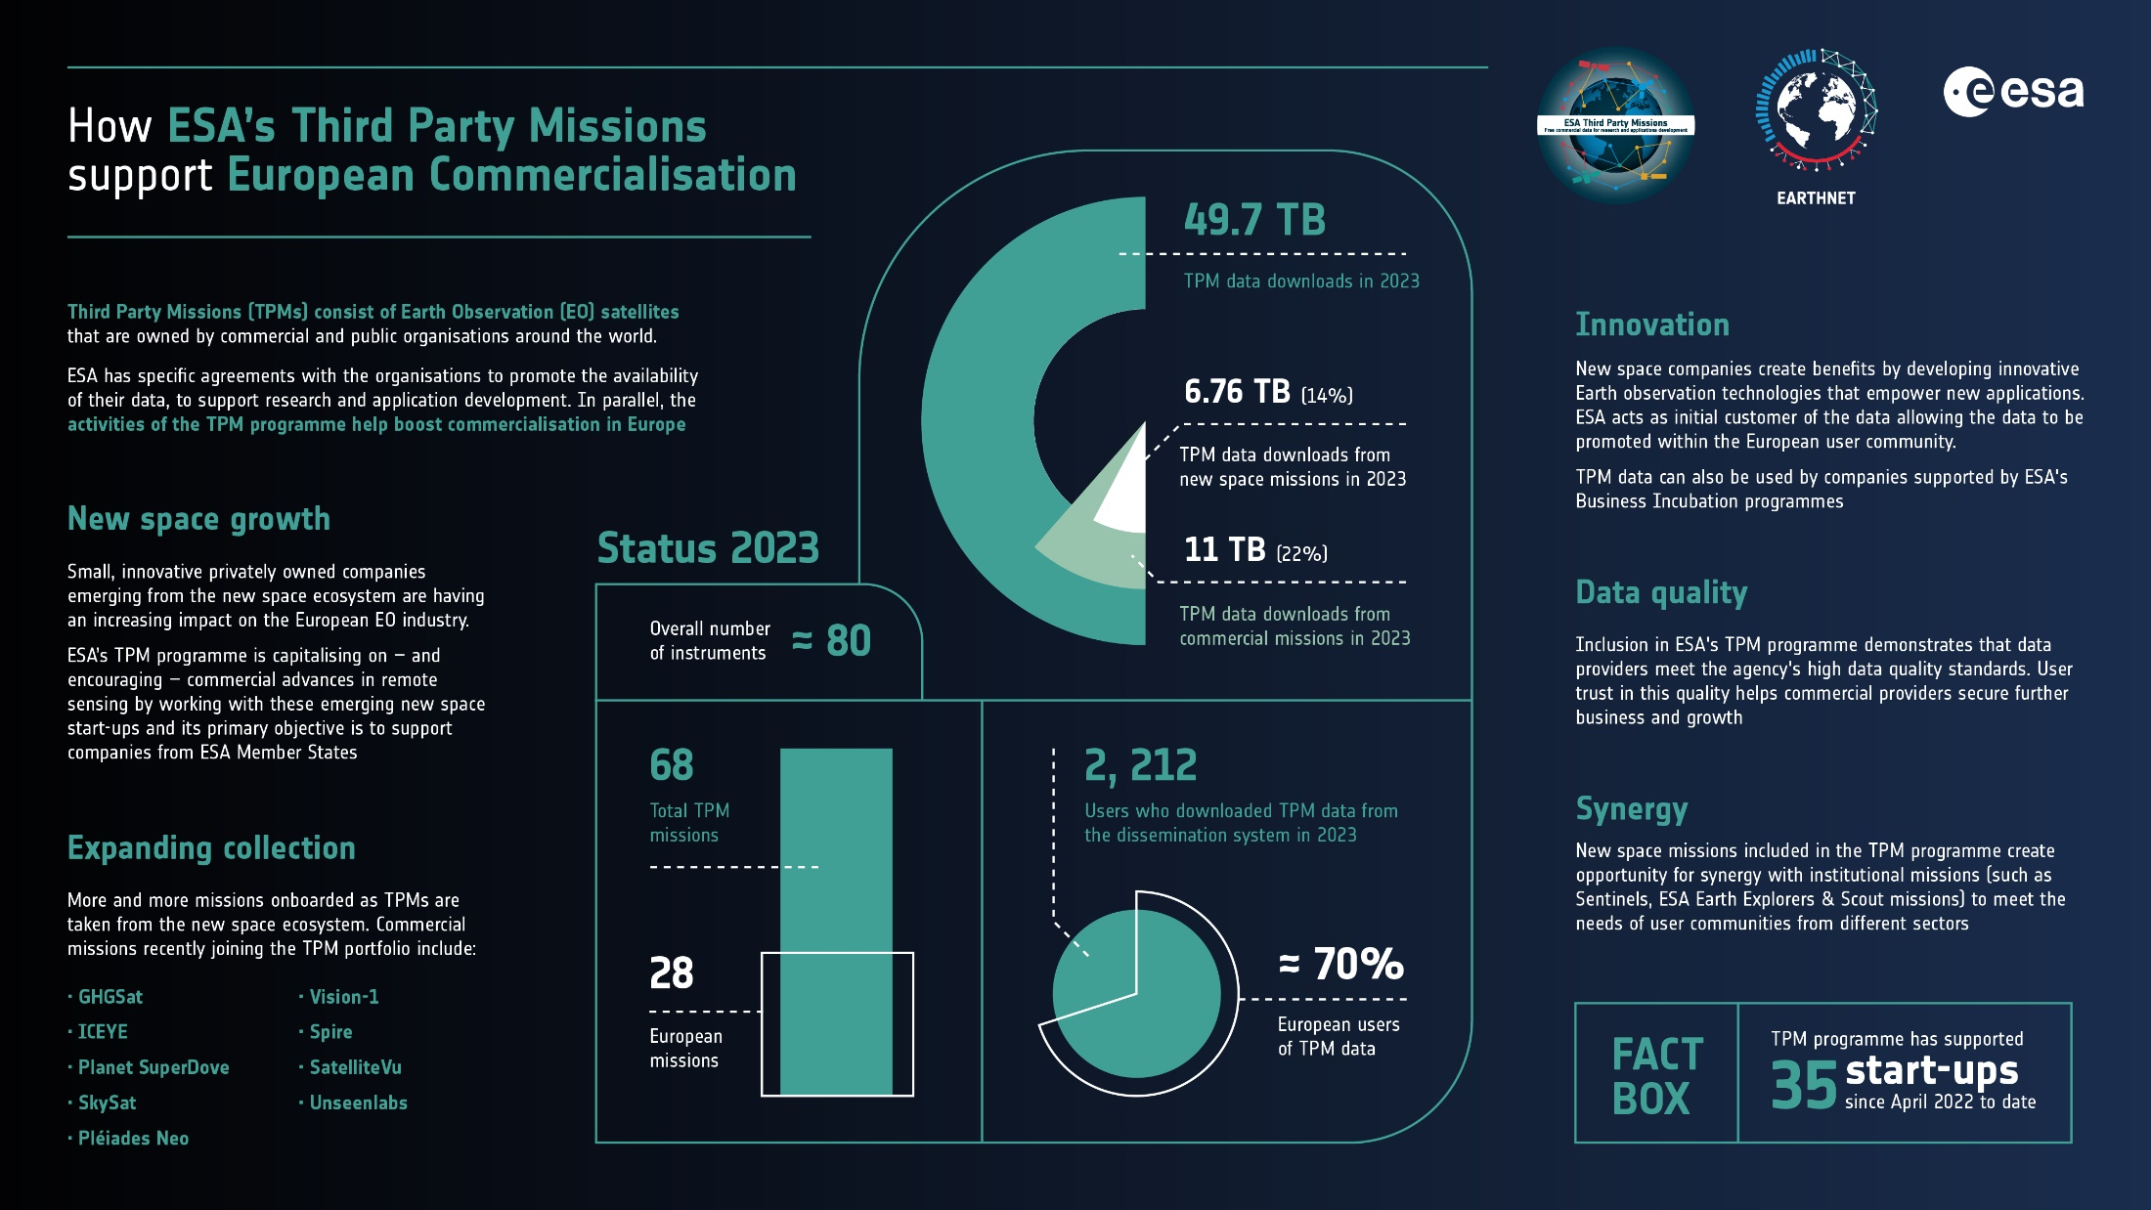
ESA TPM in Support of European Commercialisation
As a first buyer or initial anchor customer, the ESA Earthnet TPM programme enables NewSpace EO data to be opened to the broader European scientific community for innovative research and pre-operational applications development including in green commercialization and Earth Action
More than 17,700 research applications development and incubation projects used TPM data since 2008.

Slide 4



https://earth.esa.int/eogateway/events/vh-roda
Through EO data procurement, ESA assess the quality of commercial EO data → a benchmark concept (Product Quality Evaluation Matrix) has been developed)
Deadline for registration, 28/11/2024 (only remote participation still possible)

Slide 5

ESA’s Dynamic Purchasing System for CCM
The DPS is a digital procurement process – accessible via the esa-star procurement system – that shortens and simplifies the bidding process for commercial Earth observation data providers (Copernicus Contributing Missions)
This DPS includes opportunities for three groups of data providers:
9 Contracts signed with companies in 2023. A further competition to be issued in December 2024 (up to 7 additional contracts)
CCM Category 1
European Earth Observation Emerging Data Suppliers :
Mini-competitions awarding anchor customer contracts (max. duration of 5 years) for data
purchase & data quality validation activities; addressed at European companies, which are
registered in an EU Member State or Copernicus Participating Country for less than 15 years
CCM Category 2
Two competitions released in Q4 2023. (VHR2024 & rapid on-demand),
7 contracts signed
European Earth Observation Established Data Suppliers :
Mini-competitions awarding commercial contracts for systematic or on-demand data purchase; addressed
at European companies, which are registered in an EU Member State or Copernicus Participating Country.
Objective is to buy increasingly more European data in line with the EU Space regulation on Strategic Autonomy.
CCM Category 3
First competition released in January 2024;
4 contracts signed
Earth Observation Data Suppliers for miscellaneous data needs :
Mini-competitions awarding commercial contracts to companies which either act as owner or as a broker of
non-European satellite data

Slide 6


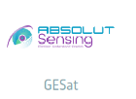







As outcome of the 1st competition in CCM Category 1, 9 contracts were awarded in 2023
Release of 2nd CCM competition in Emerging CCM category in December 2024
commercial EO data complementary to Sentinel observations

Slide 7







Copernicus Contributing Missions – Benefits to Industry
Non-Monetary benefits observed by industry in 1 year
Investment raised and expected since the start of CCM Category 1 data procurement contracts (April 2023)
Strengthened credibility and trust of customers and investors
Enhanced recognition among European institutions
110M€
275M€
Increased brand awareness on social media thanks to communication efforts
development of European Emerging data suppliers towards operational status
Access to ESA expertise in image quality (Cal/Val activities)
Strengthened company capabilities, job creations and boosted staff motivation
Access to new market
Exports
2023 Raised
2024 Expected

Slide 8
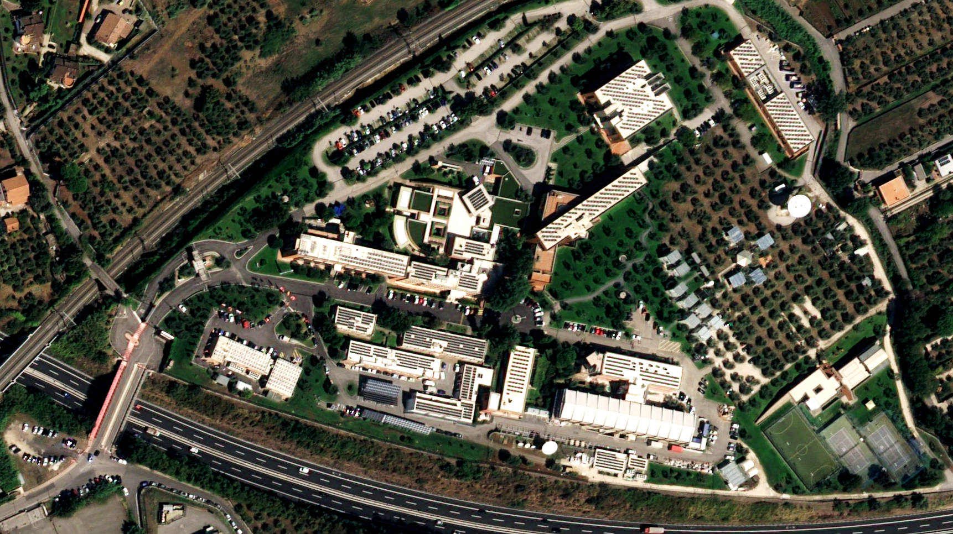
ESA/ESRIN, Frascati
Airbus Pleiades Neo
5 key points about EO data buy at ESA
ESA buys EO data for its own purpose (i.e., R&D studies) or on behalf of other institutions (e.g., for European Commission within Copernicus programme)
→ ESA Third Party Missions, Copernicus Contributing Missions:
EO data buy is a powerful way to support European EO industry, ESA customer role an important mechanism to foster commercialisation
Dynamic Purchasing system now fully established as a key tool for CCM procurement; allowing an impactful industrial policy to be implemented (preference to European commercial missions, support to emerging European commercial missions)
Through data buy, ESA assess the quality of commercial EO data, allowing for capacity building and enhanced recognition, trust amongst data customers and investors
Through data buy, ESA stimulates the synergy between commercial EO missions and public EO missions (e.g., Sentinels) including in emerging data domains

