Slide 1

Increased use of satellite data in crop insurance
ESA EO Commercialization Forum
Frankfurt, 27.11.2024

Slide 2

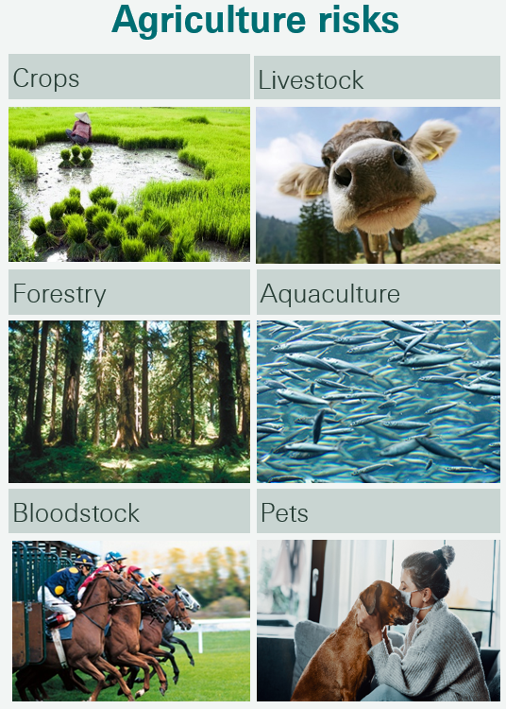
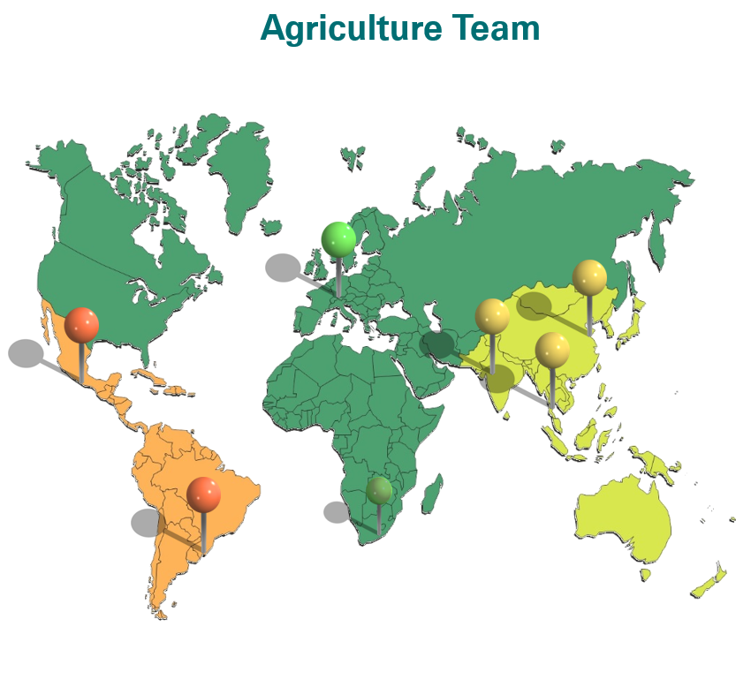
Swiss Re, who we are:
The Swiss Re Group is a leading and highly diversified global re-insurer, founded in Zurich, Switzerland, in 1863. We operate around the world and have about 13,100 employees who contribute to our success.
We are organized in three Business Units:
Our Reinsurance Business Unit offers reinsurance products and related services for property and casualty, as well as for life and health businesses.
Corporate Solutions offers commercial insurance to mid-sized and large corporations.
We also support the public sector with our Public Sector Solutions team to help increase insurance penetration around the world.

Slide 3
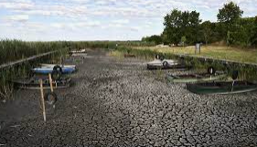
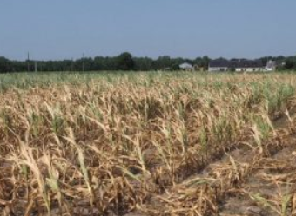
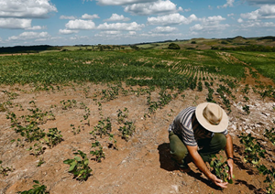
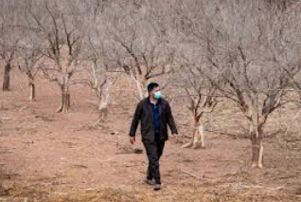
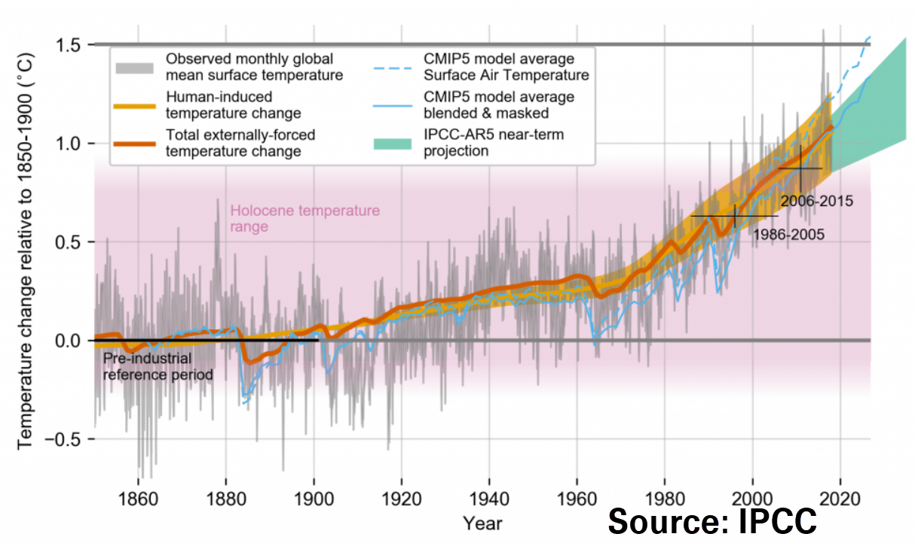
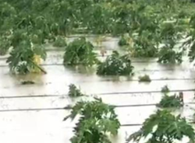
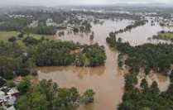
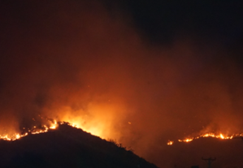
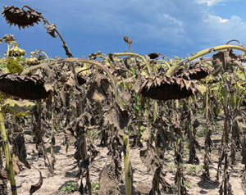
Crop insurance continues to be affected by climate events
Increase of Frequency and Severity
Hungary/ Croatia/ August 2022
Recent losses
Several major losses due to drought, flood, hail, fire
Continued growth in premiums and subsidies
Effects of climate change increasingly visible
France/Italy /Spain Drought August 2022
Canada
July 2022 Drought
Europe
April 2022 Frost
Kazakhstan
July 2022 Drought
USA Texas
May 2022 Hail
Italy/ Slovenia/ Baltics
August 2023 Hail
China
2022 August Flood
Brazil
January 2022 Drought
Morocco
Jan 2022 Droughts
India
Sept 2022 Floods
Brazil
May 2024 Flood
Australia
Feb 2022 Flood
Chile January 2023
Wildfires
Argentina
January 2023 Drought
Source: Swiss Re

Slide 4
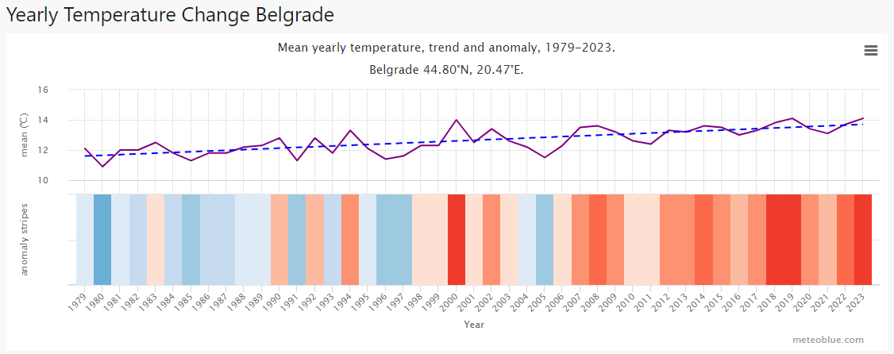
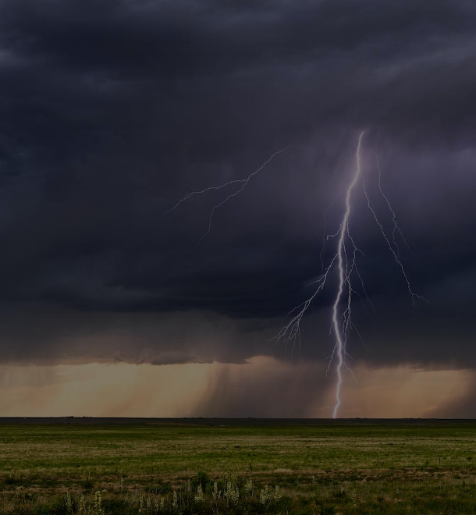
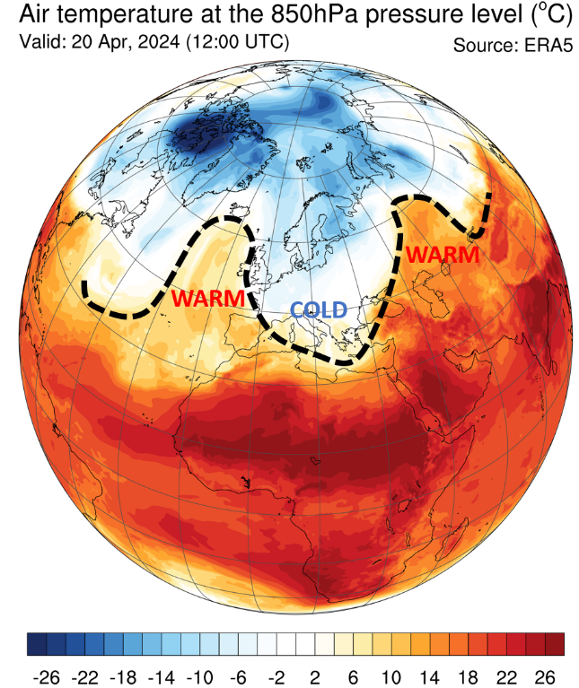
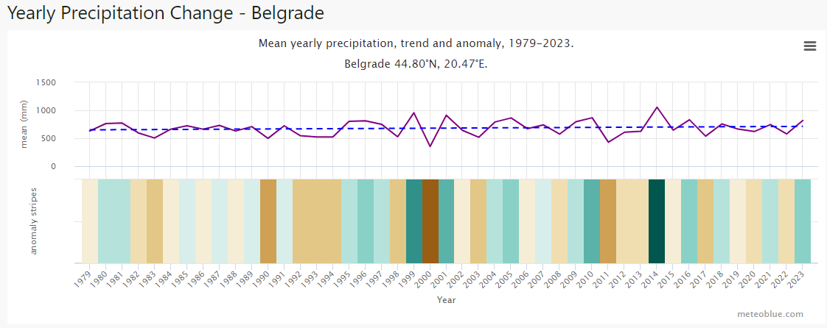
Which climate change phenomena have the greatest impact?
Increased Temperature
Higher Evapotranspiration
Lower Soil Moisture
Early start of growth season
Problems during flowering
Increased Atmospheric Moisture
Flash Floods
Hailstorms
Excess rain/ Flood
Weaker Polar Vortex
Heat waves
Cold spells
Continental interconnectivity

Slide 5
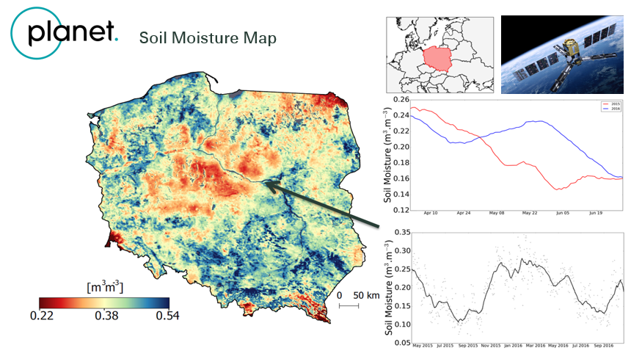
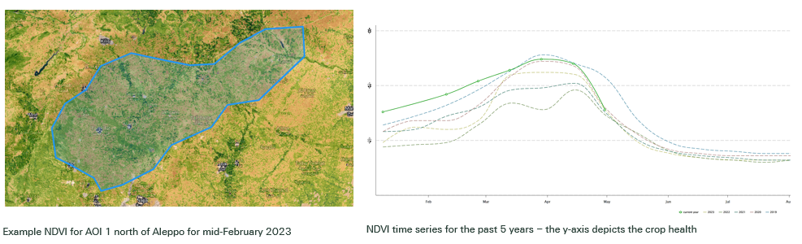
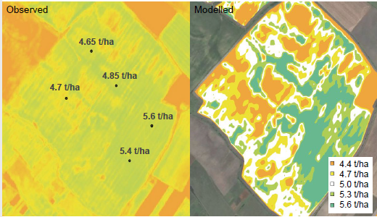
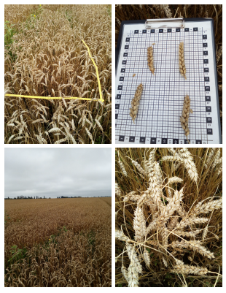
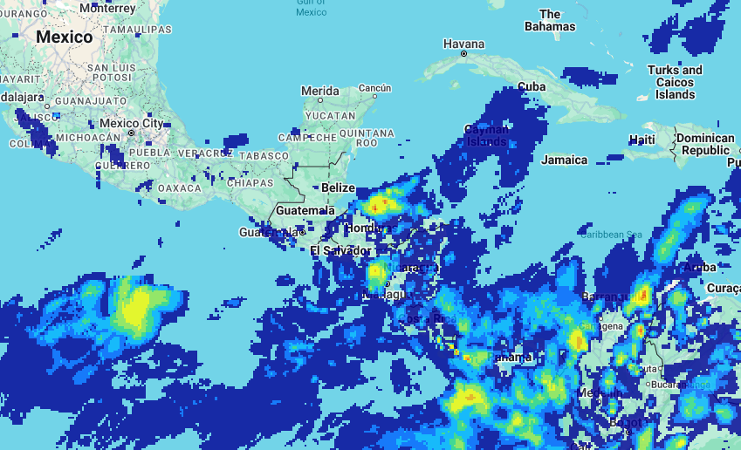
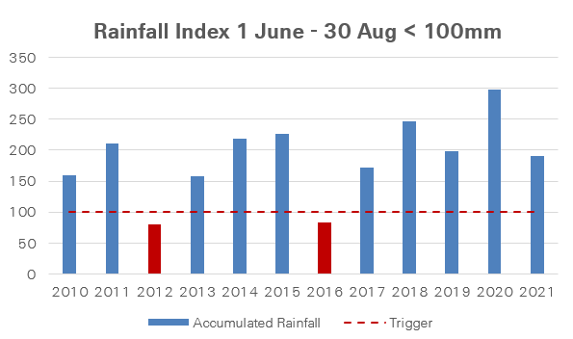
The use of satellite data in crop insurance
Soil Moisture Index
NDVI Index
Rainfall Index
Loss adjustment in the field

Slide 6
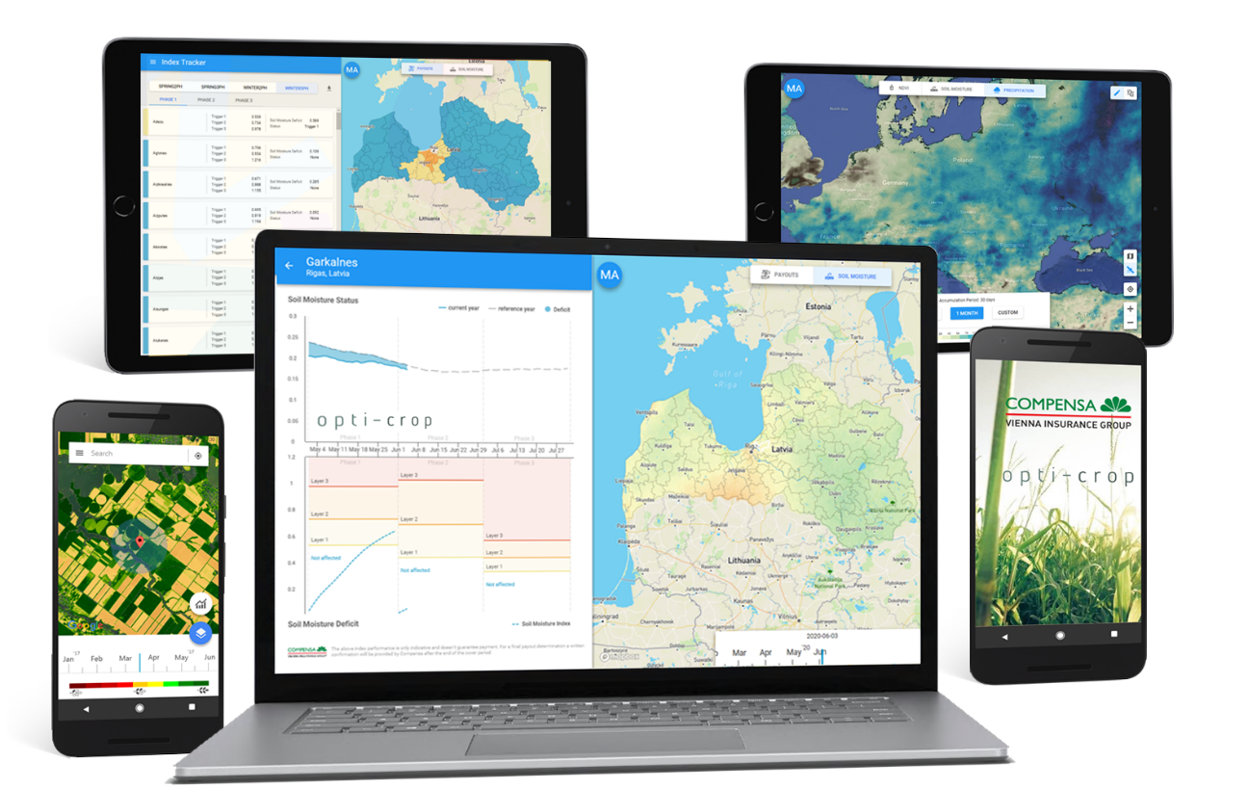
Satellite useability for insurance
Characteristics
Stable signal
Able to measure extremes
Global availability
Cloud free data every 2-3 days
Near Real Time
Historical data (min. 15 years)
Back-up satellite’s
Resolution Index 100-250 meter
Resolution Field Survey 3-20 meter
Viewer + API access

Slide 7






Thank you!
Contact us
Follow us
Marcel Andriesse
marcel_andriesse@swissre.com
7
7

Slide 8
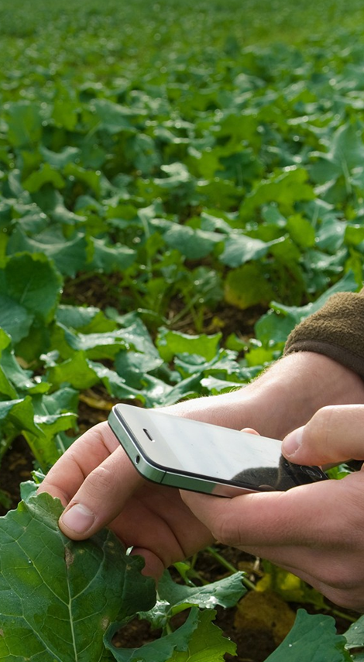
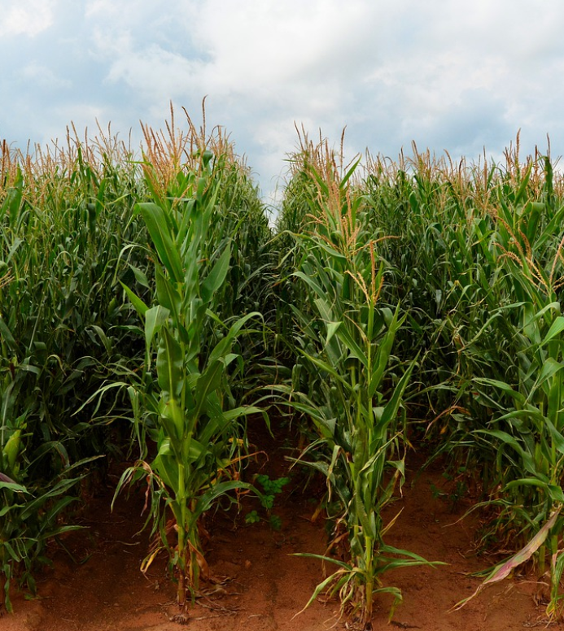
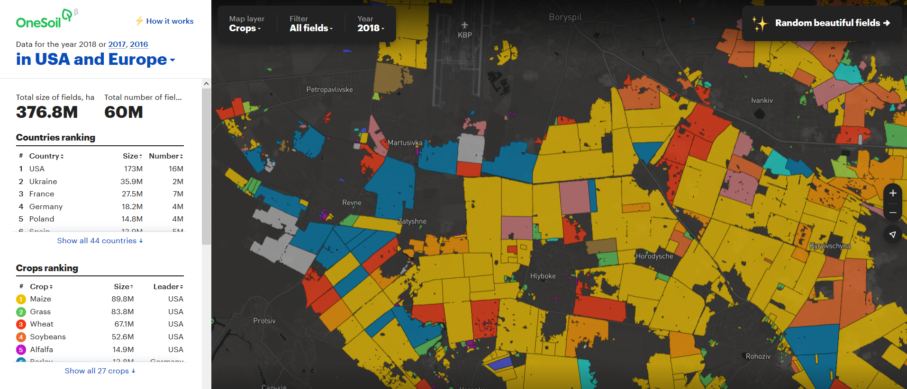
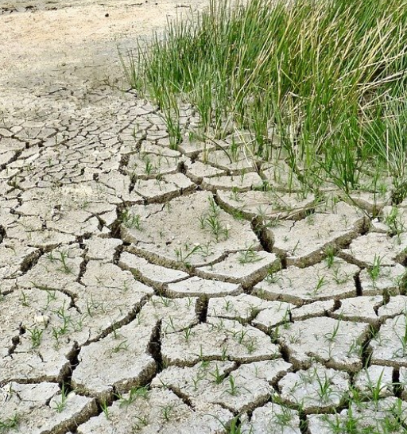
Agriculture (Re)insurance
Global Trends
Globalisation
Digitalisation
Climate Change & Sustainability
Global Agriculture insurance premium is increasing. Many countries are pushing premium subsidies and national schemes.
Farming is changing with investments in Agri Tech, high-res satellite and weather data and the global availability of Smart phones
For farmers Climate Change means increased risks for droughts, hail, heat waves, spring frosts and floods.
8

Slide 10
Legal notice
©2024 Swiss Re. All rights reserved. You may use this presentation for private or internal purposes but note that any copyright or other proprietary notices must not be removed. You are not permitted to create any modifications or derivative works of this presentation, or to use it for commercial or other public purposes, without the prior written permission of Swiss Re.
The information and opinions contained in the presentation are provided as at the date of the presentation and may change. Although the information used was taken from reliable sources, Swiss Re does not accept any responsibility for its accuracy or comprehensiveness or its updating. All liability for the accuracy and completeness of the information or for any damage or loss resulting from its use is expressly excluded.

