Slide 1
Introducing…
Accelerating Commercialisation and Competitiveness for European Space Systems
Nick Appleyard
Head of Applications and Solutions
Commercialisation, Industry, Competitiveness
European Space Agency

Slide 2
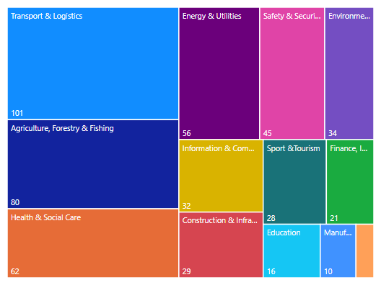












BUILDING SOLUTIONS FOR CUSTOMERS
HRE 2%
2
GNSS 57%
8
23
14
12
24
2
16
EO
61%
Satcom 43%
500+ solutions built by 1000+ companies with 51% going directly to a sale

Slide 3

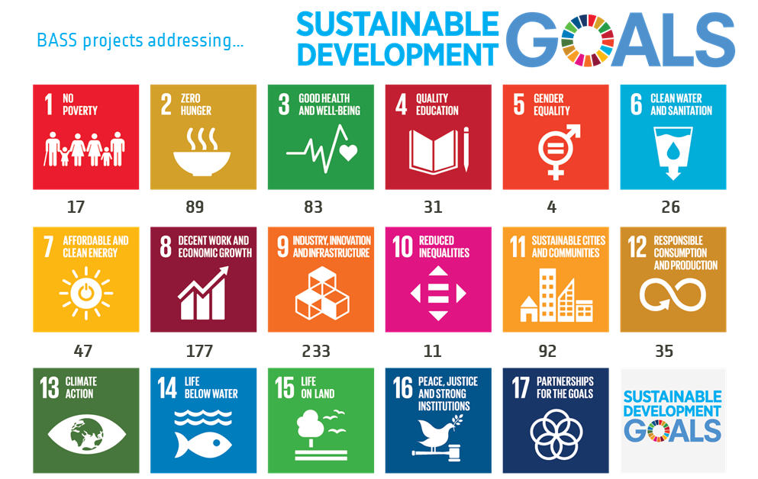





COMPANIES WHO MAKE A DIFFERENCE
Environmental Impact
Societal Impact
€6
3%
€11
6%
€41
22%
Green Buildings
& Sustainable Cities
Clean Water
Protecting Ecosystems
Sustainable
Farm to Fork
Circular Economy
Energy Transition
Sustainable Tourism
Green Finance
Sustainable Mobility
€40
22%
€4 2%
€3 2%
€34
19%
€39
22%
€4
2%
48% contributed to Green Transition
81% contributed to one or more SDGs

Slide 4
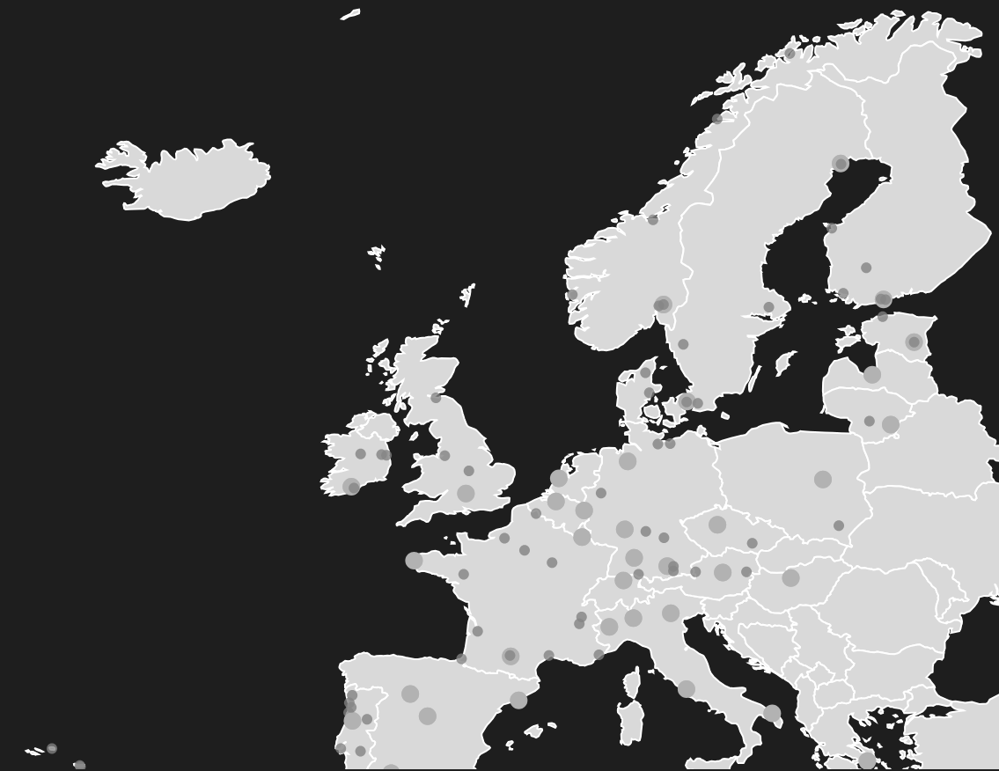
BUILDING NEW EUROPEAN SPACE COMPANIES
1700+ startups incubated in 100+ locations in every ESA Member State

Slide 5






SCALING AND OPENING NEW MARKETS
Academia / Industry Joint Ideation
Derisking
Market Entry
Private
Capital
Climate Cooperation
Natural Hazards
Sustainable Space

Slide 6





AN INTEGRATED JOURNEY IN ACCESS
Market Derisking
Desirability
Feasibility
Viability
Business Derisking
Technical Derisking
IDEATION
PREPARATION
DEVELOPMENT
PILOTING
GROWTH

