Slide 1
High-accuracy timber and carbon stock measurements from space

Slide 2
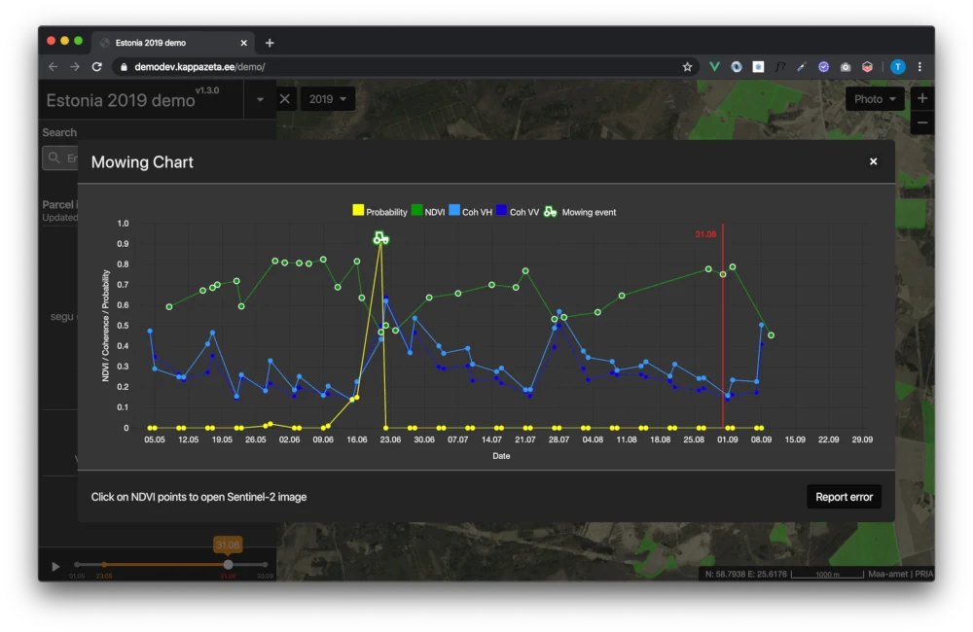
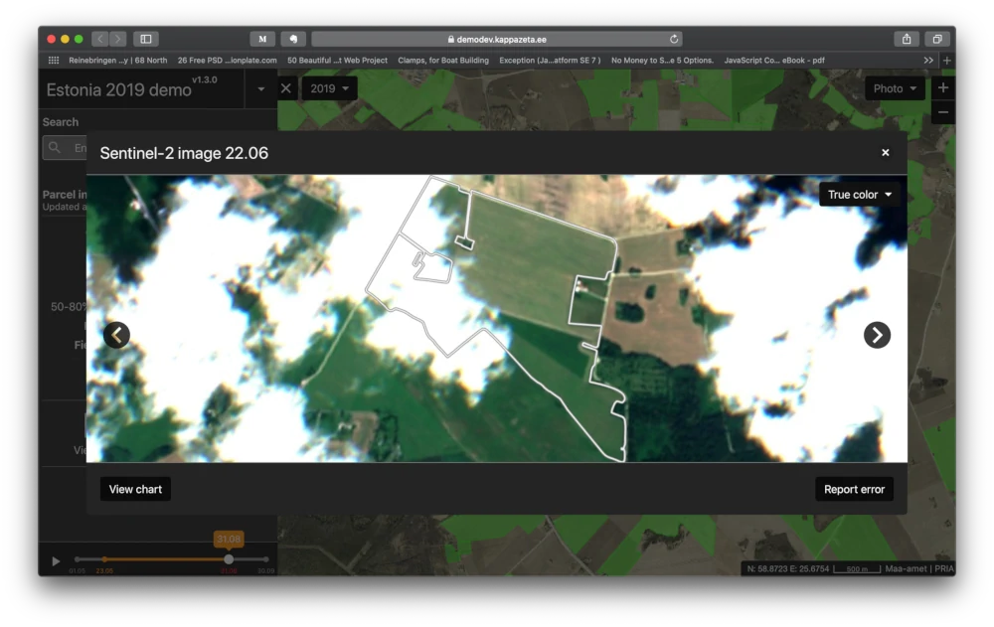
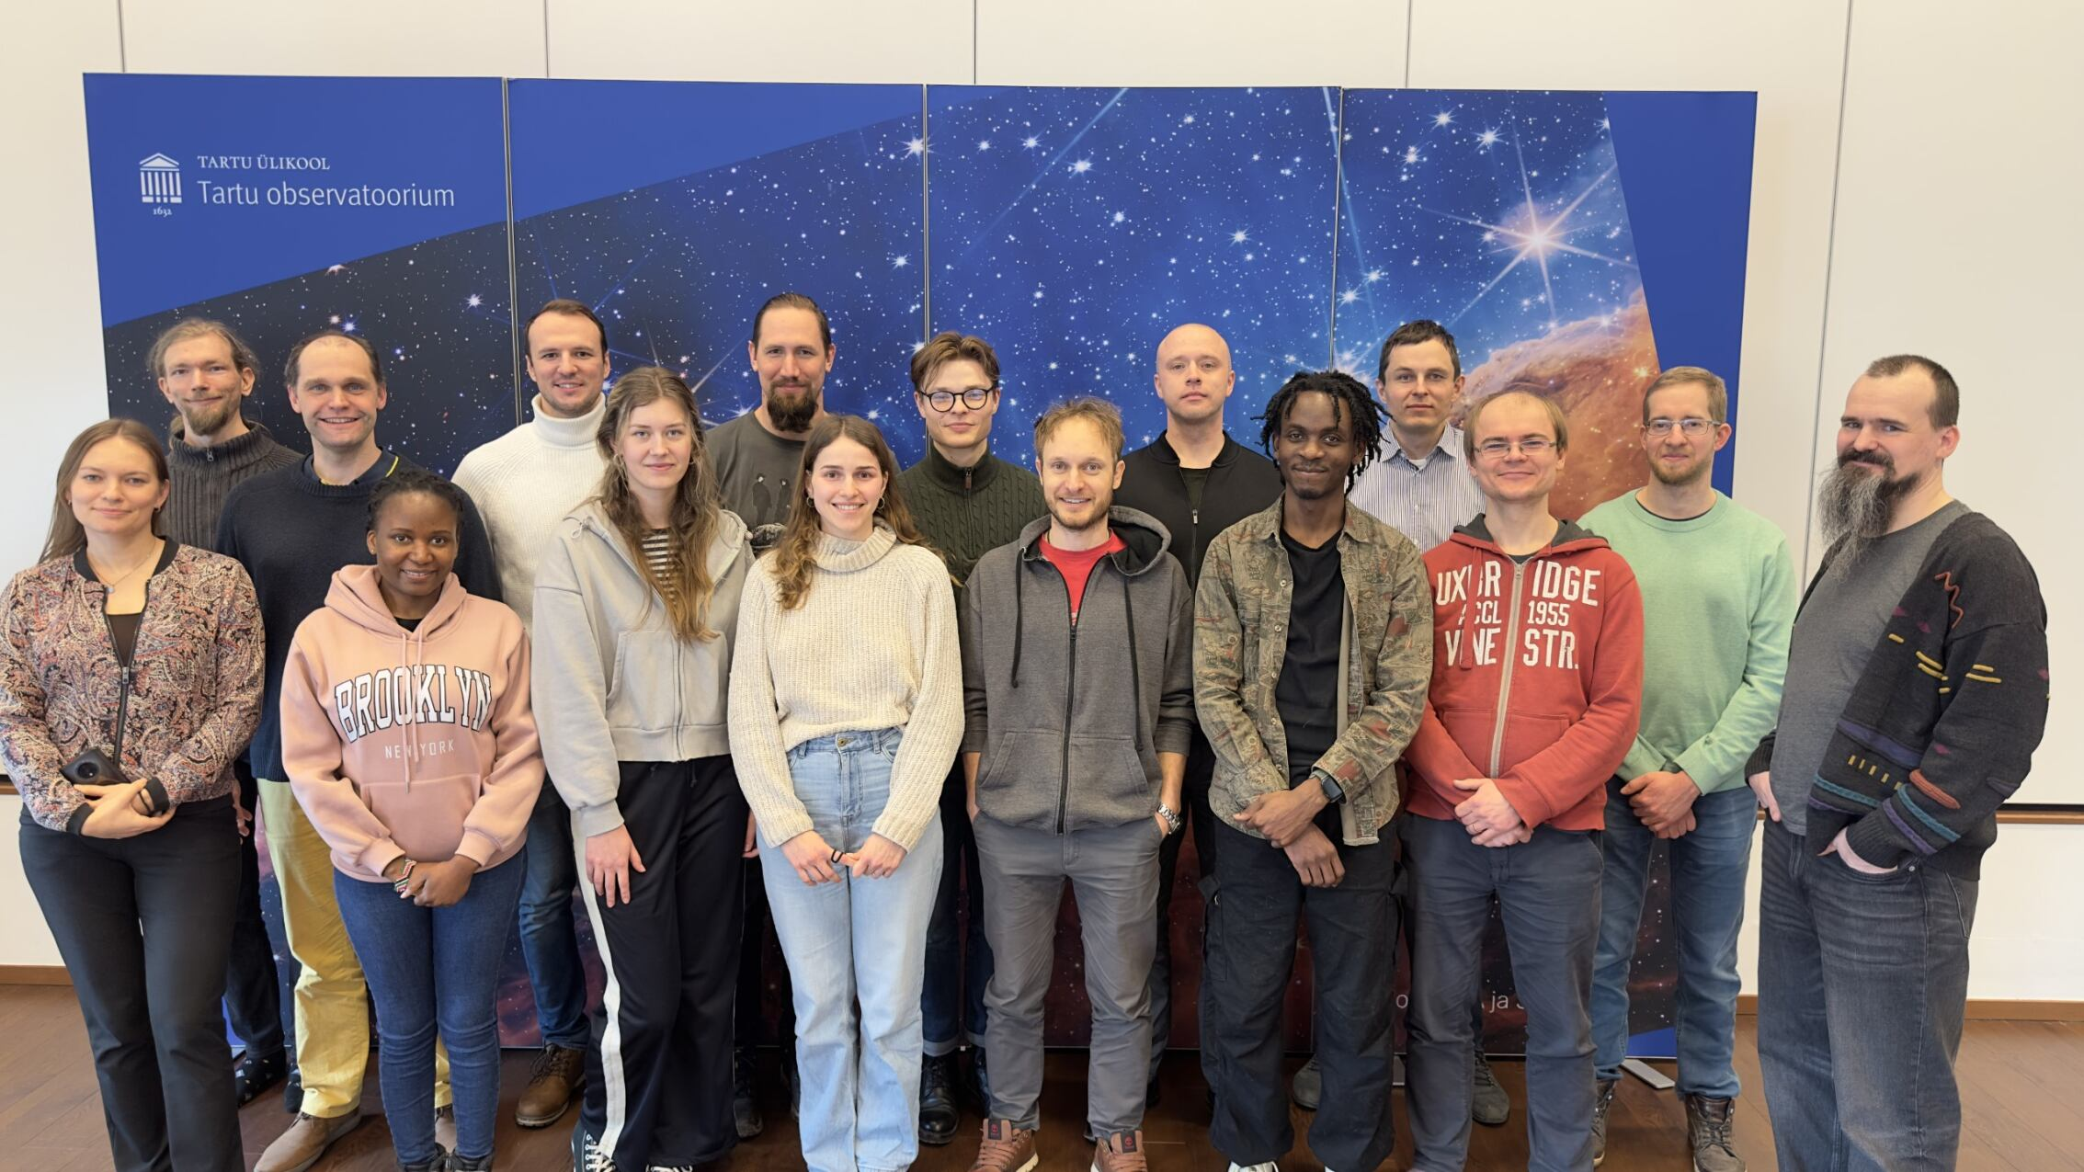
A leading EO insights provider from Estonia
BACKGROUND
World’s first EU CAP compliance system provider
Estonia since 2017
Denmark since 2023
Other applications in forestry and defence
Proprietary high-accuracy measurement technology
Concept for a world-changing EO mission

Slide 3
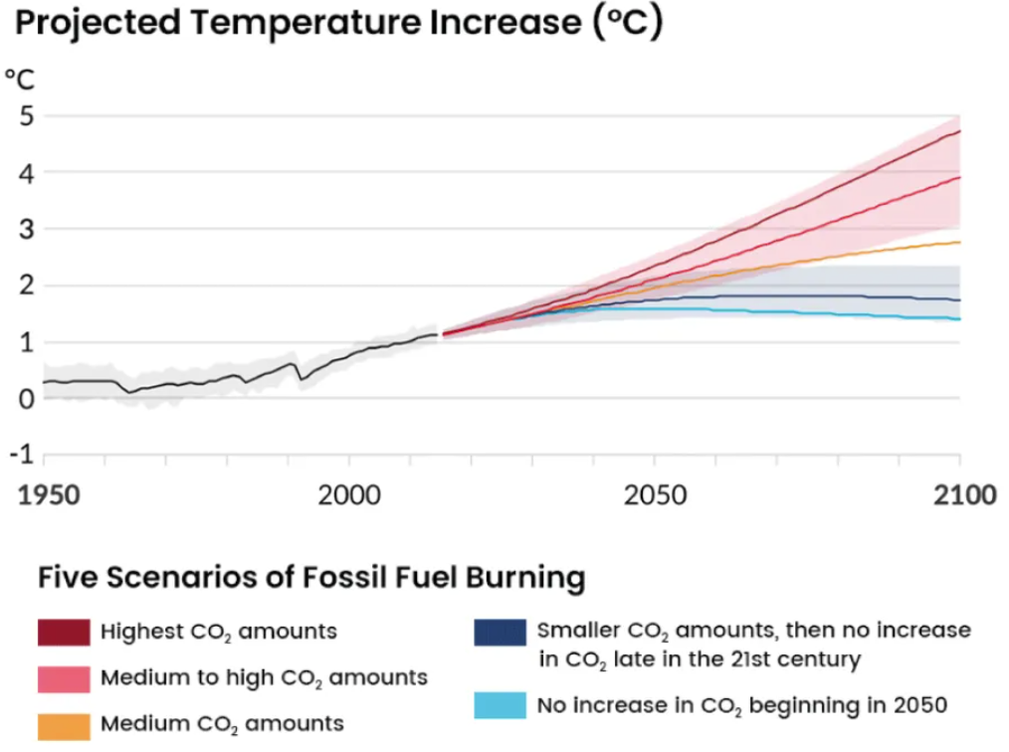
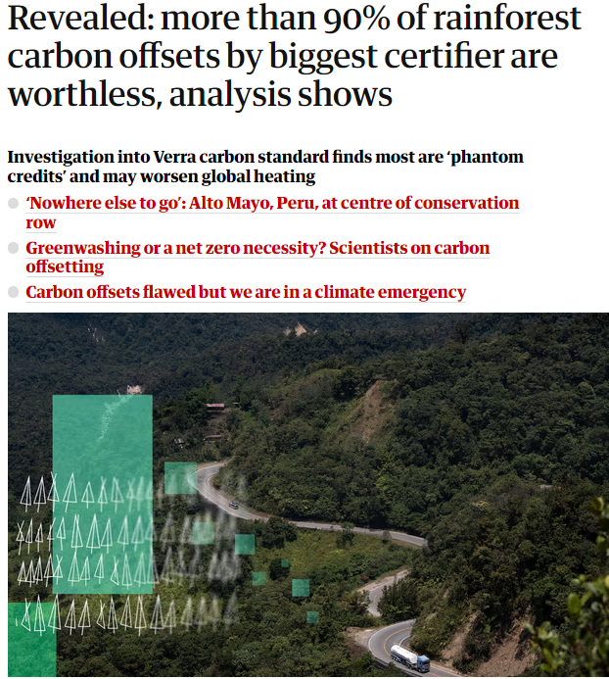
CLIMATE EMERGENCY!
OUR COLLECTIVE PROBLEM
Millions of hectares of unaccounted deforestation
The world’s forests: a crucial component in the carbon cycle
Information fragmented and localized
Decisions made on out-of-date statistical data
Carbon credit buyers losing millions in revenues and image damage
$90M of credits deemed worthless
Millions-worth image damage to the buyers

Slide 4
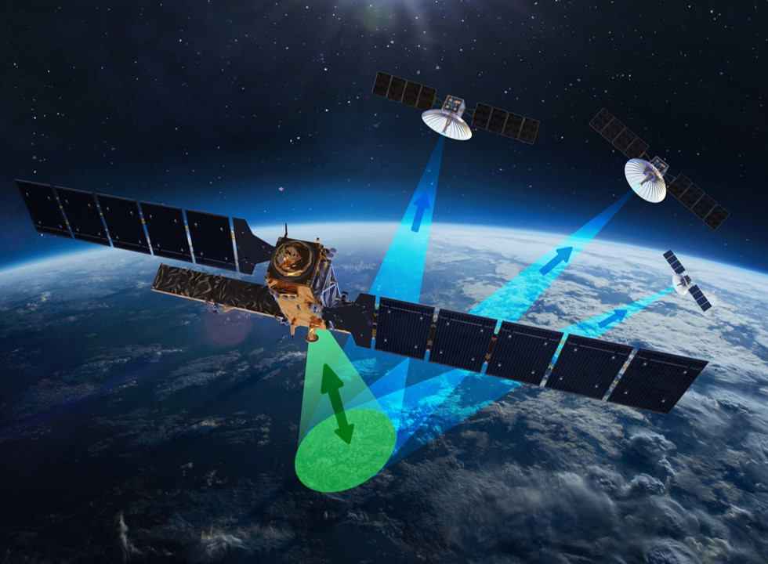
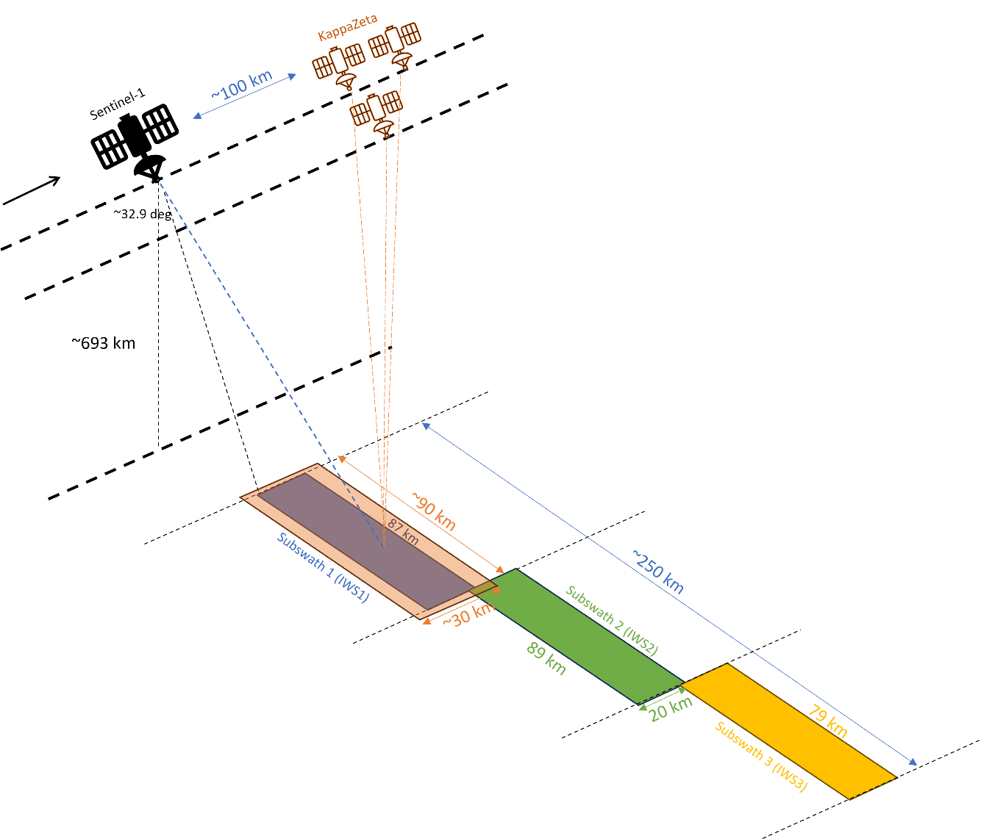
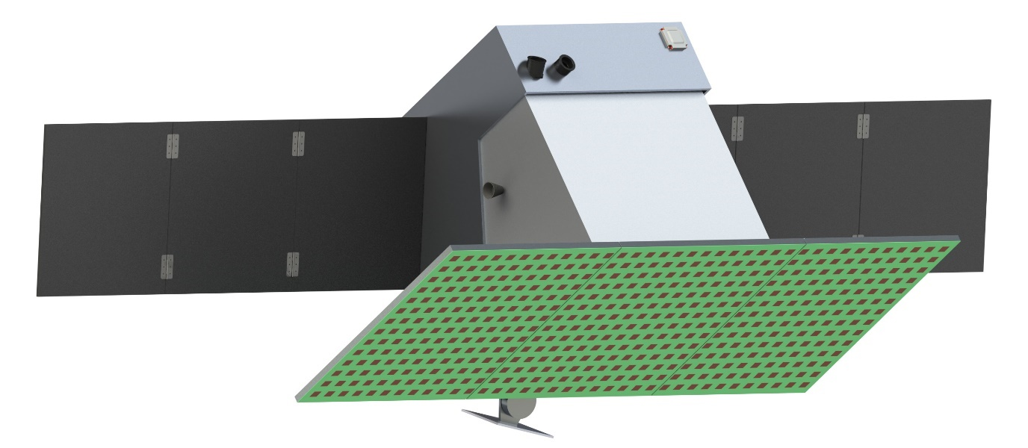
Enabling forest height and volume measurements from space, globally and bi-weekly
THE 3D-SAR MISSION
Passive receiver satellites flying in formation with Sentinel-1
Best known combination of:
Global coverage – 12 days revisit
High accuracy – direct height measurements; 90%+ confidence based on TanDEM-X
Affordability
Clever augmentation of existing Copernicus space infrastructure
Sentinel-1 as a “mother” mission
Fraction of cost to double the value
Estimated €35-40M mission cost: less than 20% of one Sentinel-1 satellite
Estimated mission cost: €25-30M
That is ~10% of the Copernicus Sentinel 1’s space segment or

Slide 5
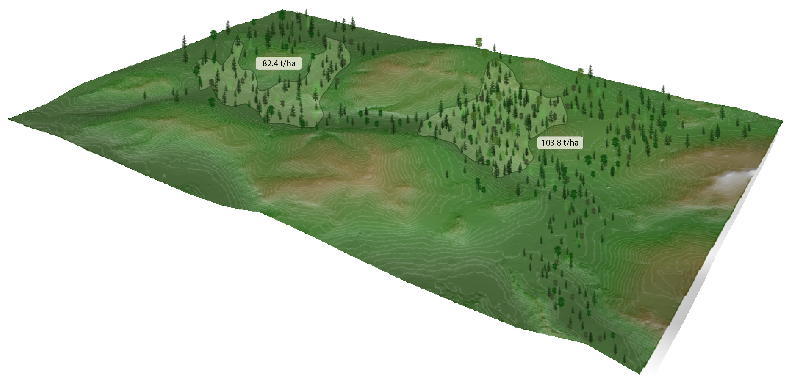
Forest volume and carbon stock measurements from space
END PRODUCT OFFERING
Globally, with 12-day revisit
90% accuracy
Areas >0.5ha
Global carbon markets:
Compliance market: 95.3B€ in 2023, estimated 302.7B€ by 2032 (14.7% CAGR)
Voluntary market: 2.2B€ in 2023; estimated 15B€ to 250B€ in 2030
Global logging market:
322B€ in 2024, estimated 437B€ in 2029 (6.3% CAGR)
Defence market:
NATO countries’ total defence budget €1.02 trillion in 2023

Slide 6
Customer segments & competing solutions
END PRODUCT OFFERING
Segment | Product | Why | Alternatives
Carbon project developers | Carbon stock | Number of credits and credit value directly proportional to your carbon stock measurement accuracy | Field surveys Publicly available satellite data
Carbon credit buyers | Carbon stock | Lack of reliable global data Fear of greenwashing Competitive pricing | Local LiDAR Field surveys NUVIEW, Sylvera
Forestry companies | Forest inspection (stem volume, species, height) | Complete data package Uniform quality Fast & frequent Competitive pricing | Local LiDAR Field surveys NUVIEW
National defence forces | Forest passability and cover map | Uniform quality at global scale Accessible in areas where drones can’t go Optical data can’t see inside forest | Field intelligence Drones Optical satellites
KappaZeta research heritage with highly cited papers makes us a reliable authority, ready to defend our methodology.

Slide 7
Status, Approach and Roadmap
THE 3D-SAR MISSION
2024: Conducting user interviews, finalizing mission concept
2025: Detailed mission study (Phase A-B), TanDEM-X based product development and demonstrations
2026: Preliminary user product launch based on TanDEM-X; payload demo launch
2025-2027: Mission development, integration, testing
2028: 3D-SAR launch, full product rollout
ESA funding: Estonian IIS, RPA, InCubed PPP, GSTP
Private funding: 5-10M€ seed round in Q2/2025; next rounds TBD
Commercial revenue: from KappaZeta core business, prototypes
Other EU grant funding: EIC, Horizon etc.

Slide 8
KappaZeta’s long-term vision
Making a financial impact of at least 1% of Estonian GDP (€380M annual revenue)
Transparent and reliable information about our forests’ status and health – globally and continuously

Slide 9
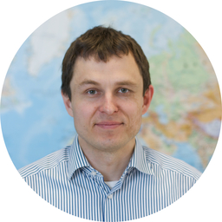
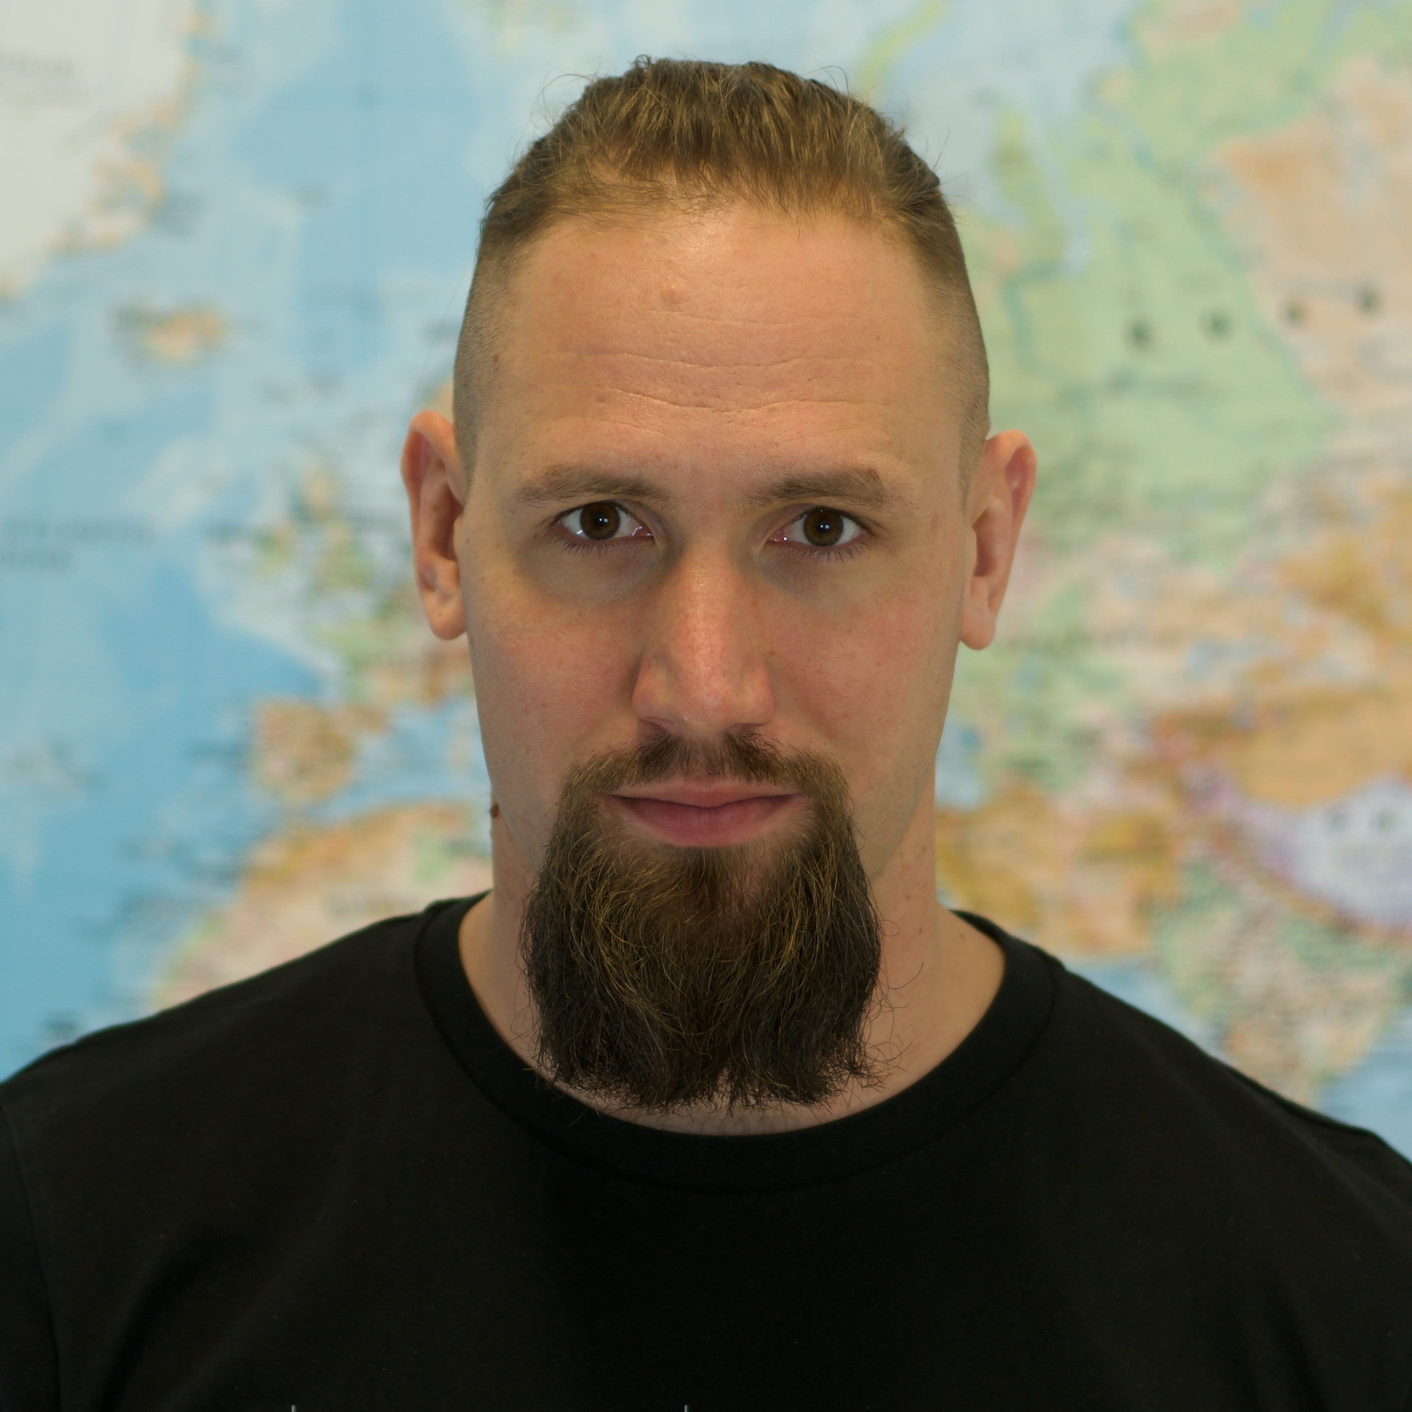
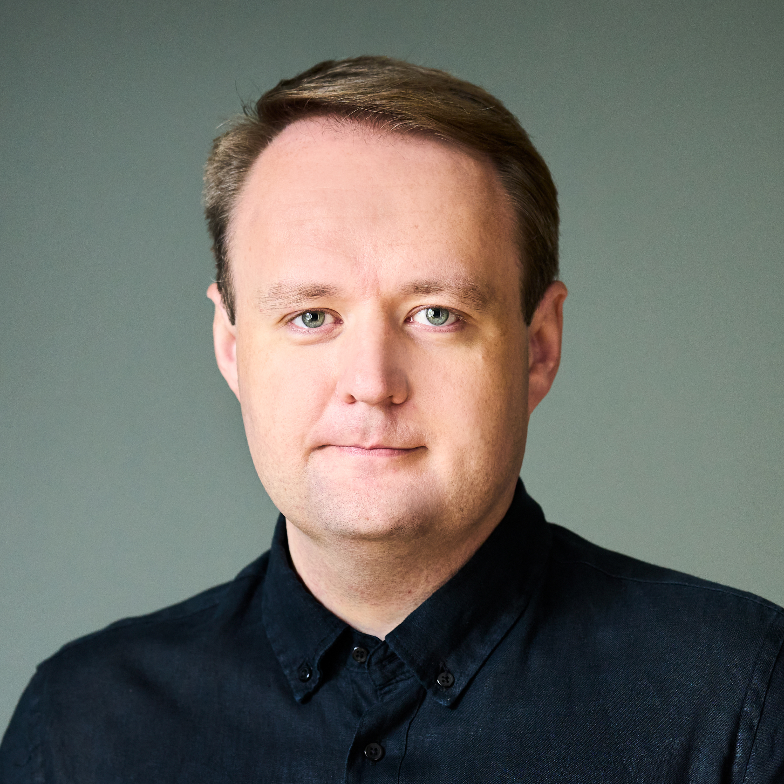
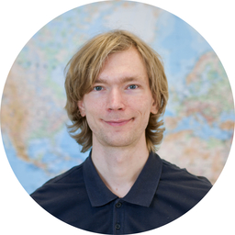
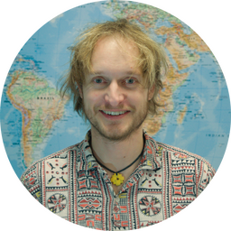
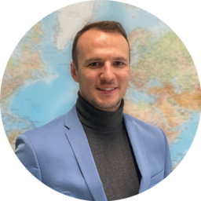
The winning combination of space technology, geography and business expertise
CORE MISSION TEAM
Kaupo Voormansik CEO and co-founder, SAR expert, PhD in SAR, Systems engineer of ESTCube-1, 10+ years in Earth Observation business
Martin Jüssi Mission Manager, ex. CGI, MSc in Space Studies, 10+ years in Earth Observation business
Erik Kulu Space Systems Engineer, ex. Kepler Communications and Clyde Space, 10+ years of experience in space hardware business
Indrek Sünter Space Systems Engineer, PhD in physics, electronics & software engineer in ESTCube-1 and ESEO satellites
Tauri Tampuu Data Product Manager, PhD in SAR, extensive international network in scientific community
Tanel Kobrusepp Sales and Customer Relations, ex. Flowbase (co-founder), experience in sales & fund-raising

Slide 10
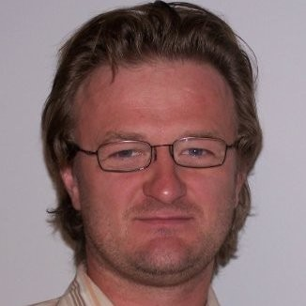
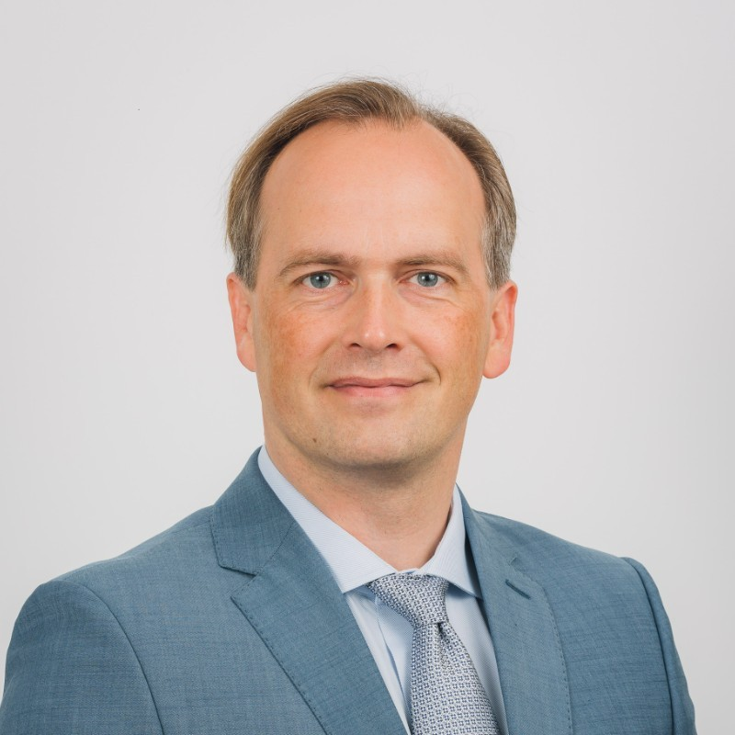
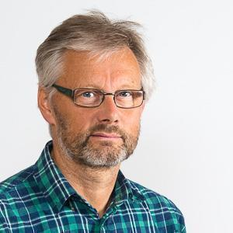
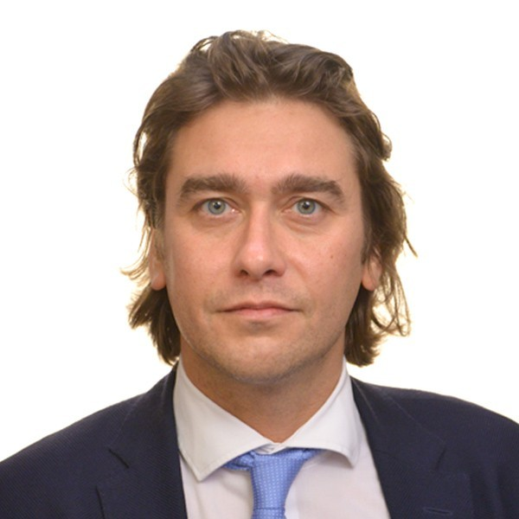
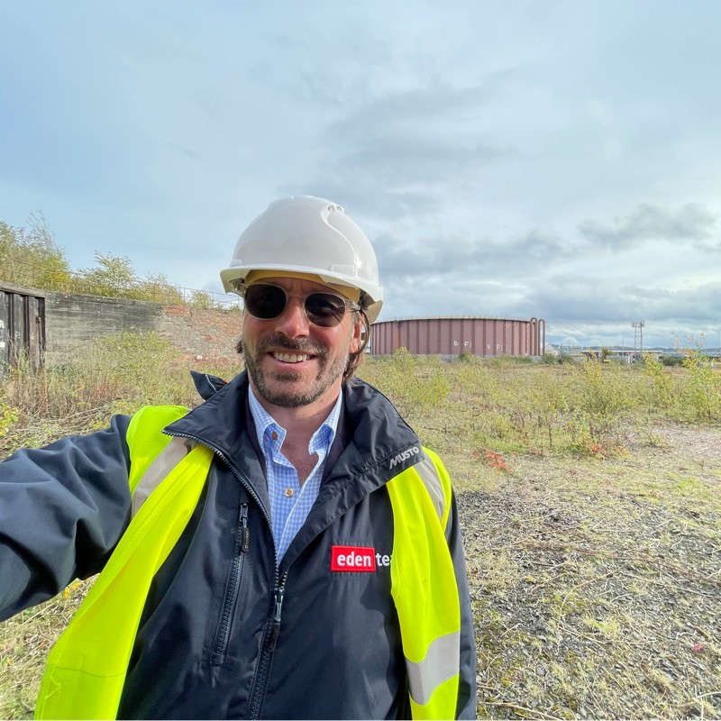
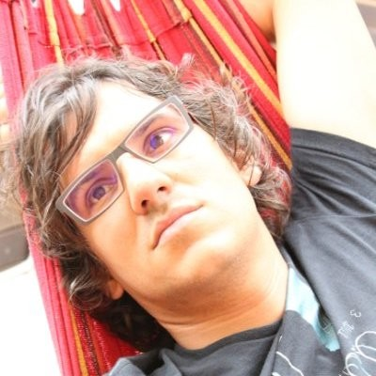
External Advisors and Angel Investors
MISSION TEAM
Toomas Kams, Investor 30+ years in commercial forestry
Mart Noorma, Investor NATO CCDCOE, ESTCube-1 visionary
Svein Solberg, Advisor
Norwegian Institute of Bioeconomy Research ESA SESAME forestry lead
Andreas Veispak, Investor Ex-European Commission (DG GROW)
Product development support
Adam Beaumont, Investor
Estonian Consul in the UK Ground Stations and Data Centers domain support
Paco Lopez Dekker, Advisor
TU Delft
ESA Harmony mission Lead Investigator, SAR systems and product engineering support

Slide 11
Let’s get to know each other!
Martin Jüssi
3D-SAR Mission Manager
martin.jussi@kappazeta.ee
+372 56 466 997
Kaupo Voormansik
CEO and co-founder
kaupo.voormansik@kappazeta.ee
+372 56 669 225

