Slide 1
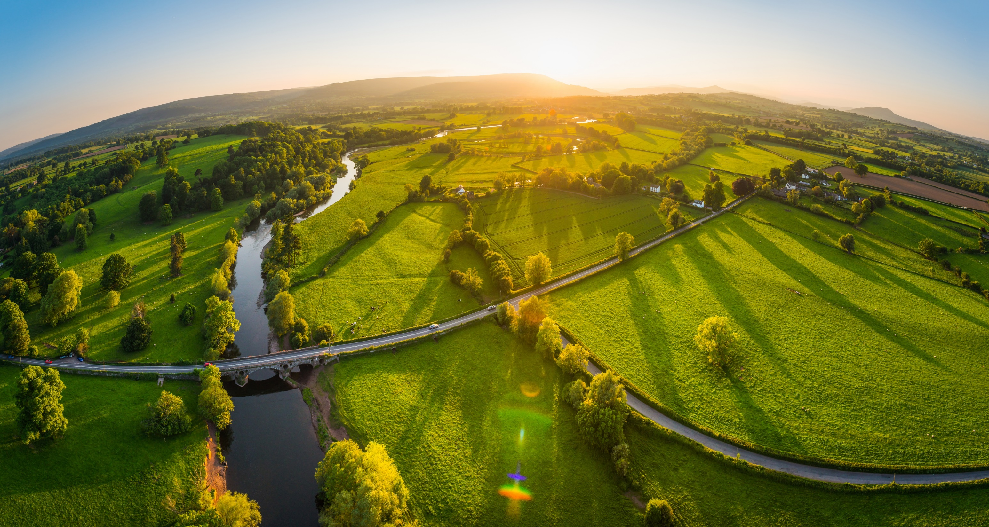
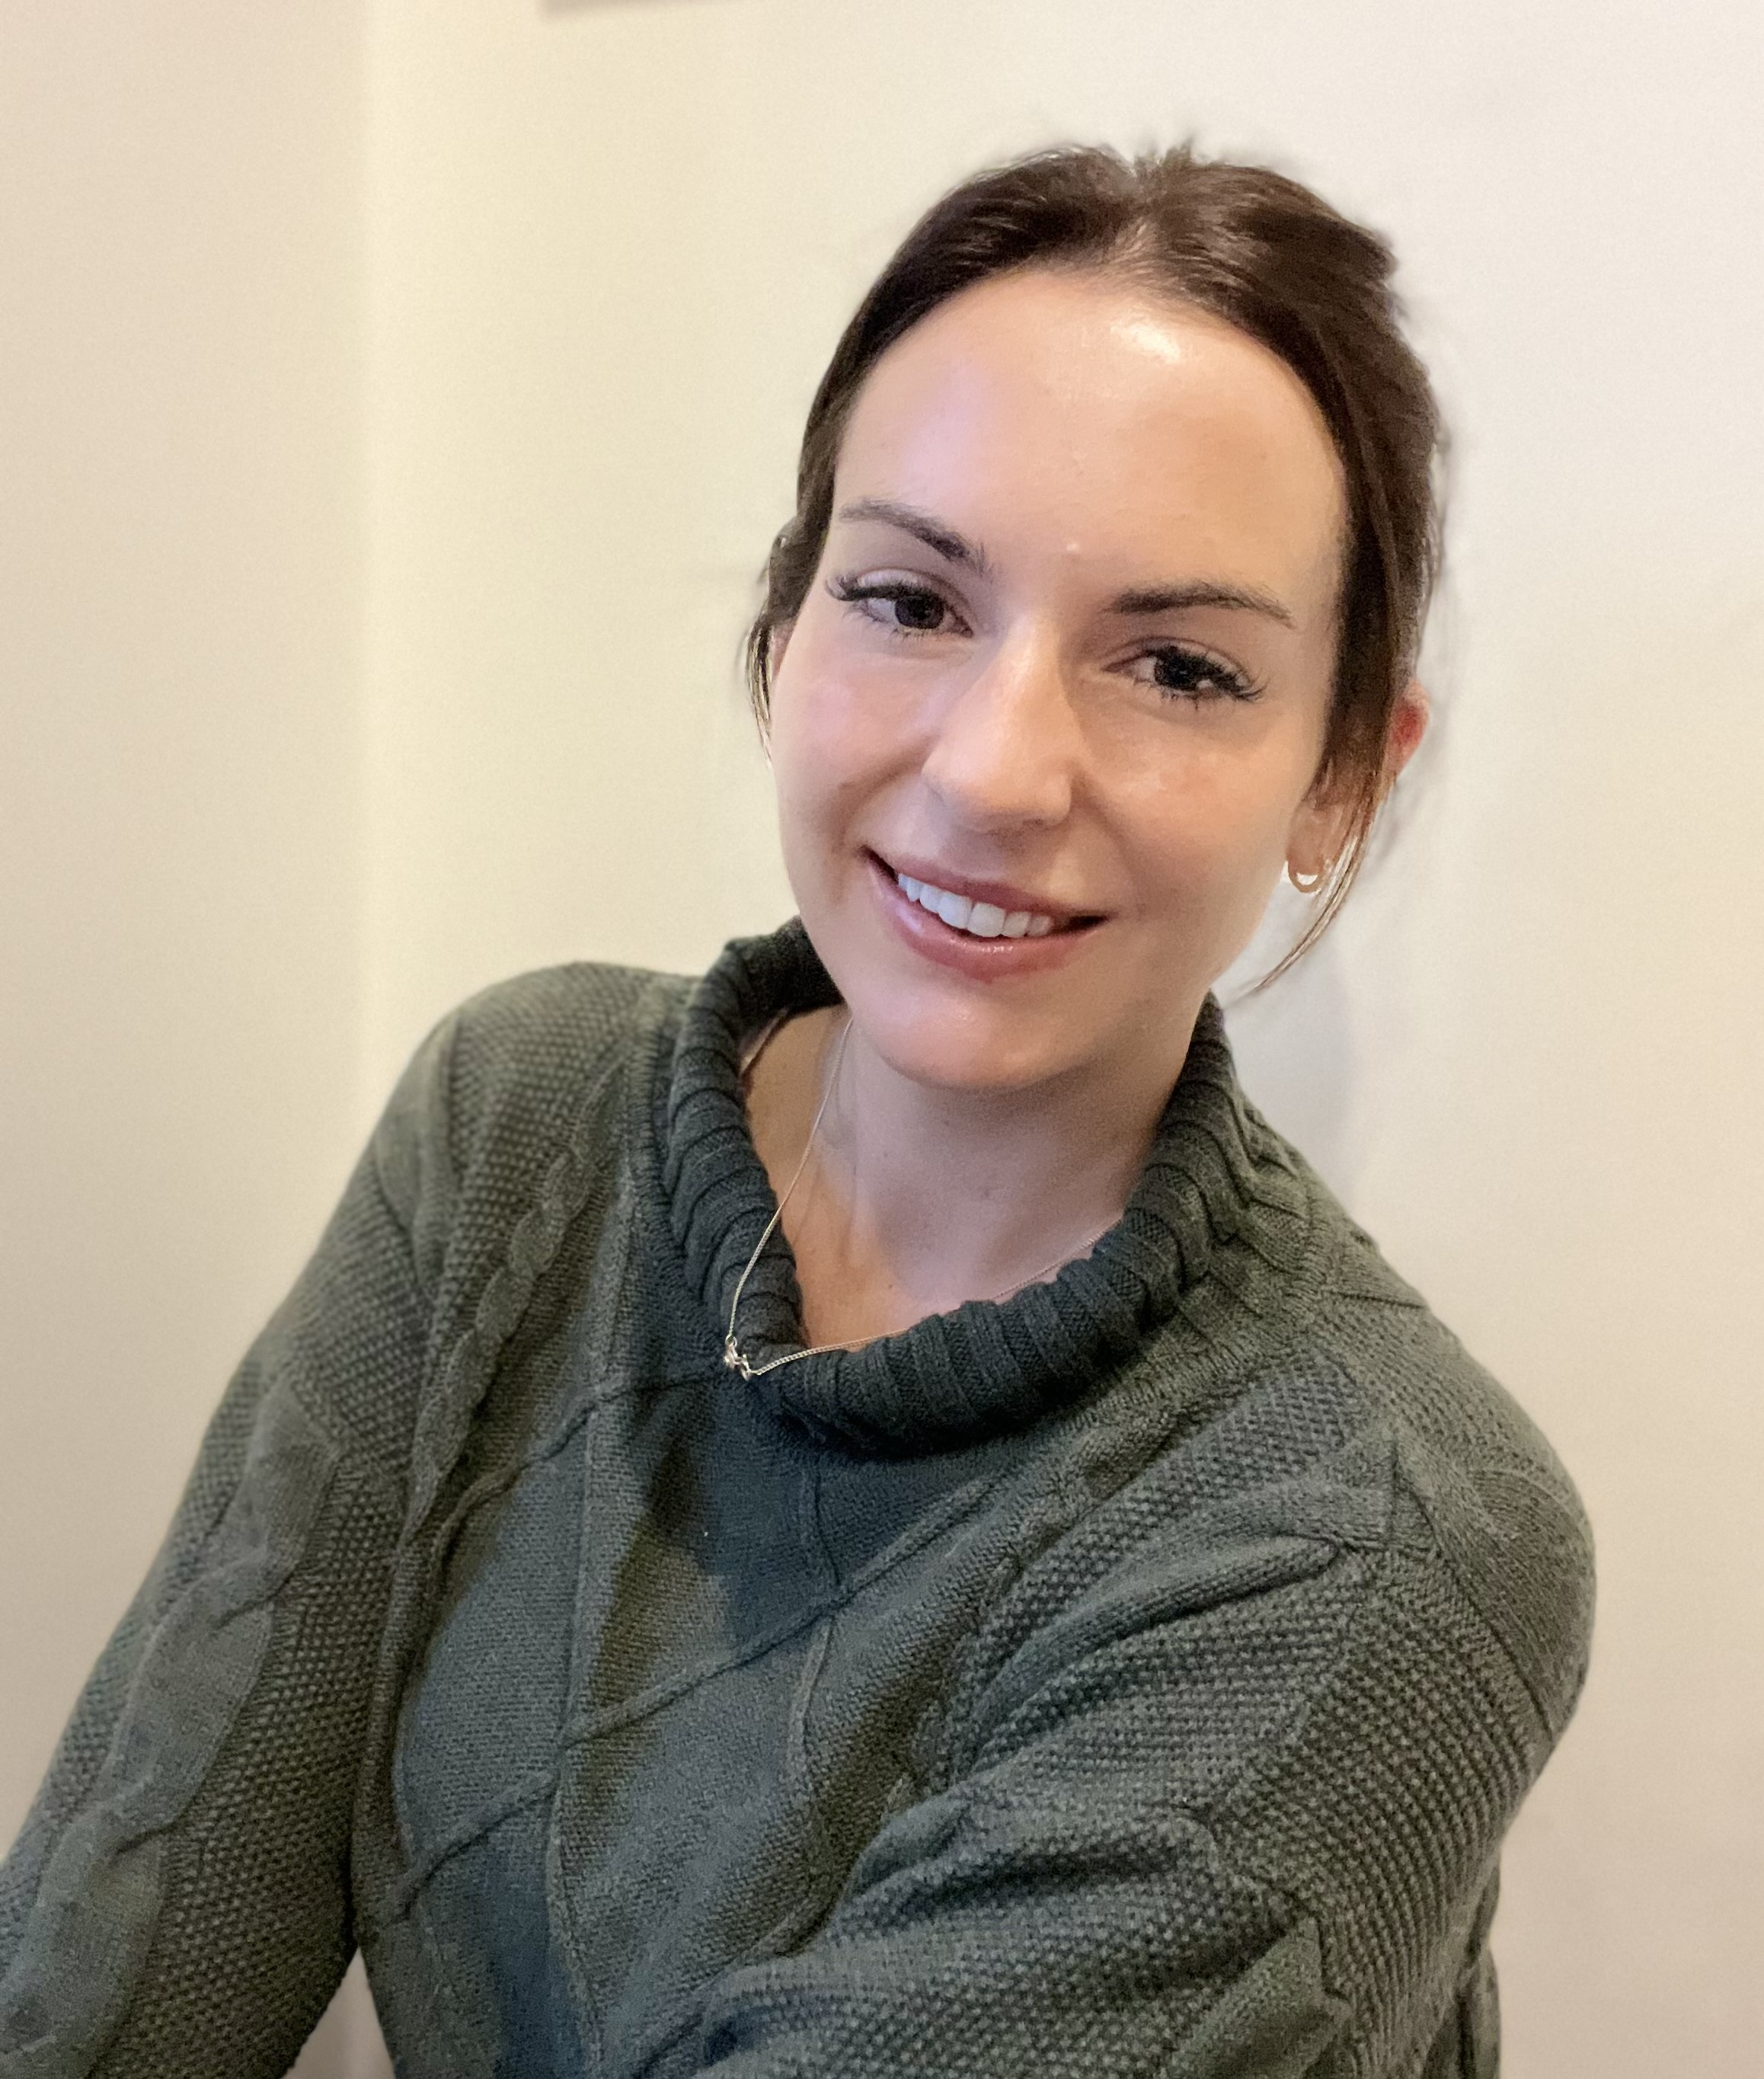
Zita McCarthy
Sustainability Manager
Kerry Dairy Ireland
Notes:
Good afternoon, it’s a pleasure to be here today on behalf of Kerry Dairy Ireland to speak to you about our Project Galileo.
Project Galileo aims to close the gap between earth observations and in time analysis on the ground and to create a way of farming that is more proactive than reactive. Agricultural practices across the world are reliant on weather patterns, in recent years these weather patterns have become more unpredictable, which poses a threat to the lean and efficient farming methods developed by our farmers over decades. By harnessing advanced technology in the sky and in the ground we at Kerry Dairy Ireland can own this challenge and support our farmers to make the most impactful everyday decision making on their farms and to trailblaze the route toward our business mission to facilitate and accelerate sustainable action within our business and across our milk supplier farms.

Slide 2
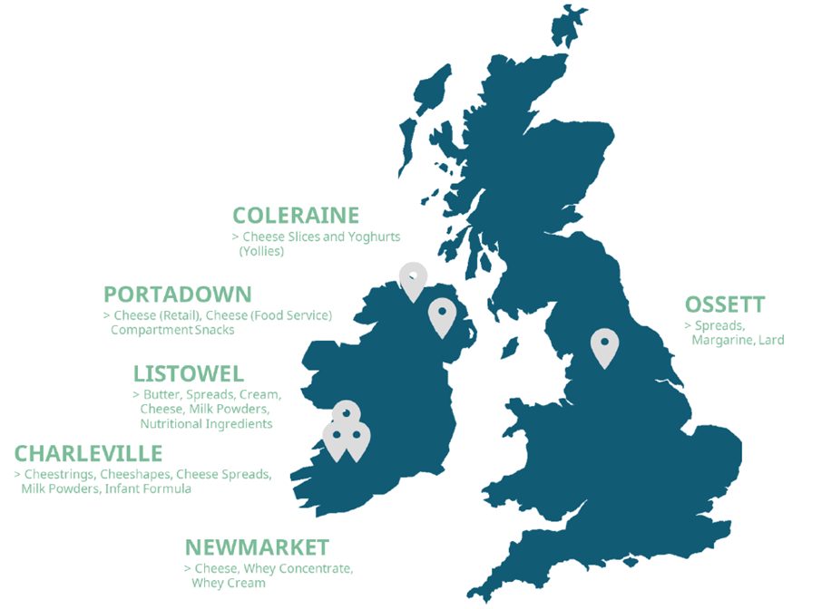
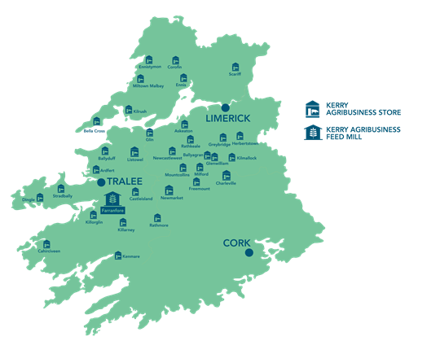
Kerry Dairy Ireland – Who we are
Better for
Planet
Better for
People
Better for
Society
1.25 billion litres of sustainable, grassfed milk
100% SDAS Certified farmers
100% Bord Bia Grassfed Verified dairy
2800+ family farmer milk suppliers
Nurturing rural communities in the South-West of Ireland
Evolve on farm sustainability programme
Notes:
In the Southwest of Ireland where Kerry Dairy Ireland and our 2800 milk suppliers are based, we collect about 1.2bn litres of milk annually and process it into a wide range of dairy products and nutritional ingredients. We have 6 manufacturing facilities within Kerry dairy Ireland, three are located in our catchment area for milk collection and processing in the southwest. We also have 31 farm and home supply stores scattered across the catchment and a large feed mill in county Kerry which produces tailored animal nutrition for our herds.
We are fortunate in having a very layered and robust monitoring, reporting and verification system for sustainability at Kerry Dairy Ireland.
100% of our milk supplier farms are certified under the Bord Bia Origin Green Sustainable Dairy Assurance Scheme (SDAS), this is a third party verified audit of on farm activity that provides granular individual farm focused insights into the sustainability of operations on farm. Additionally 100% of our milk carries the Bord Bia certification for Grassfed milk meaning a minimum 95% of the cows feed is grassbased. We have farm programmes running to incentivise farmers toward tangible and impactful action in all the areas of sustainability and emission reduction at farm level. Kerry Dairy Ireland’s on farm sustainability programme is called Evolve. The programme is revised annually. The focus and detail given to each initiative within the programme is assessed and tailored to react to the sustainability needs of our milk suppliers as interpreted by the results of the SDAS audits and feedback from the farmers themselves. With this incentivised and focused approach we aim to move the cultural dial with regard to how our farmers view, approach and adapts sustainability on their farms.

Slide 3
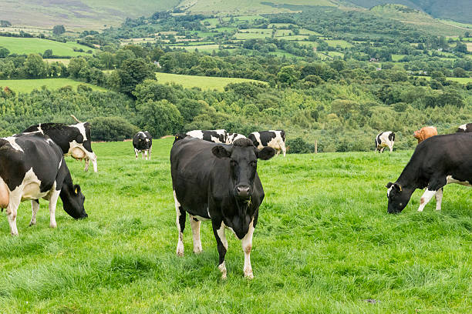
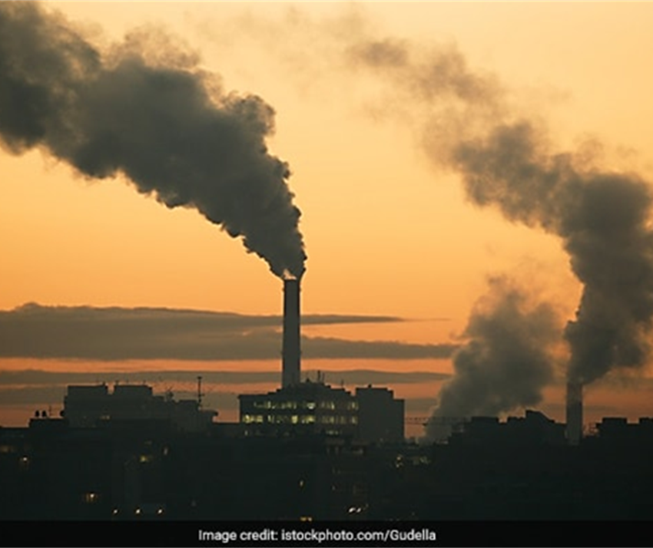
Sustainability Challenges
Biodiversity
Water Quality
Ammonia
Animal Health & Welfare
Carbon
Notes:
Ireland has an ideal climate for growing grass, which ultimately improves the efficiency of Irish Dairy farming - making us a low input, medium output farming system. However, keeping the grass growth at optimum and predictable quantities has always been a challenge, one that is becoming more difficult to manage as the impacts of global warming continue to interrupt weather conditions. We have some key sustainability challenges across our farming system including: biodiversity, water quality, ammonia and carbon emissions and animal health & welfare. A pressing challenge is the legislative requirement that Irish Agriculture as a whole must achieve a 25% absolute carbon emissions reduction by 2030. In our endeavour to achieve this ambitious carbon emission reduction target it is important that all areas of sustainability are addressed.

Slide 4
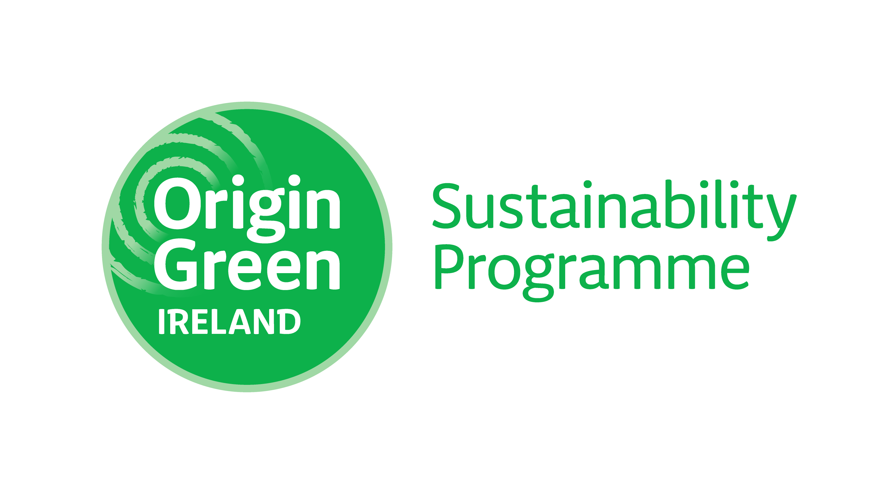
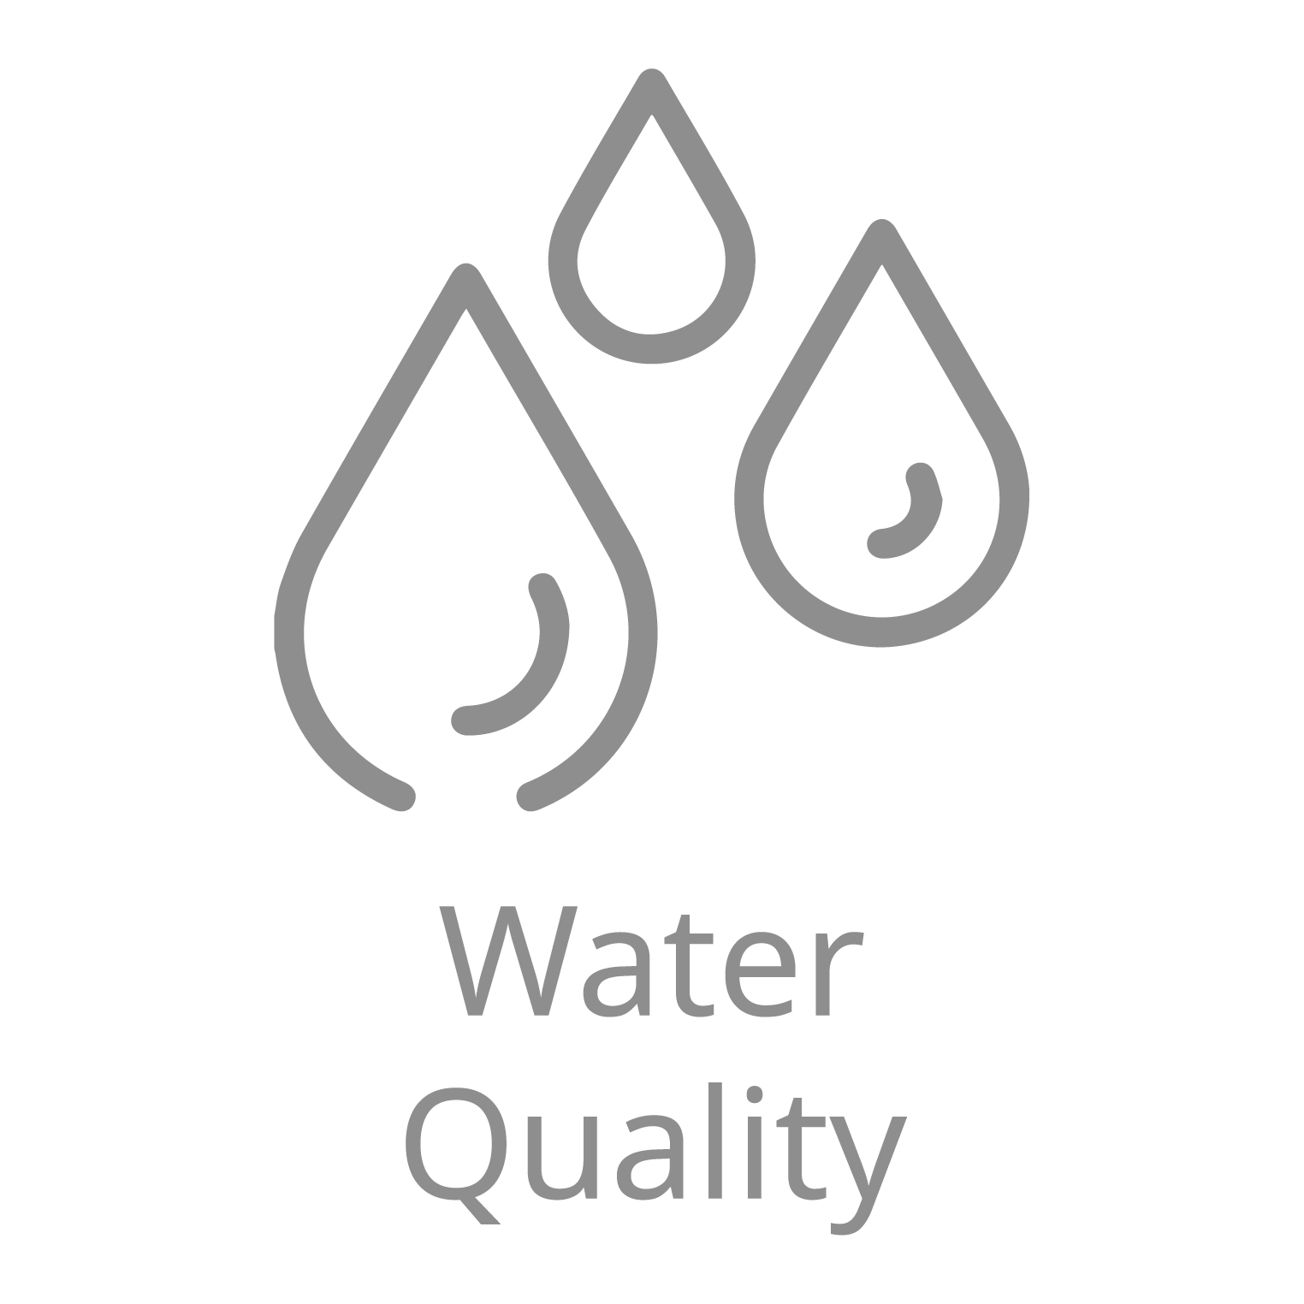
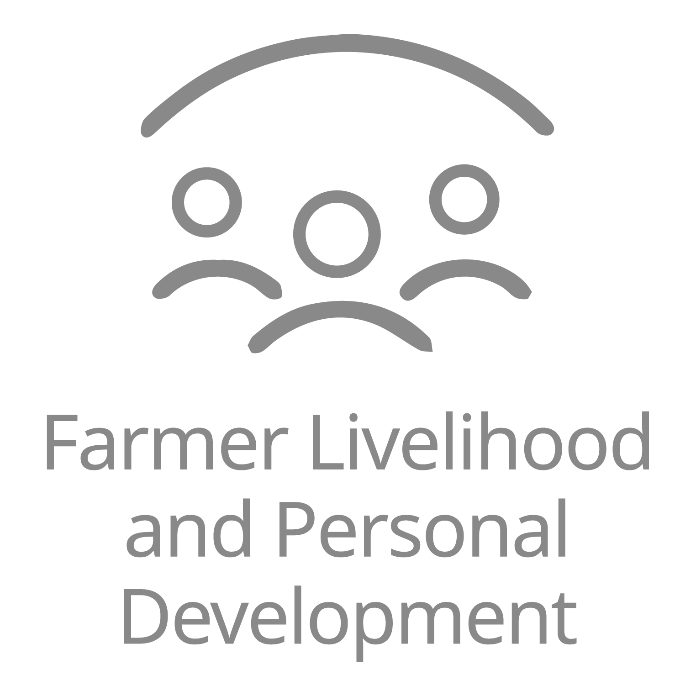
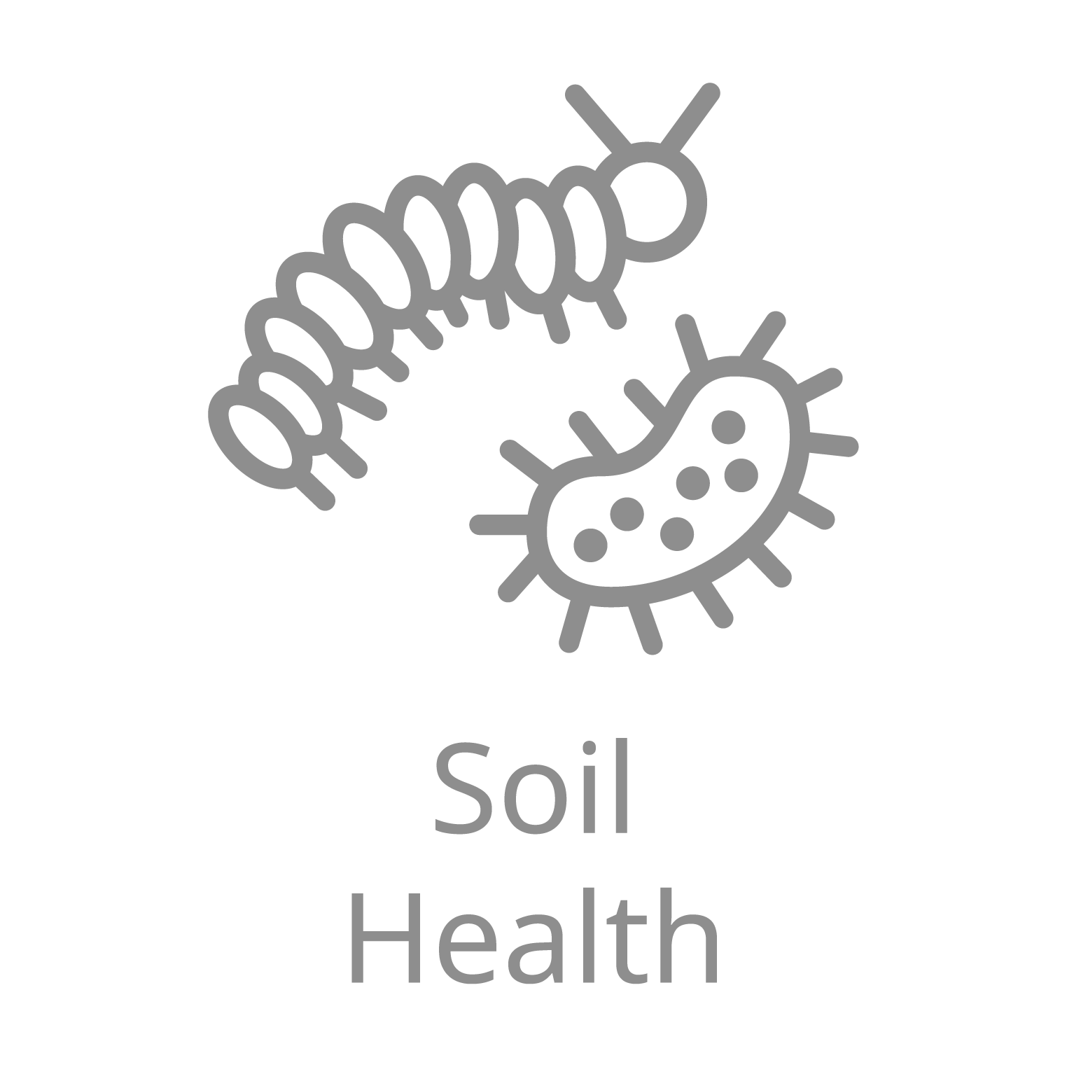
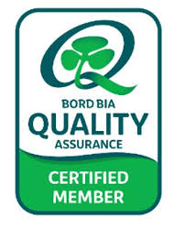
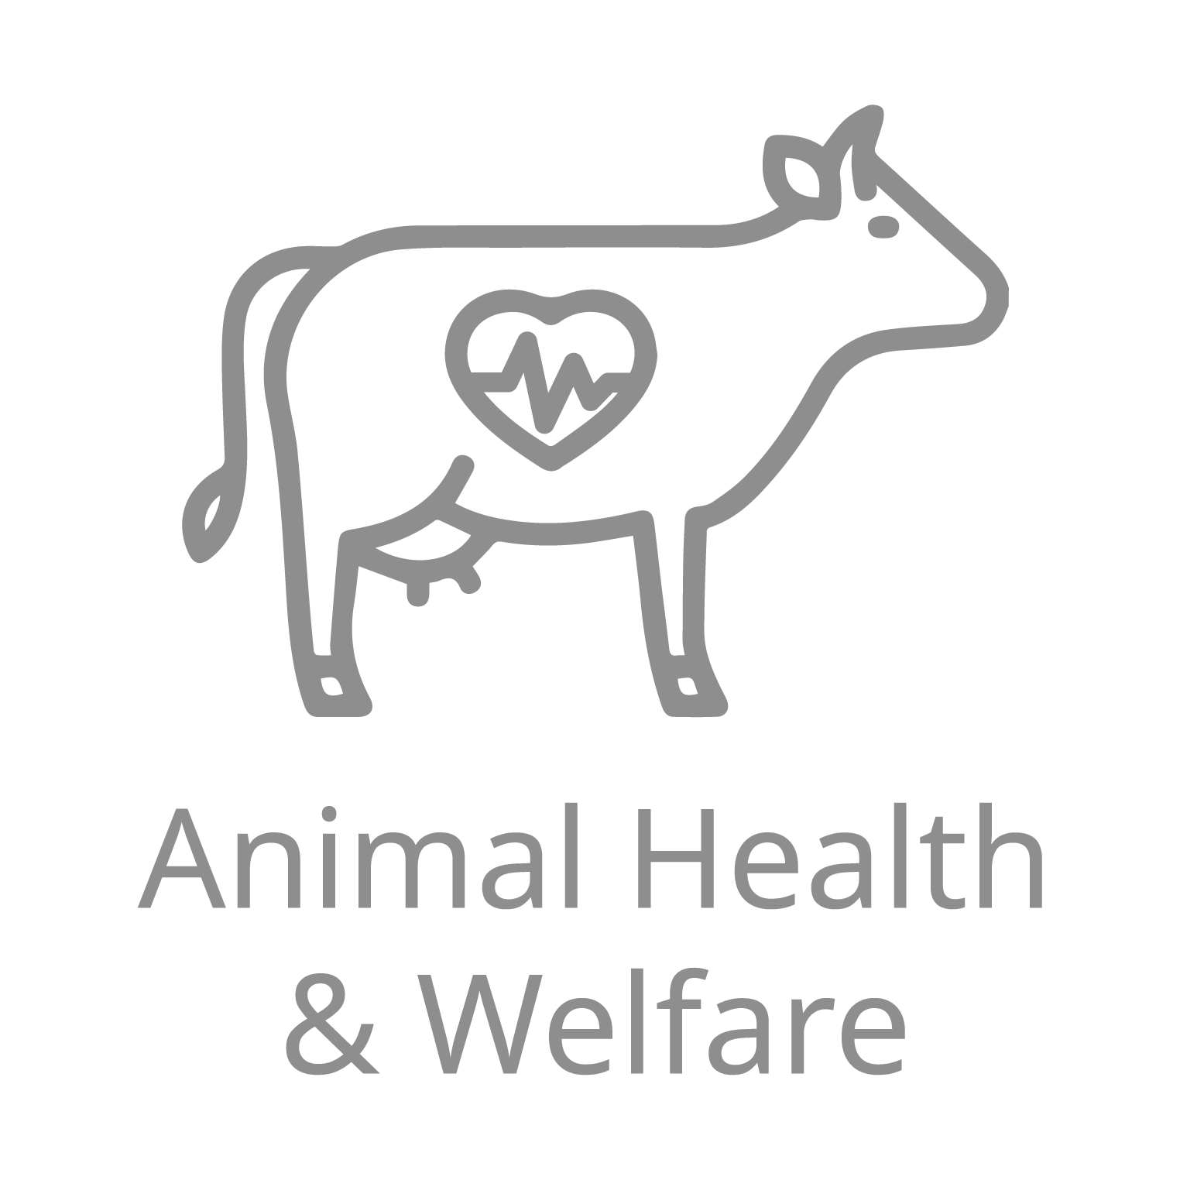
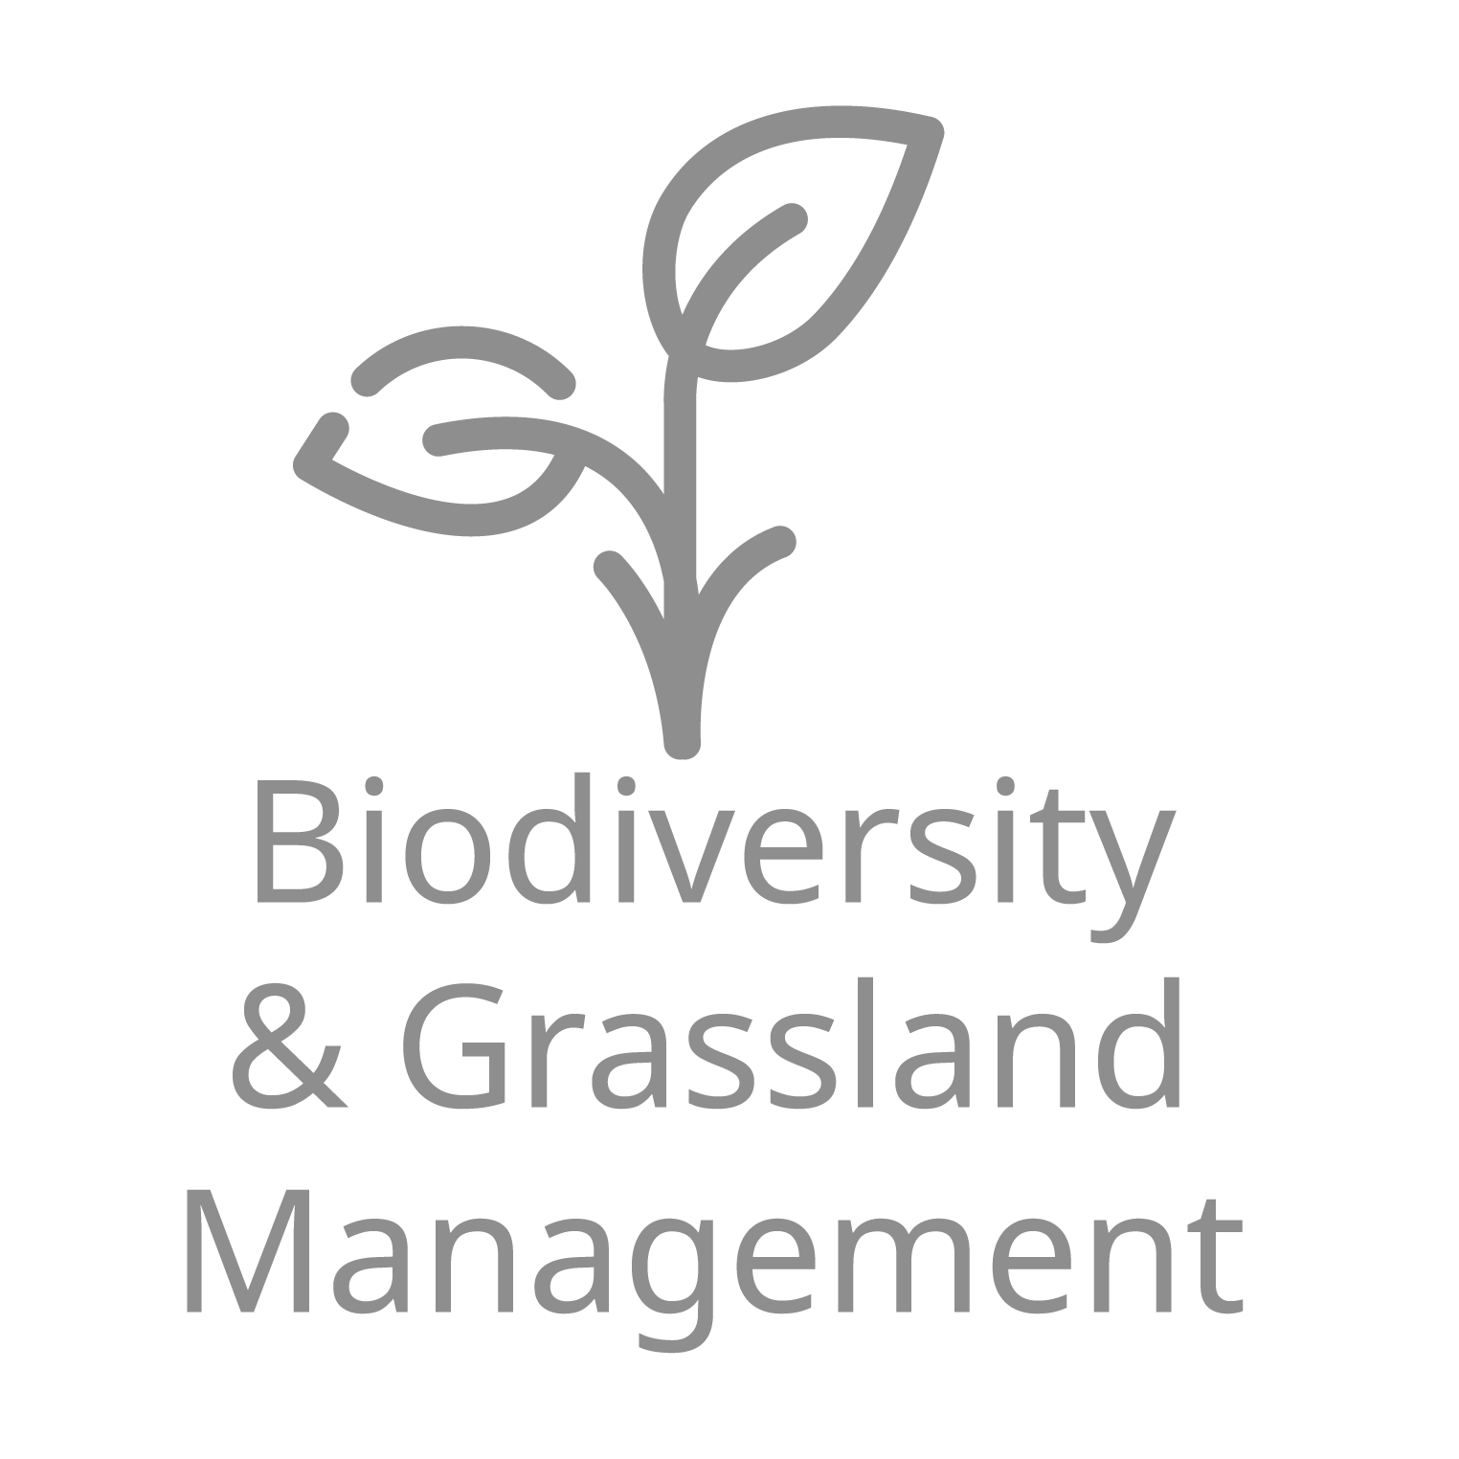
How have we been addressing these challenges?
Evolve
Ireland’s Origin Green is the world’s first national food sustainability programme
9% carbon intensity reduction versus base year 2017
Sustainable Dairy Assurance Scheme
Animal welfare, traceability, environmental protection, and food safety standards.
Bord Bia Grassfed Certified Dairy
cows >95% grassfed
Notes:
We recognise our privilege in having granular individual information for all milk suppliers, paired with our longstanding relationship and Evolve, our award winning sustainability programme for farm activity that has been the model for many sustainability initiatives launched around the world by our peers and competitors. With these strong foundations of sustainability in place we have achieved 9% reduction in our scope 3 carbon intensity since our base year. This has been a result of communication from Kerry Dairy Ireland’s quality & sustainability advisors and commitment & dedication by the farmers to adopt and blend new methods of farming their land and animals. We are proud of the progress made to date and commend the farmers who have adopted new technologies and methods of farming. We have made progress, but not enough for what is required in the aim to revolutionise a system that is already considered to be one of the most sustainable in the world.

Slide 5
We needed to Amplify our Efforts to Achieve Our Goals
Kerry Dairy Ireland
MRV
Satellites
Sensors
Notes:
We also recognise that in isolation this won’t be enough to address the steep challenges that achieving our vision of becoming world leaders in grass based milk production brings, it is clear to us that we need to act and think bigger, wider and clearer. We understood that we need to harness satellite technology to align and purify data and enable farmer decision support.
To achieve our vision and mission we need a scalable system that can manage the evolving complexities of farming and support farmers on their sustainability journey. We have fantastic data banks established across all our milk suppliers but we identified that we have some systems management communication problems and often the data is not in real time thus compounding the reactive farming approach we are trying to move away from. We need our systems to sync together.
An overhead view of the real time farming system that employs all the farm specific data currently fed into our MRV system and creating in time and useful information for the farmers to amplify the sustainability progress that can be made with excellent supports in place. And so project Galileo was born.

Slide 6
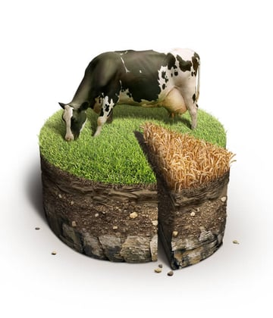
Project Galileo - A Staged Approach
Create a decision support tool for our farmers
Understanding Data and Information Creation
Data Bank access and development
Screening & Identification of Trial Farmers
Project Design & Scope
Notes:
How did we start?
We approached this in a phased manner, knowing that although we have years of data available to us that could be deployed in the project, that data was collected without controlling for the impact of variables, such as weather. To that end, we created a shortlist of farmers that best represented the soil and climate conditions across our catchment and enrolled them into project Galileo. Our aim was to put the infrastructure and controls in place on their farms while we set about collecting a broad range of data over the life of the project to enable data bank building, modelling and ground truthing. Enrolling these farmers also means we have a ready pilot cohort available to us down the line. We also embarked on a journey to validate the latest technologies available at farm level, particularly in the area of sustainability, as well as looking at technology partners that could best facilitate the remote sensing and satellite elements we wanted to explore, all enable by Enterprise Ireland.

Slide 7
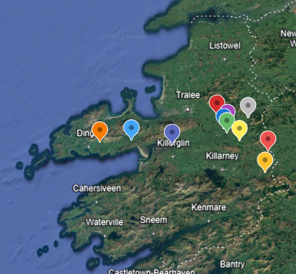
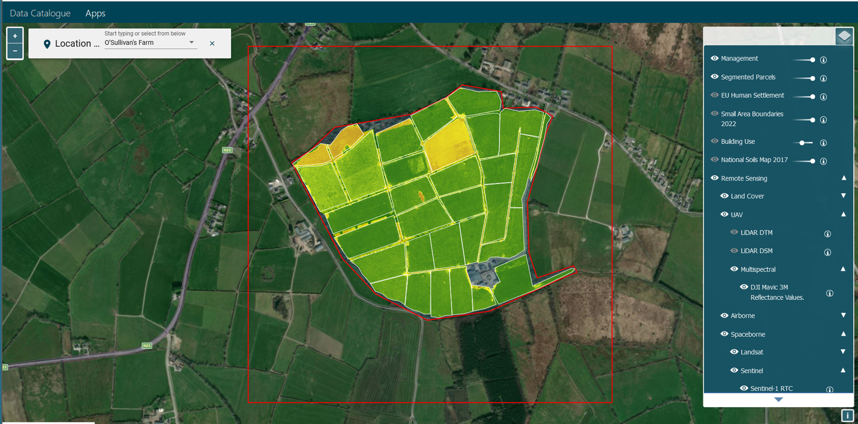
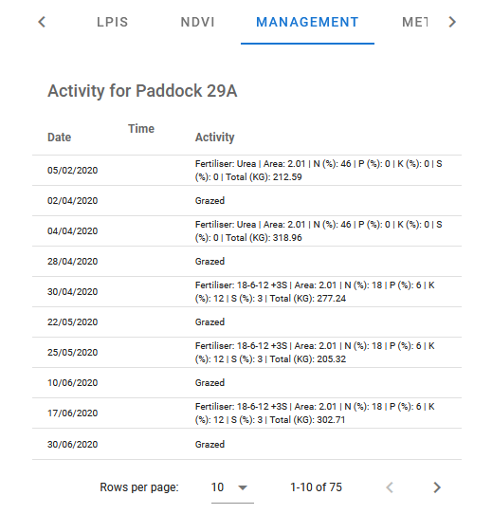
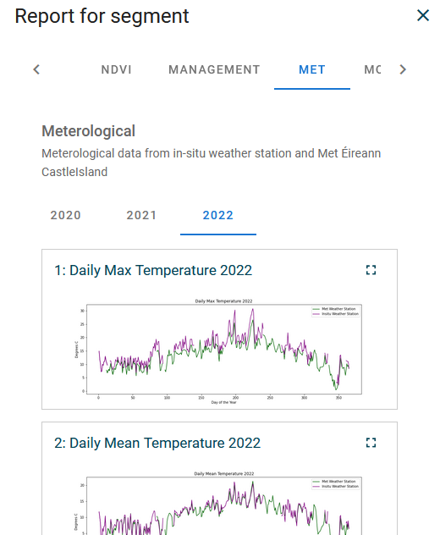
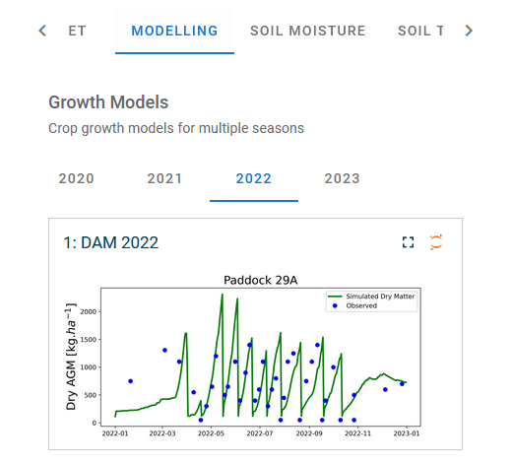
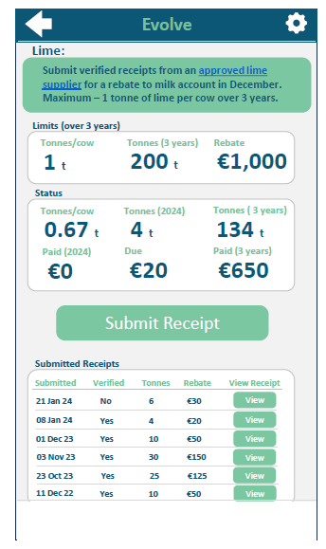
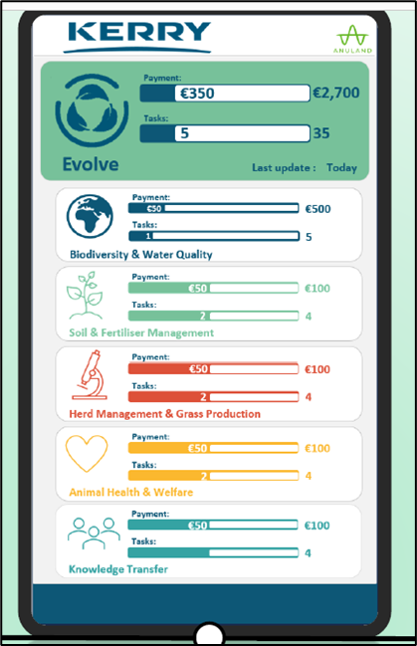
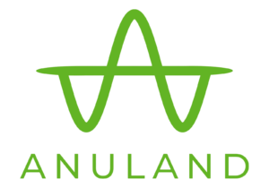
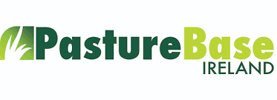
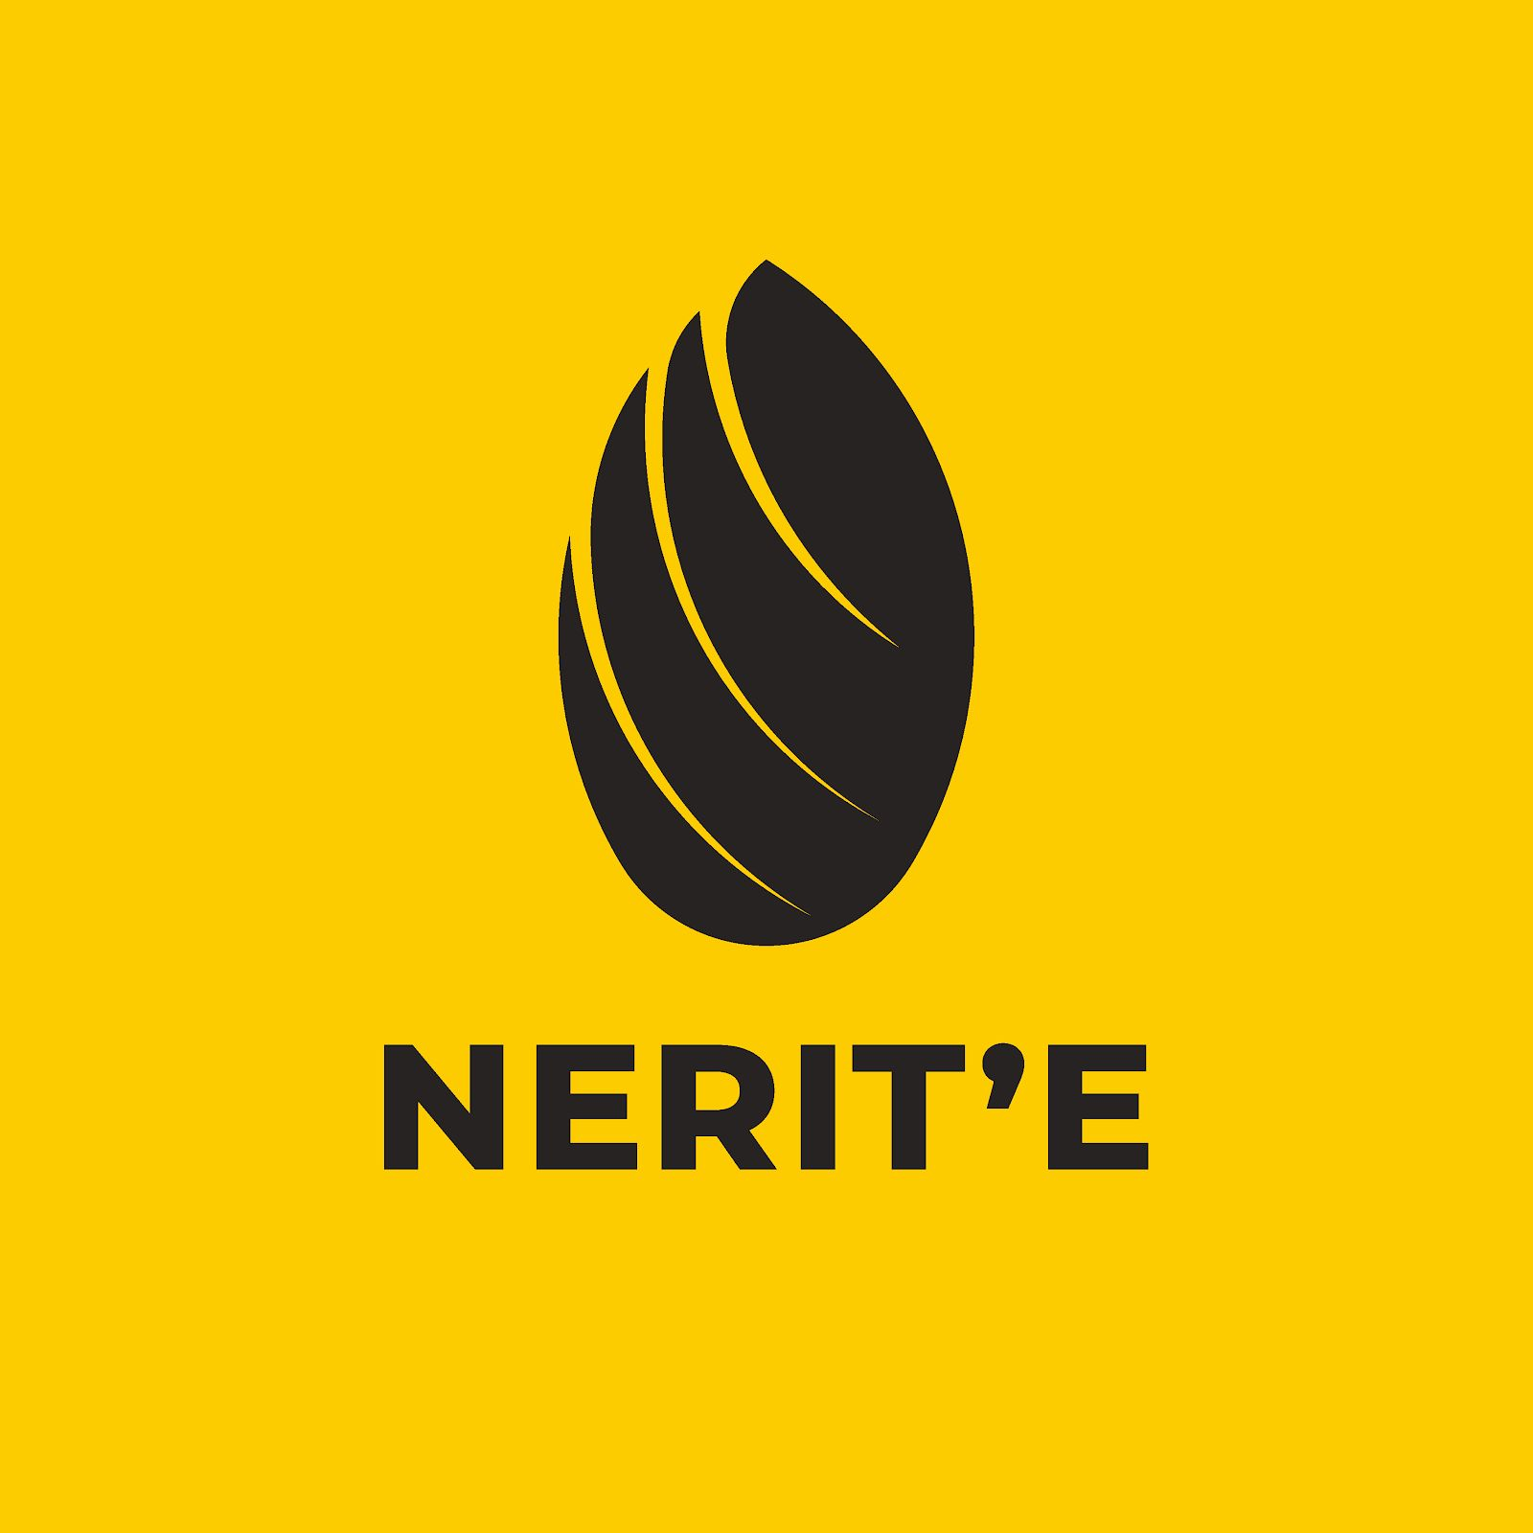
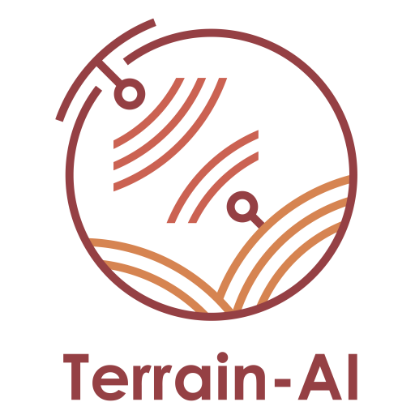
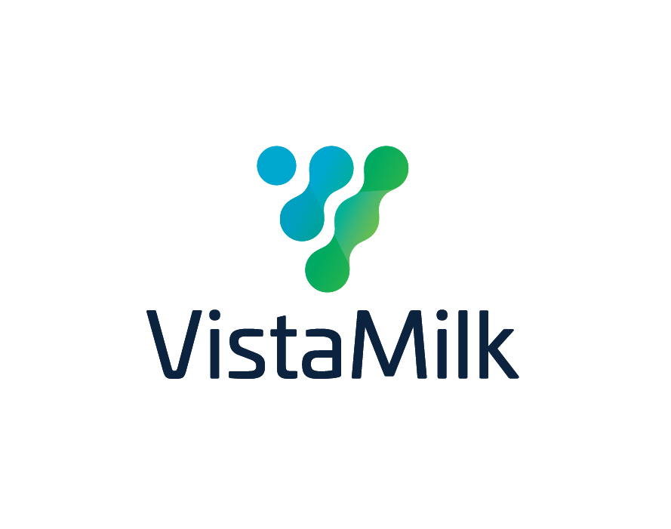
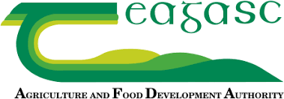
Building Project Galileo
N
Animal Pathway
- Efficiency
- Genetics
- Performance
In app decision support tool
Pasture Pathway
- Nutrient management
- Soil
- Grassland
Notes:
On the ground we continuously employed the use of on-farm weather stations, in soil sensors, soil sampling & analysis, grass growth measurement, grass sampling & analysis, soil carbon analysis via several methodologies, milk sampling and MIR spectrum analysis both on bulk milk and at an individual cow level, herd health screening, Genomic analysis on all animals, GPS animal tracking & monitoring and much more. This data will be married with satellite and drone derived data by our technology partners Terrain AI (Maynooth University) with the aim of delivering a digital twin farm that will be developed and refined over time to enable a step change in how the farming system is monitored, measured, managed, and supported through expert decision support.

Slide 8
Pushing the Boundaries of the Status Quo
Project Galileo
Evolve
Grassfed standard
Sustainable dairy Assurance Scheme
Farmer decision support in real time
Improved farm efficiency
Real time decision support on farm
Supply chain information flow
A step change toward sustainability targets
Notes:
We believe that the development and commercialisation of this application will enhance the ability of farmers to manage the entire farming system in a granular way through both soil and animal pathways.
This project will also enable Kerry Dairy Ireland to support our farmers by delivering on our business vision and mission.

