Slide 1
From Science fiction to science fact
Rob Desborough
General Partner, Seraphim
Chair, Seraphim Space Accelerator

Slide 2
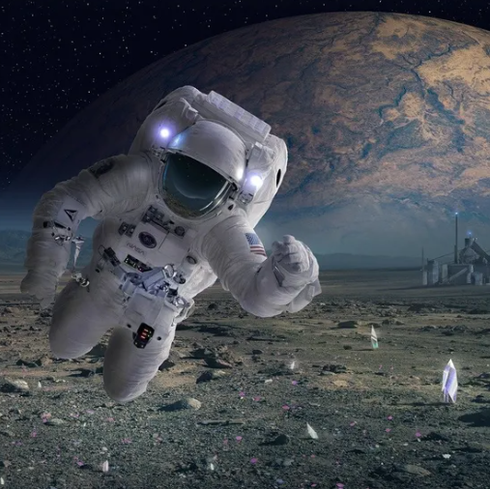
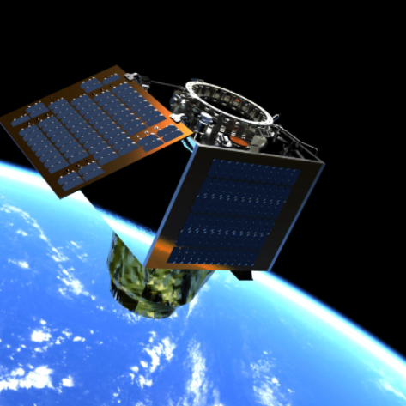
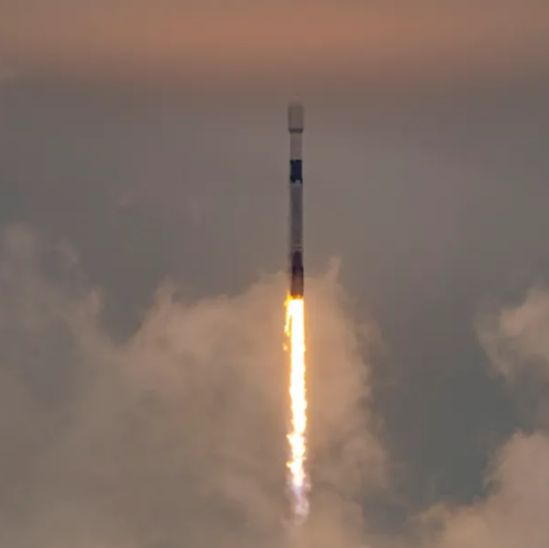
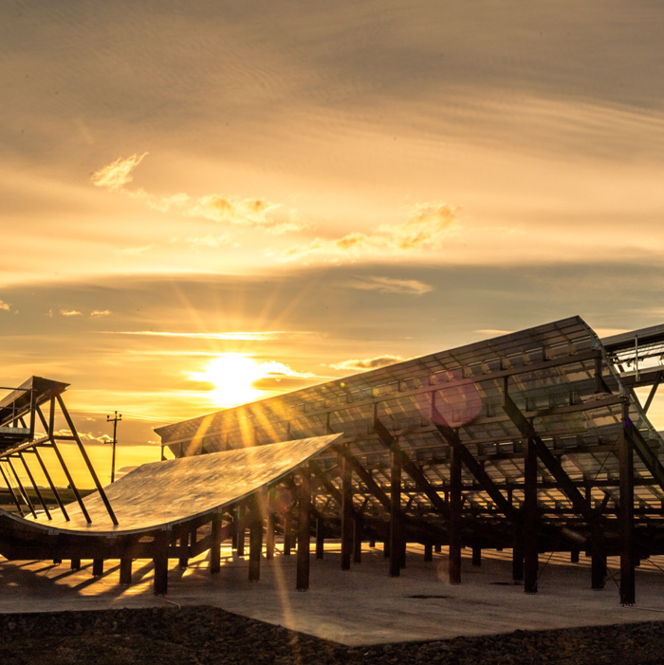
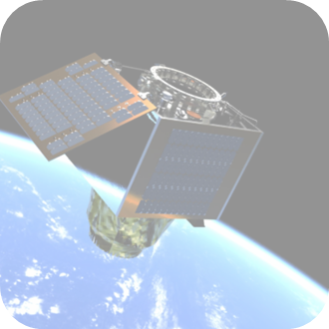
WORLD’S LEADING SPACE INVESTMENT GROUP
United in our mission to align our investments with ESG strategy
Worlds
leading and most prolific Space Investor
Worlds 1st Space VC Fund 2016
Supporting from Inception to Exit
$250k to $25m
Top 5% Performance Globally PE/VC
Founder world’s 1st Listed Fund LSE SSIT Plc
$350m AUM
Visibility of 75% of all global SpaceTech deals
Worlds 1st SpaceTech Accelerator
$550+ invested
EU/USA/Asia
133 Companies across 30 countries
Raised $5.5bn
4 Unicorn IPO’s to date

Slide 3
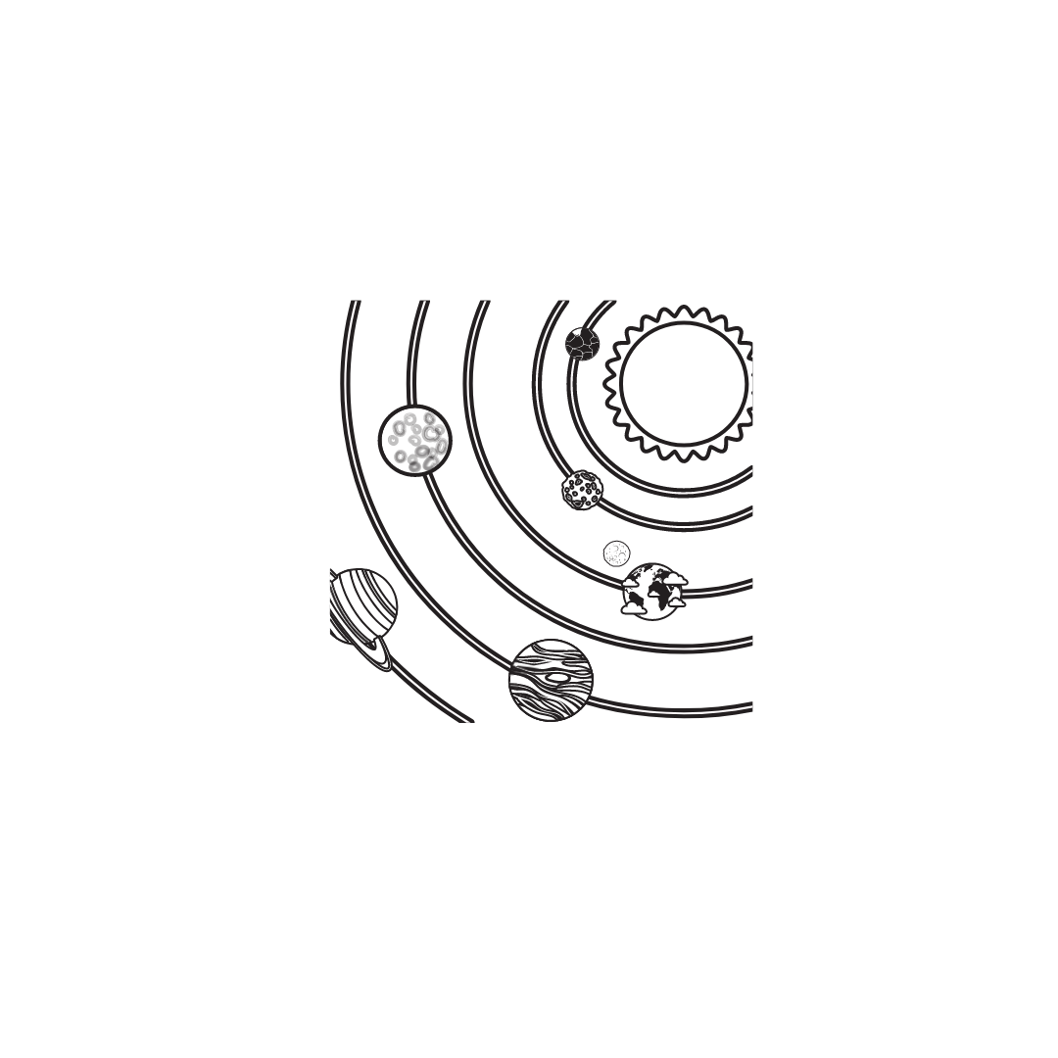
Investment opportunity
Space 2.0 (now)
Space 3.0 (next)
Space 4.0 (future)
Space to Earth digital platform
Large constellations of satellites are creating a new digital infrastructure in the sky
Real time insights on every m² of the planet. A.I. + data fusion = Google scale data set
Reshaping entire sectors, unlocking new applications, catalysing megatrends
Space infrastructure: Earth to Space and back
Space-based networks: on orbit edge compute, internet, comms and data relay
Sustainable Space: Space debris removal, satellite servicing, situational awareness
New platforms for R&D, manufacturing. Scientific breakthroughs – new drugs, new materials
Infinite Space resources to sustain the planet
Space- based solar energy: sun delivers more energy in an hour than world consumes in a year
Lunar / asteroid natural resources: replacement for terrestrial rare earth materials
Real estate: commercial space stations for commerce + tourism, lunar habitations and beyond
Notes:
The fund will offer diversified early exposure to future category leaders aligned with each phase of the SpaceTech market’s continued evolution

Slide 4
SEED
SERIES A
SERIES B
SERIES C+
$1-$25m
$10-$40m
$30m-$150m+
$50-$500m+
Develop concept
Validate demand
Complete design
Launch test satellite(s)
1st customers
Deploy MVP constellation
1st recurring revenues
Scale full constellation
Diversify products
Pre IPO / strategic acquisitions
SPACE ACCELERATOR
SERAPHIM
FUNDS
SPACE VENTURE FUND I I
SPACE INVESTMENT TRUST PLC

Slide 5
Once in a generation opportunity Private capital driven by long term $trillion market outlook
VC Investment ($bn)
Annual deal Tracker (12 months rolling)
(5 yrs)
(5 yrs)
(5 yrs)
(5 yrs)
Number of deals by stage (12 months rolling)
12 months rolling Investment by taxonomy ($bn)

Slide 6
2024 Index Highlights Recording the investment activity in New Space
$8.8bn invested in TTM to Q3 24
$5.6bn invested in TTM to Q3 23
57% Increase
TTM Investment ($bn)
Quarterly Investment Tracker ($bn)
595 deals in TTM to Q3 24
TTM Deals (#)
Quarterly Investment Trends: SpaceTech vs. General VC
386 deals in TTM to Q3 23
54% Increase

Slide 7
Earth Observation Constellations & Analytics
Total Investment, All SpaceTech VS Earth Observation ($Bn)
EO Constellation investment by region TTM ($bn)
EO Investment
$46bn Into SpaceTech since 2017
Largest rounds in Earth Observation
Company | Country | Round | Date | Raise
Chang Guang Satellite Technology | China | Series C | 2020 Q4 | $376m
Galaxy Space | China | Series C | 2020 Q4 | $300m
Map Box | US | Series E | 2023 Q3 | $280m
World Labs | US | Series A | 2024 Q4 | $230m
Planet | US | Series D | 2019 Q1 | $168m
Map Box | US | Series C | 2017 Q4 | $164m
HawkEye 360 | US | Series D | 2021 Q4 | $145m
ICEYE | Finland | Series D | 2022 Q1 | $136m
Descartes Underwriting | France | Series B | 2022 Q1 | $120m
Synspective | Japan | Series A | 2019 Q3 | $100m
$10.7bn Into EO since 2017
23% of total investment
$4.1bn Into satellite constellations
$6.6bn Into downstream applications

Slide 8
State of Finance:
The US and China are engaged in a capability arms race that is fueling investment in both regions, especially in China.
The EU's investment drivers differ, with a focus on climate and EU sovereignty.
Within the EU, there is a higher volume of deals, but these deals are generally smaller in scale.
As of year-to-date 2024, the EU accounts for 20% of global investment but represents 29% of all deals.
This trend has been consistent over recent years, underscoring the ongoing challenge of accessing growth capital within the EU.

Slide 9
Will affect the world tomorrow
What we do today
Seraphim Space has invested into over 30+ industry-leading SpaceTech startups.
We believe that this is just the beginning…
Rob Desborough
General Partner, Seraphim
Chair, Seraphim Space Accelerator

