Slide 1
EO Commercialization Forum Agriculture Session
Vista GmbH
Water – Energy – Food : Nourishing the Future
Dr. Heike Bach
CEO and Founder
Notes:
Current Context: Emerging issues and the opportunities they present
BayWa’s history began 100 years ago with the co-operative agricultural trade: BayWa supplied and still supplies rural areas with everything that agriculture needs. Today, BayWa is grown to a global solution provider for our basic human needs: food, housing, heating, electricity and mobility.

Slide 2
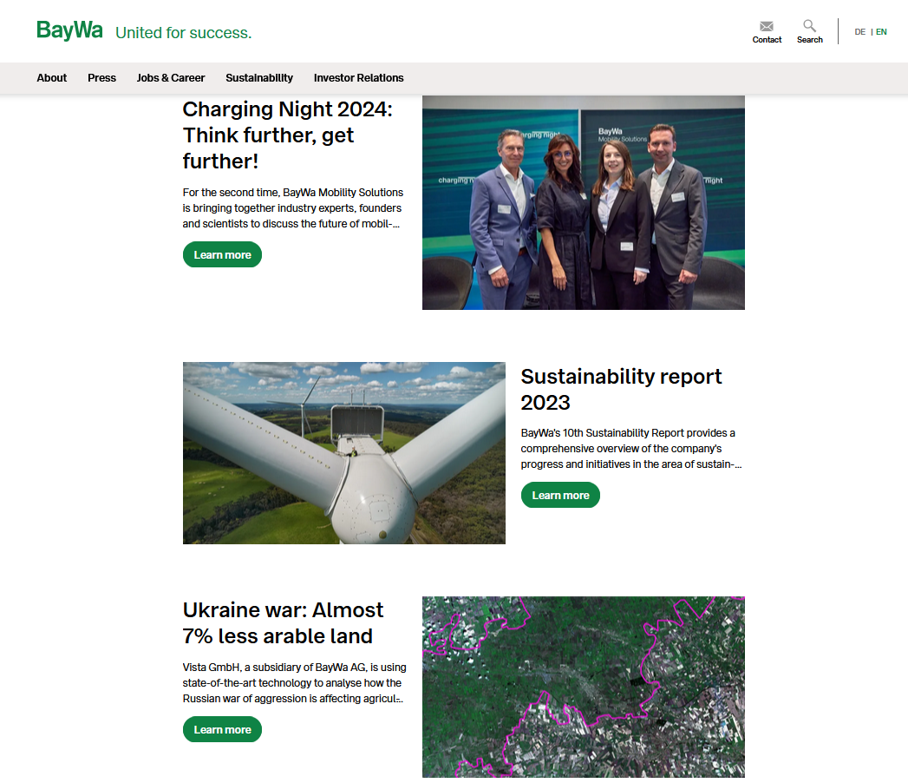
EO Commercialization Forum Agriculture Session
Vista GmbH
Water – Energy – Food : Nourishing the Future
Dr. Heike Bach
CEO and Founder
Notes:
Current Context: Emerging issues and the opportunities they present
BayWa transaction motivation; buying expertise from EO, big data, AI to support transformation to digital agriculture – as many others in the ag industry
Vista as a part of BayWa provides dedicated services to BayWa, but from the beginning we wanted to share this knowledge, being service providers to the whole agricultral ecosystem.

Slide 3
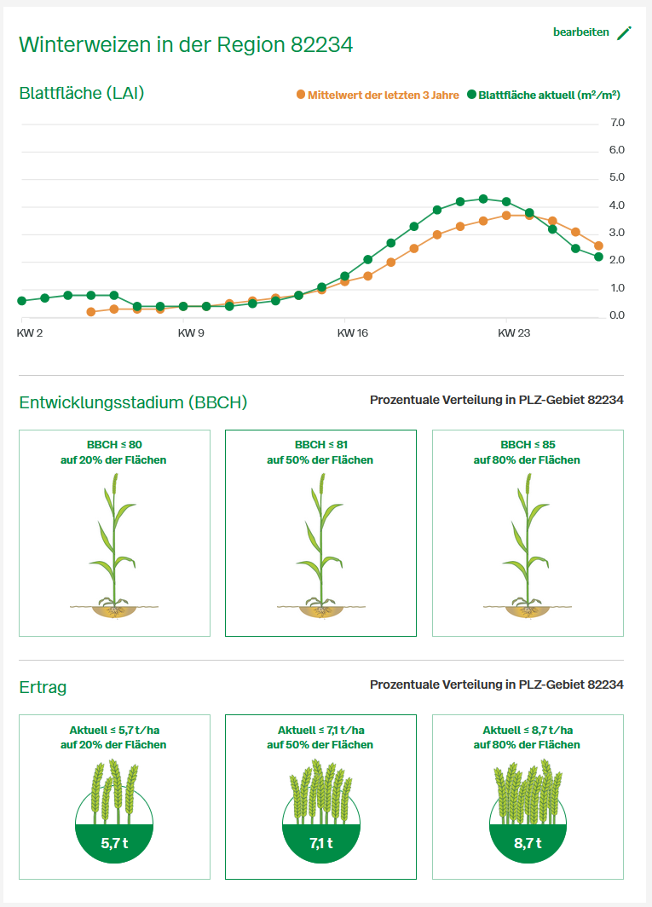
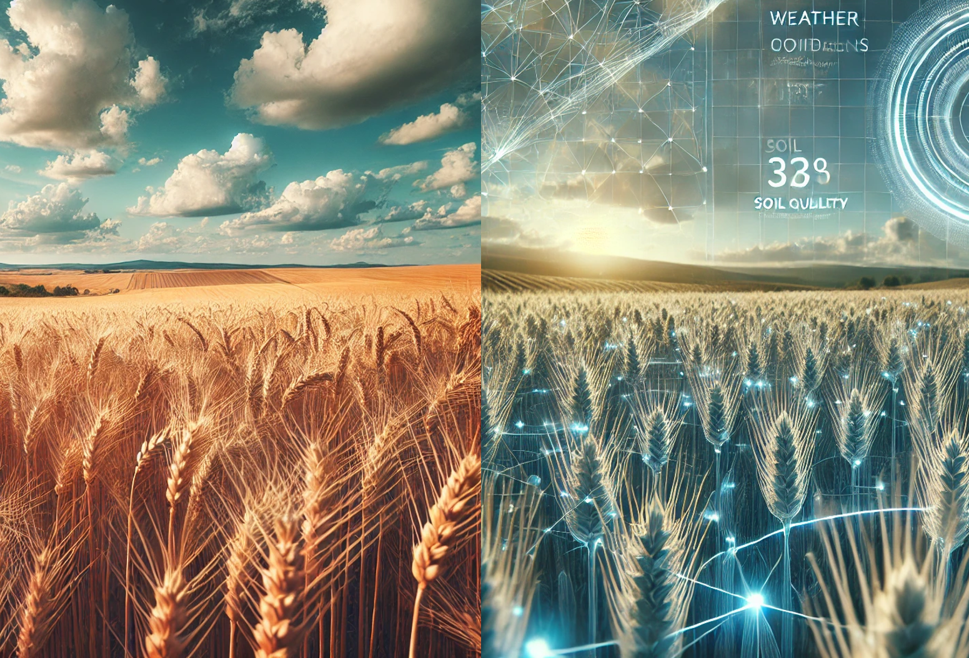
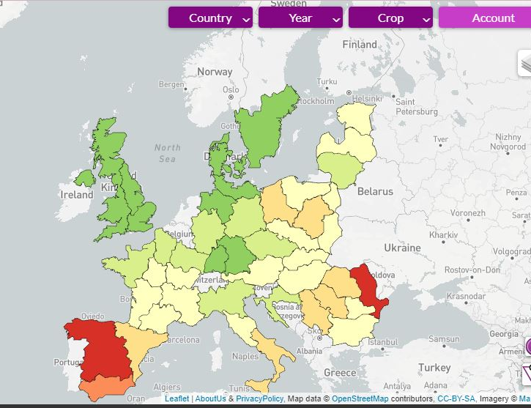
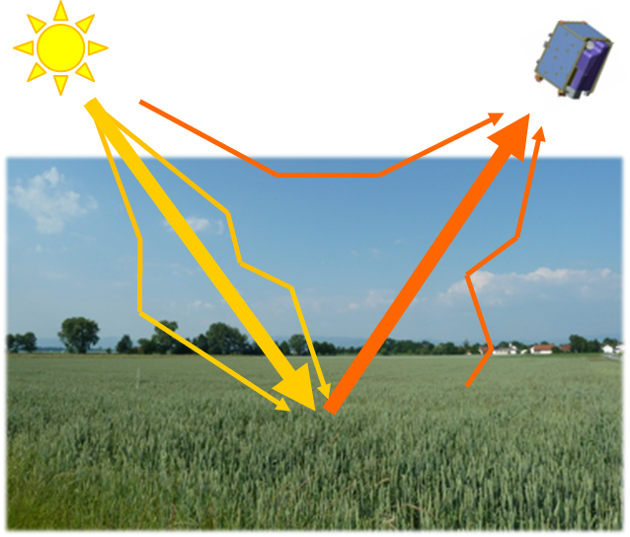
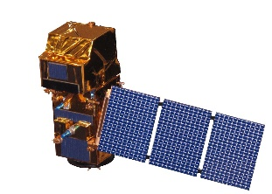
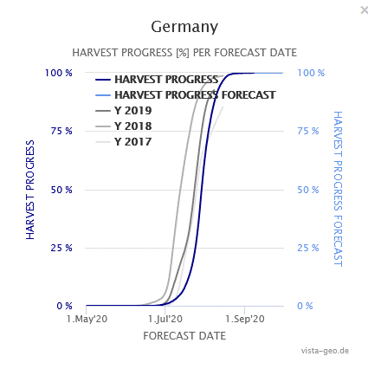
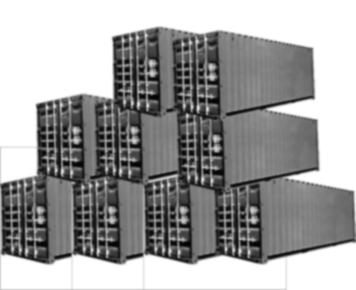
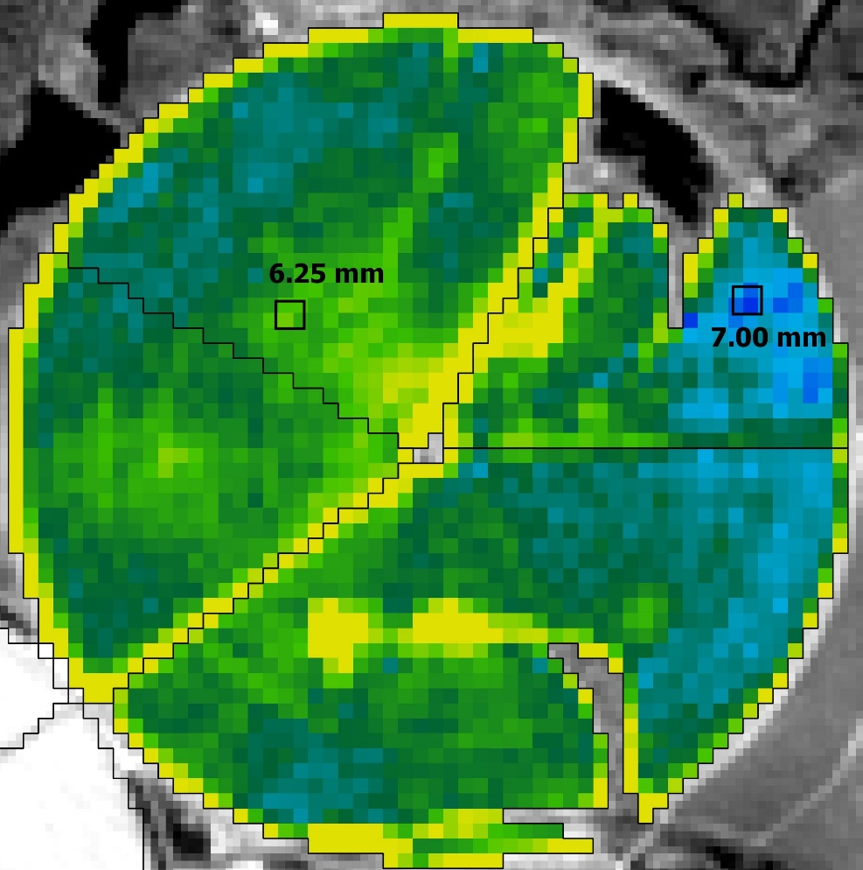
We accelerate the digital and sustainable transformation of agriculture by connecting the real and digital worlds
Massive Cloud Processing
IT Expertise:
Big Data and AI
Scientific Excellence: Models and EO
Proven Operational Services
Digital Twins
THE REASON WHY
Notes:
Embedding EO: Building the necessary connections between EO and non-EO players to ensure access to the required analytics
EO is key input to the digital and sustainable transformation of agriculture and provides the spatial reality in the digital twin approach
Initiating Change: How to introduce new analytics capabilities and the key challenges
However EO is only one component. Services need to be developed that fit the needs of farmers and ag businesses. One should not need to be be expert in the data analytic domain to understand and use the service.

Slide 4
Using complex Digital Twins for providing easy-to-use solutions serving the farmers needs.
Notes:
Initiating Change: How to introduce new analytics capabilities and the key challenges
However EO is only one component. Services need to be developed that fit the needs of farmers and ag businesses. One should not need to be be expert in the data analytic domain to understand and use the service.

Slide 5
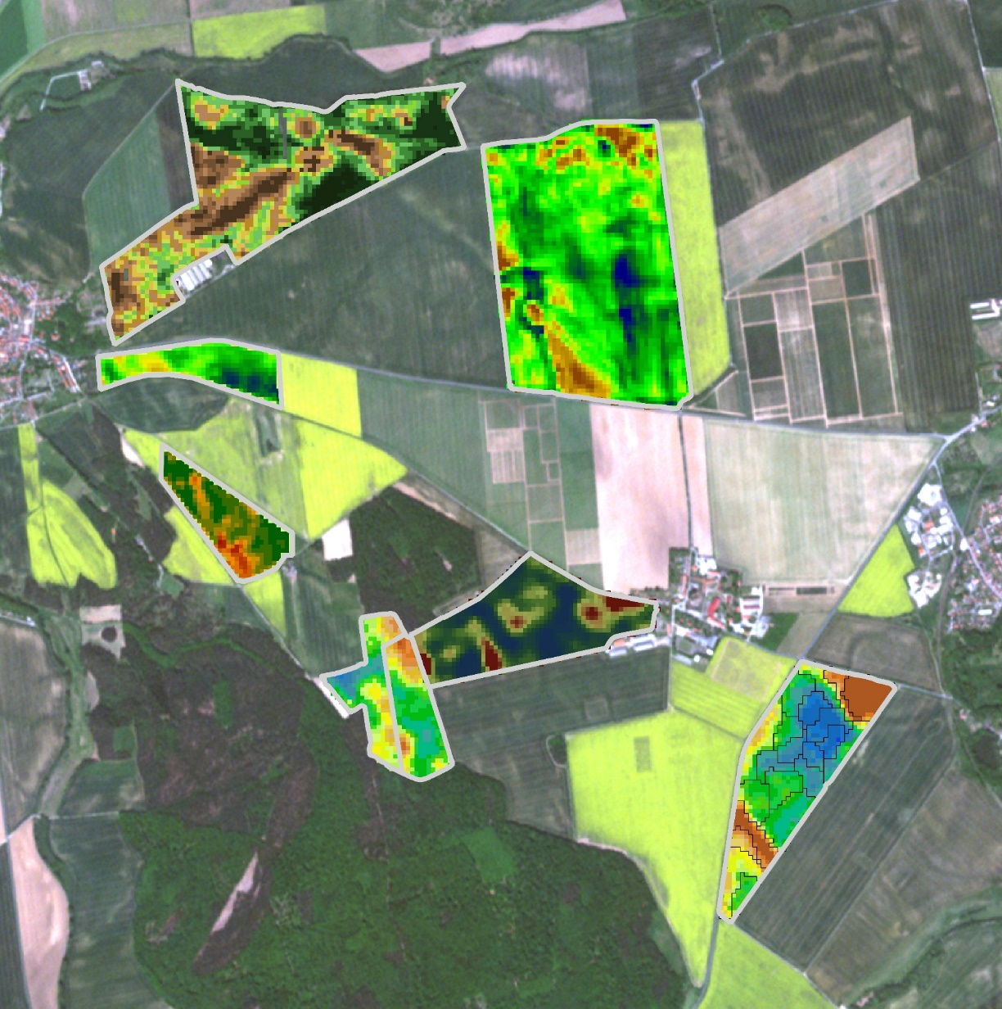
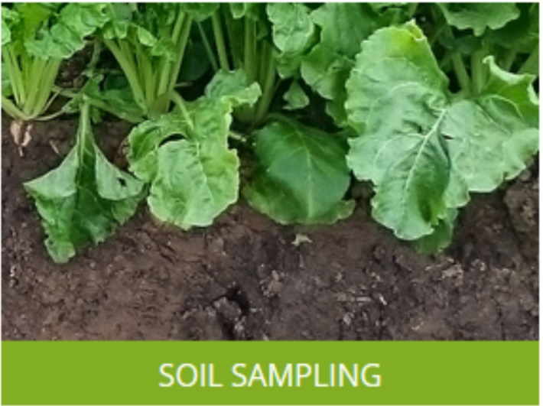
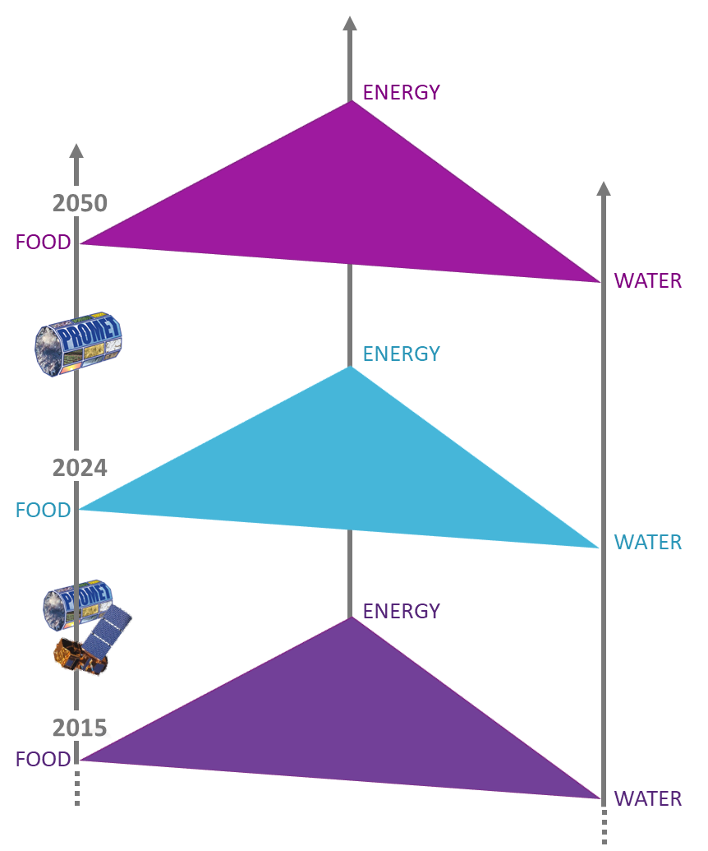
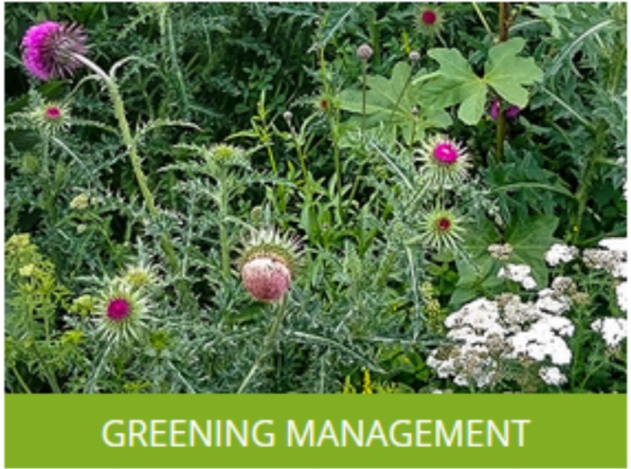
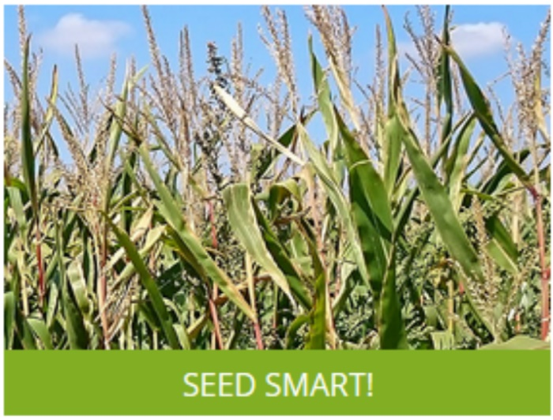
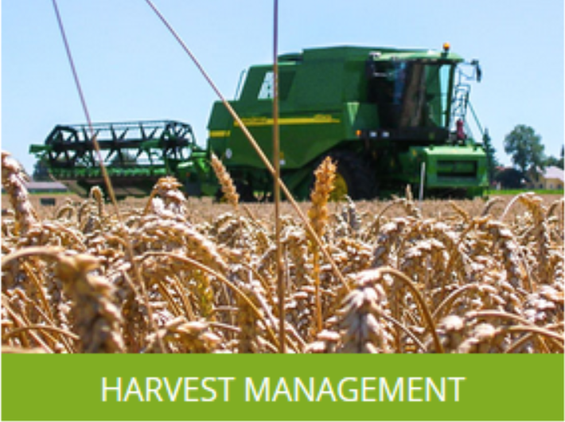
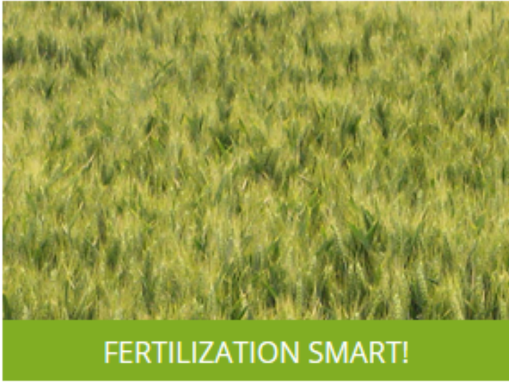
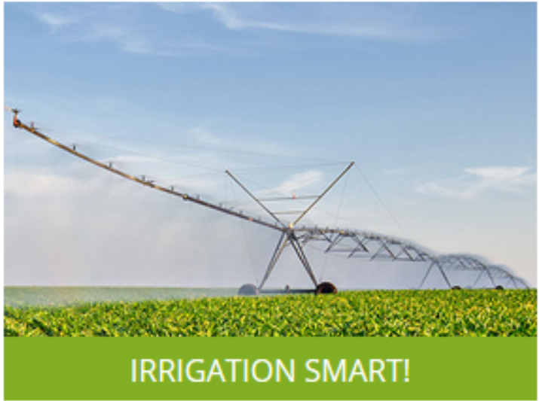
Development Paths of Vista
TF Biomasse Karte
t/ha
TF Ertragskarte t/ha
TF Blattfläche
m²/m²
TF Ertragspotentialkarte t/ha
TF Blattchlorophyll µg/cm² (Blattfläche)
TF Basiskarte langjährige Biomassemuster
TF Zonenkarte Hoch- und Niedrigertragszonen
Further development of the service
Automation, Scaling
2010 ROI
2020
2024
Smart Farming ESA IAP
2030
New Space ESA incubed
Carbon Market, ESA Artes
Energy: Agri PV
Notes:
Scaling Up: Encouraging broader adoption within the industry
Copernicus was/is a key enabler to success and ROI Investments for scaling up are high. Scaling up at present requires support.

