Slide 1
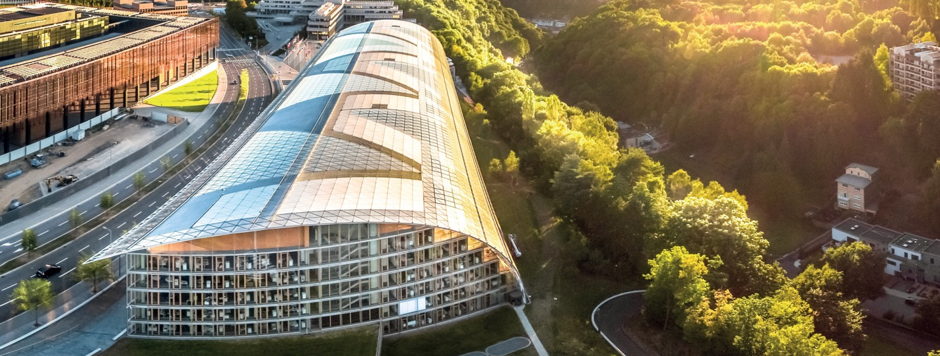
EIB Group & the Space Sector
Jaroslav Toth, Senior Advisor, Corporate Finance Advisory
THE 2nd EO COMMERCIALISATION FORUM (Frankfurt, Germany)
27 November 2024

Slide 2
EIB Group: overview
World’s largest multilateral lender
Established 1958, with over €1.5 trillion invested
Governed by EU Member States
Nearly 5 000 staff; HQ in Luxembourg
€88 billion invested in 2023:
€49 billion in green finance
€20 billion in innovation
EIB Group 8 core priorities: Climate action; Digitalisation and technological innovation; Security and defence; Cohesion; Agriculture and bioeconomy; Social infrastructure; High-impact global investment; Capital Markets Union

Slide 3
EIB Group: innovative start-ups and Mid-Caps
Indirect
equity
Investment advisory
Funding
Scale-up Debt
(direct lending)
Venture Debt / Growth Capital
(direct finance)
Investment funds
Financing advisory
Direct Equity
Co-investments
Grants
Innovative startups
Innovative
Scale-ups
Innovative
Startups & Midcaps
Innovative
startups
Innovative startups
Tickets €40M - €120M
Tickets €10M - €40M
Tickets <€15M
Example transactions in the space sector:

Slide 4
EIB Advisory products
Financial advice
Technical advice
Capacity building
linked to EIBG funding
linked to EU policy objectives
linked to clients’ needs
Improve bankability of companies and projects
Advice on financing alternatives
Structure PPP projects
Develop scalable, effective and efficient financial products
Design and implementation of EU financial instruments
Project structuring, planning and management
Feasibility & technology assessment
Sectorial studies and development
Climate action and environmental sustainability advice
Gender equality & social programs advice
Capacity building on technical and financing issues
Design of specific in-house training
Knowledge sharing & dissemination of best practice
Needs assessment for project advisory support
Support in institutional development

Slide 5
Tripartite Collaboration Arrangement EIB/ESA/EC
A landmark tripartite arrangement intended to further the cooperation in the domain of space:
Promote EIB advisory services towards the companies forming part of the ESA Commercialization Networks and of the CASSINI ecosystem
Strengthen organization-wide coordination, in particular through information exchange, knowledge sharing and outreach.
Exchange best practices and advice around space-related Public Private Partnerships (PPP).

Slide 6
Earth Observation and Finance
Banks as financiers
Banks as customers
Environmental monitoring. Project life cycle monitoring.
Strategic approach needed, including objectives, milestones, key monitoring indicators and KPIs
Discussion of the data, methodologies, data protocol on storage and processing.
Procurement

Slide 7
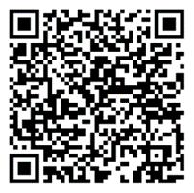
Do not hesitate to contact us:
Contact the Corporate Finance Advisory team at the European Investment Bank
EMAIL: corporatefinanceadvisory@eib.org
SUBJECT: “DSLS ADVISORY: NAME OF YOUR COMPANY’’
Jaroslav TOTH
Senior Advisor, Corporate Finance Advisory -
European Investment Bank
EMAIL: j.toth@eib.org

Slide 8
THANK YOU

