Slide 1

ESA Earth Observation Programmes and European EO industry
2nd EO Commercialisation Forum
27 November 2024
Simonetta Cheli
Director of Earth Observation Programmes, ESA
ESA UNCLASSIFIED – For ESA Official Use Only

Slide 2

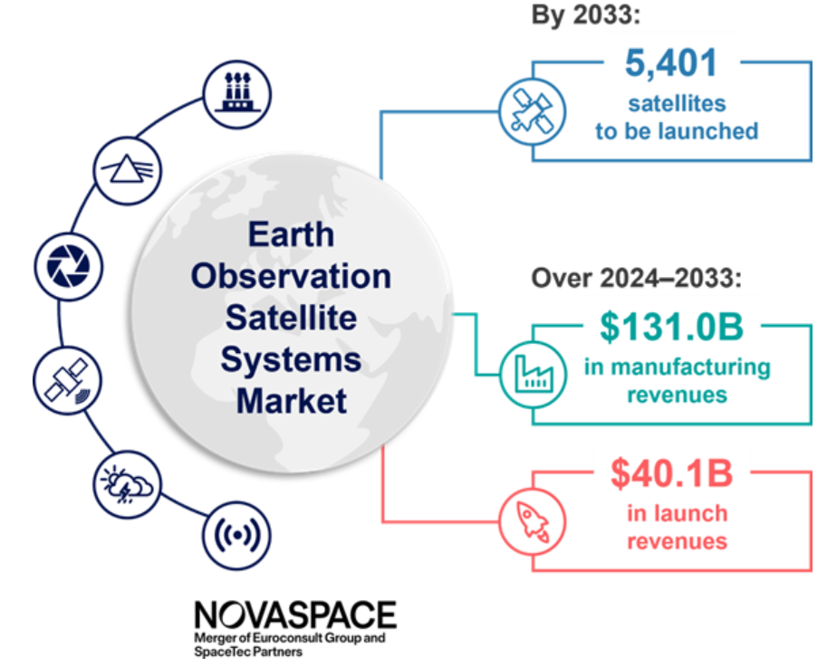
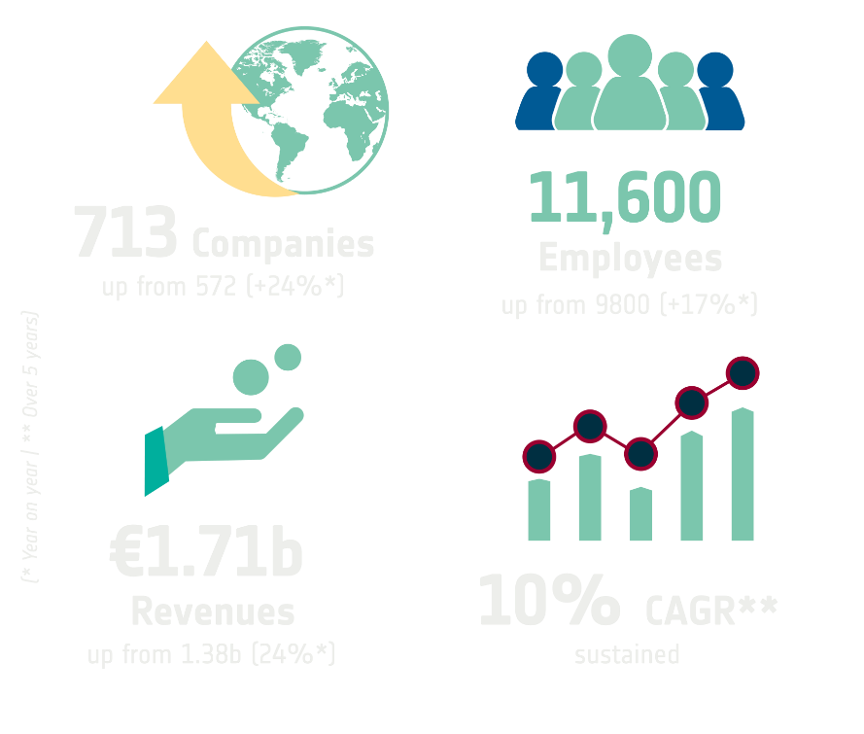
Up- and Downstream Earth Observation Market
European EO Up & Downstream Market Value 2023
Earth Observation satellites set to triple by 2033
14928 Employees
Up from
13796 (+8%*)
796 Companies
Up from
772 (+3%*)
2.27B€ Revenues
up from
1.79B€ (+27%*)
10.7%**
Growth rate
Source | EARSC - European EO Industry (2023 study done 2024)
Source | Euroconsult 11 July 2024 (https://www.euroconsult-ec.com/press-release/)
2
Notes:
Source | EARSC - European EO Industry (2023 study done 2024)
survey on the state & health of the EO services industry - Direct research on over 800 companies; survey sample of 71 EARSC members
796 Companies Up from 772 (+3%*)
1498 Employees Up from 13796 (+8%*)
2.27B€ Revenues Up from 1.79B€ (+27%*)
10.7%** Growth rate
Source | Euroconsult 11 July 2024 (https://www.euroconsult-ec.com/press-release/)
The number of EO satellites in orbit is expected to almost triple as the manufacturing market grows by 40% and the value of the launch market increases by 55% over the coming decade.
Predictions indicate that 5,401 EO satellites will be launched between 2024 and 2033. This is up from 1,864 launched over the previous decade and marking a 190% increase.
Market growth is
being driven by technology miniaturization allowing EO satellites to carry a diverse array of instruments and facilitating the deployment of smallsat constellations across a wider variety of orbits.
further supported by a burgeoning ecosystem of satellite manufacturers and payload providers, along with advances in computational capacity and data analytics, leading to the creation of low-cost platforms and payloads capable of delivering high-quality operational services.

Slide 3
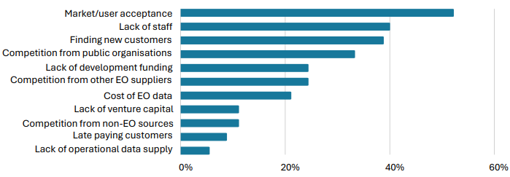
Understanding Main Barriers Faced by the EO Private Sector
Industrial and market challenges
e.g. high fragmentation, downstream dominated by public demand
Adoption and user engagement
e.g. government dependency, slow user adoption, customer acquisition challenges
Operational barriers
e.g. workforce shortages
Source: EARSC Industry Survey 2023, Most significant barriers to growth for companies
3
Notes:
Eurospace: “The smaller value of sales of Earth observation and navigation systems on the commercial and exports markets is due to the lower commercial maturity of these market segments, compared to telecommunications.”
Euroconsult presentation Feb 2024: “Governmental needs remain the main EO market driver while user adoption is slower than expected as the EO sector must adapt its offering to a global data economy.”
EARSC report 2023 (on 2022 data) surveyed companies about their biggest barriers to growth with market/user acceptance, lack of staff, and finding new customers being the top 3 most identified barriers.
The growing privatization of the EO industry has expanded capabilities and data supply, but also intensifying global competition still primarily driven by institutional demand.
Europe is losing market share and leading positions in this domain, despite the technological excellence of its industry and ecosystem. Government expenditures in the EU, which are crucial for high-risk industries like space, are expected to remain flat and fragmented across various bodies
Downstream remains highly fragmented and dominated by public demand

Slide 4
EO Commercialisation Plan
To support the growth of European EO companies, enable the generation and demonstration of EO applications that can lead to sustainable business cases and engage with other institutional players to aggregate demand.
Enable a Strategically Autonomous and Competitive European Space Sector
To enable large-scale commercial uptake of EO technologies and solutions, particularly in areas like natural resource monitoring, energy management, infrastructure planning, finance, maritime surveillance, disaster management, and environmental protection.
Build a Cohesive and Vibrant Space Ecosystem
To strengthen collaboration between space start-ups, scale-ups, large system integrators, and institutional stakeholders.
Drive Space Sustainability for a Green Future
To drive competitiveness among European companies by stimulating innovation, advancing disruptive technologies, and aligning with broader industrial strategies across Europe.
4
Notes:
EO commercialisation plan:
Ambition: To support the growth of European EO companies, enable the generation and demonstration of EO applications that can lead to sustainable business cases, and engage with other institutional players to aggregate demand
Built upon the following pillars:
Drive Space Sustainability for a Green Future
Through its programmes, D/EOP supports both upstream and downstream sectors, empowering businesses to leverage EO for more sustainable practices and to maximize the impact of institutional projects such as those addressing climate change and resource efficiency.
Build a Cohesive and Vibrant European Space Ecosystem
Programmes like InCubed, Third Party Missions, and a subset of the pillars of FutureEO will help accelerate this cooperation, while D/EOP’s unique capability to blend commercial innovation with institutional frameworks will support Europe in maintaining a globally competitive EO industry. The strategy will also prioritize attracting external capital to boost commercial viability, aiming to create a sustainable ecosystem of private investment for space-based ventures.
Enable a Strategically Autonomous and Competitive European Space Sector
To achieve this, D/EOP will fully utilize its Enabler role, supporting European economic operators through industrialization efforts and commercial ventures, and fostering home-grown innovations and supporting their path to commercialization. ESA’s Customer and Partner roles will aim to ensure that demand for EO services grows both within Europe and internationally, helping to secure Europe’s position in a global market that is increasingly dominated by competitors from the U.S. and China.
IMPLEMENTATION of the plan via:
Incubed
Third Party Missions (TPM): The Third Party Missions (TPM) programme has been operating for over 45 years as part of the Earthnet program within the ESA basic activities and consists of a series of satellites specifically focused on Earth Observation which are owned by commercial and public organisations worldwide. Over the last years, the TPM offer was continuously further enhanced with EO data from commercial missions including data from emerging commercial data domains in line with evolving data needs of ESA and the users in ESA Member States.
Copernicus Contributing Missions: EU Copernicus ensures the operational access to (commercial) third party missions in the Copernicus Contributing Missions scheme. ESA coordinates all the Copernicus Contributing Missions' activities on behalf of EU as entrusted entity to ensure supply of commercial data to the Copernicus Services in complement the Sentinel observations.
FutureEO: addresses three key commercialisation objectives: 1) strengthen industrial competitiveness through innovation 2) address critical technology development, 3) address Earth Action (incl. development and delivery of new types of information products and their delivery to enable improved policy elaboration, implementation and impact monitoring)

Slide 5
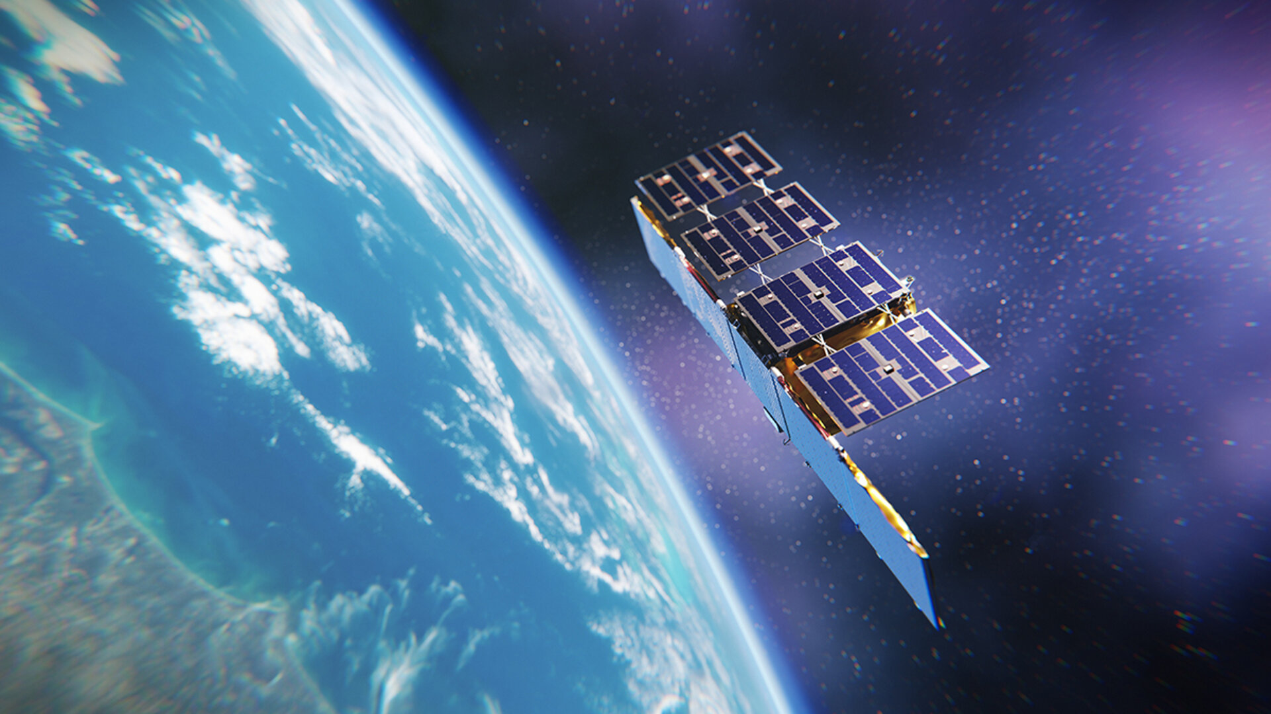
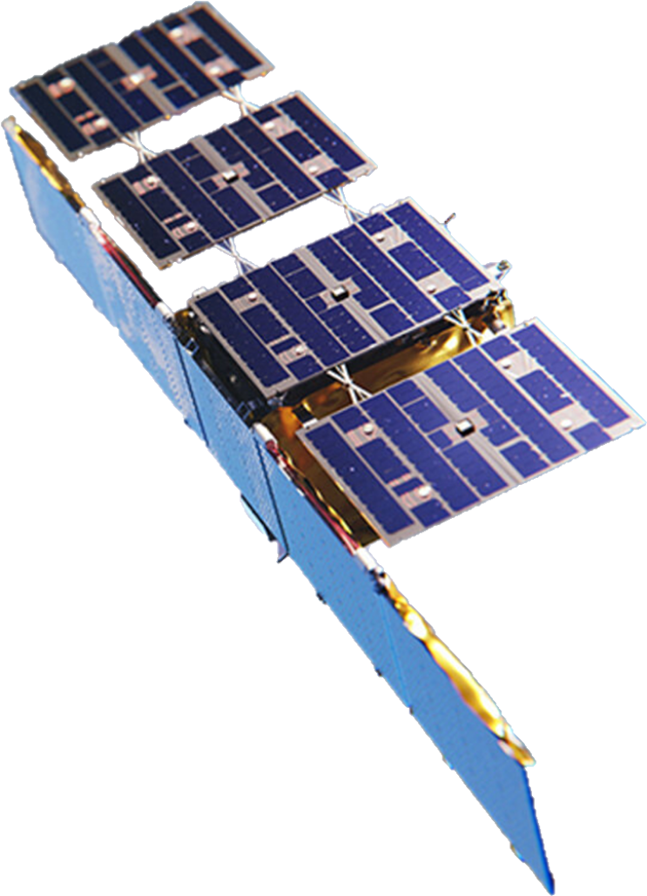
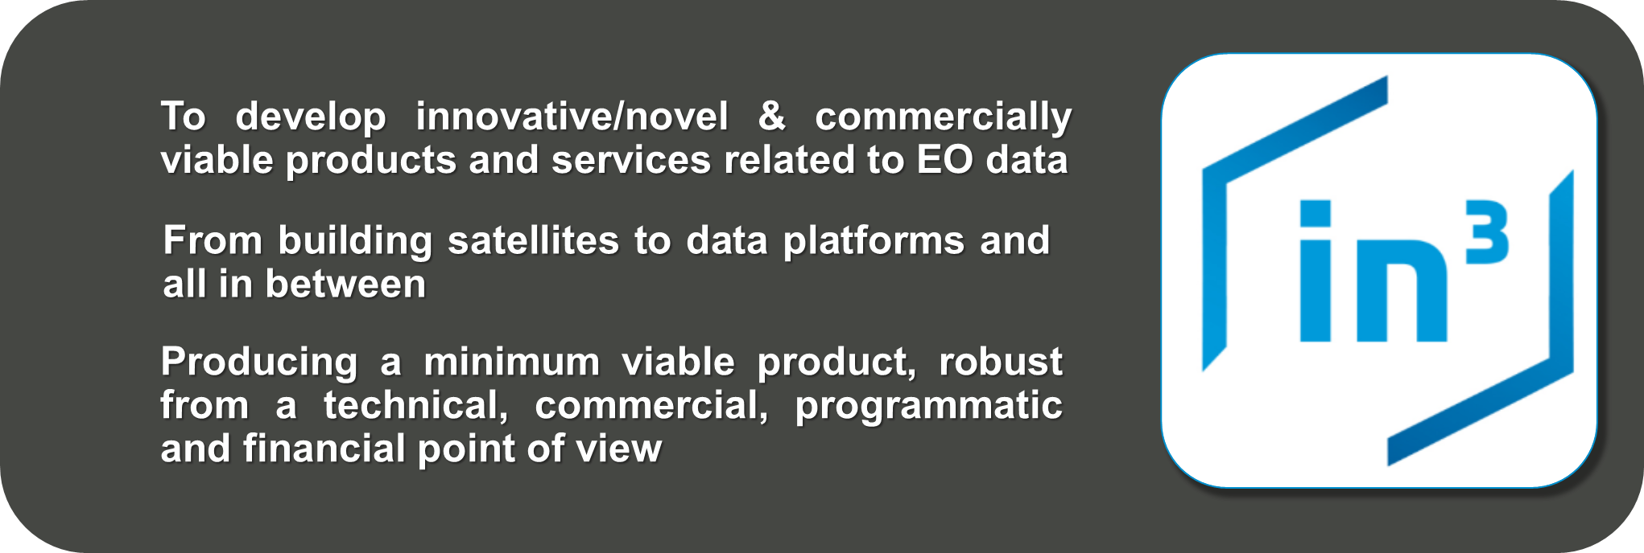



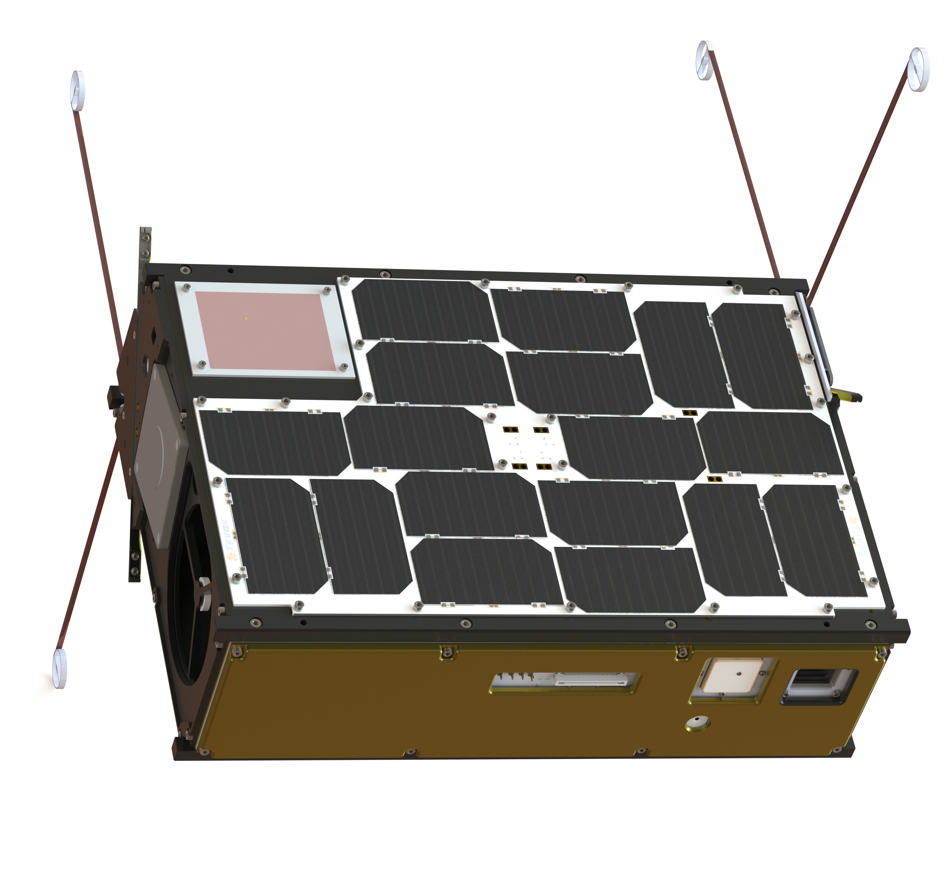
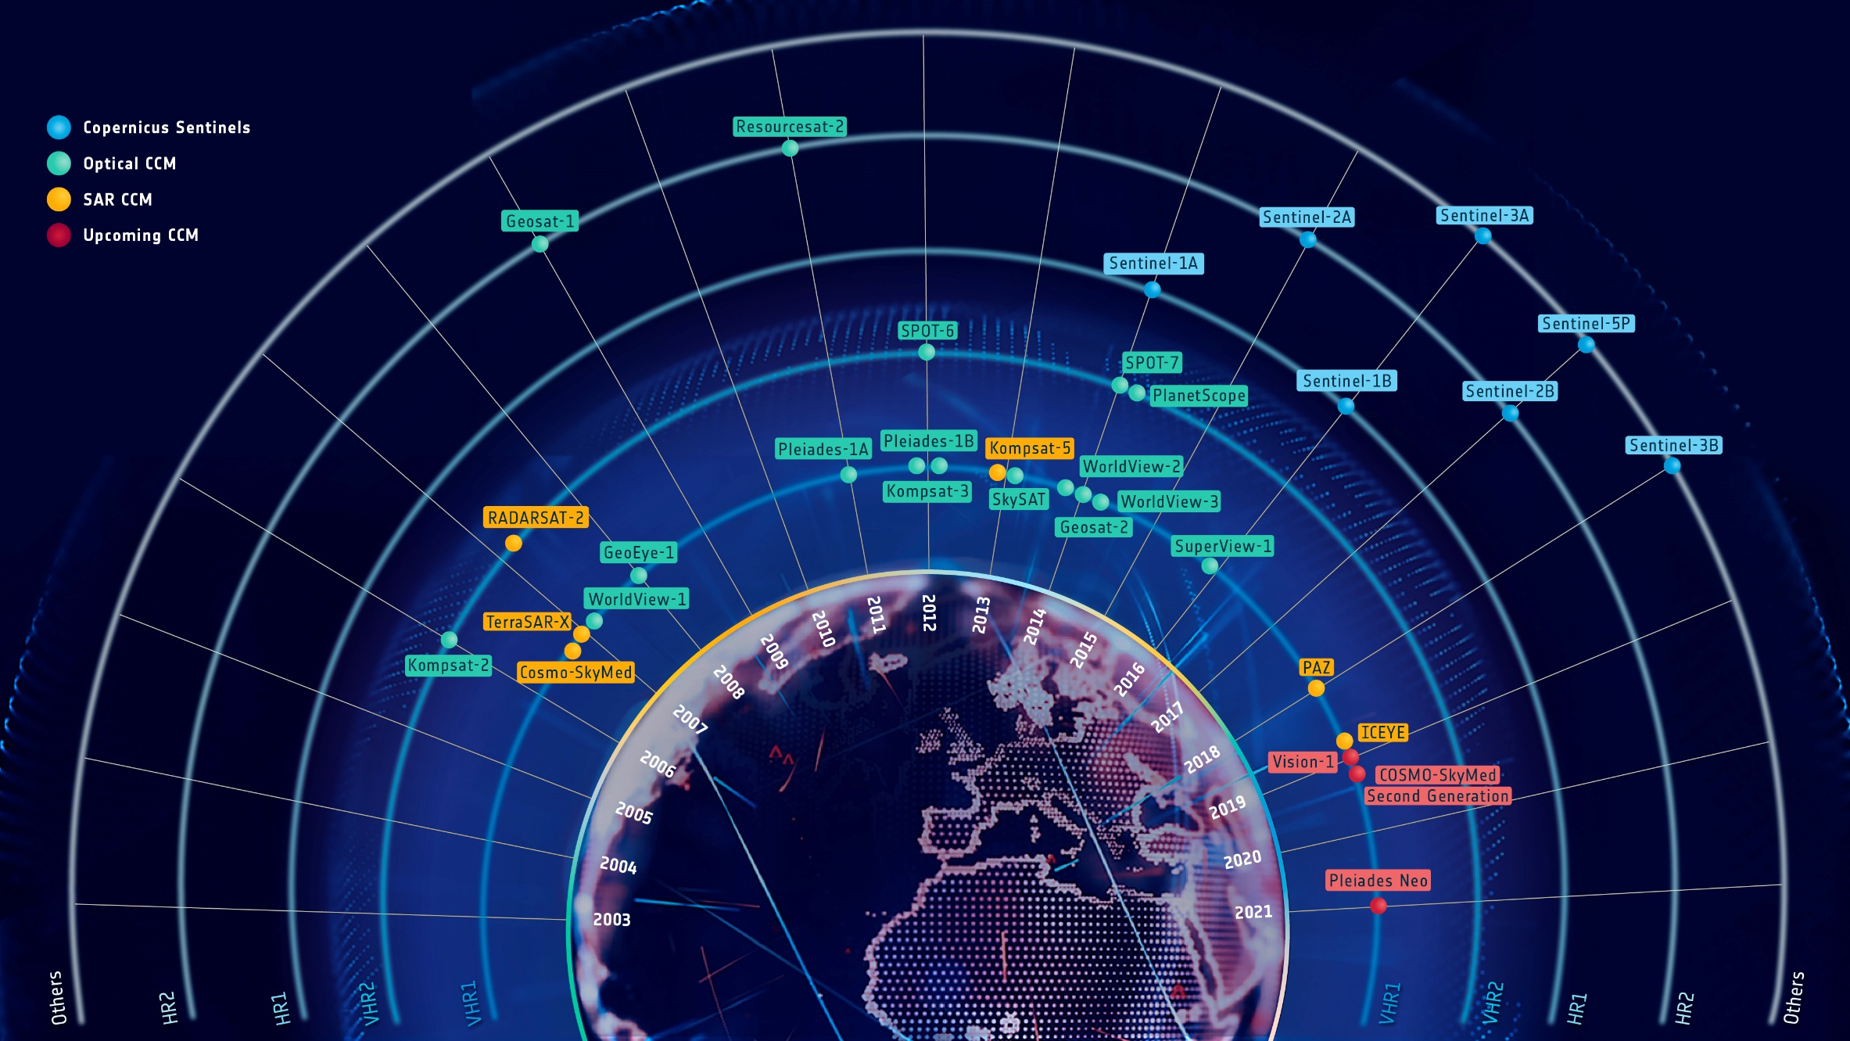


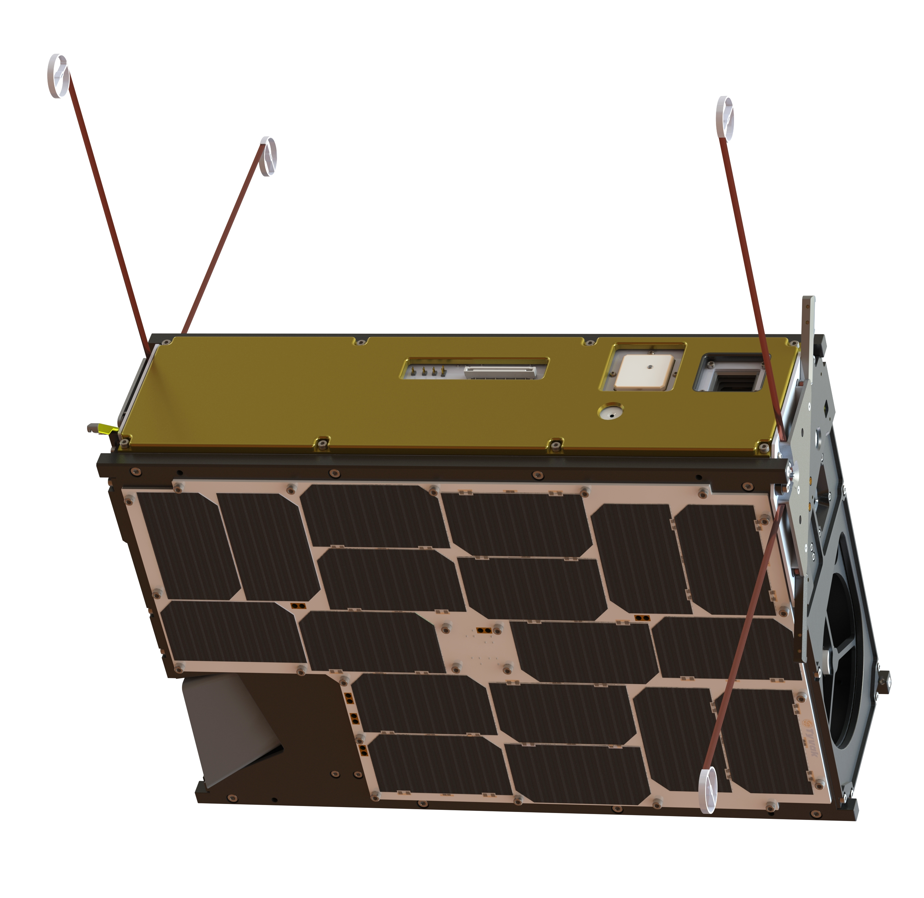
ESA Supporting Development of European EO
ESA as Enabler/Partner
ESA as Anchor Customer
Earthnet Third Party Missions
InCubed
Data for R&D and science needs
ɸ-Sats
SCOUT Missions
Copernicus Contributing Missions
³Cat-5/A
Data (and delivering services) for operational public needs using a Dynamic Purchasing System (DPS)
³Cat-5/B
5
5
Notes:
In addition to the science, Copernicus and Meteorological missions, ESA programmes support development of the upstream EO sector in other ways.
ENABLER of a sustainable commercial EO by closing know-how and technology gaps
PARTNER the development of innovative product/services to reduce dev and fin risks
CUSTOMER of commercial products and services to reduce market risks (e.g. anchor customer)
ESA has multiple initiatives to support New Space Companies:
ESA as Enabler/Partner:
Through a New Space procurement approach, buying Earth Science data as a service e.g. Scouts
Through traditional Space System procurement, applying New Space industry standards e.g. AWS
Through the development of specific small missions such as ɸ-sats (FutureEO), or Proba-V Cubesat Companion (ESA GSTP, ESA Proba-V)
Through the ESA InCubed EOP commercial co-funding programme
Strengthening Industrial Competitiveness: This includes initiatives to boost the European EO industry by developing innovative methods and applications, integrating EO with non-EO technologies, and expanding the customer base beyond geospatial information into decision support and predictive analytics
Addressing Critical Technology Development: This involves advancing EO capabilities through disruptive and incremental innovations, such as new sensors and processing technologies, and fostering cooperation between institutional EO platforms and privately funded systems
Enabling Earth Action: This focus shifts from passively assessing the planet's state to directly supporting two key action lines i) developing new information products for improved policy-making and ii) long-term analytics tools that help stakeholders identify necessary investments for the Green Transition
In addition, ESA EO support Cal/Val activities to assess, improve and validate data quality, increasing the generated value from emerging suppliers typically from New Space industry
ESA as Anchor Customer (i.e. buying the data provided by New Space companies)
Customer (Data Buy): ESA acts as an anchor customer by procuring data for R&D purposes (TPM) and Copernicus Services (CCM with and for EC) from established and 11 emerging data suppliers.
Note on CCM: In order to ensure more agility and efficiency, ESA launched the DPS: Dynamic purchasing system (DPS): The DPS is a digital procurement process – accessible via the esa-star procurement system – that shortens and simplifies the bidding process for commercial Earth observation data providers (Copernicus Contributing Missions) - Benefits: Proven procurement approach of European Commission, Ensuring wider uptake of strategic public procurement, Will, as a fully electronic process, serve to boost the digital transformation of public procurement, both for ESA and for Economic Operators, The use of standardised documents and procedures will shorten the time needed for procuring Copernicus Contributing Missions ‘commercial EO data’
Note on TPM: The programme currently comprises over 50 missions with data sourced from more than 60 instruments which is supplied to users for research and development purposes. ESA promotes the availability of these third party datasets so that they are offered through a single programme for ease of access.

Slide 6

ESA’s Dynamic Purchasing System for CCM
The DPS is a digital procurement process – accessible via the esa-star procurement system – that shortens and simplifies the bidding process for commercial Earth observation data providers (Copernicus Contributing Missions)
This DPS includes opportunities for three groups of data providers:
9 Contracts signed with companies in 2023. A further competition to be issued in December 2024 (up to 7 additional contracts)
CCM Category 1
European Earth Observation Emerging Data Suppliers :
Mini-competitions awarding anchor customer contracts (max. duration of 5 years) for data
purchase & data quality validation activities; addressed at European companies, which are
registered in an EU Member State or Copernicus Participating Country for less than 15 years
CCM Category 2
Two competitions released in Q4 2023. (VHR2024 & rapid on-demand),
6 contracts signed
European Earth Observation Established Data Suppliers :
Mini-competitions awarding commercial contracts for systematic or on-demand data purchase; addressed
at European companies, which are registered in an EU Member State or Copernicus Participating Country.
Objective is to buy increasingly more European data in line with the EU Space regulation on Strategic Autonomy.
CCM Category 3
First competition released in January 2024;
4 contracts signed
Earth Observation Data Suppliers for miscellaneous data needs :
Mini-competitions awarding commercial contracts to companies which either act as owner or as a broker of
non-European satellite data
Notes:
Investment raised and expected since the start of CCM Category 1 contracts: 110M euros in 2023 and 275M euros expected in 2024Non-monetary benefits observed by industry in one year included: Strengthened credibility and trust of customers and investors, Enhanced recognition among European institutions, Increased brand awareness on social media thanks to communication efforts, Access to ESA expertise in image quality (Cal/Val activities), Strengthened company capabilities, job creations and boosted staff motivation, Access to new market Exports
In order to ensure more agility and efficiency, ESA launched the DPS: Dynamic purchasing system (DPS): The DPS is a digital procurement process – accessible via the esa-star procurement system – that shortens and simplifies the bidding process for commercial Earth observation data providers (Copernicus Contributing Missions) - Benefits: Proven procurement approach of European Commission, Ensuring wider uptake of strategic public procurement, Will, as a fully electronic process, serve to boost the digital transformation of public procurement, both for ESA and for Economic Operators, The use of standardised documents and procedures will shorten the time needed for procuring Copernicus Contributing Missions ‘commercial EO data’
This DPS includes opportunities for three groups of data providers:
CCM Category 1: European Earth Observation Emerging Data Suppliers
State of play: Contracts signed with 9 companies in 2023. A further competition to be issued in December 2024 (up to 7 additional contracts)
CCM Category 2: European EO established data suppliers
State of play: Two competitions were released in Q4 2023. (VHR2024 & rapid on-demand), 6 contracts signed
CCM Category 3: EO data suppliers for miscellaneous data needs
State of play: First competition released in January 2024; 4 contracts signed

Slide 7
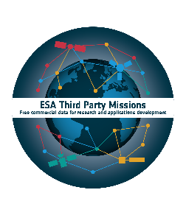
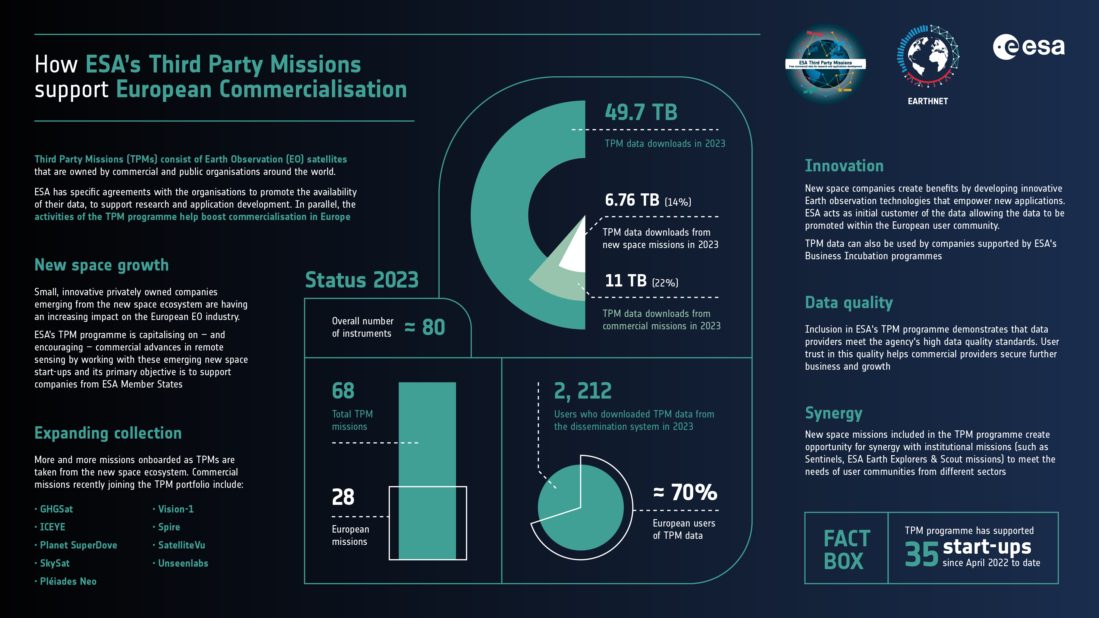
ESA TPM in Support of European Commercialisation
As a first buyer or initial anchor customer, the ESA Earthnet TPM programme enables NewSpace EO data to be opened to the broader European scientific community for innovative research and pre-operational applications development including in green commercialization and Earth Action
More than 17,700 research applications development and incubation projects used TPM data since 2008.

Slide 8
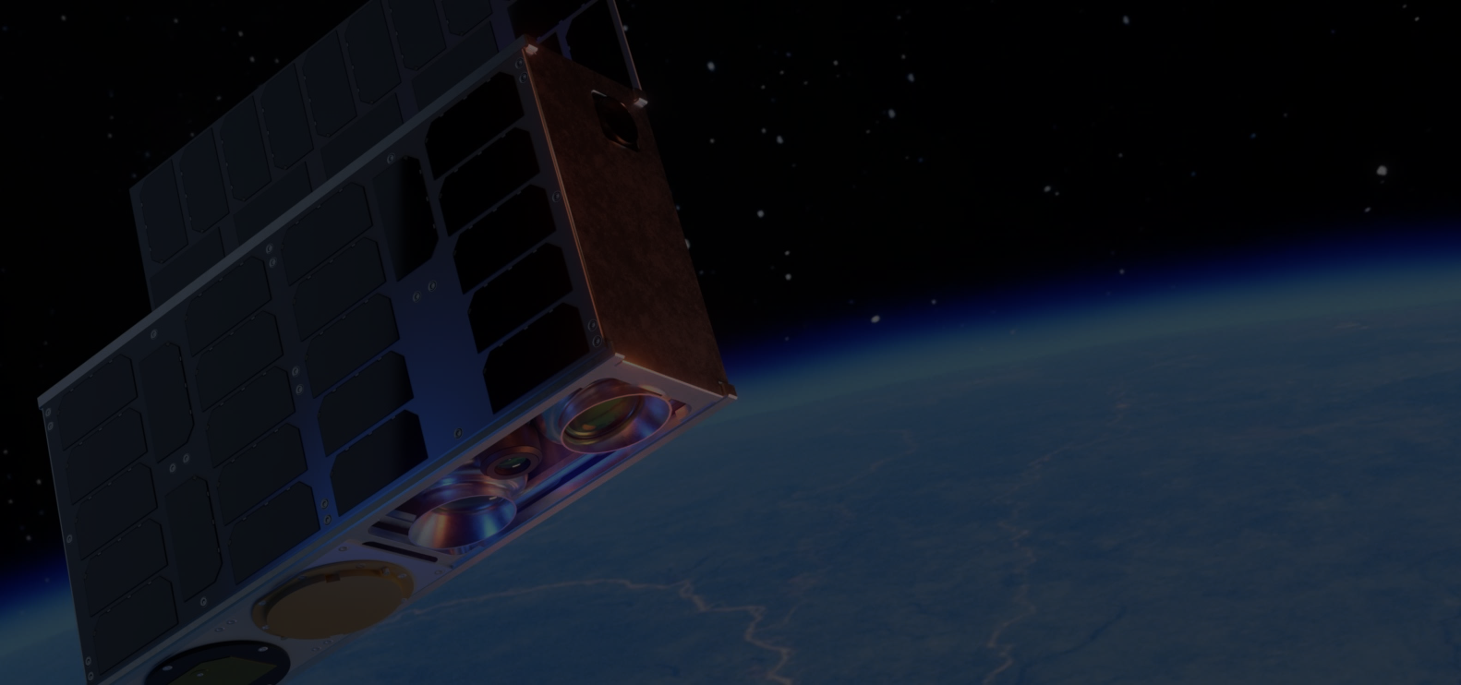


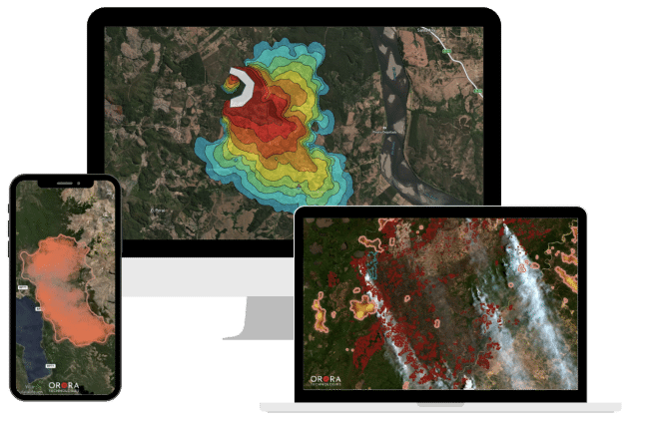
InCubed Supported OroraTech’s Thermal IR CubeSat
Tackling global wildfire problems and satisfying needs of customers worldwide with a constellation of ca. 14 nanosatellites in a sun-synchronous orbit at local afternoon time.
ESA’s InCubed Programme focuses on building a successful product for the markets and has been eagerly supporting OroraTech with world-class technical expertise for developing their Forest-3 8U CubeSat thermal infrared imager.
OroraTech Technology to be used in Greece’s National Wildfire System

Slide 9


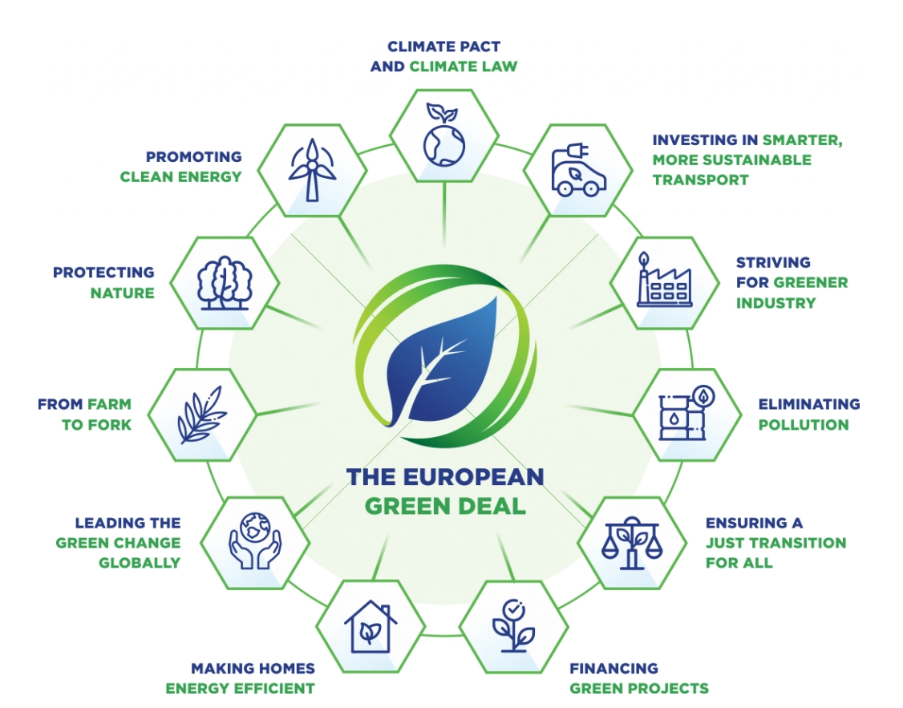
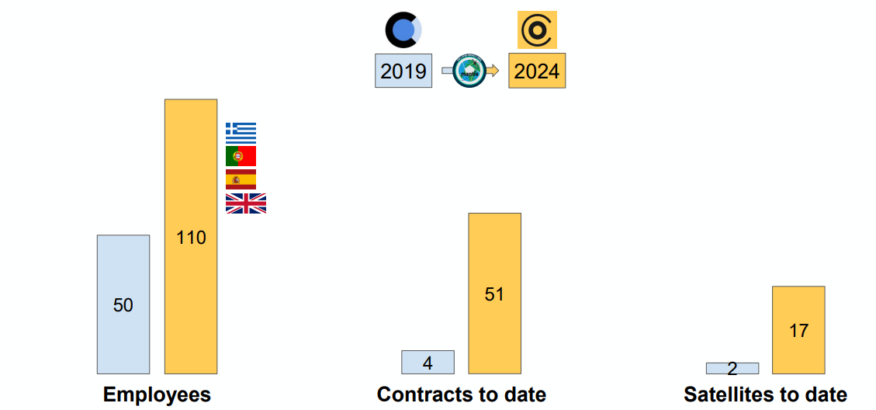




InCubed Supports OpenCosmos in Context of MANTIS Project
Open Cosmos is the prime contractor of the MANTIS project (Mission and Agile Nanosatellite for Terrestrial Imagery Services), a demonstration mission to jointly develop, build, launch and operate an innovative nanosatellite platform that will fly a high resolution Earth Observation camera with main applications in energy and mining
Open Cosmos’ development since the start of the project:
Capability gained
Upstream: design, build, launch, commissioning of an EO satellite
Downstream: EO satellite operator, data processing and distribution
100
50
,,
,,
9
Notes:
Incubed allowing the development of Open Cosmos through the MANTIS project:
Upstream - Capability gained: design, build, launch, commissioning of an EO satellite
Downstream – Capability gained: EO satellite operator, data processing and distribution
Potential data sales: several millions
Indirect:
14+ EO satellites secured (dozens of millions)
Supported $50m VC funding
Between 2019 and 2024 (information from PB-EO 201):
Workforce growth: the company more than doubled its number of employees (Workforce growth: +120%)
Went from 4 to 51 contracts
Went from 2 to 17 satellites
Background information – MANTIS (Mission and Agile Nanosatellite for Terrestrial Imagery Services):
MANTIS is a demonstration mission to jointly develop, build, launch and operate an innovative nanosatellite platform that will fly a high resolution Earth Observation (EO) camera. The ESA InCubed programme activity is funded by the UK Space Agency and brings together expertise from three space companies. As prime contractor, Open Cosmos Ltd. is responsible for the end-to-end space mission service covering the space, launch, ground and user segments of the mission. Open Cosmos leverages its strategic partnerships with key players in the industry to enable the delivery of services across these segments.
Customers and their needs:
This MANTIS satellite is particularly suitable for energy and mining applications. 60% of resources for these companies can be found in remote and hostile regions, leading to more complex and expensive projects.
Two thirds of these major projects go over-budget or are delayed due to unforeseen risks and hazards. These failings are usually a result of inadequate upfront due diligence, planning and prior knowledge of the challenging operating environments. Actionable intelligence plays a vital role in improving safety, planning and mitigating the risks of these projects.
The MANTIS satellite addresses these challenges with periodic statistical reports on regions of interest. These reports are computed through the latest data processing and machine learning techniques as well as other data sets, such as those derived from the EC/ESA Copernicus Programme.

Slide 10


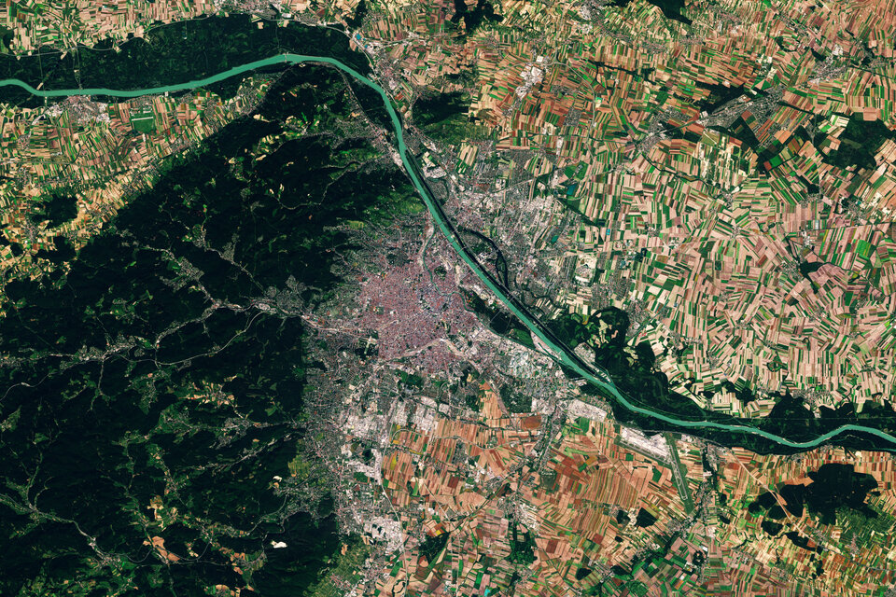
Incubed Boosting Market Traction for Agri-monitoring Service
The consortium’s EO-WIDGET software provides the farming sector with critical satellite-derived information and is a key tool in compliance monitoring for the European Common Agricultural Policy (CAP).
ESA’s supporting role:
Provision of outputs of Sentinels for CAP (Sen4CAP) activities, co-funding, technical input and business mentoring
As a result of this InCubed activity, the consortium secured a long-term contract with AgrarMarkt Austria, the national agency for administering CAP payments

Slide 11

EO @CM25
EO programmes provide critical information to understand and address major challenges such as climate, environment & natural resource crises at global, regional and citizen levels
EO Programme proposals at CM25 aim to:
Strengthen science excellence and worldwide leadership in EO infrastructure while ensuring operational mission continuity
Ensure availability and uptake of valorised EO data & information products to better understand – and more fully address – climate, environmental and natural resources crises
Promote European industrial competitiveness – both upstream and downstream – in the worldwide EO market and lead on uptake of technology innovation and synergies with other digital domains
Further develop space solutions to enable Earth action, addressing sustainability, SDGs, food security, regulatory enforcement, water & carbon management
11

Slide 12




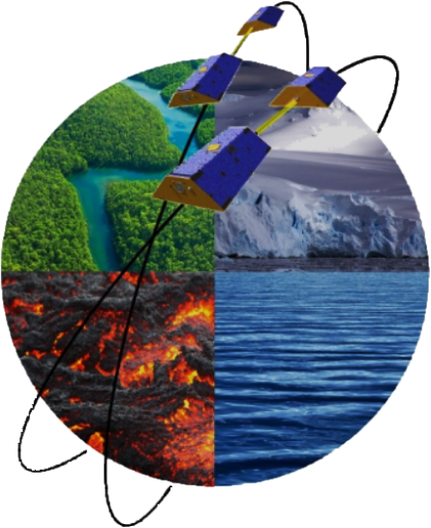


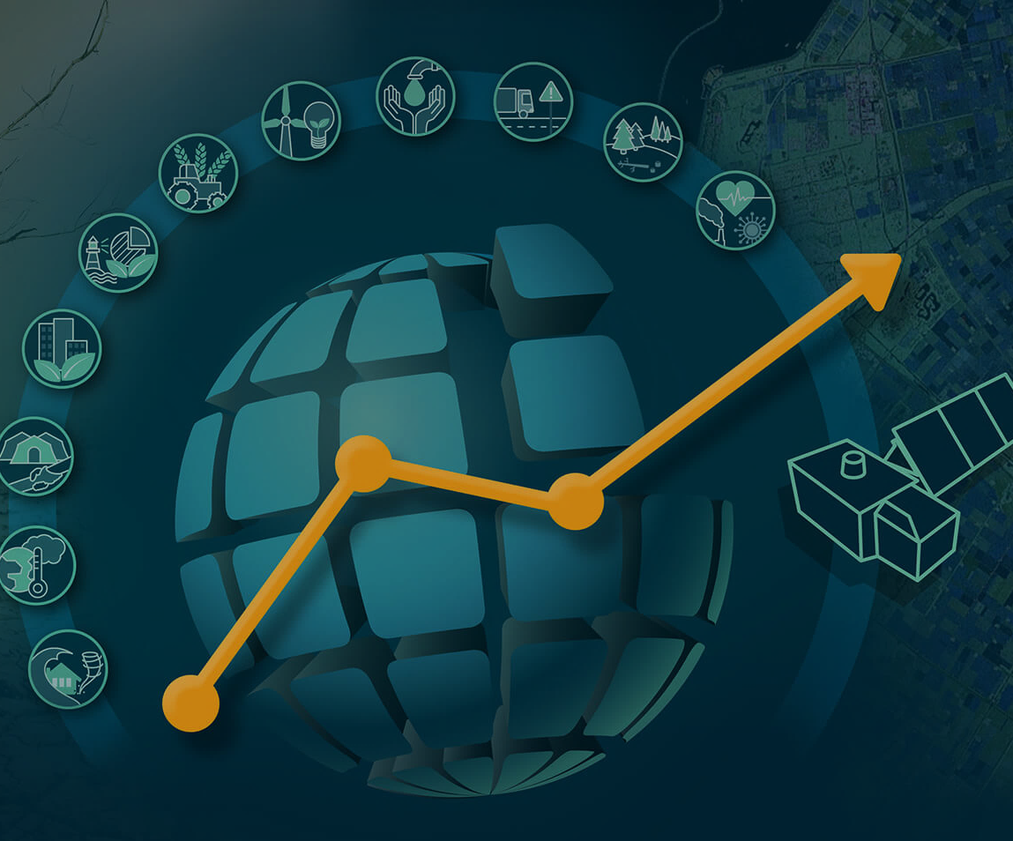

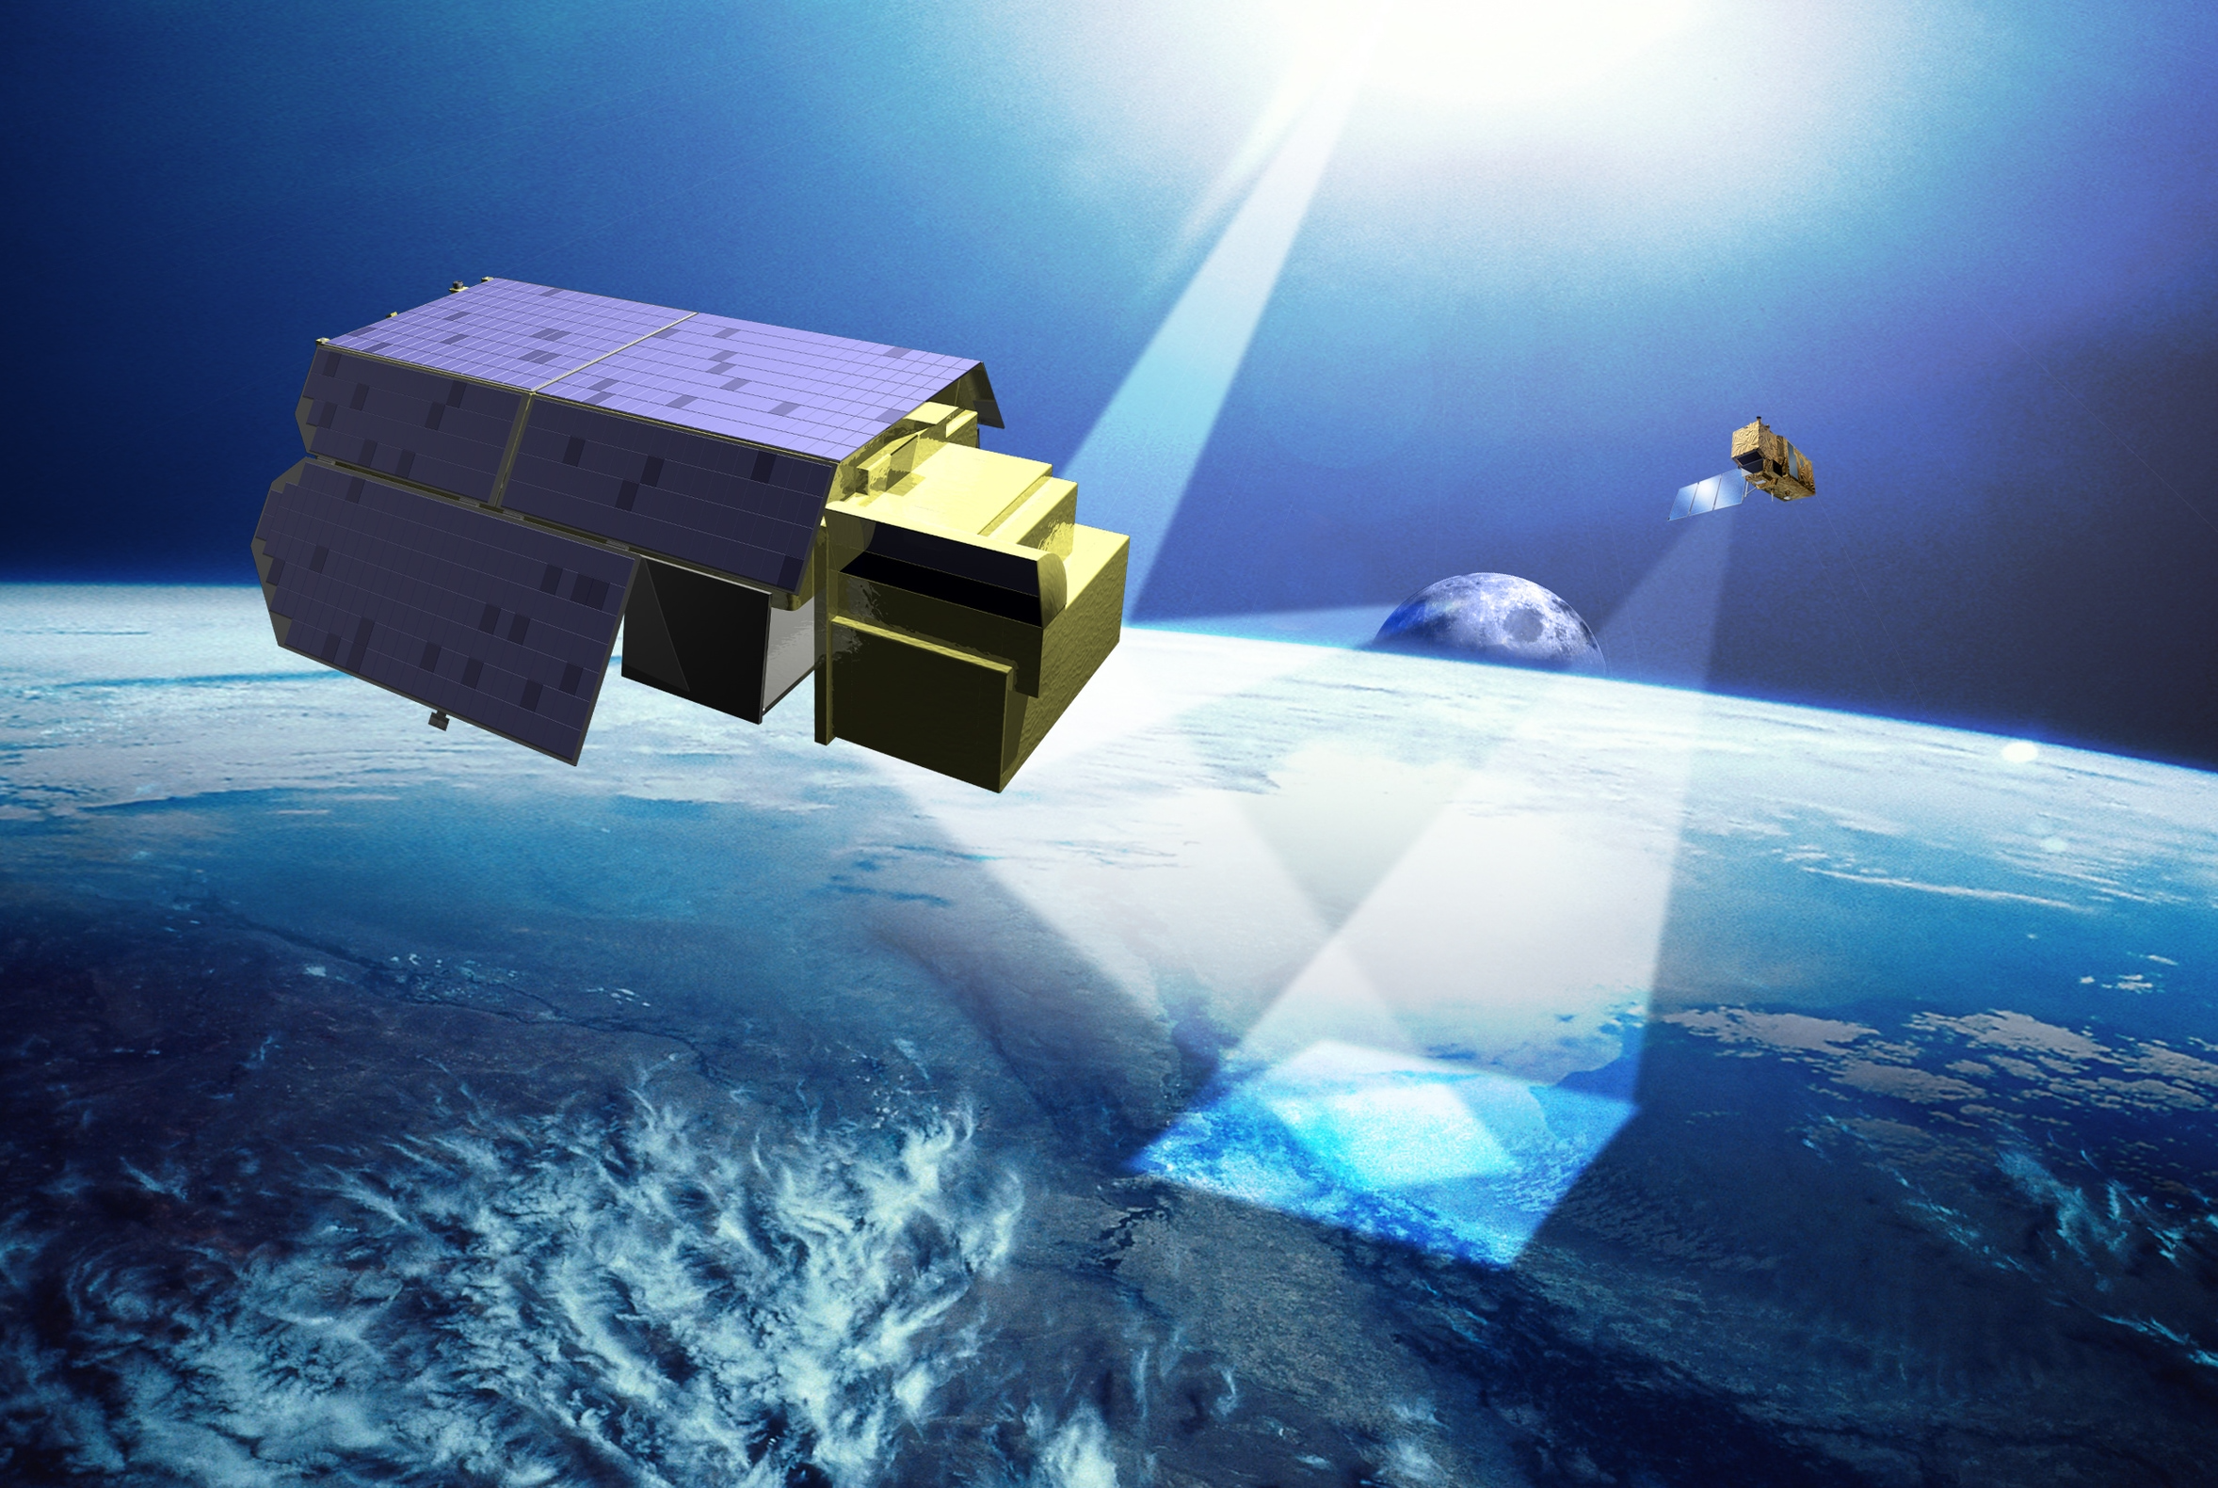


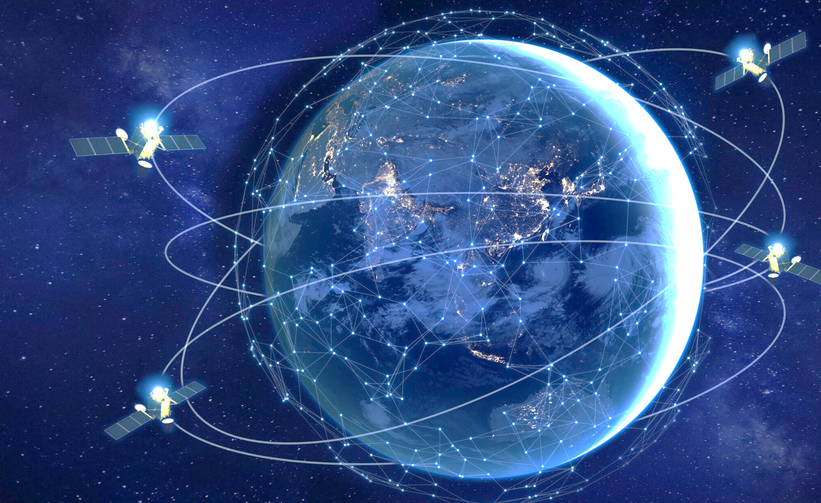


EOP @CM25
Upgraded FutureEO
Copernicus
(CSC-4 Phase-3)
EO Foundations
Earth Explorer 11
NGGM / MAGIC
Mission Management & Ground Segment
Earth Action
Global Development Assistance
Climate
Space
TRUTHS
Φ-lab
InCubed-3
Digital Twin Earth (DTE-2)
Harmony
Hybrid Constellation
Scouts 5 & 6
12
Notes:
Highlighting the proposals for EOP at CM25, closely linked with the ambition of supporting industry
Proposing 5 programmes (all already existing)
FutureEO: distributed over three thematics/pillars
Pillar 1 - EO Foundations
Pillar 2 - EO Missions & Data:
Pillar 3 - Earth Action (CLIMATE-SPACE, Global Development Action. Phi-Lab)
TRUTHS
InCubed
Digital Twin Earth
Copernicus Space Component (CSC4)
These activities will create numerous opportunities for the industry to participate and benefit from, with several Invitations to Tender (ITTs) expected, leading to greater commercial maturity in the Earth Observation (EO) market.
Examples:
FutureEO activities on EO Foundations Standardized EO technology development will increase European industry competitiveness, through de-risking new platform technologies, progressing towards more standardised interfaces, and reducing costs. Priority topics will notably include: more efficient platform and communication modules, platform planned demise and end-of-life disposal, and miniaturisation of platform hardware.
FutureEO contributes to innovation, with ESA's Φ-sats demonstration missions, which can offer opportunities to New Space companies on institutional programmes (such as the Scouts missions) and in the commercial domain.
Copernicus: development of Copernicus with contracts to be placed with industry, contracts will be co-funded 50% each by ESA (as part of CSC-4 Phase 3), & EU (as part of MFF 2028-2034)
DTE: ESA DTE will offer ESA Member States the programmatic framework to scale up, operationalise and integrate developments (related to HPC/Cloud computing, AI, Quantum and analytics for EO) into an efficient ecosystem delivering a set of EO Digital Twin Components. This will offer companies a single-entry point to an advanced “ESA reference” virtual mock-up of the Earth system, and will maximise the use of open and free DestinE services and APIs, hence enabling open collaborative research and smart application development. This element is one way ESA is helping to support the EO market's adaptation to a global data economy

Slide 13


MAKE SPACE FOR EUROPE www.esa.int
ESA UNCLASSIFIED – For ESA Official Use Only
Notes:
As I conclude my presentation and in passing the floor to my colleague Géraldine Naja, I would like to highlight again the strong collaboration between the EOP Directorate and her Commercialisation, Industry and Competitiveness Directorate, reaffirming our commitment to creating impactful synergies and ensuring that the benefits of Earth observation extend effectively into commercial and industrial applications.

