Slide 1
InnoSat, on our path to industrialisation
2024-11-28
v2

Slide 2
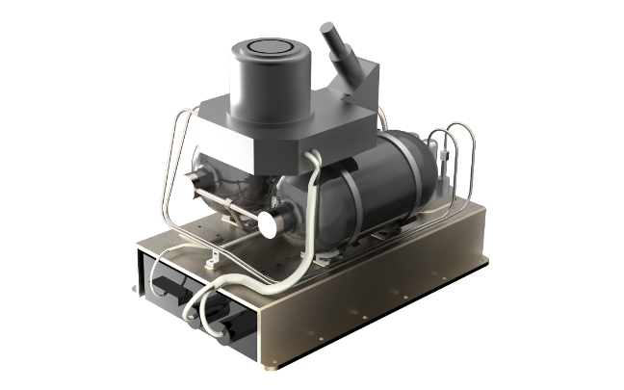
OHB Sweden in short
Business Areas
Small Satellites
InnoSat
AOCS/GNC
Propulsion
AIT
MCS
Operations
Commercial
EPsylon
Institutional

Slide 3
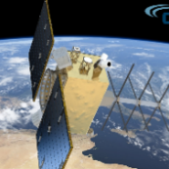
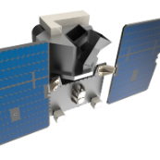

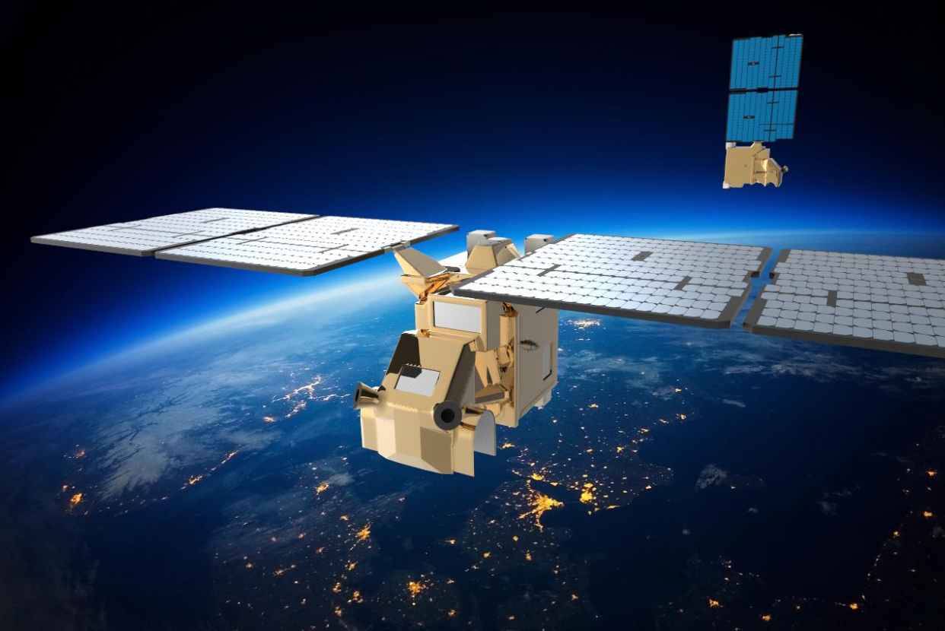
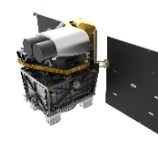
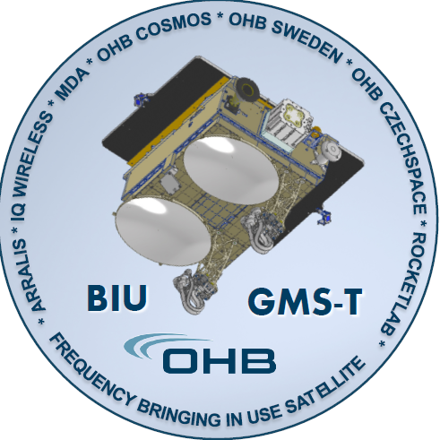
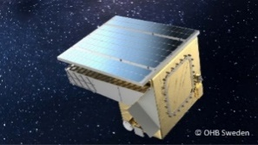
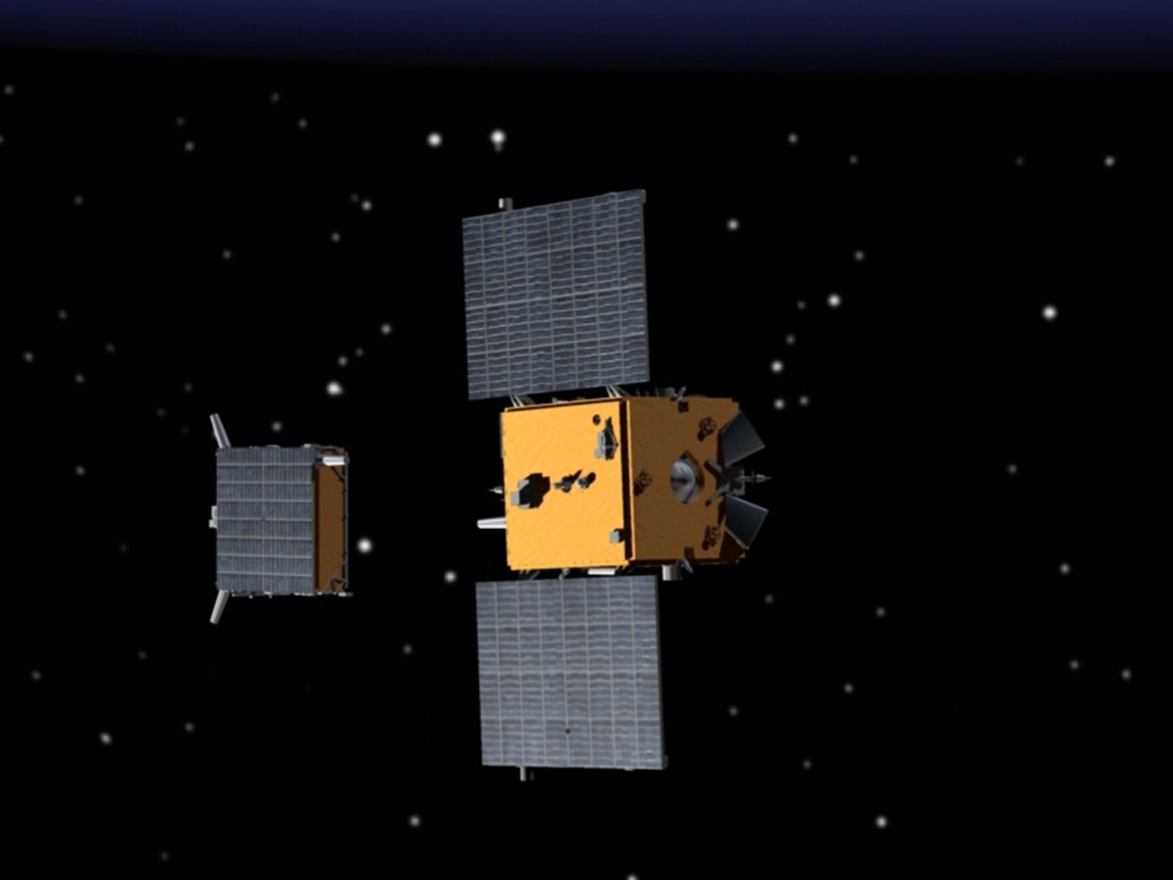
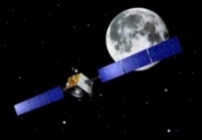
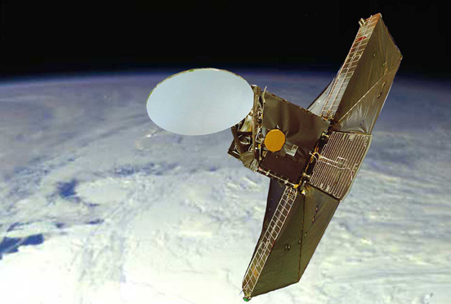
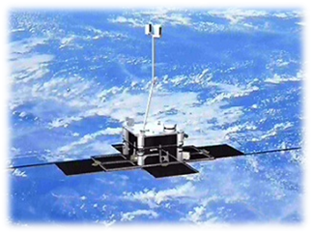
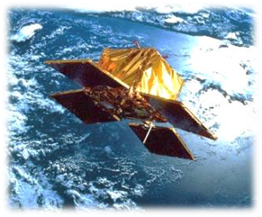
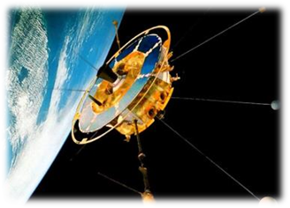
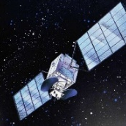
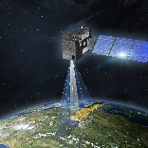
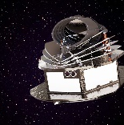
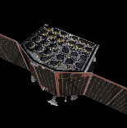
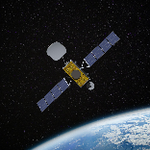
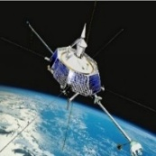
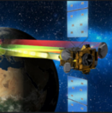
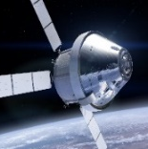


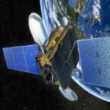
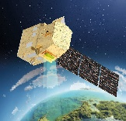
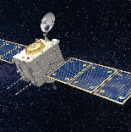
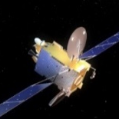
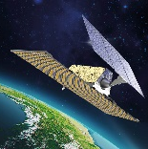
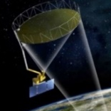
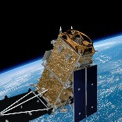

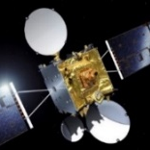
Our heritage is our credibility
Our Heritage
A European pioneer in small satellites, propulsion and AOCS since the ‘80s
ADIS
EIS
Atlantic-VHR
AWS
GARAI
GMS-T
MATS
SMART-1
PRISMA
Odin
Astrid-2
Astrid-1
Freja
TELE-X
2025
2025
2026
Viking
2024
2025
2022
2010
2021
2003
2001
ARIEL
2029
1998
PLATO
2026
Hummingsat
2026
CO2M
2026
1995
Heinrich Hertz
2023
Orion
2024
1992
SolO
2020
SARah-1
2023
HAG-1
2017
1989
CHIME
2029
COMET-I
2029
1986
ROSE-L
2028
CHORUS
2025
Electra
2026
Biomass
2024
Euclid
2023
EDRS-C
2019

Slide 4


Arctic Weather Satellite: a NewSpace success story
From PFM to Constellation
Payload: MW radiometer (19 channels), 30kg, 35W, 100% duty cycle.
Successfully launched with SpaceX Transporter 11 on August 16, 2024.
Developed in 3 years and delivered to ESA, on time and on budget.
Storm in the Arctic from the Arctic Weather Satellite.
Source: ESA

Slide 5
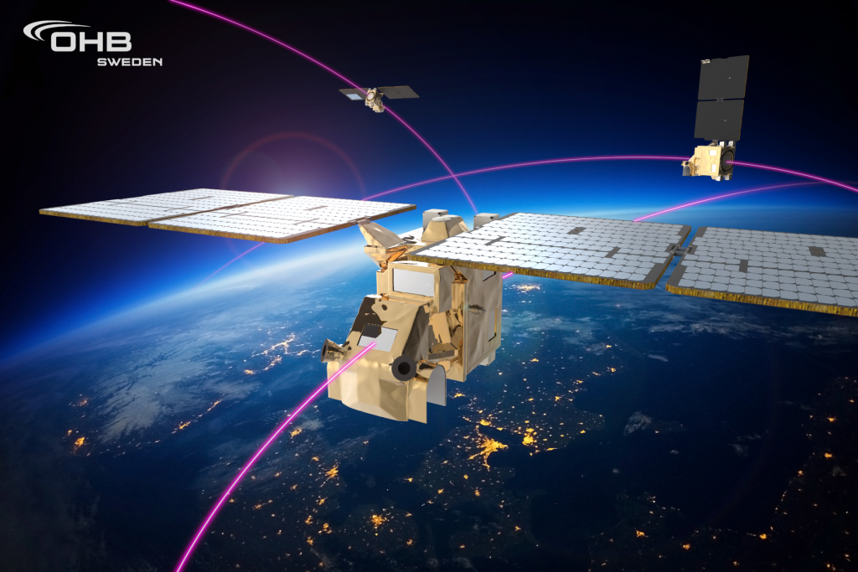
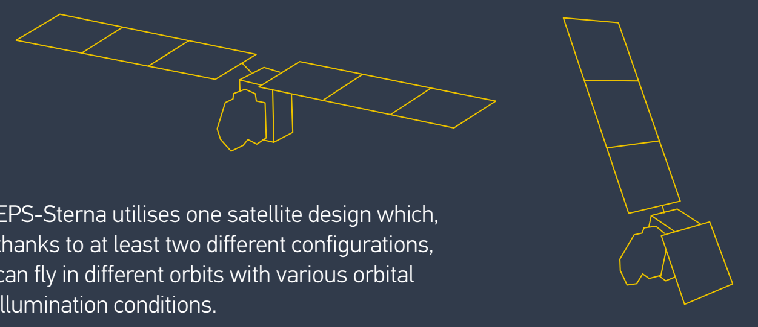
From Arctic Weather Satellite to EPS-Sterna
From PFM to Constellation
AWS: blueprint for more affordable constellations.
Precursor for the EPS-Sterna constellation to be potentially procured by EUMETSAT in 2025 (up to 20 satellites).
Designed for the constellation from the beginning – one design, different configurations, with embedded autonomy.
Illustrative render of the EPS-Sterna constellation

Slide 6

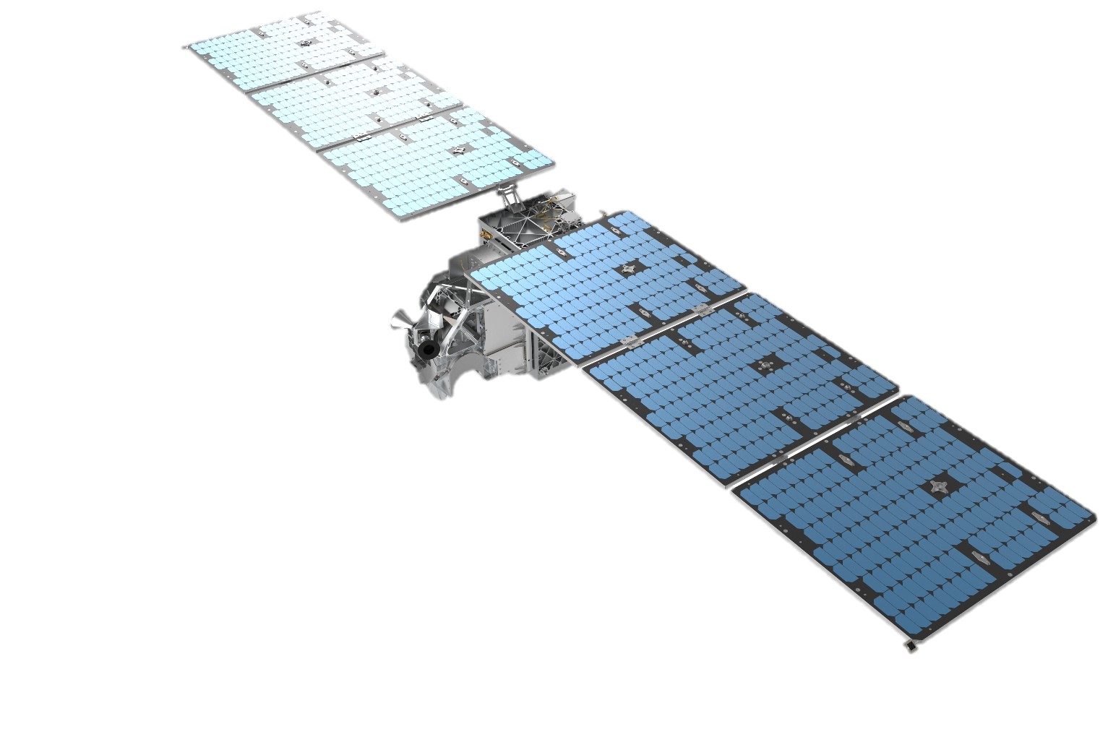
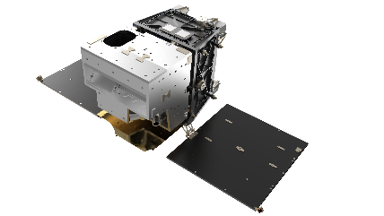

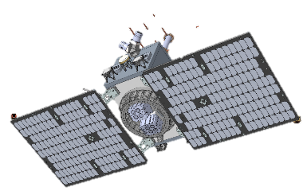

InnoSat – Technology at the service of our Customer’s business
InnoSat, Investment Good
1
2
Customer needs
Fit to purpose P/F
Variability of missions Strong needs for flexibility and customisation.
Scalable, modular design,
reliability, high performances adapted to need
Operational business case
Tailored Mission
End-to-end, turnkey solutions, developed quickly at affordable cost
High quality data, enabling return on investment
4
3

Slide 7
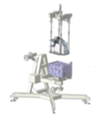
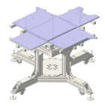
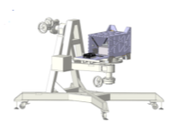
Our path to industrialisation
InnoSat, Investment Good
Payload Integration
Design to AIT
Production Engineering
Station 1
Panel
preparation
Station 2
Vertical
Integration
Station 3
System test and verification
Station 4 Cleanroom Processing
Optimised testing approach
Supply chain
Recognised PA approach tailored to smallsat industrialisation

Slide 8


Slide 9
Stimulating and enabling EO constellations in Europe
Path to Commercialisation
ESA/Institution as anchor customer
5. Consolidation
Scale effect, cost optimisation
4. ...to operational missions
Constellations going towards bigger smallsat platforms for enhanced capabilities
Throughput Time!
Short procurement and program decision
3. From demonstrating missions...
First smallsat deployments to start meeting end-user needs
2. IOD/IOV
Testing new types of payloads, subsystems, concepts of operations
1. R&D studies
Exploring new technologies (e.g., VLEO, edge computing, encryption)
ESA promoting & funding

Slide 10
Thank You

