Slide 1
CubeSat & Small Sat Missions for IOD/IOV of New Technologies/Techniques
Roger Walker, Head of the CubeSat Systems Unit (TEC-SPC)
Projects Office, Systems Department
Directorate of Technology, Engineering & Quality
1st EO Commercialisation Forum, ESA HQ
30/10/2023

Slide 2






GSTP Element Structure
ELEMENT 1
ELEMENT 2
ELEMENT 3
Develop
Development of technologies and products
Make
Market driven, industry initiated, co- funded direct negotiation activities for technology maturation leading to products
Fly (Small Missions)
Envelope which hosts projects such as satellites (for technology demonstration), ISS payloads, technology flight opportunities
from low TRL to qualification
Platform, Payload, Ground Segment and Engineering tools
Element 1- Work Plan
Element 1 - Frameworks

Slide 3

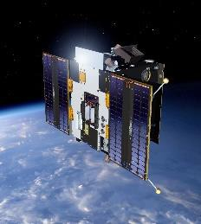
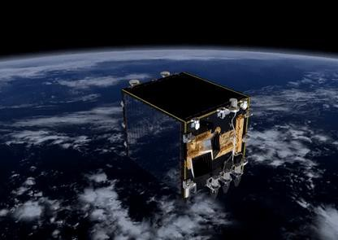
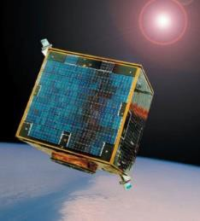
GSTP Element 3 Fly
In-orbit Demonstration of technologies and products
  Target TRL is 7-8
  Essential for products requiring flight heritage for customers
  Does not include technology development (Element 1)
Flight opportunities are identified with ESA projects and launchers, with National agencies and with primes, and with commercial missions
Accommodation/assessment study framework
  Experiment accommodation (e.g. materials experiments)
  Sound rocket / launcher service studies
  In-orbit demonstration related systems (systems, payloads…)
CubeSat mission framework: Phase A/B up to 2.5 Meuro (outline proposals)

Slide 4


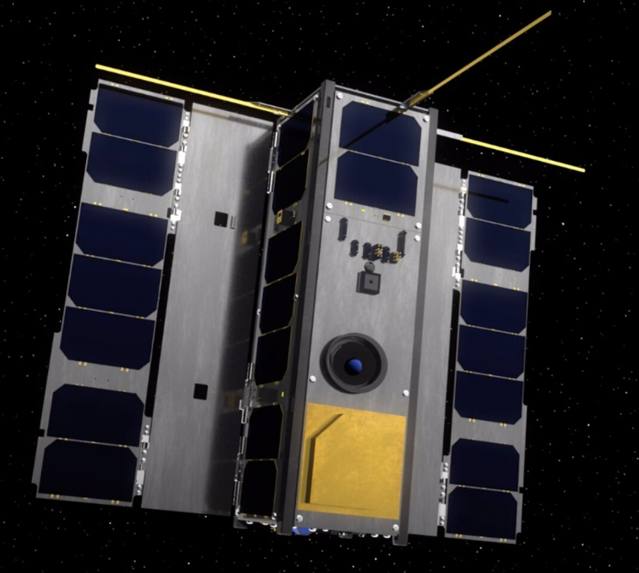
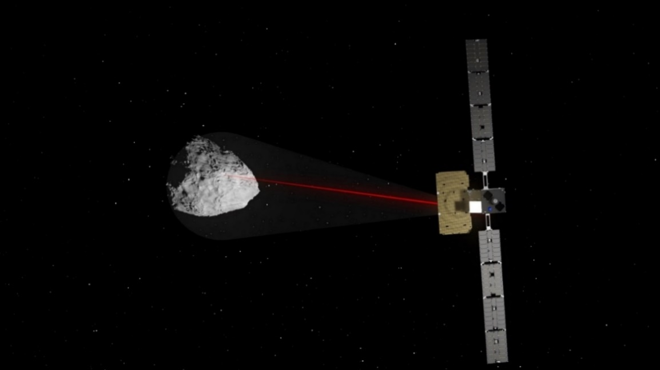

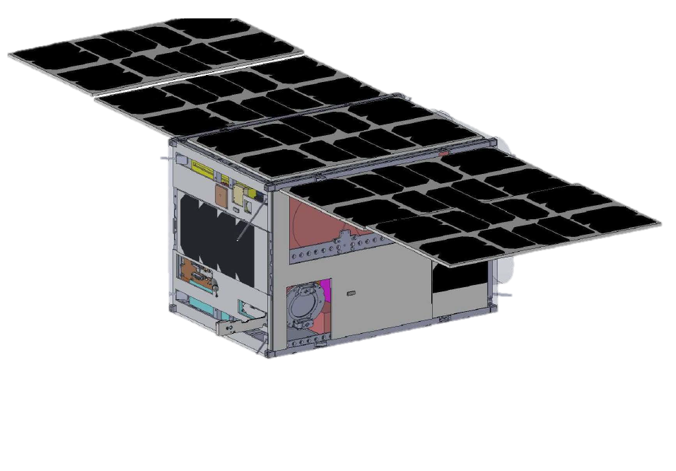
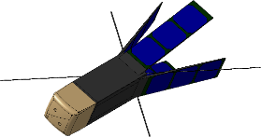
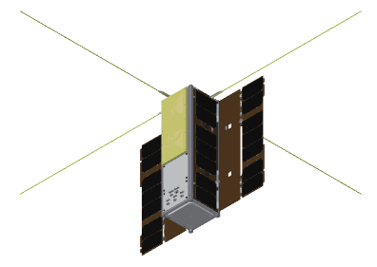
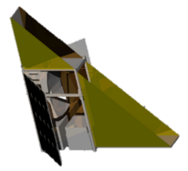
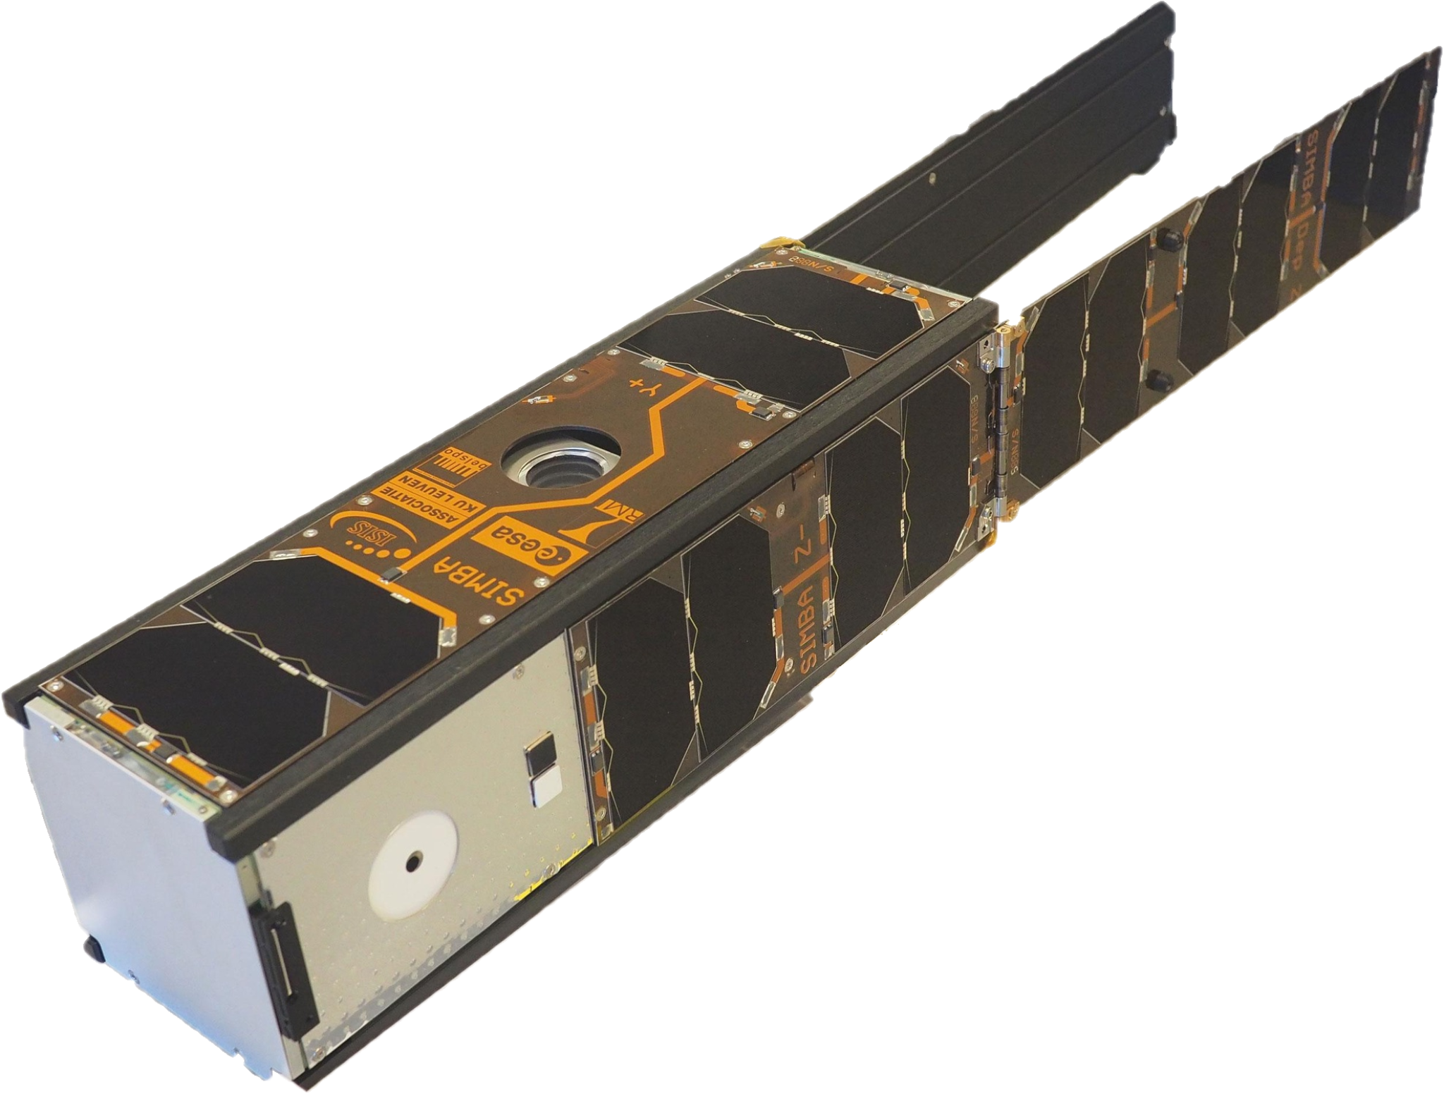
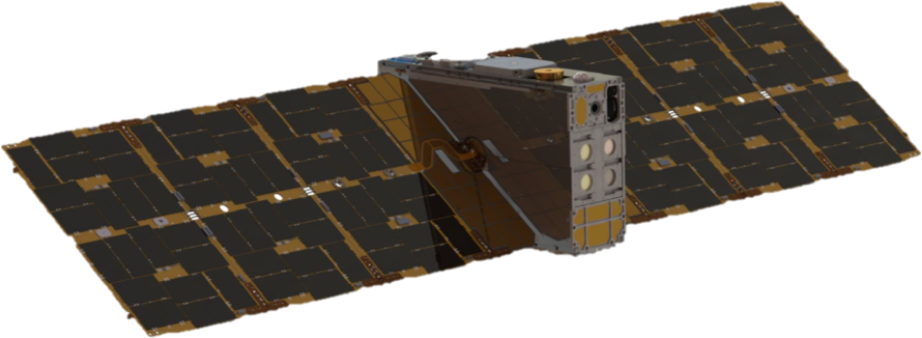
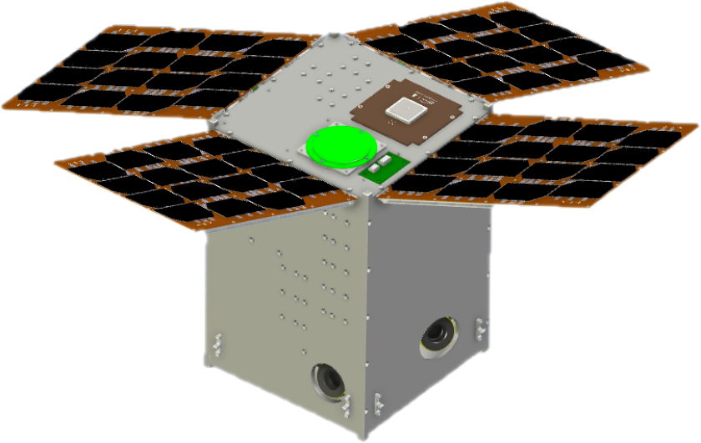
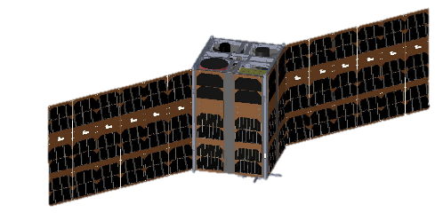
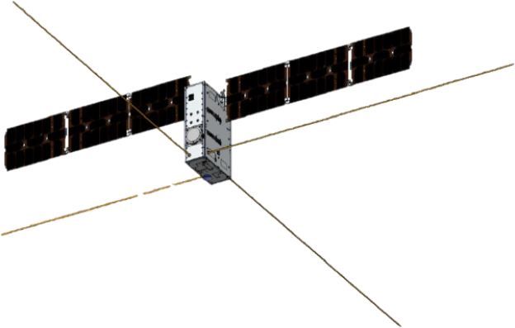
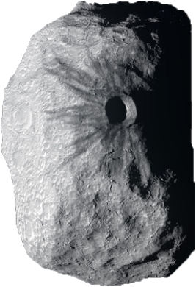
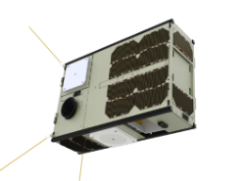
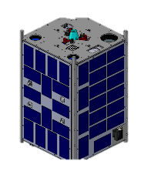
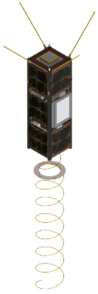
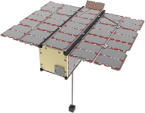
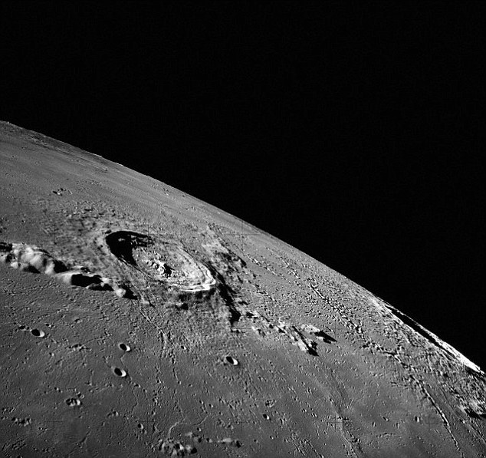
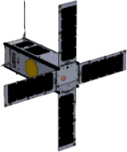
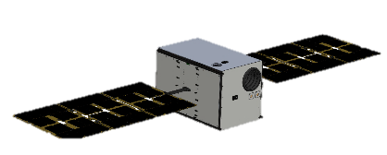
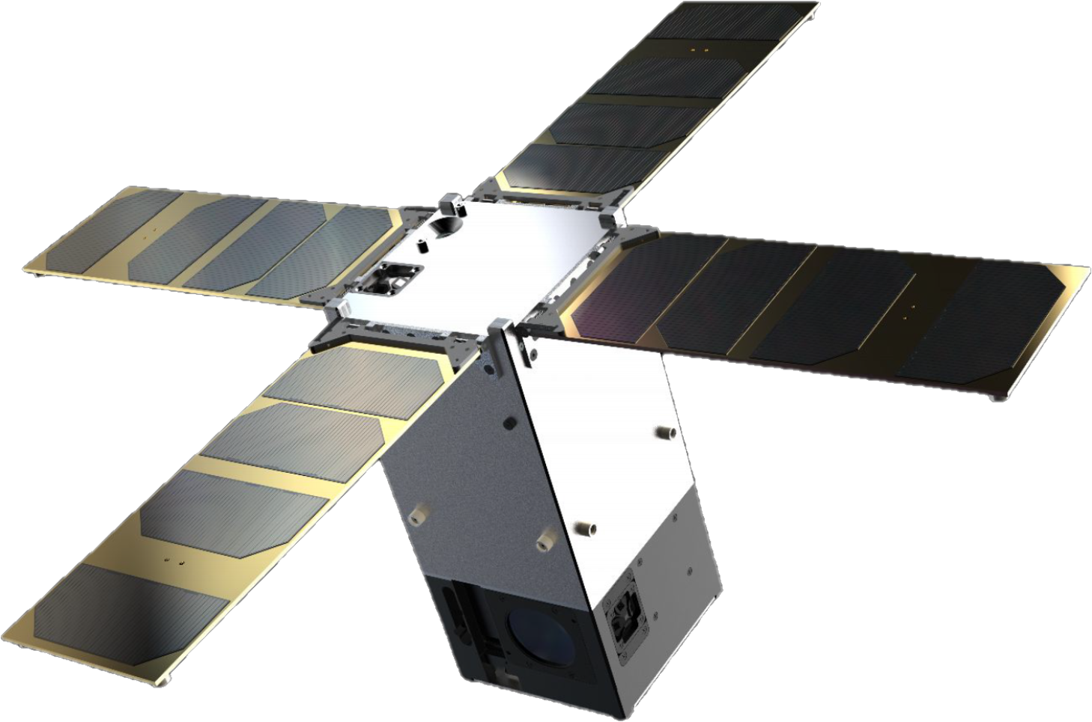
Definition
Implementation
Launched
GENA-OT (16U)
demonstrating commercial IOD/IOV services
M-ARGO & Satis (12U)
demonstrating asteroid rendezvous for in-situ resources (GSTP) & planetary defence (S2P)
OPS-SAT (3U)
new techniques in mission control
QARMAN (3U)
studying atmosphere
re-entry .
PRETTY (3U)
demonstrating GNSS
reflectometry
CubeSpec (6U)
stellar spectroscopy
from space
Juventas & Milani (2x6U)
observing asteroid
deflection assessment funded by Space Safety Programme (Hera)
SIMBA (3U)
monitoring climate
variables
e.Inspector (12U)
demonstrating debris inspection
GOMX-4B (6U)
demonstrating constellation
technologies
PROBA-V Companion (12U)
Imaging Vegetation
HENON (12U)
space weather early warning from
Distant Retrograde Orbit
GOMX-3 (3U)
demonstrating new platform
technologies
RadCube (3U)
measuring space radiation and magnetic field
SROC (12U)
demonstrating close inspection (Space Rider)
PICASSO (3U)
studying the atmosphere & in-situ plasma
VULCAIN (2x12U)
formation flying for stereoscopic IR imaging of volcanos
Sunstorm (2U)
measuring X-Ray
fluxes
LUMIO (12U)
measuring lunar surface impact hazards
www.esa.int
→ ESA’S TECHNOLOGY CUBESAT FLEET
European Space Agency
Funded in GSTP Fly unless otherwise stated

Slide 5
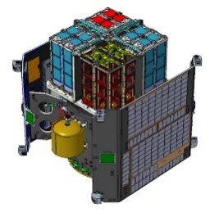
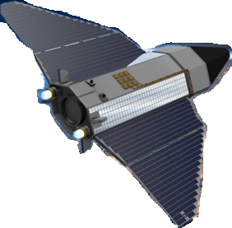

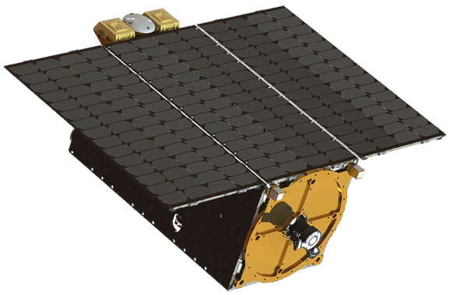
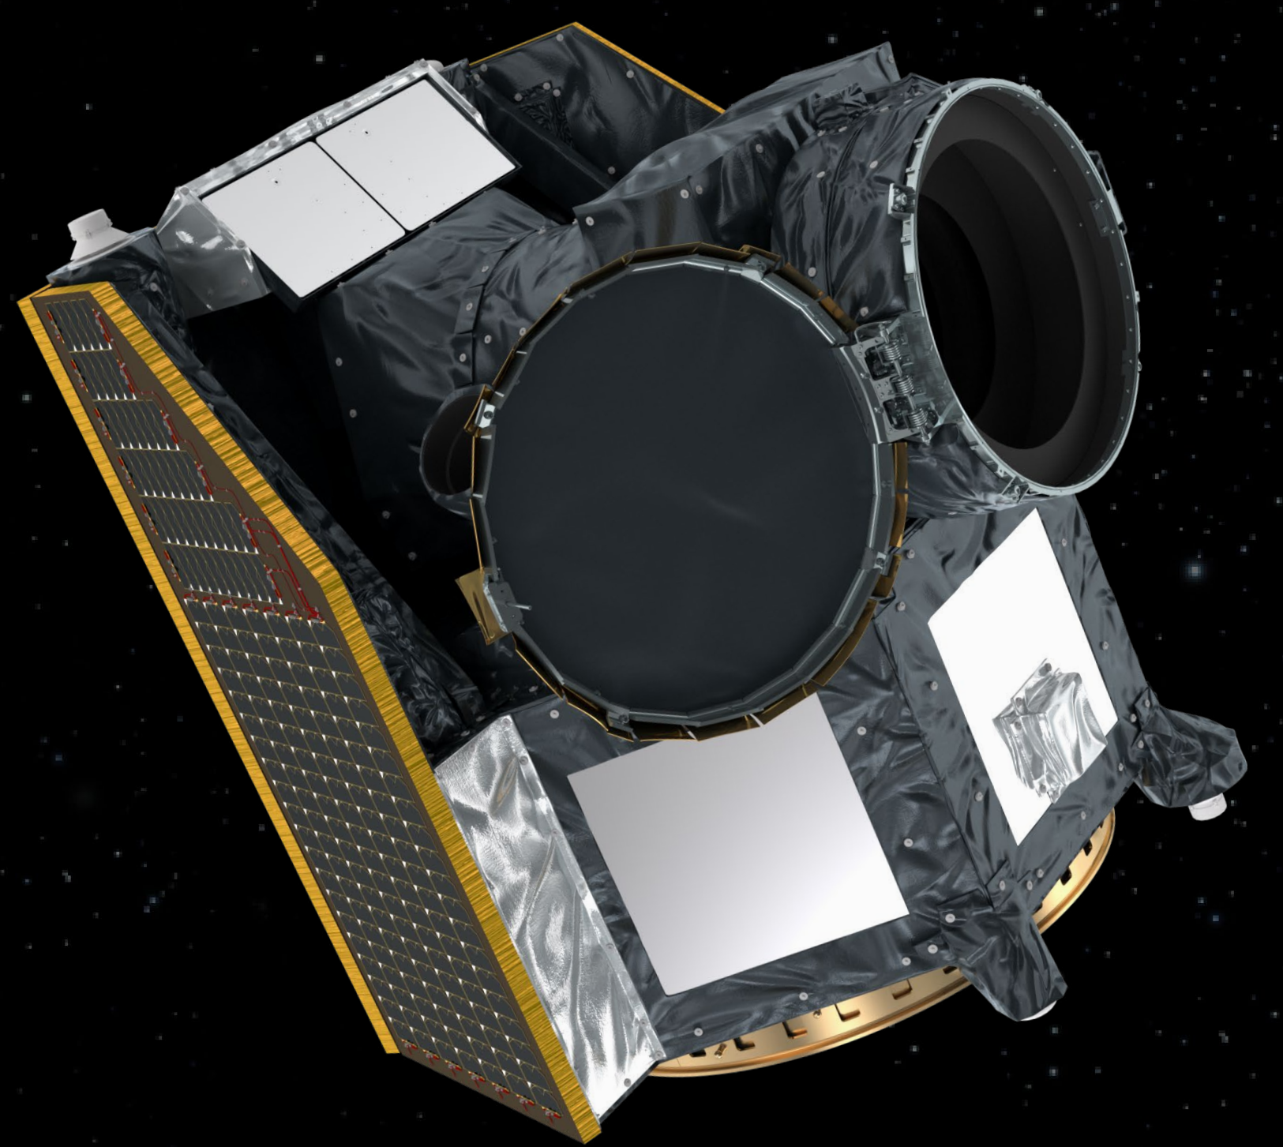
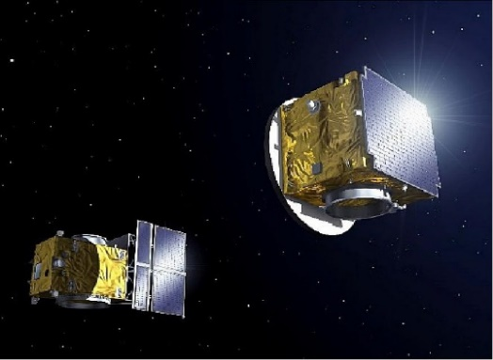
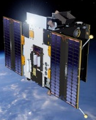

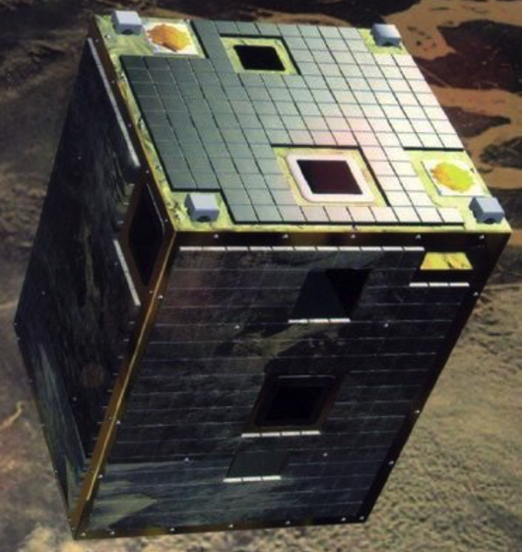
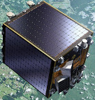
SMALLSAT MISSIONS
SkimSat (VLEO)
electric
propulsion
PCDSat
Electric propulsion
Flying Deployer IOD
Launched
To be launched 2023
To be launched
uHETSat
electric
propulsion
CHEOPS
CHaracterising ExOPlanet Satellite
Proba-2
Solar observation
Proba-2
Solar observation
Proba-3 (HEO)
Sun Corona study
& Formation Flying
Proba-3 (HEO)
Sun Corona study
& Formation Flying
Proba-1
Autonomous operations
Proba-1
Autonomous operations
Proba-V
Earth Vegetation
Notes:
New technology products have to be tested in orbit, particularly when there is a high risk associated with the use of the new technology and so it can get flight heritage.
Nanosatellites typically weigh between 1 and 10 kilograms and follow the popular ‘CubeSat’ standard, which defines the outer dimensions of the satellite within multiple cubic units of 10x10x10 cm.
Due to their high degree of modularity and extensive use of commercial off the shelf subsystems, CubeSat projects can be readied for flight on a much more rapid basis compared to traditional satellite schedules, typically within one to two years.
Also used for Education purposes.
More on the examples:
The PICosatellite for Atmospheric and Space Science Observations (PICASSO) CubeSat, designed to investigate the upper layers of Earth’s atmosphere.
Developed for ESA by the Belgian Institute of Space Aeronomy with VTT Finland and the UK’s Clyde Space, Picasso will measure the distribution of ozone in the stratosphere and profile the temperature of the mesosphere and the electron density in the ionosphere. Picasso is one of a number of CubeSat missions being backed by one of the Programmes supporting ESA’s technology development.
Sun-Earth IMBAlance (SIMBA), alongside the ozone-measuring Picasso and PhiSat CubeSats, is investigating the application of artificial intelligence to Earth observation and whether or not the same instrument can measure both the Sun’s incoming radiation to Earth, and Earth’s own outgoing radiation.

Slide 6
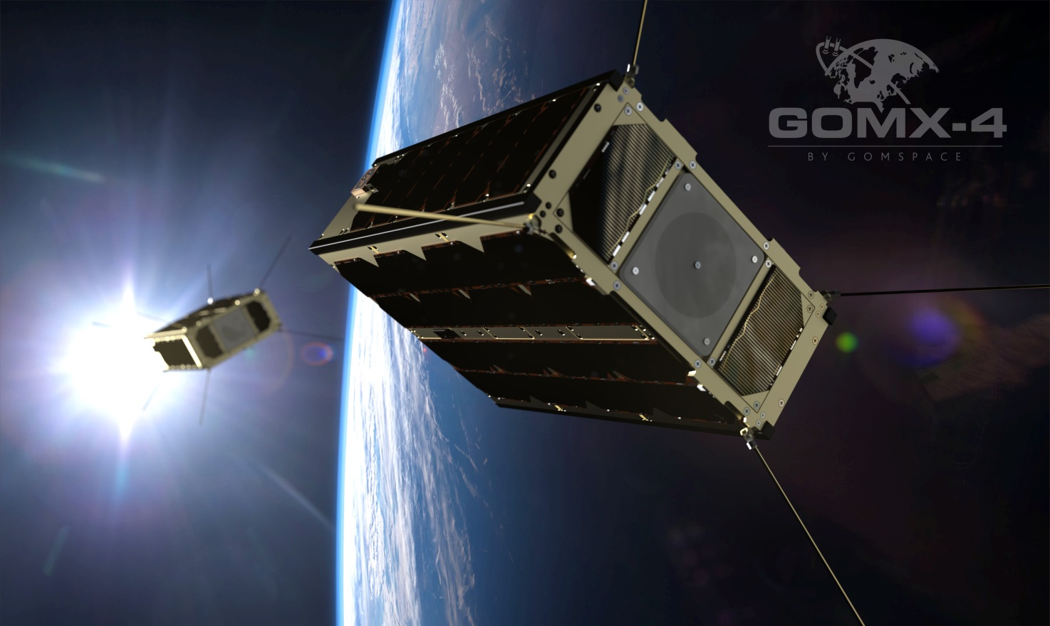
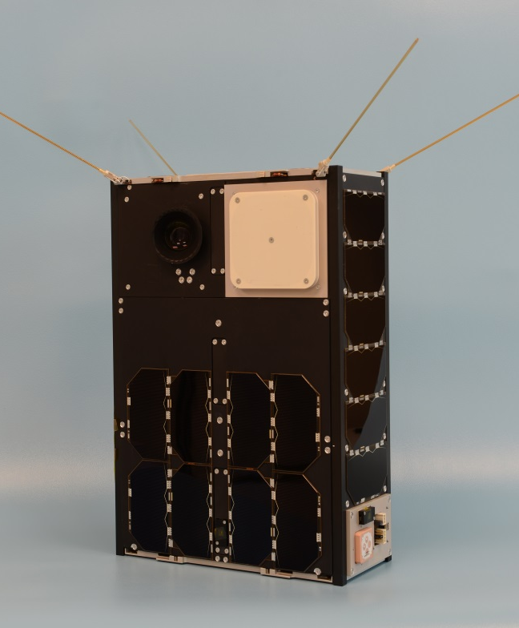
1st Gen. Constellation Technology Demo (GOMX-4)
Successful demonstration of:
Orbit control with cold gas propulsion (GomSpace)
Long-range S-band Inter-Satellite Link (GomSpace)
First Hyperspectral imager (Cosine HyperScout)
Launch: 2/2/2018
Status:
Mission Successful

Slide 7
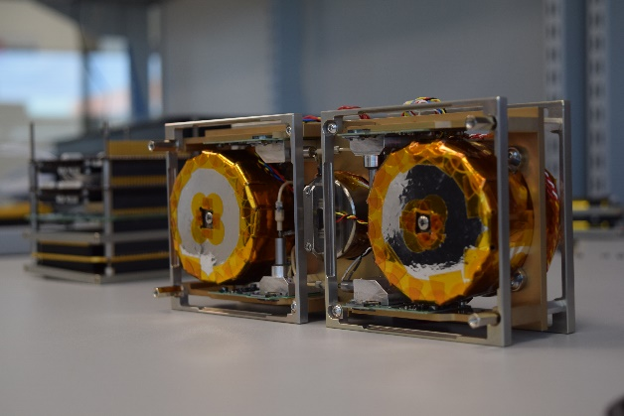
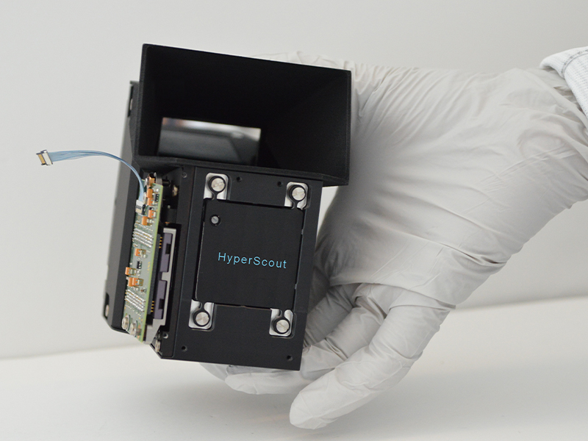
Technologies Demonstrated on GOMX-4B
Cold gas propulsion
(Gomspace Sweden)
HyperScout
(Cosine NL)
S-band Inter-Satellite Link (Gomspace)
Orbit control manoeuvres
(10 m/s @ 70 s)
Hyperspectral imagery & analysis ready data
(GSD 70 m, 45 spectral bands)
Data transfer over long range
(5 kbps @ 4500 km)

Slide 8
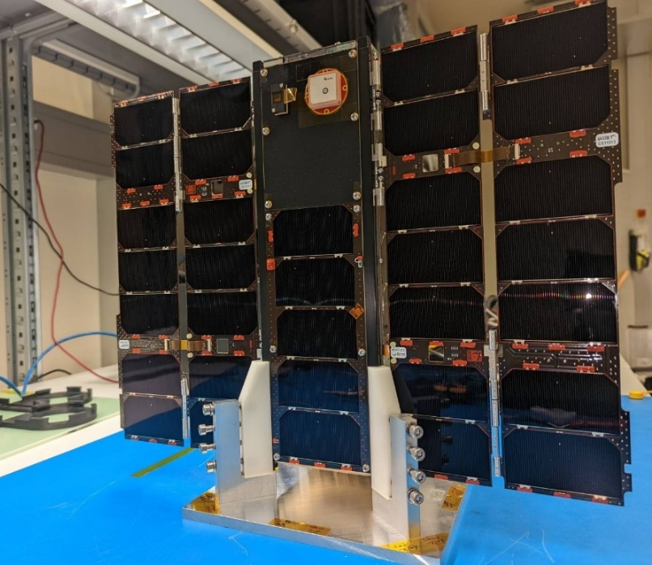
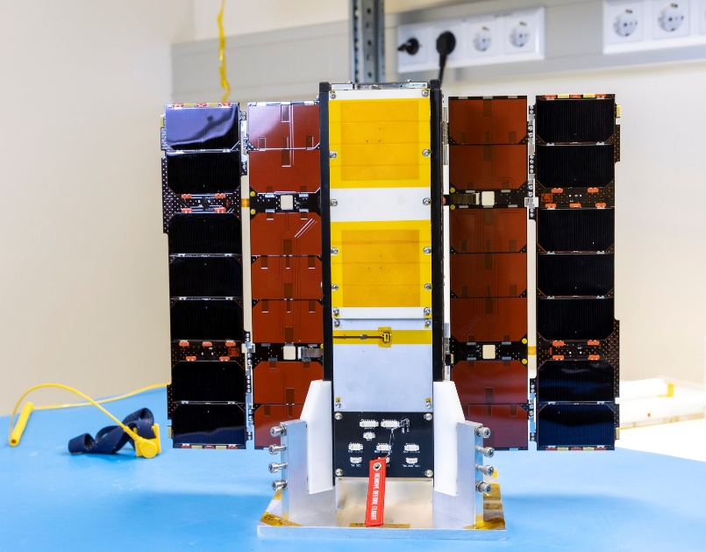
PRETTY Mission (GSTP)
Project: PRETTY
Contractor: RUAG Austria, TU Graz, Seibersdorf Labs
Platform: 3U CubeSat (TU Graz) with 3-axis pointing
Payloads:
  Software-defined GNSS-Reflectometry receiver & L-band multi-patch antenna (RUAG, TU Graz)
  Radiation dosimeter (Seibersdorf Labs)
Mission:
  First CubeSat to exploit GNSS-R grazing altimetry technique at L5 frequency and using beam steering to measure sea state, ice and ocean currents at high precision
  Characterisation of radiation dose environment
  Launch: 08/10/2023 to SSO 568 km on Vega VV-23
  Status: LEOP completed, commissioning phase ongoing, 1 year of nominal operations planned

Slide 9

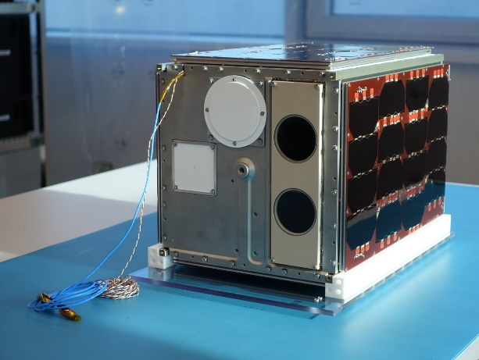
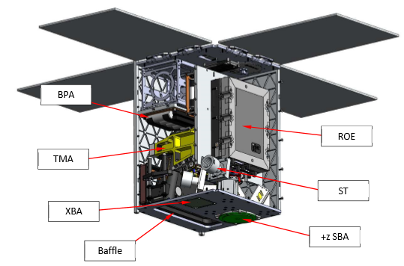

Proba V Companion Cubesat Mission (GSTP)
Originally planned to complement Proba-V mission to continue the generation of Vegetation products and the service provided to the User’s community, it is flying a scaled-down version of the vegetation monitoring system deployed on the Proba-V satellite.
12 U “Cubesat” Volume
Spare SI instrument from ProbaV
Technology enabler towards possible BE multi-band nanosat constellations
Currently in Phase E1 (Launched: Oct 2023 on Vega VV23)
Phase 0
A
B
C
D
E
F
PDR
CDR
FAR

Slide 10
VULCAIN Mission (GSTP)
Project: VULCAIN
Contractor: Politecnico di Milano, Istituto Nazionale di Geofisica e Vulcanologia, Leonardo Company, T4innovation, Leaf Space, FlySight (IT)
Platform: Two 12U CubeSats with 3-axis pointing and low-thrust EP
Payloads:
  Thermal Infrared Imager (270-400 K – Leonardo)
  Visible Imager (context, morphological analysis – Dragonfly Aerospace)
Mission:
  Stereoscopic imaging of the Earth focusing on Volcanos & coastal areas (surface temperature change, detect SO2 and ash emission)
  Along-track formation flying with 150 km separation @ 400km altitude
  Orbit control using low-thrust EP
Launch: SSO 400 km - 500 km, 12:00 or 22:30 LTAN, T0+48 months
Status: PRR close-out ongoing in October 2023

Slide 11
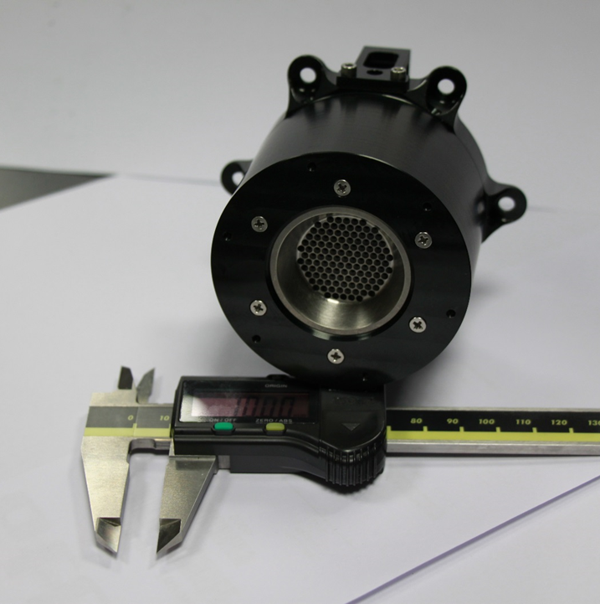
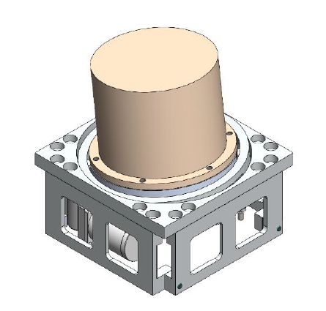
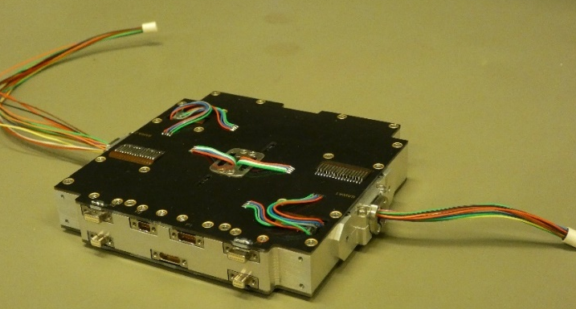
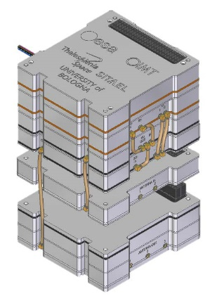
Enabling Technology Developments (GSTP Develop & Make)
6 DoF
Cold Gas Propulsion
(Gomspace SE)
High Performance Electric Propulsion subsystem
(Mars Space UK)
Thruster Pointing Mechanism for small EP thrusters
AVS (UK)
Solar Array Drive Assembly
(IMT IT)
Deep Space X-band Transponder
(IMT, TAS-I, Sitael, UniBo IT)
X-band Reflectarray antenna
(TICRA, Gomspace DK)
Ka-band 1m Deployable Reflector antenna
(Prosix Eng. & Comet Ingenieria ES)
Multi-Parallel Micro-Pumped Loop
(Demcon, NLR, ISIS NL)

Slide 12
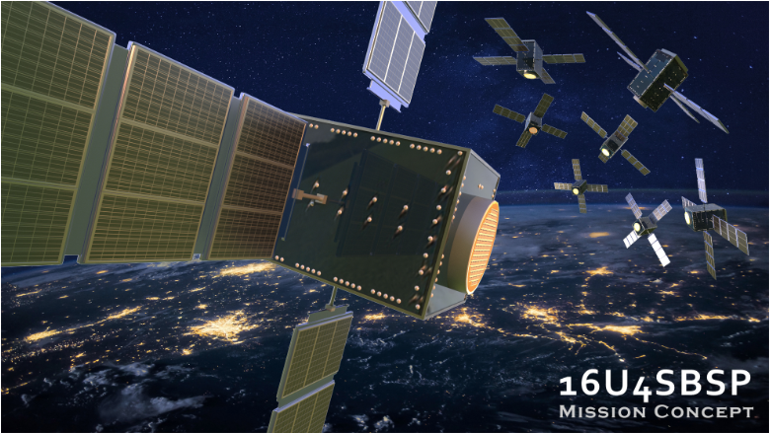
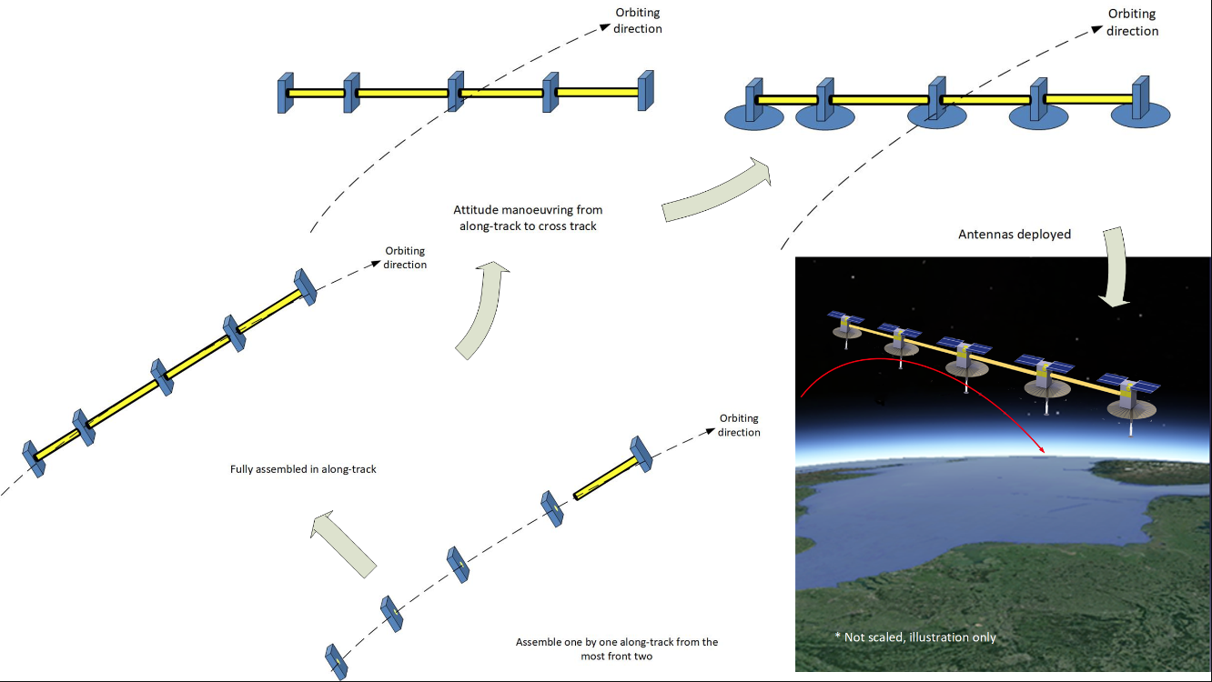
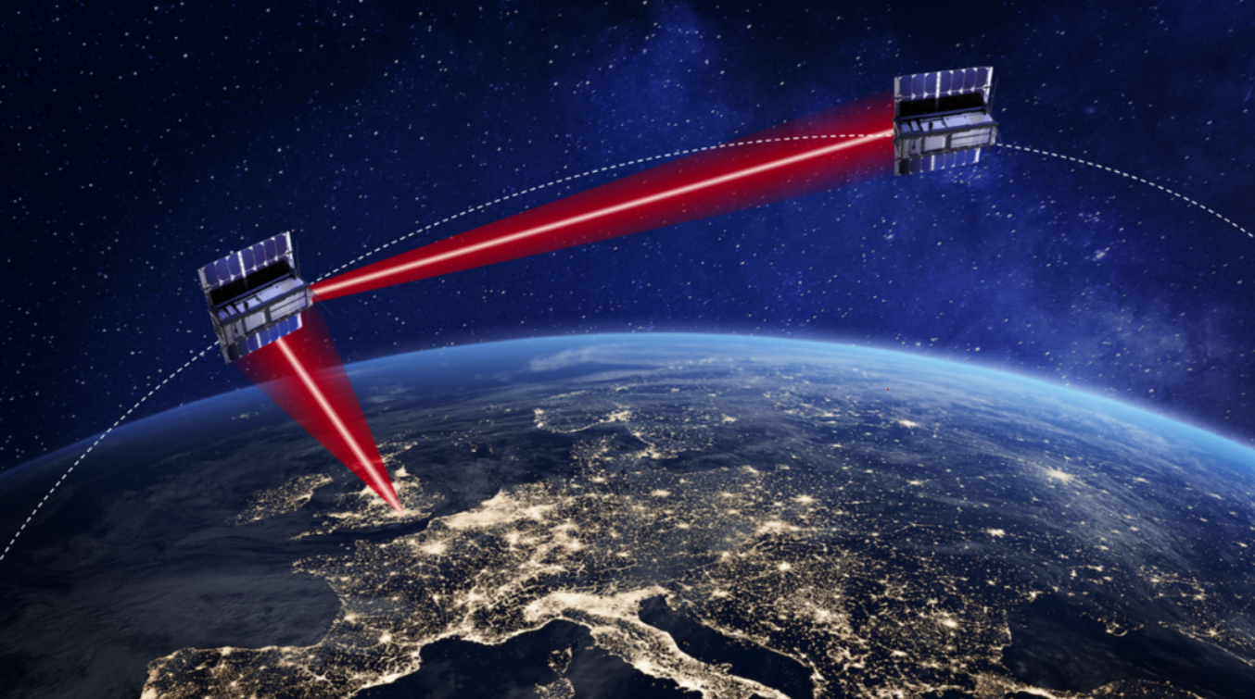
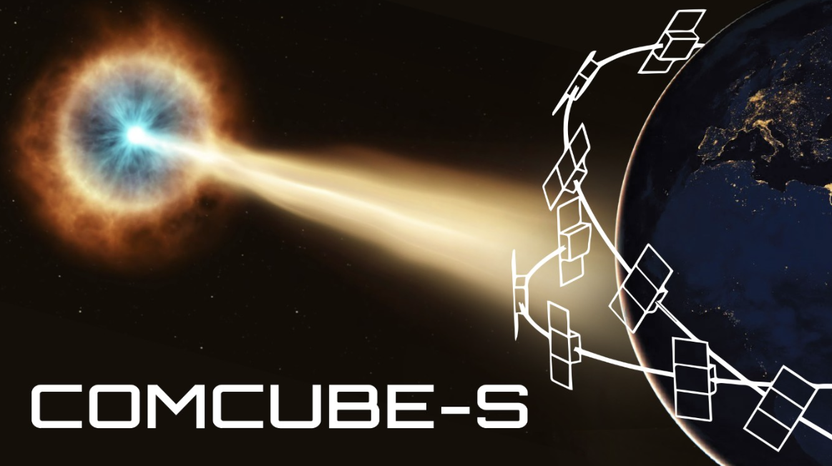
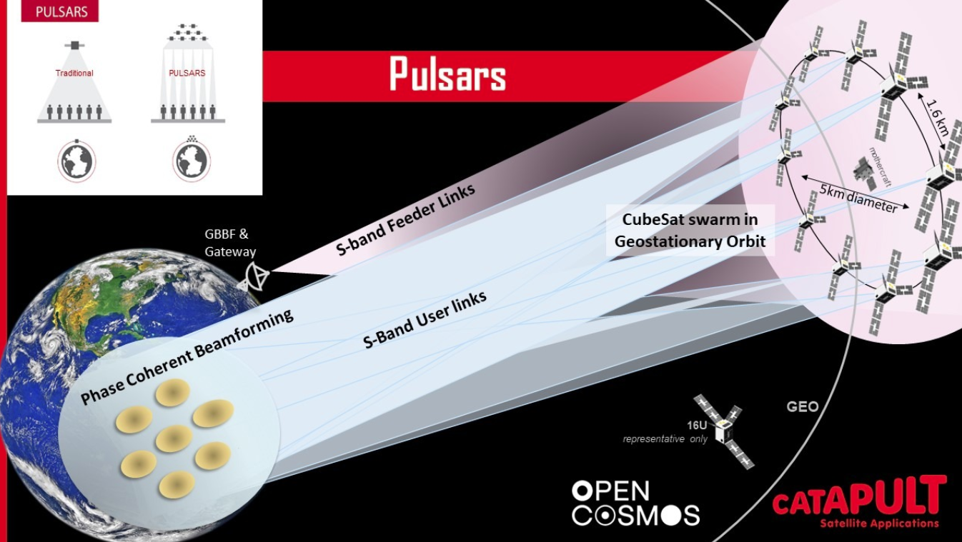
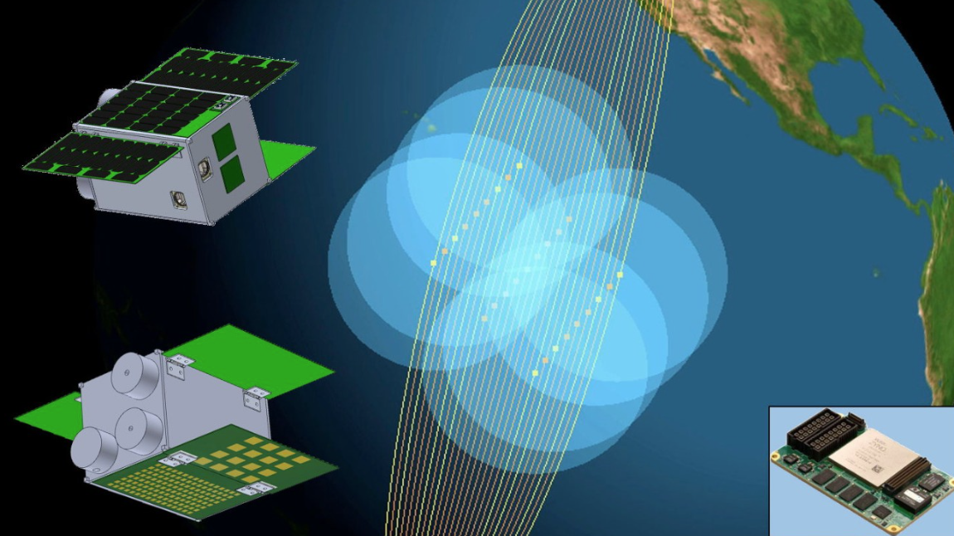
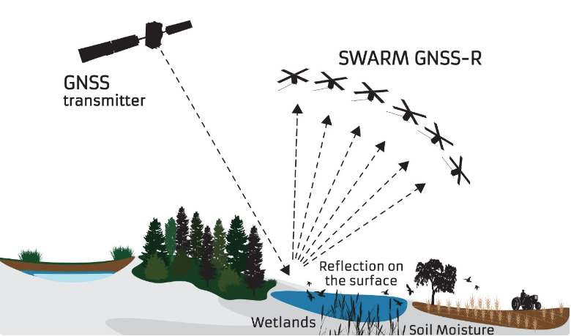


CubeSat Swarms: mission concept studies (OSIP)
Project Name | Description | Consortium
16U4SBSP | Demonstrate the use of a Swarm of 16U CubeSats for Space-Based Solar Power Supply energy to end-users in remote areas with low power requirements (<MW) Emergency power supply for operations in blackout zones. | Sirin Orbital Systems (P), TU Delft, University of Strathclyde
AltiCube+ | Autonomous in-space assembly of a tens of meters level radar antenna baseline. Each 16U CubeSat is a complete radar altimeter and together form a sparse array Will provide sub-km resolution cross-track and meter ~level along-track. | TU Delft (P), COMET Ingenieria S.L., ISISpace Group
Revealing Orbital and Atmospheric Responses to Solar activity (ROARS) | In-situ observations (augmented by ground-based measurements) of distributed neutral, plasma, and magnetic field observations Will help understand the evolution of field-aligned and ionospheric currents, Joule heating and the response of the neutral atmosphere. | University of Warwick (P), Open Cosmo, University of Bath, UCL, University of Warwick, University of Stuttgart, Northumbria University, University of Birmingham
COMCUBE-S | Swarm of Compton telescopes for all-sky detection and polarisation measurements of gamma-ray bursts First high-accuracy polarisation measurements of the prompt gamma-ray emission from a large sample. | University College Dublin (P), IJCLab, Clyde Space
PULSARS (Precision Ubiquitous Low-cost Synthetic Aperture Regional Satellites) | Swarm of 16U CubeSats with deployable antenna in a geostationary orbit slot Will provide a high capacity and scalable bi-directional 5G Narrow-Band IoT service Exploits ground-based beamforming technology to dynamically create coherent beams over individual users. | Space Application CATAPULT (P), Open Cosmos
Radar Cluster for Earth Remote Sensing (RaCERS) | Swarm of eight 16U radar satellites acting cooperatively in a controlled formation Concurrent altimetry, scatterometry, and synthetic aperture radar imaging. | GeoOptics Switzerland (P), Tyvak International, University of Birmingham, CNIT, ETH Zurich.
HydroSwarm | Increasing GNSS Reflectometry instantaneous coverage to address flood monitoring and soil moisture with a swarm of cooperative GNSS-R CubeSats Will demonstrate two different measurement techniques: individual coherent track mode and SAR mode | Surrey Satellite Technology, ICE-CSI C/IEEC

