Slide 1


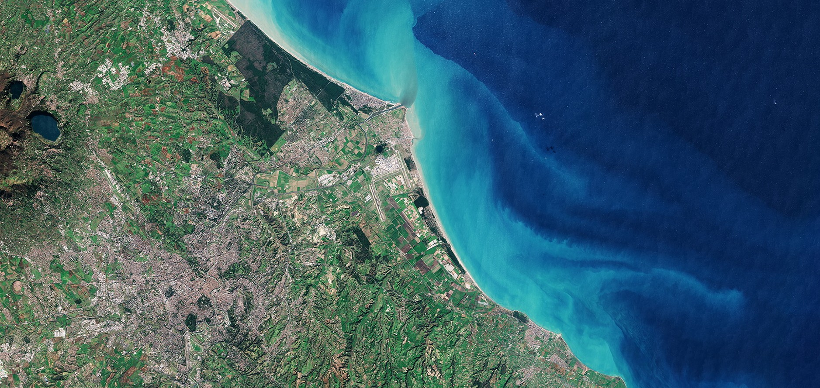
A Survey into the State & Health of the European EO Services Industry 2023.
SYNTHETIC PRESENTATION
Prepared by EARSC with the support of ESA

Slide 2


































































































































EARSC members

Slide 3




Introduction
The survey contains direct research on more than 700 companies, and a survey sample of 140 companies, including 79 members of EARSC.
772
EO Companies Up from 746 (+3.5%) year on year
13796
Employees
Up from 12085
(+14.2%)
year on year
€ 1.9b Revenues Up from €16b (+10.9%)
year on year
7.5%
Growth rate
over the last 5 years
3

Slide 4
Industrial Landscape
Dept 3.2%
Large 0.5%
Company Class | Employees
Micro-sized | 1-9
Small | 10-49
Medium | 50-249
Large | 250+
Medium 4.6%
One man company 12.7%
Small 26.0%
Micro1 35.2%
Micro2 17.8%
About 90% of the EO downstream companies with less than 50 employees and 65% less than 10
4

Slide 5
Revenue split
Revenue by Company Category:
The breakdown of revenue per company class shows that small-sized companies generate the largest share of revenues for the sector, and 3,7% of the companies gather 29% of the revenues.
Dept 5.5%
Micro 10.9%
Large 23.6%
Small 35.4%
Medium 24.5%
5

Slide 6


Market Activity
52% of the market revenues for the data sales
Consultancy 6%
Hardware/ software 9%
Downstream/GIS services 6%
Satellite operator (data sales)
32%
Added-value services 27%
EO data reception and
Data reseller 12%
distribution 6%
Other data acquisition 2%
6

Slide 7
Market Sectors
Defence
Agriculture
Env ironment
Security and Emergency services
Forestry
Infrast ructure
Oil & gas
Insurance
Citizens and society
Urban development
Maritime
Renewable energy
Raw materials
Fisheries
Defence still the largest market by far and only 14% of customers in the private sector
5%
10%
15%
20%
25%
30%
35%
40%
organisations (including NGOs) 8%
Academia
1%
Private sector 14%
Public R&D sponsor (H2020, ESA, National Agency)
11%
Public sector (Local/Regional) 6%
Public sector (National/European) 60%
7

Slide 8
Barriers and Challenges
Over 55% of companies who responded indicated that market and user acceptance/awareness represent their most significant barrier to growth.
Market/user acceptance
Lack of staff
Finding new customers
Competition from public organisations
Lack of development funding Competition from other EO suppliers
Cost of EO data Lack of venture capital Competition from non-EO sources
Late paying customers
Lack of operational data supply
60%
8

