Slide 1
EO data for a
sustainable world
1st ESA Earth Observation Commercialisation Forum
October 30, 2023
The information contained in this document is confidential, privileged and only for the use of the intended recipient and may not be used, published or redistributed without the prior written consent of Kayrros SAS.

Slide 2
EO : already managing 21 Gigatons of CO₂e per year
Carbon Watch & Renewables
ca. 8 Gt CO₂
Methane Watch
ca. 2 Gt CO₂e
Biomass
ca. 11 Gt CO₂
IPCC Report 2022

Slide 3
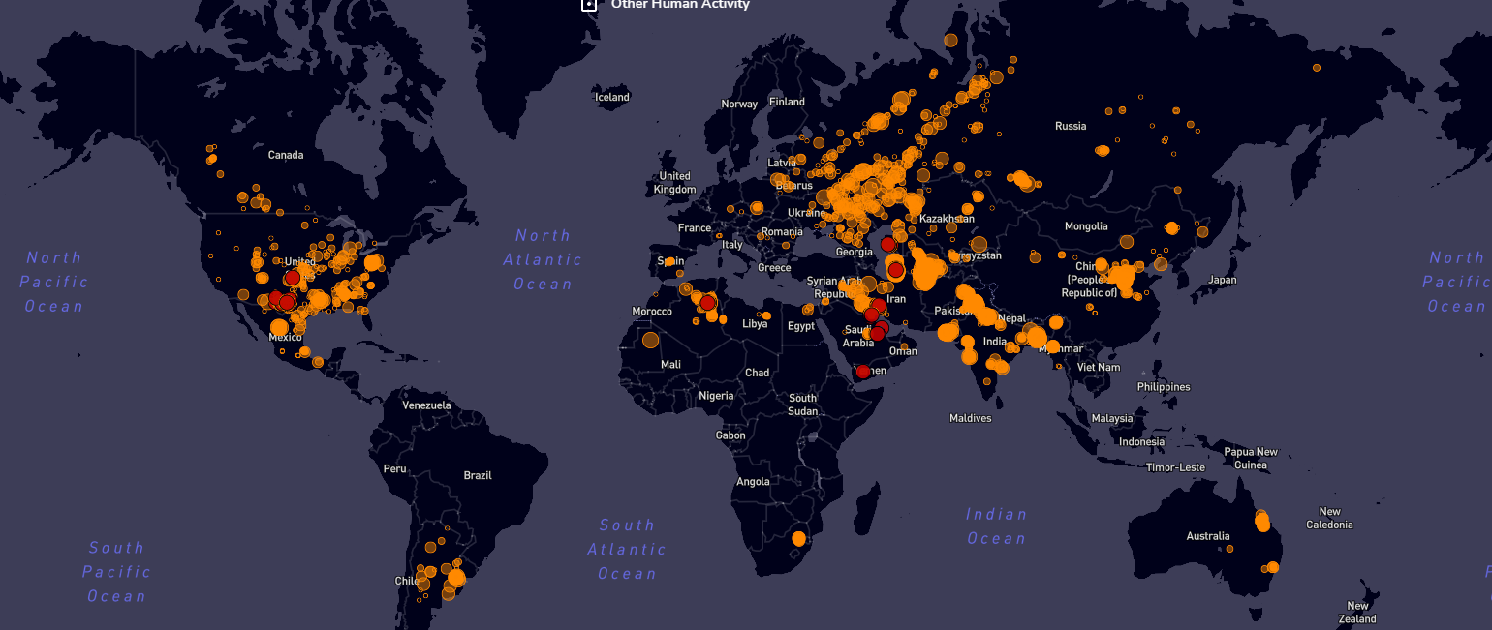
Kayrros EO Products for Reducing Emissions
Global Methane Emissions
Global Carbon Emissions
Global standard for detecting, quantifying and allocating methane emissions globally
Measuring CO₂ & live physical demand for certificates at national and facility level

Slide 4
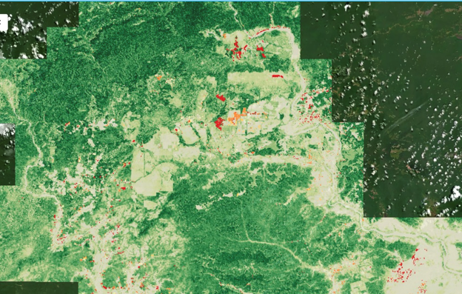
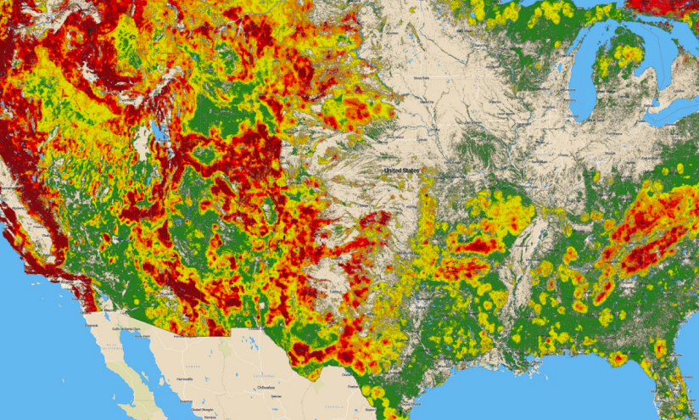
Kayrros EO Products for Protecting the Planet
Forest Carbon Monitor
Flood Monitor
Wildfire Monitor
Tracking illegal activities in forests, biodiversity & carbon sequestration at parcel-level
Forecasting, Nowcasting and evaluating risks and damages of floods before, during and after an event
Forecasting, Nowcasting and evaluating risks and damages of wildfires before, during and after an event

Slide 5
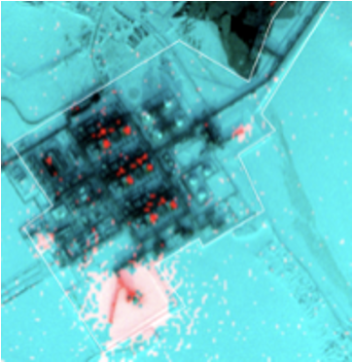
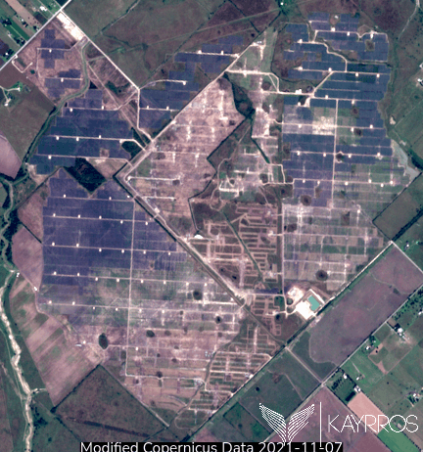
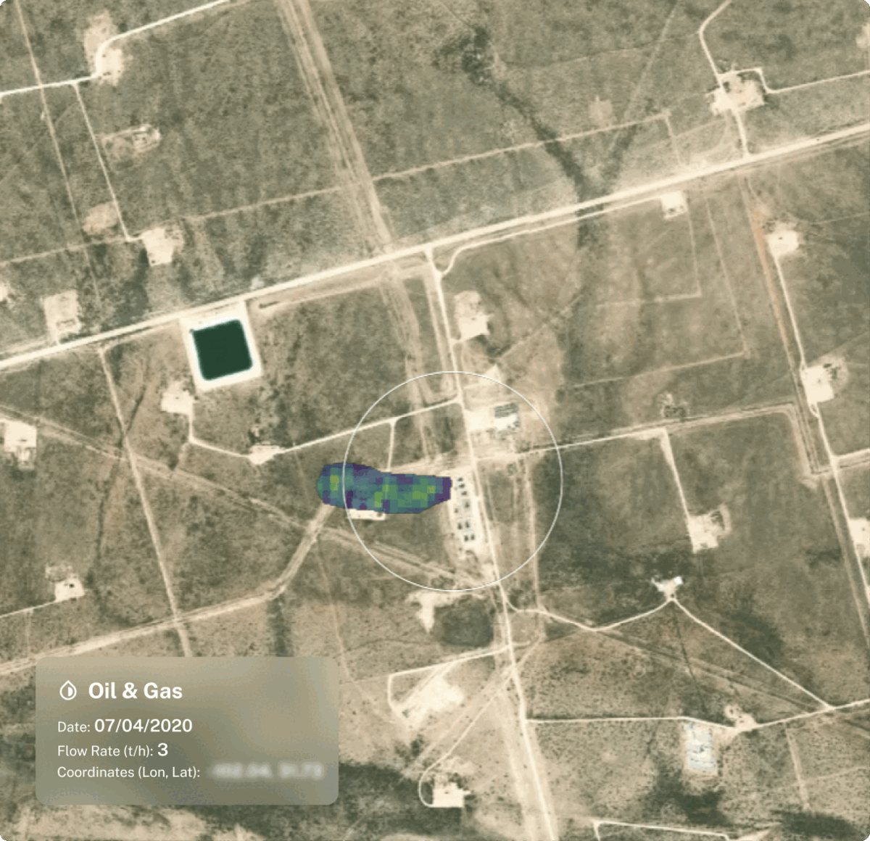
Kayrros EO Products for Financial Institutions
Tracking plant activity
Solar Project completions
Emissions monitoring
20 of world’s leading asset managers & hedge funds use Kayrros datasets for public and private markets
Asset classes: Commodities, real assets, listed companies, fixed income, project finance, voluntary carbon markets…

Slide 6
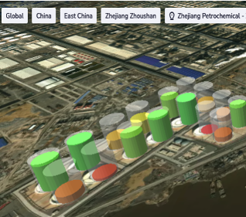
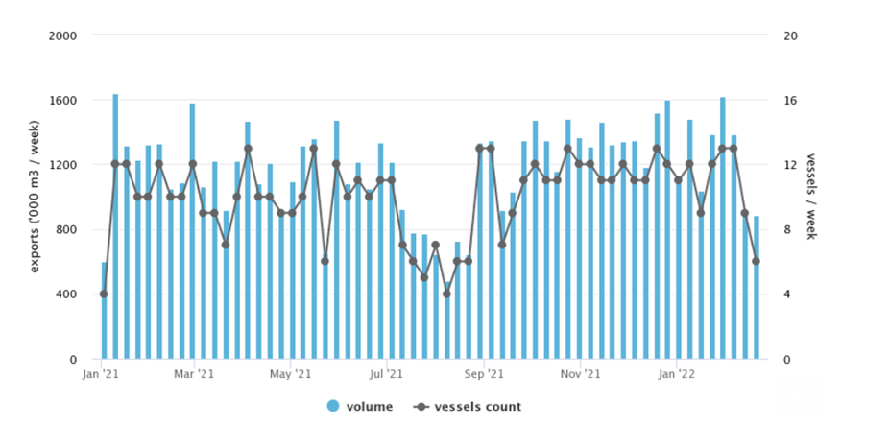
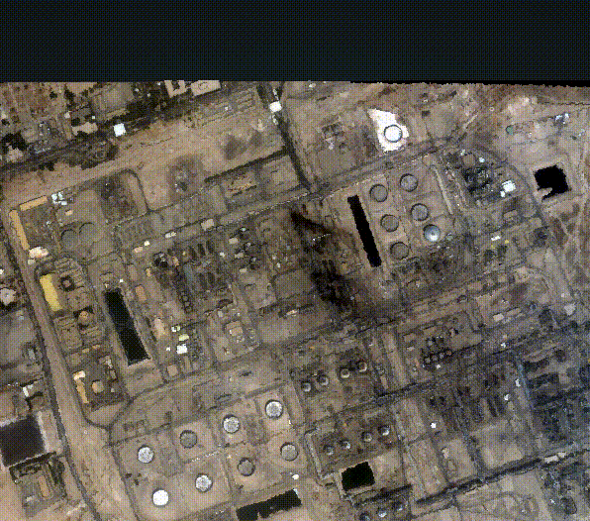
Kayrros EO Products for Financial Institutions
Returns
Expected risks
Unexpected risks
Direct, granular, reliable asset level observation increases precision of probability distribution of returns
Global, real-time and historical asset-level observation detects deviation from normal activity
Global coverage helps predict & quantify potential losses & actual impact of unexpected events
(man made and natural)

Slide 7
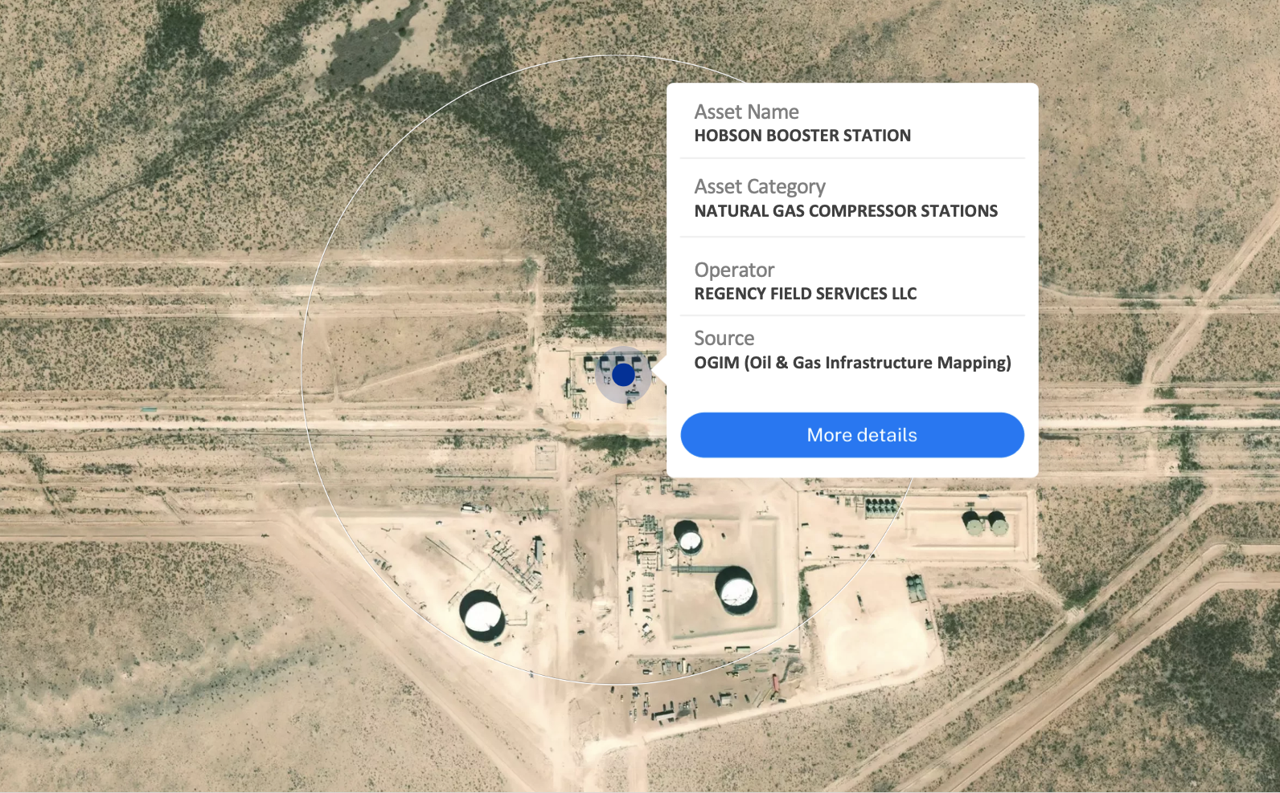
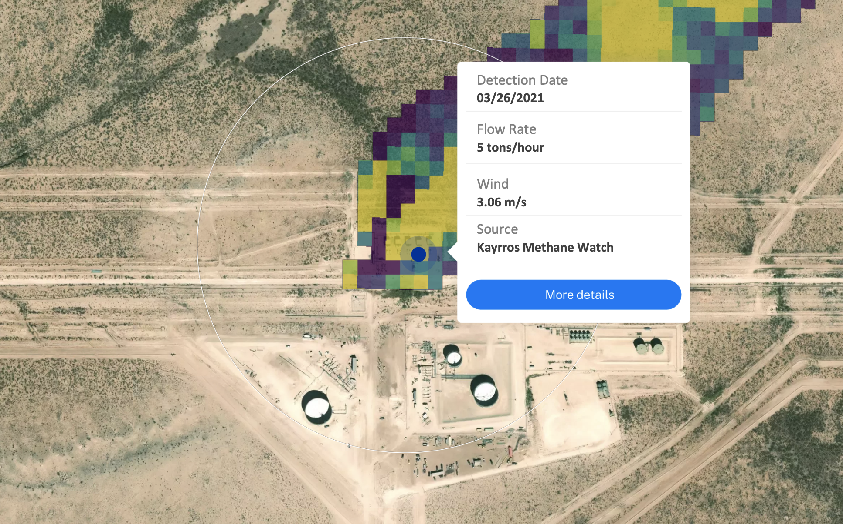
Kayrros attribution capabilities & asset-level metrics
Kayrros asset attribution
Asset-level methane metrics
Source: Omara, M., Gautam, R., O'Brien, M.A., Himmelberger, A., Franco, A., Meisenhelder, K., Hauser, G., Lyon, D.R., Chulakadaba, A., Miller, C.C., Franklin, J., Wofsy, S., and Hamburg, S.P. Developing a spatially explicit global oil and gas infrastructure database for characterizing methane emission sources at high resolution. In review, Earth System Science Data journal (2023).
Source: Mapbox, Sentinel-2 (European Space Agency)

Slide 8
ESA contribution to Kayrros success story
What worked
To keep EO champions in Europe (#Sinergise)
Création of an “NGA like” Agency
90% of Kayrros data
Massification of contracts €€€
Simplification of consortium criteria
Co-funding Methane Watch
Accelerate procurement in downstream

Slide 11
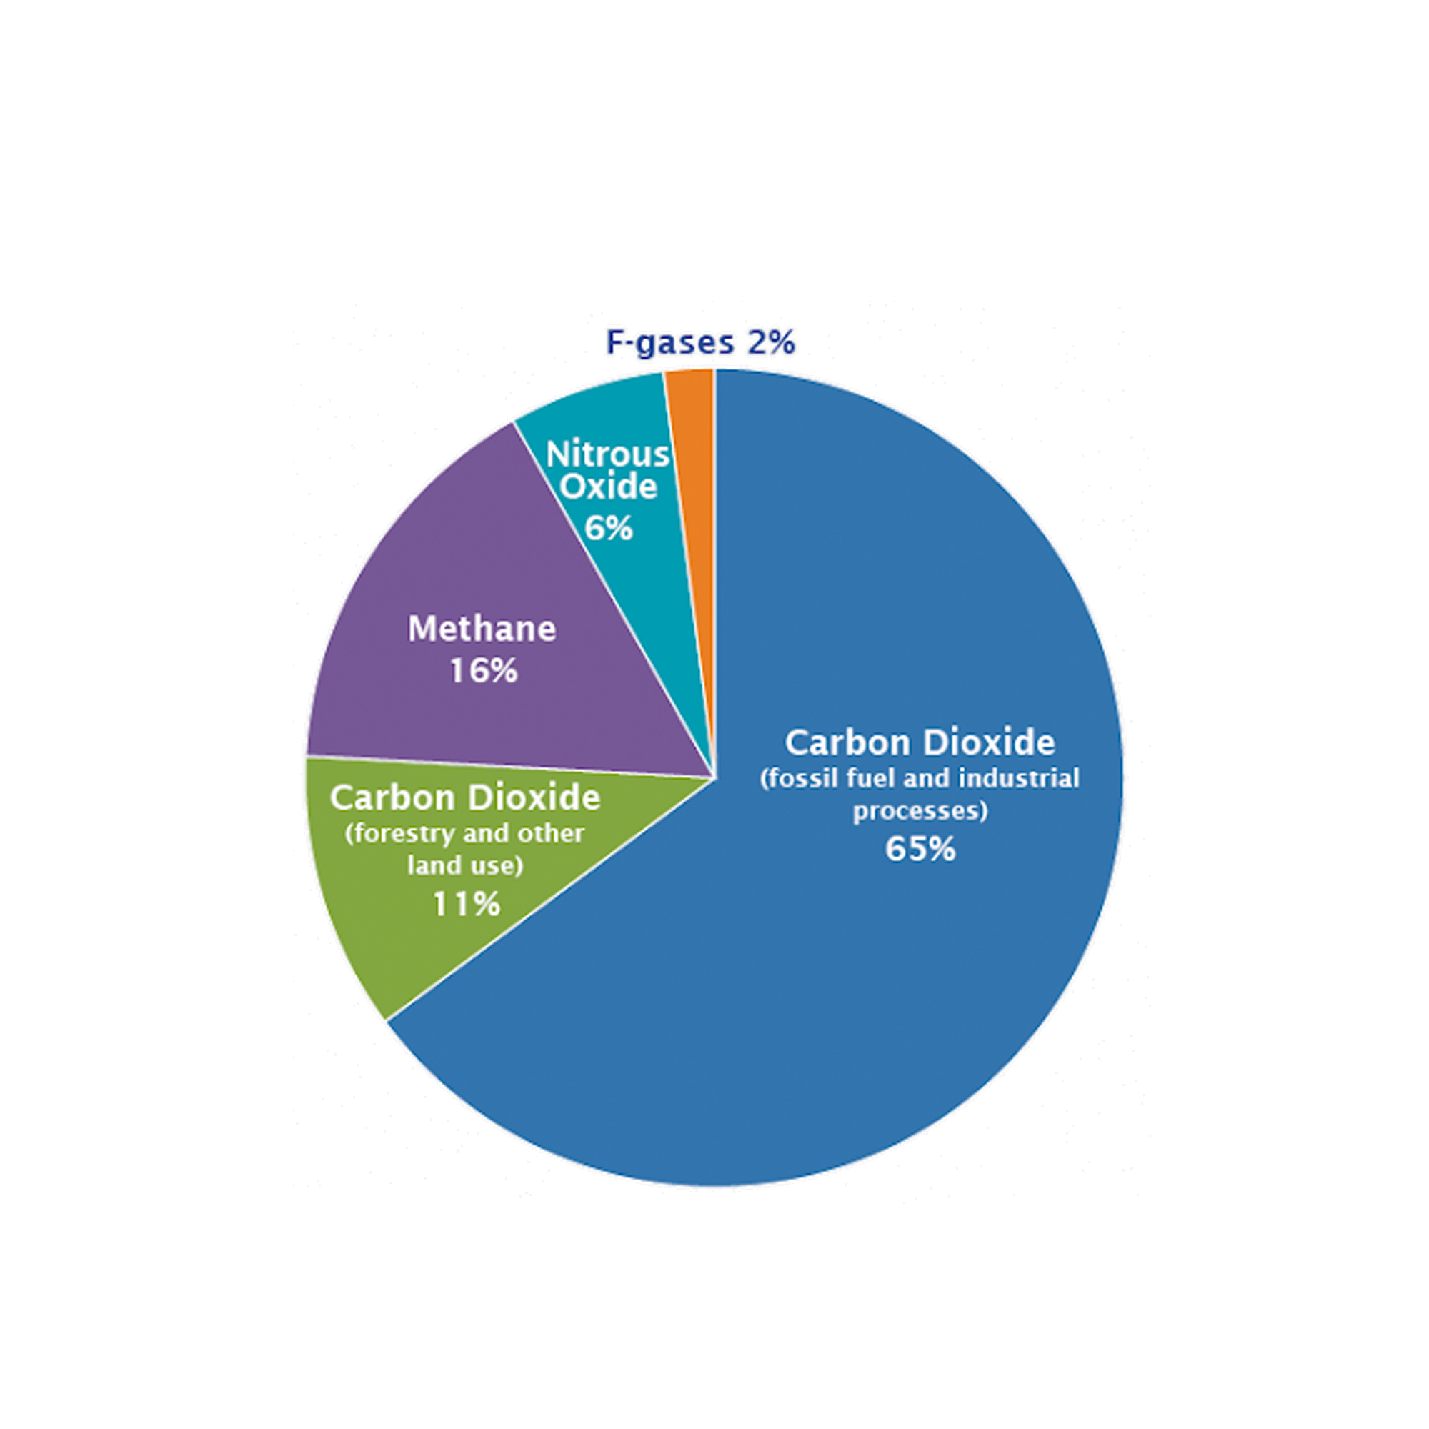
Kayrros EO: potential coverage is 42 Gigatons of CO₂e
Projected Kayrros tracking per gas in %
42.5 billion metric tons CO₂e per year
60% of global N₂O
85% of the 50 billion metric tons CO₂e emitted globally per year (Oxford, 2020).
90% of global CH₄
MW: Reducing the number of global super emitters by 50%
Equivalent to removing 330 million cars driven
for one year.
20% of CO₂ from Biomass
100% of global CO₂

