Slide 1
ESA Earth Observation Programme as enabler - Future EO block 1 “Foundations and concepts”
Juliette Lambin
Head of Future Missions and Architecture Department, Earth Observation Programmes
THE 1st EO COMMERCIALISATION FORUM
ESA HQ, Paris
30th October 2023

Slide 2
EO commercialisation and New Space at ESA
7 presentations in this session
The session is not exhaustive, i.e. does not address all actions related to EO commercialisation
ESA EOP as a CUSTOMER
ESA EOP as a PARTNER
ESA EOP as an ENABLER
“Traditional” EOP R&D procurement agency role
Funded by ESA and/or with a third-party partner
Co-funded (generally with industry)
Fully funded by ESA
Fully funded by ESA
“ New Space approach”
3
FutureEO
Block 4 : Enabling downstream applications
Block 3: Enabling commercialisation with GS & data management
Block 1 : Commercialisation with upstream technology
4
1
2
Scouts
(FutureEO Block 2)
Commercialisation through EO Data Buy for science (Earthnet) & for operations (Copernicus)
InCubed
(Earth Watch)
5
Arctic Weather Satellite (Earth Watch)
6
7
[D/CIC]
BICs, Scale Up Invest
Business Applications & Space Solutions (BASS)
[D/TEC]
General Support Technology Programme (GSTP)
THE 1st EO COMMERCIALISATION FORUM
ESA HQ, Paris
30th October 2023
Notes:
Some suggestions of modifications have been received on these definitions. Main ones:
ESA as a Customer: Refer to “projects” or “activities” instead of “missions”
ESA as a Partner
Fully funded activities excluded – only co-funding
Clarify difference between Partner and Enabler regarding the role of ESA: being a customer of the service for Partner (anchor or not), not being a customer of the service for Enabler
Notion of technical involvement is not binary ? (case of FLPP – Themis & Prometheus)
Replace Technical involvement with “ESA technical authority/responsibility in the development

Slide 3
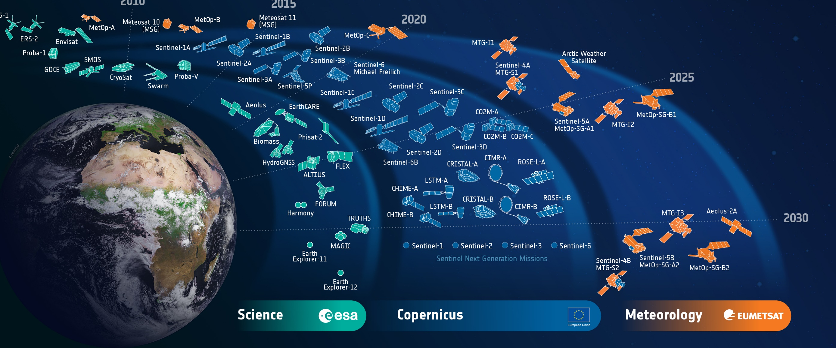
Block 1 prepares for all EO missions
Future preparation:
- Long term focus
- Technical credibility (TRL, risk reduction activities)
- Requirements and performance fit to users needs

Slide 4
Block 1 activity lines
Generic preparation of future
Early phases (pre-phase 0 to phase B1)
Earth Explorer
EUMETSAT future missions
Copernicus Next Generation Sentinels
Potential Mission of Opportunity
Instrument Pre-development (IPD)
Small satellites:
Phi-Sat
SCOUTs consolidations studies (and possibly risk reduction activities)
EO-enabling platform technologies
Frequency Management

Slide 5
Earth Explorers : Early phases funded through Block 1
Low TRL
High TRL
Technology:
For traditional or new actors
Key req.: high TRL at end Ph.B1
Technology cycle much faster than mission cycle
TDE + GSTP leverage
Platform Technology
(avionics, comms to ground, etc.)
TDE,
FutureEO
GSTP,
FutureEO
Multi-mission Instrument Technology
Risk Retirement(s)
TRL=6/7
EE-11
dates
Techno Pre-Development(s)
4 Mission Concepts
TRL=5
2 Mission Concepts
1 Mission Concept
4x Ph.0 system studies
Q2-2022
Q3-2023
2x Ph.A system studies
Q4-2023
Q2-2025
Ph.B1
early 2026
ITT
2026
Phase-B2/C/D
Future EO Bock 2
~2032
14 months
UCM / ACEO
PB-EO
14 months
UCM / ACEO
PB-EO
~5 years
2 // contracts per Mission Idea
Supporting science studies, campaigns
Science and Performance:
Validation of measurement concept
Achieve ambitious science wrt cost, maturity
Understand key performance drivers, uncertainties
End-to-end performance simulator

Slide 6
Block-1 and commercial EO
- Focus on credibility: Future EO – Block 1 as an enabler, as outcome of studies are generally a very thorough and reliable assessment of technology readines, fit with user needs, and development plan robustness
- Technology demonstration and low-TRL actions, in full coordination with GSTP, DPTD and other EO programmes
- Long-term, sustained effort: we start from very early concepts, and competition/selection along the way towards “world-class” systems (Earth Explorer, Copernicus, Meteo). But non selected concept usually also find their “customer”

