Slide 1
From one-off EO projects to streaming IT services
THE 1st EO COMMERCIALISATION FORUM 30-31 OCTOBER 2023 ESA HQ | PARIS

Slide 2
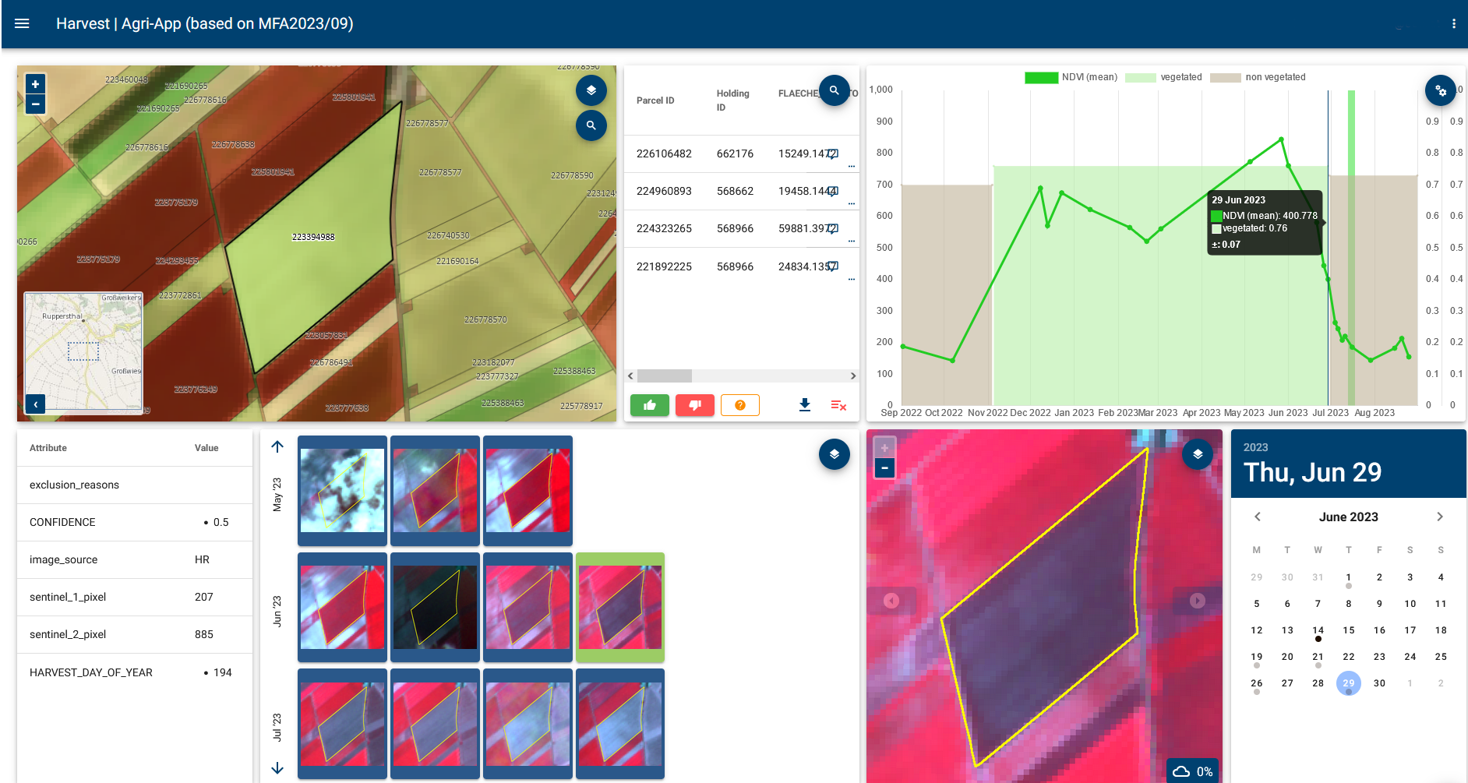
The solution for managing area-based
payments in the CAP Context
ESA InCubed
joint industrial development
Investment leverage attained
11
Operational service for national paying agencies for
monitoring the Common Agriculture Policy (CAP)
Public demo: https://agri-ogd-at-public.demo.hub.eox.at/

Slide 5
Patent # EP 22 152 167 pending

Slide 6
Space industry status today

Slide 7
Closing the cycle - expanding space to biz
Think outside the box – learn from tech giants to fuel the economic cycle
Proven over 30-40 years, successful missions, Copernicus
EO as IT Information Services
NewSpace & Start-ups are forerunners
Notes:
*Access (data dissemination)
*Business models for sellable solutions
*Revenues
*Success
*Design
*Integrate / Value creation
*Launch
*Operate / QA/QC

Slide 8
What
We
Do
GLOBAL INSIGHTS
AT YOUR FINGERTIPS
GeoVille is internationally renowned for its leading role in innovative Earth observation services and offers a one-stop-shop for targeted value-added geo-information products and related solutions.
CONTACT US
OR FIND US ONLINE
GeoVille Information Systems
& Data Processing GmbH
Sparkassenplatz 2
6020 Innsbruck, Austria
Go to GeoVille.com
info@geoville.com
www.GeoVille.com

