Slide 1

SSTL - Pioneer of the Smallsat Revolution Presents how ESA programmes are supporting EO commercialisation of Space
Andrew Haslehurst
Surrey Satellite Technology Ltd - CTO

Slide 2
UK Export Control |  | This document and any hardware referred to within has been UK Export Control Rated as:
Hardware UK Export Rating Number: |  |  | [Nor Export COntrolled | Date of rating: 21/10/2023
Information UK Export Rating Number: |  |  | Not Export COntrolled
I confirm I am an approved SSTL Export Rater and this rating is correct as of the date above: |  |  |  | Andrew Haslehurst
US Export Control |  | [Manually Entered]
ITAR | The information contained herein is controlled under US ITAR and is authorised for export under the provision of TAA/DSP: N/A
EAR | The information contained herein is controlled under US EAR and has been classified as ECCN: N/A
ITAR EAR | The following statement is only applicable for documents containing ITAR/EAR classified information. This document contains information controlled by the U.S. government and authorized for export only to the country of ultimate destination for use by the ultimate consignee or end-user(s) herein identified. It may not be resold, transferred, or otherwise disposed of, to any other country or to any person other than the authorized ultimate consignee or end-user(s), either in its original form or after being incorporated into other items, without first obtaining approval from the U.S. government or as otherwise authorized by U.S. law and regulations.
Pages | EAR | ECCN No. | ITAR | Country | End User | Licence No.
 | ☐ |  | ☐

Slide 3
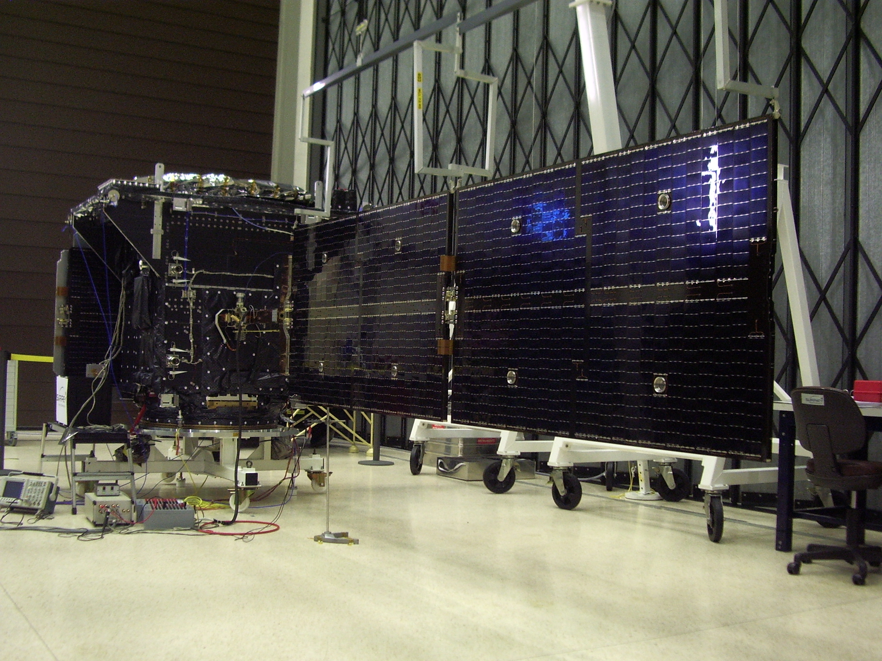
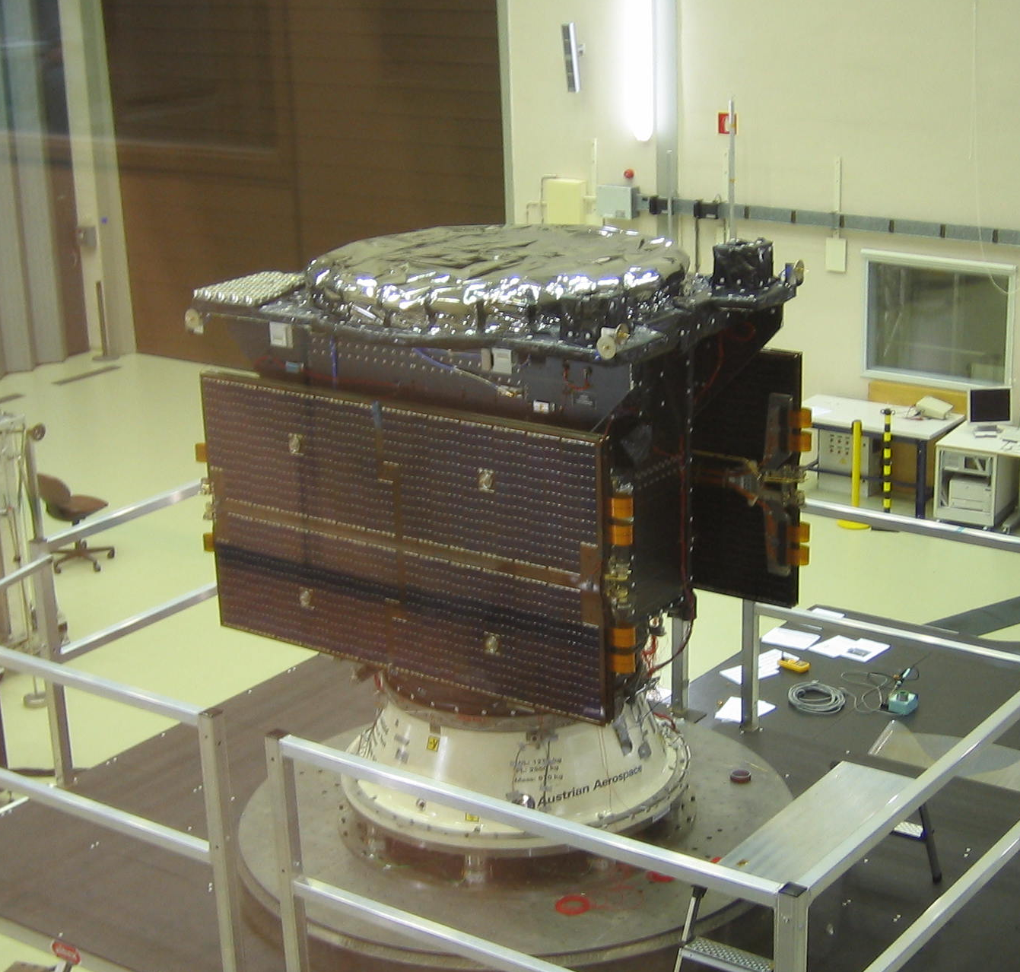


A Different Approach, GIOVE A

Slide 4

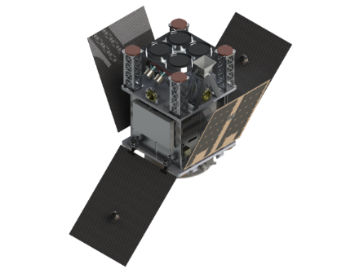
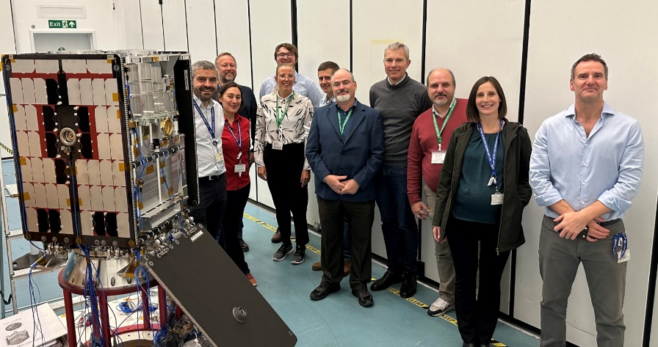
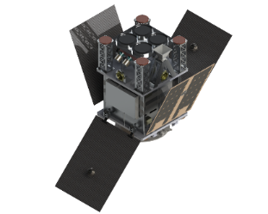

HydroGNSS
Using small satellites for sensing weather as we continue to tackle climate change
Scouts: ESA’s agile research missions, a new initiative from ESA’s Earth Observation directorate, demonstrating Small satellite science missions with small budget and rapid schedule
This new family of small satellites delivers value-added science, characterised by an agile and low-cost development process to prove new concepts for future ESA endeavours with a different approach
HydroGNSS mission uses GNSS Reflectometry surface reflections collected from low Earth orbit of Global Navigation Satellite Systems, including GPS and Galileo used to measure key climate variables
  70 kg SSTL-Microsatellite, 5-year life based on the SSTL core Avionics
  3-axis attitude stabilised with star tracker
  Propulsion for orbit phasing and collision avoidance
  Up to 200 Mbps X-band downlink via
  Svalbard, with back up at Guildford
  Rideshare on Vega-C

Slide 5
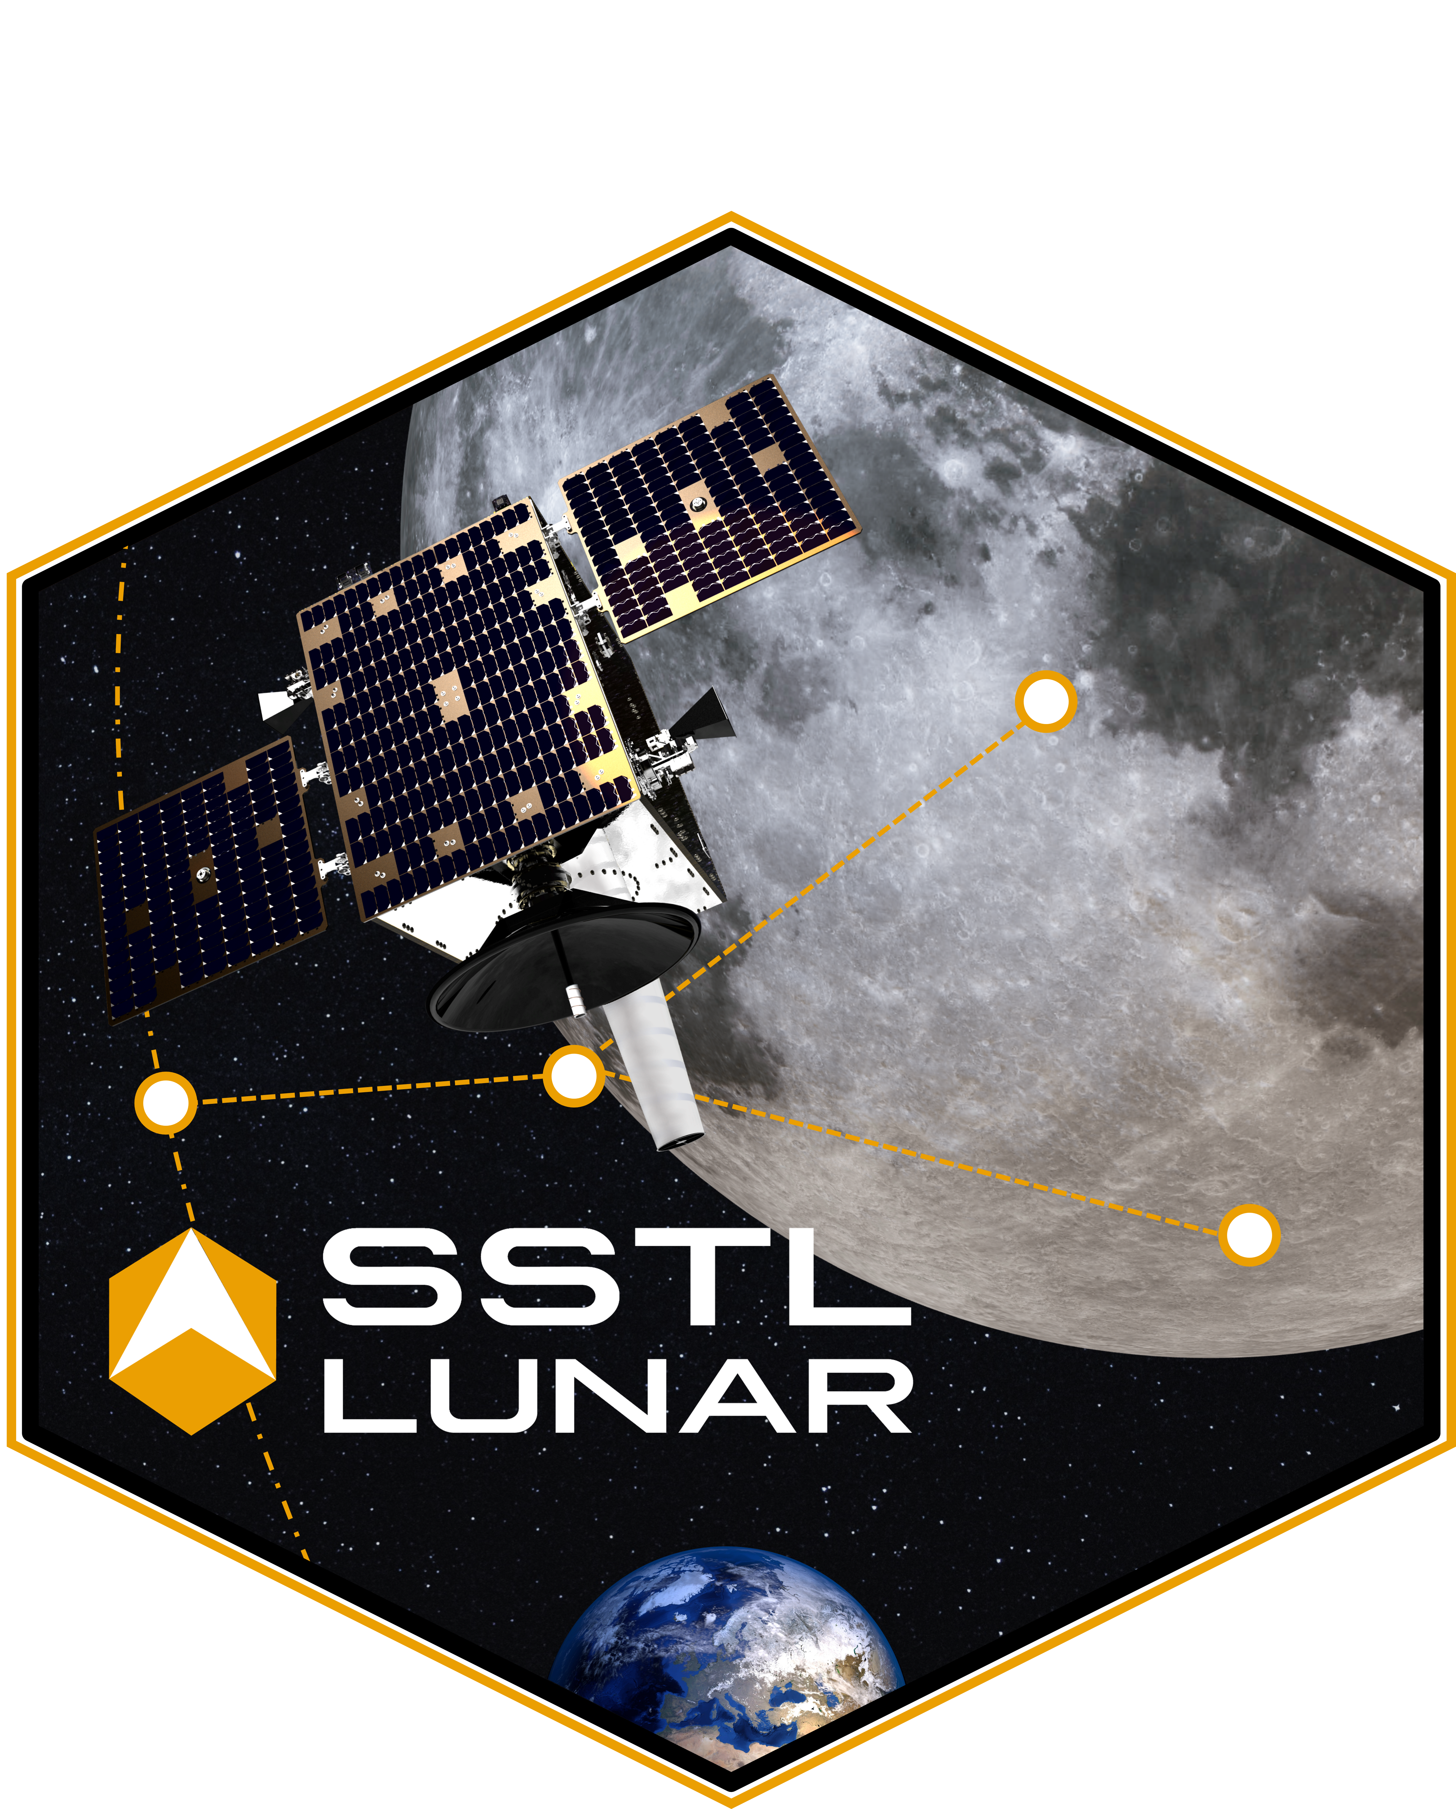
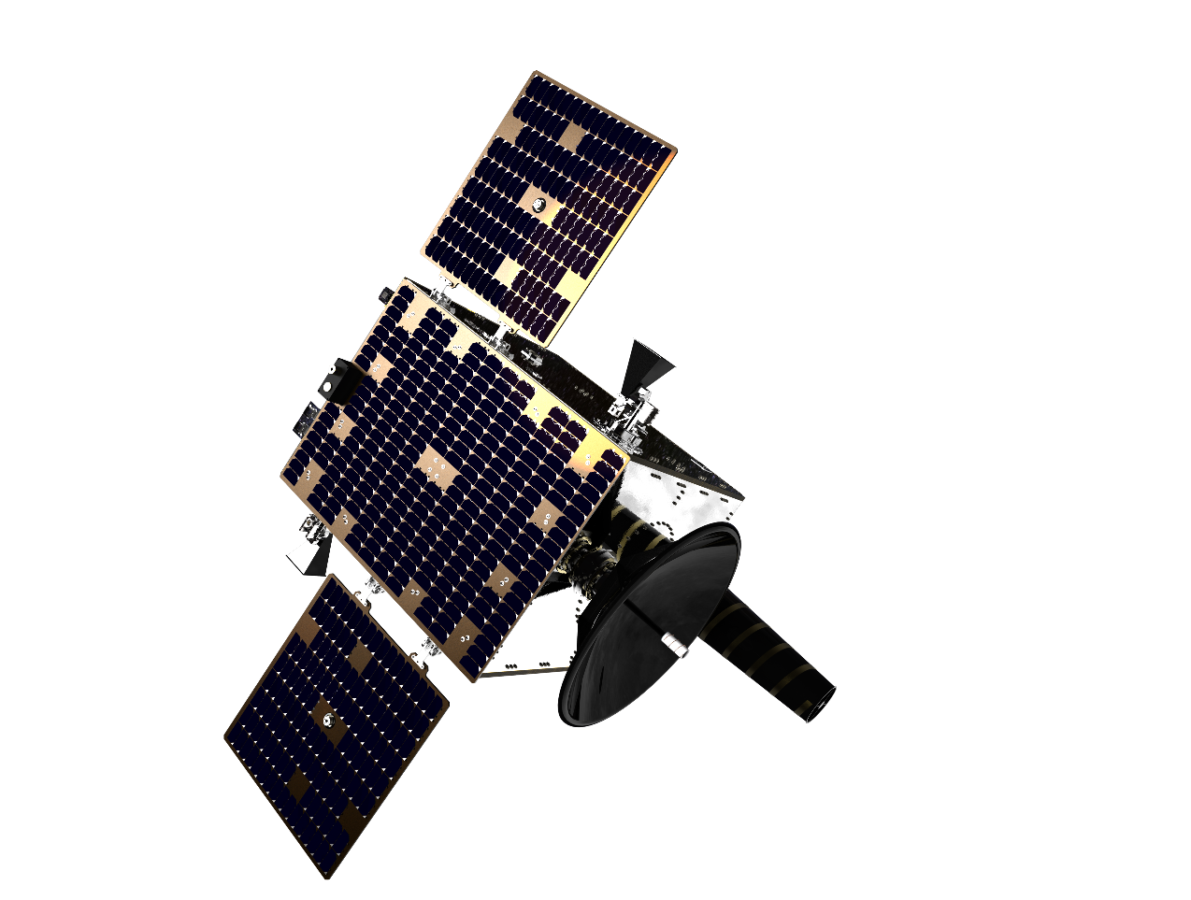
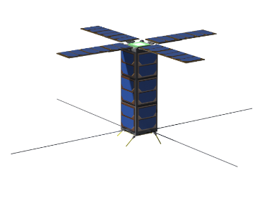
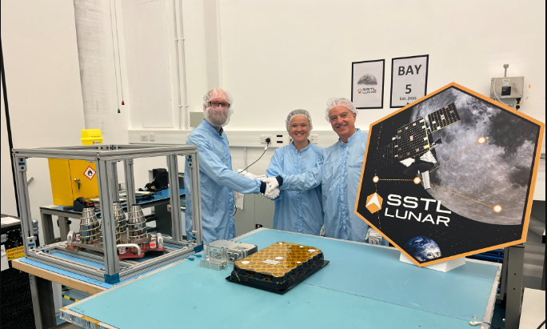
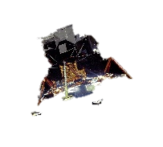
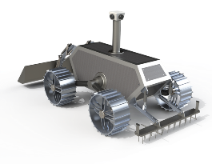


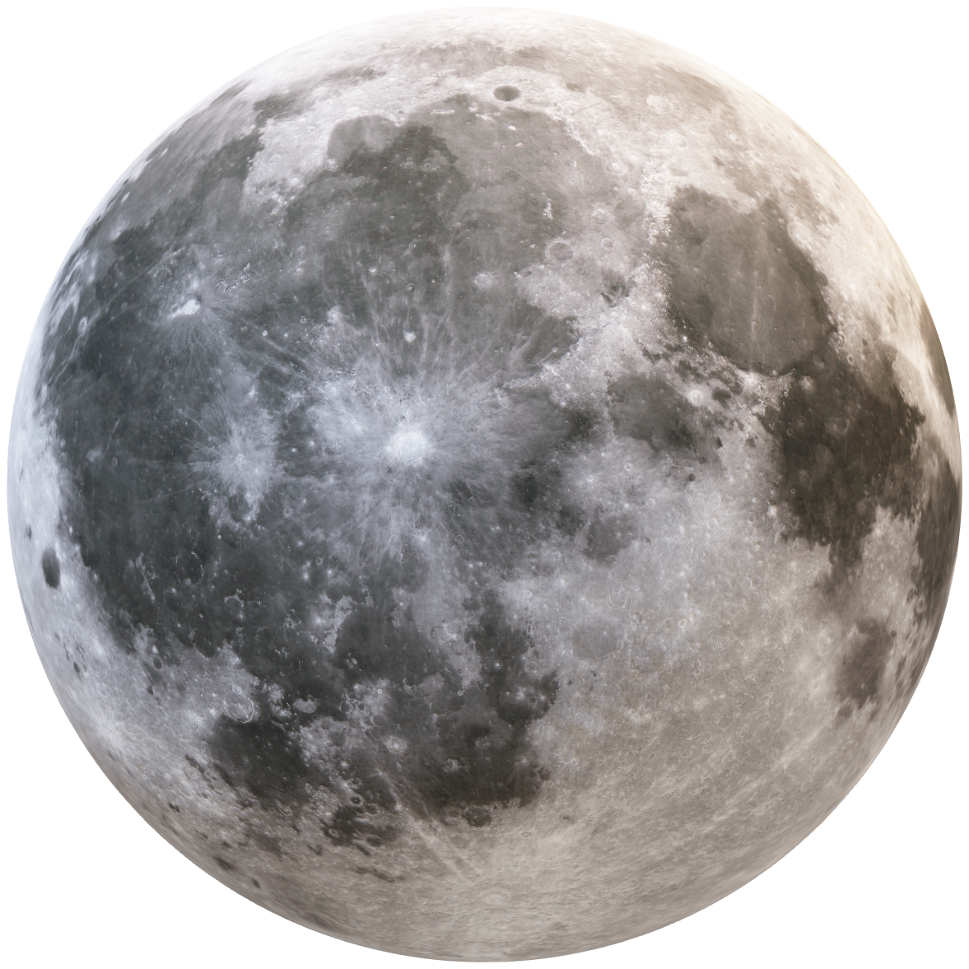
Lunar Pathfinder
Commercial communications around the moon
Lunar Pathfinder (LP) is a single data-relay satellite, designed, built and operated by SSTL and realised in partnership with ESA.
Based around the same Core SSTL Avionics and heritage design approach LP is an enabler for exploration and science missions
An alignment of driving factors has rejuvenated a global interest in returning to the Moon:
  Reduced launch and technology costs
  New Space public private partnerships enabling commercial exploration
  Greater appetite for private investment in space industry
  Cislunar space becoming more of a national strategic interest
Orbiters
Far side
Landers
Rovers
GNSS Weak Signal Detection
Laser Retro Reflector

Slide 6


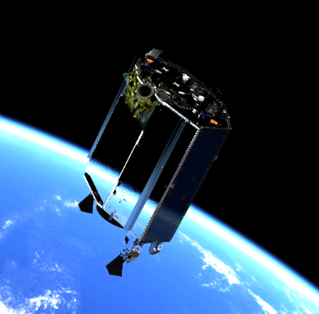
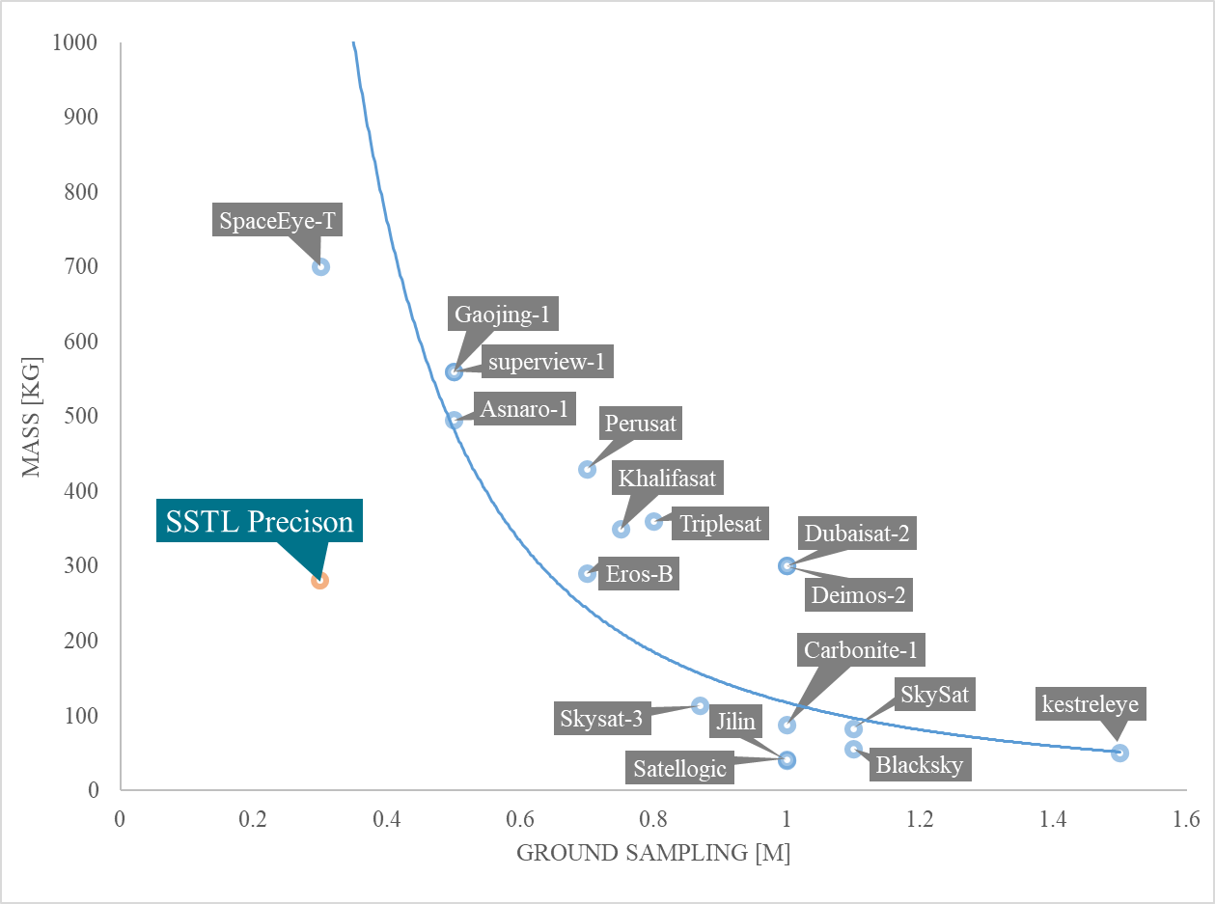
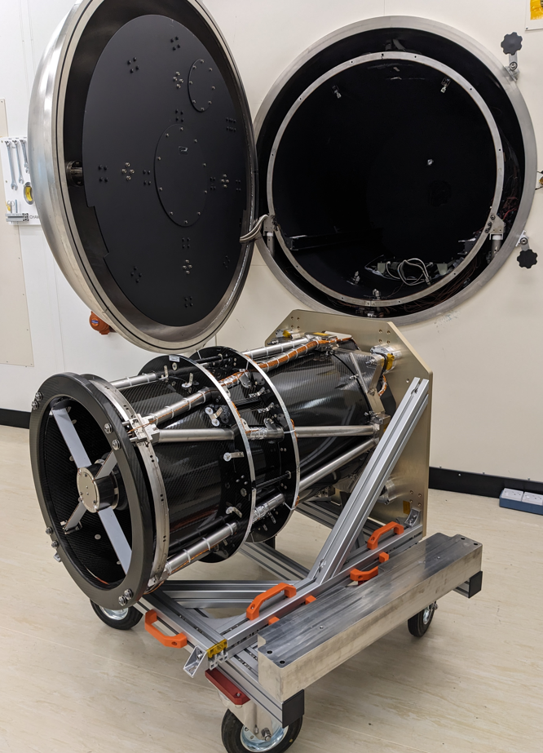
Incubed Technical Development
Precision high resolution EO payload
SSTL’s new very high resolution multispectral imager Precision which utilizes a novel CCD-in-CMOS time delay and integration (TDI) line scan detector and innovative opto-mechanical techniques to achieve cutting edge performance at a market-leading size, weight and power to increase the value for money to EO satellite customers
SSTL - Precision

Slide 7

Incubed Technical Development
Flexible and Intelligent Payload Chain (FIPC)
SSTL’s new High throughput FIPC is designed specifically to tackle the data bottleneck and onboard data processing pipeline to increase the value for money to EO satellite customers
SSTL’s FIPC sub-system provides an innovative end-to-end solution. The end-user development framework has been designed to facilitate both in-house and third-party advanced onboard processing capabilities. To enable applications from data calibration to Machine Learning (ML) for image classification and information extraction towards greater satellite autonomy.

Slide 8
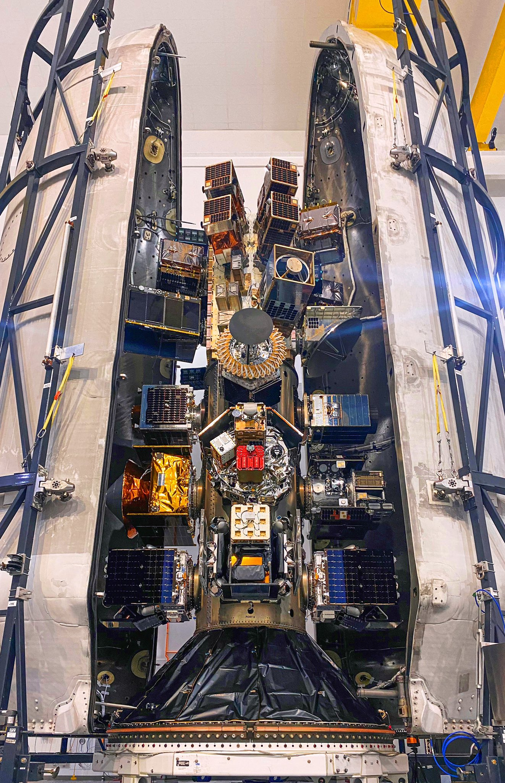
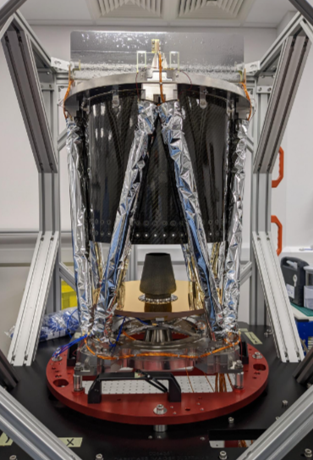
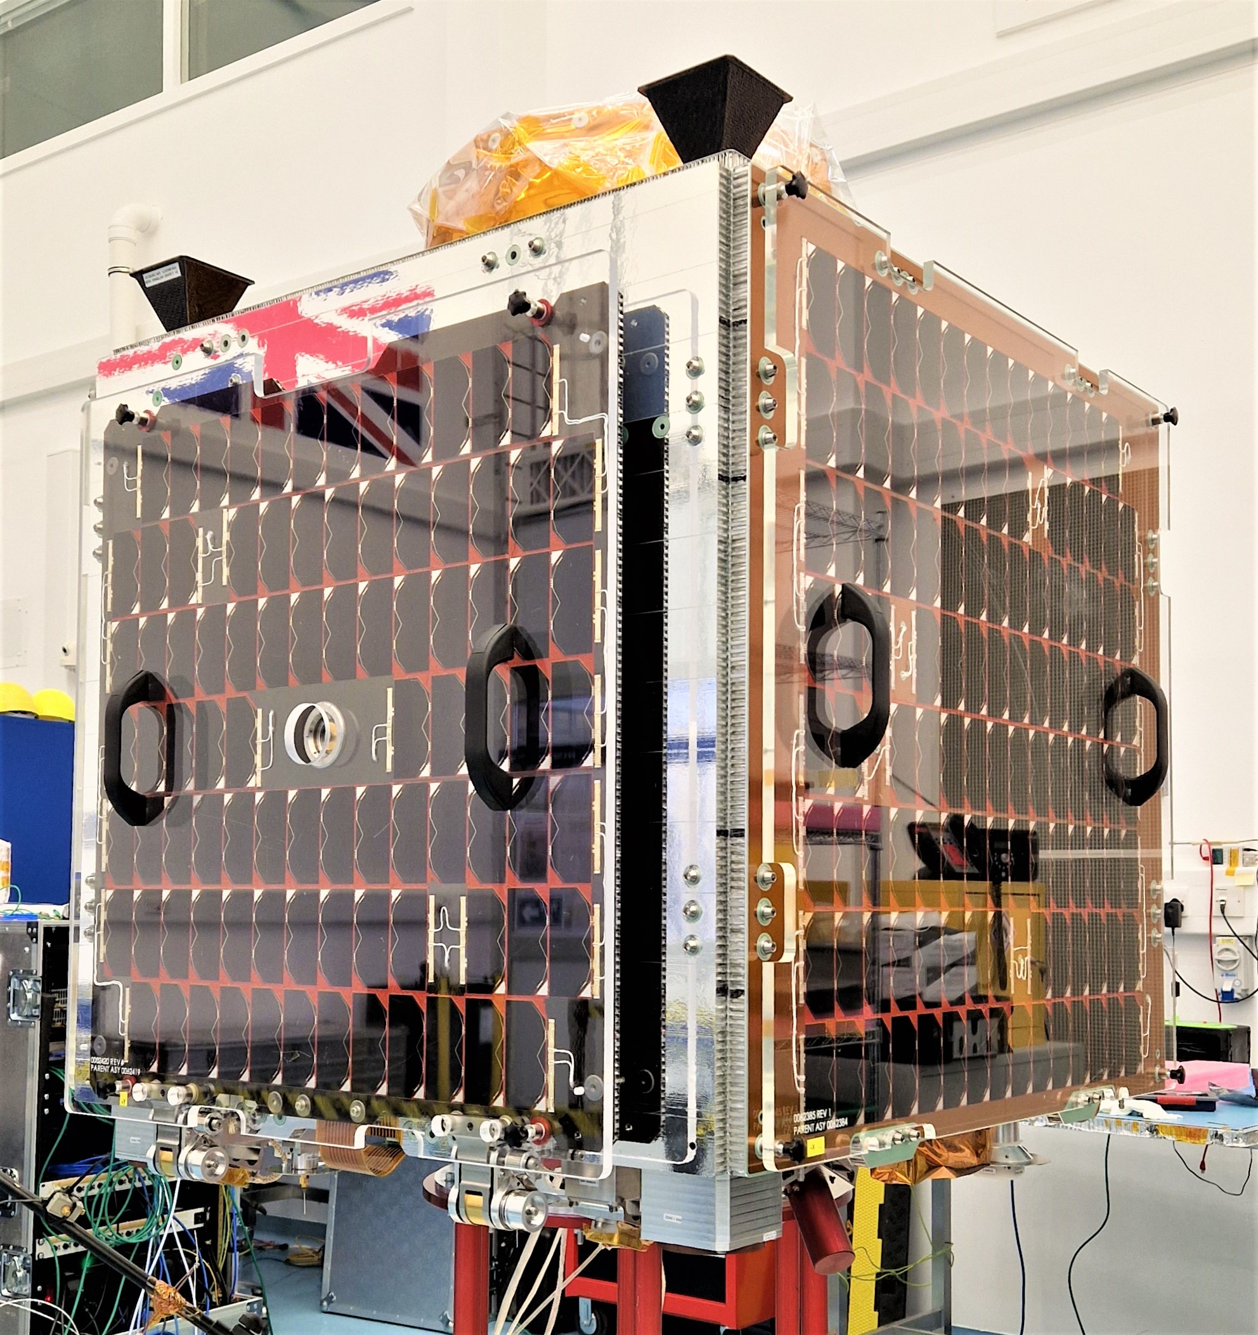
Commercialising technologies - Darkcarb
Leveraging Incubed developments into new commercial programmes
40 years of doing space differently, pushing technology boundaries
MWIR Payload
HOTSAT-1

Slide 9
Atlanta

Slide 10

Atlanta

Slide 11
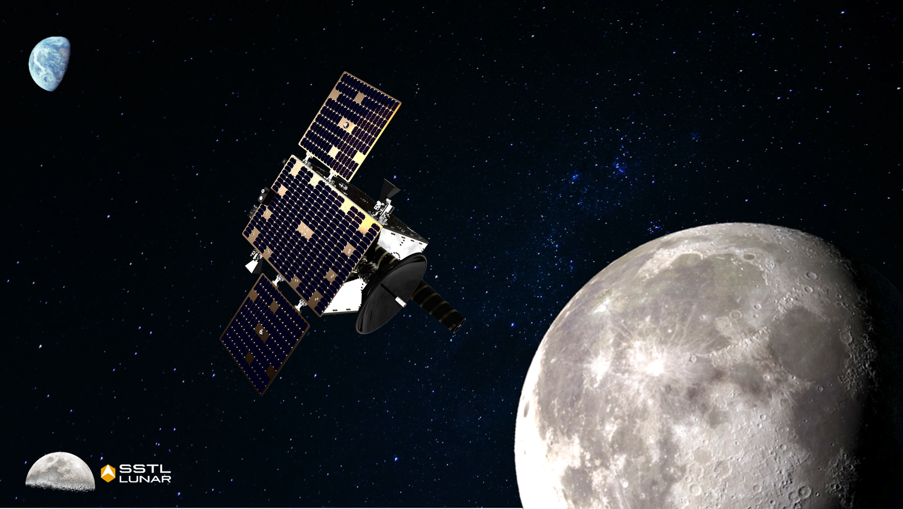


The frontiers of commercial space are growing…
SSTL has been demonstrating a different approach to rapid, cost-effective spacecraft engineering for over 40 years
Continue to be open mined to different approaches
Speed up the small mission pipeline
Be bold, the possibilities are endless

Slide 12
Thank You!

