Slide 1
ESA EOP as a CUSTOMER
Commercialisation
through EO Data Buy
for science & for operations
Funded by ESA and/or
with a third-party partner
Commercialisation
through EO Data Buy
for science (Earthnet)
& for operations (Copernicus)
Peggy Fischer, ESA EO Third Party Missions Manager
THE 1st EO COMMERCIALISATION FORUM
ESA HQ, Paris
30th October 2023

Slide 2

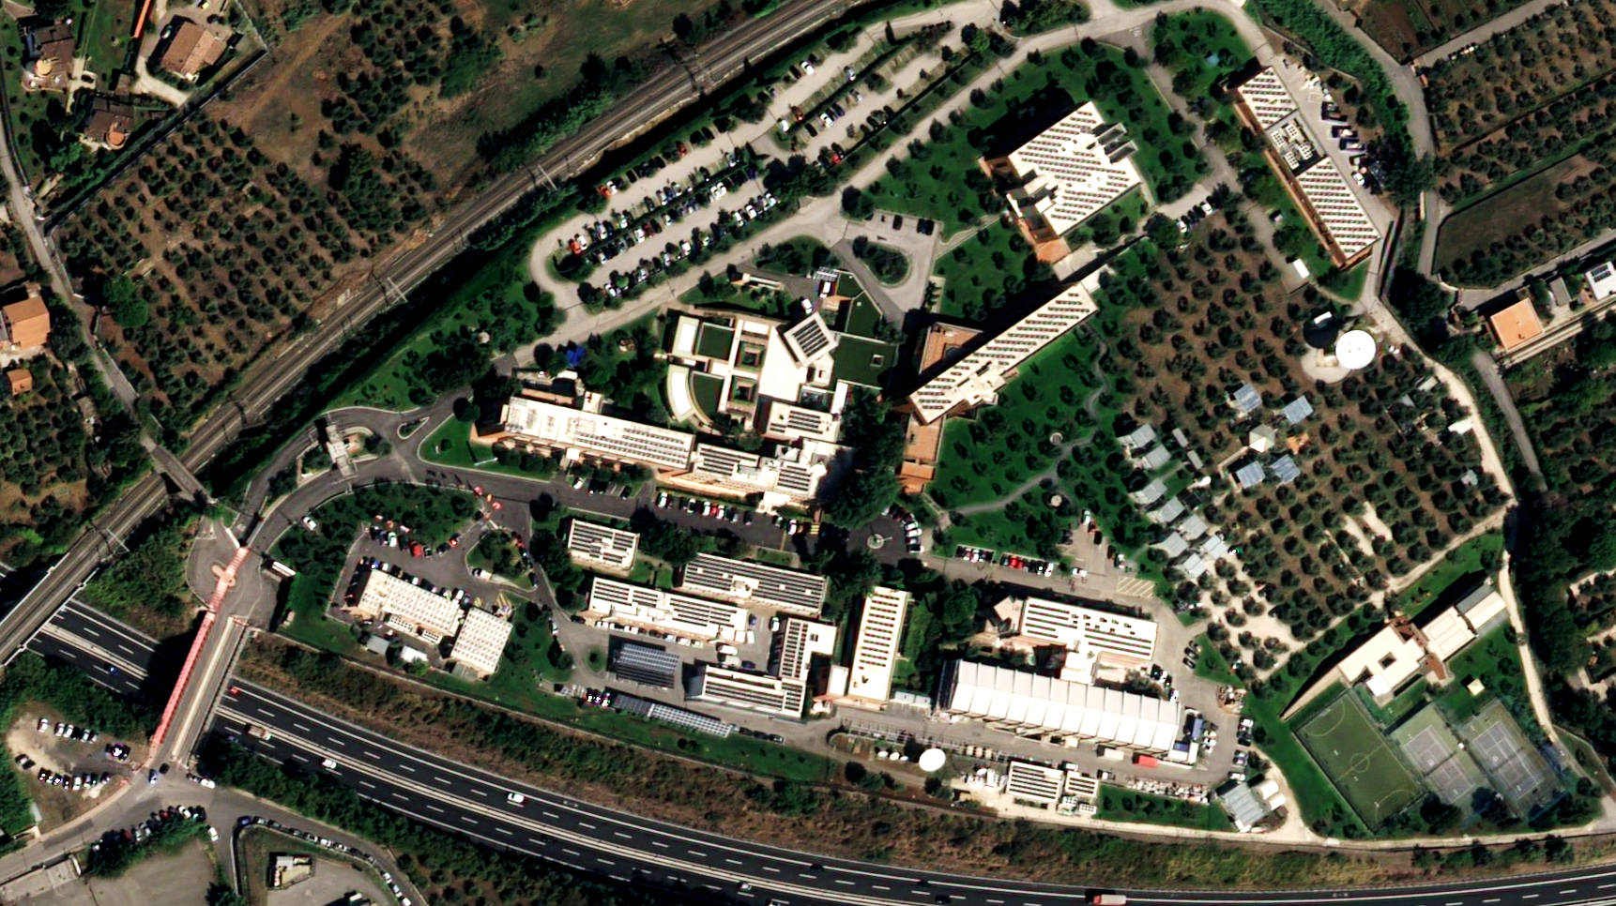
ESA/ESRIN, Frascati
Airbus Pleiades Neo
5 key points about EO data buy at ESA
EO data buy is a powerful way to support EO industry
→ US case vs Europe
Buying data comes with an impactful industrial policy
→ ESA customer role
ESA buys EO data for its own purpose (i.e., R&D studies) or on behalf of other institutions (e.g., for European Commission within Copernicus programme)
→ ESA Third Party Missions, Copernicus Contributing Missions
Through data buy, ESA assess the quality of commercial EO data
→ ESA data quality stamp
Through data buy, ESA stimulates the synergy between commercial EO missions and public EO missions (e.g., Sentinels)

Slide 3
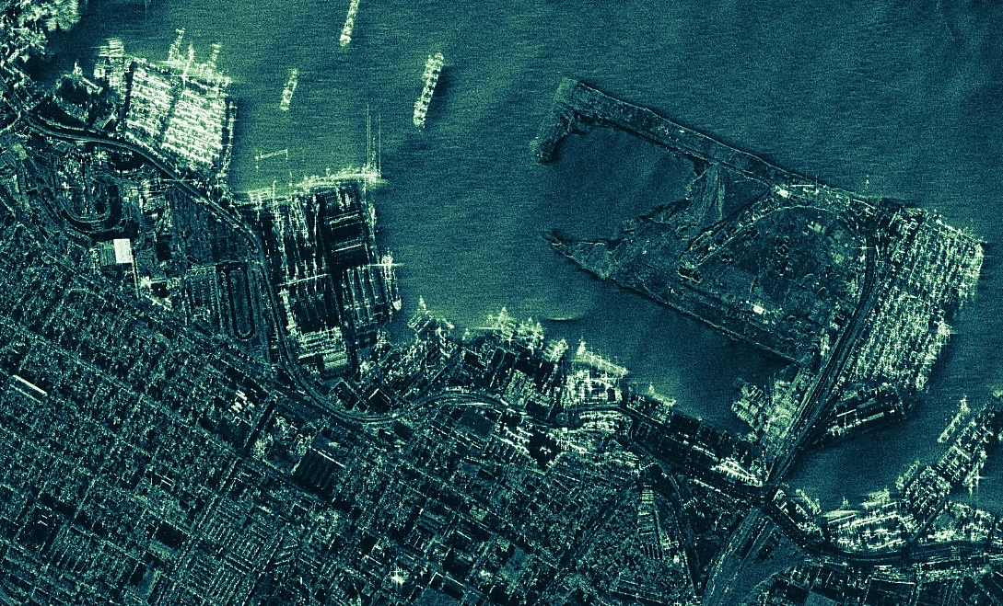
Alexandria, Egypt
ICEYE
EO data buy is a powerful way to support EO industry → US case
Using data buy, US institutions play a major role in consolidating the position of US commercial EO industry:
NASA buys EO data for science purpose: within the Commercial Smallsat Data Acquisition (CSDA) program, NASA recently announced a data buy of up to 476 M$ over 5 years with 7 commercial data providers, mainly from US ⁽¹⁾.
→ this value is 7 times bigger than for the equivalent ESA program (Earthnet Third Party Missions)
NOAA buys EO data for operational purpose, like sea ice monitoring
NRO and NGA buy EO data at a very large scale (e.g. MAXAR got a 10-years contract worth 1.5 B$ + 1.75 B$ to be confirmed at a later stage; Planet got an initial 5-years contract worth 146 M$, etc.). Those data are used for a mix of purposes, i.e. not only for defence purpose.
→ an initial estimation (TBC) is that, for EO commercial data buy, US public institutions would use 4 times more budget than the sum of all European public institutions (ESA/EC, national, regional)
⁽¹⁾ Maxar, Capella, Umbra, Spire, PlanetiQ, GHGSat, Airbus (SAR) [previous data buy contracts also included Planet]
NASA Selects Commercial Smallsat Data Acquisition Contractors - NASA
Notes:
To say that there is also a strong similar competition from Chinese EO companies

Slide 4
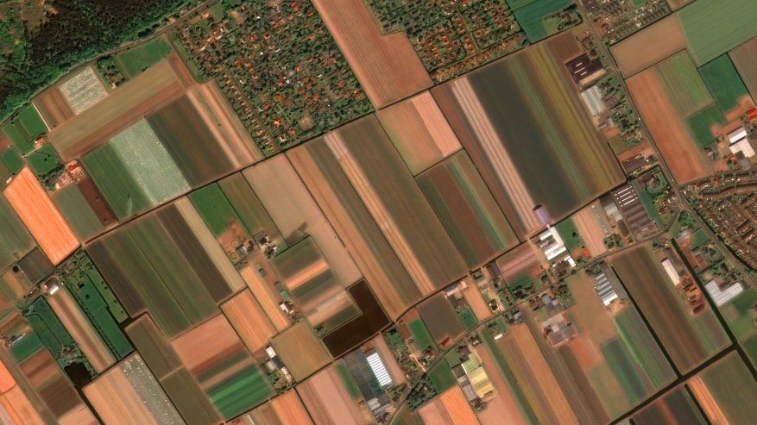
Noordwijk, NL
Geosat-2
Buying data comes with an impactful industrial policy → ESA customer role
While the prime purpose of the EO data buy activity is to fulfil public user needs (scientific and/or operational), the activity at ESA comes with an industrial policy:
Preference to European commercial missions
→ keeping in mind that the current European commercial offer is not sufficient to fulfil all user needs in some EO domain like optical Very High Resolution or Atmospheric Composition
Support to emerging European commercial missions
ESA/European Commission as anchor customer of New Space companies
enabling an efficient synergy/coordination with ESA development programs like EO InCubed
The above policy, shared with the European Commission within Copernicus programme, aims to give European commercial missions a long-term perspective of data purchase for public needs in Europe
Notes:
To say that there is also a strong similar competition from Chinese EO companies

Slide 5







Paris, France
COSMO-SkyMed
ESA buys EO data for its own purpose or on behalf of other institutions
→ ESA Third Party Missions and Copernicus Contributing Missions
Earthnet Third Party Missions
Copernicus Contributing Missions
EO data for R&D and science needs
EO data (and associated delivery services) for operational public needs
Initial data assessment
(mainly for commercial EO data)
Operational data delivery:
from established data suppliers
from emerging data suppliers
→ includes some coordination with NASA
Notes:
To say that there is also a strong similar competition from Chinese EO companies

Slide 6

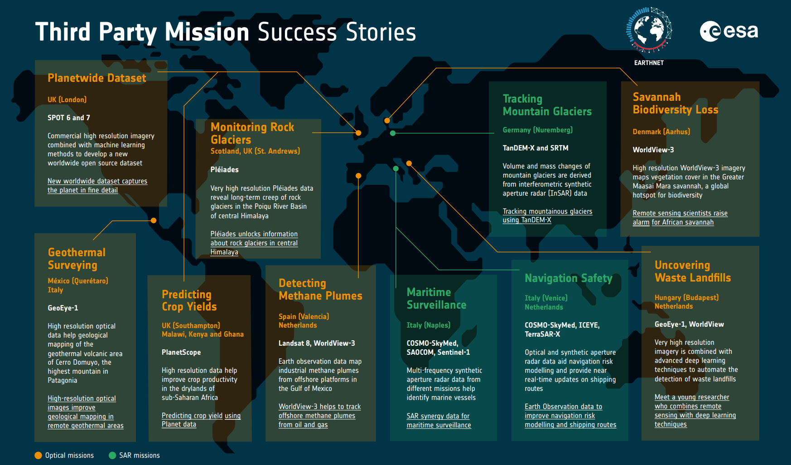
https://earth.esa.int/eogateway/news/third-party-mission-success-stories

Slide 7
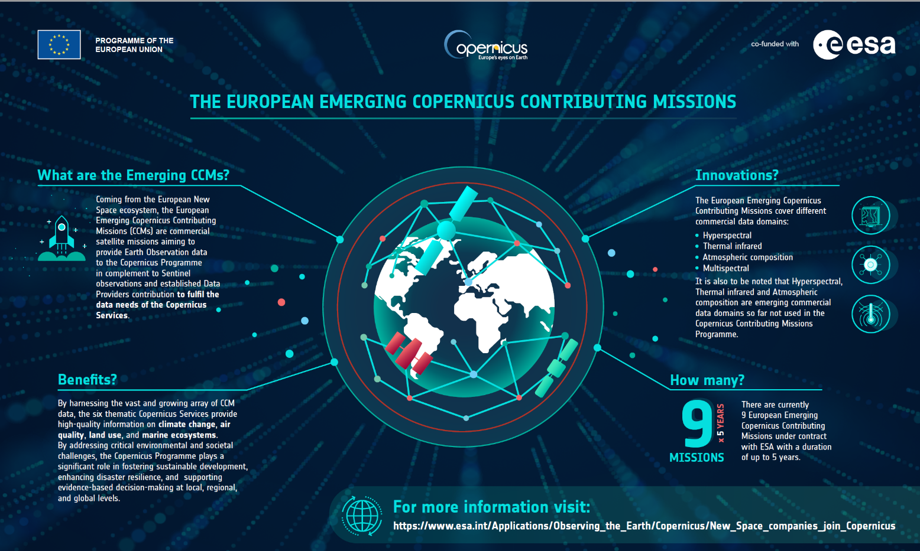

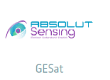



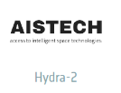
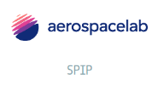



Slide 8
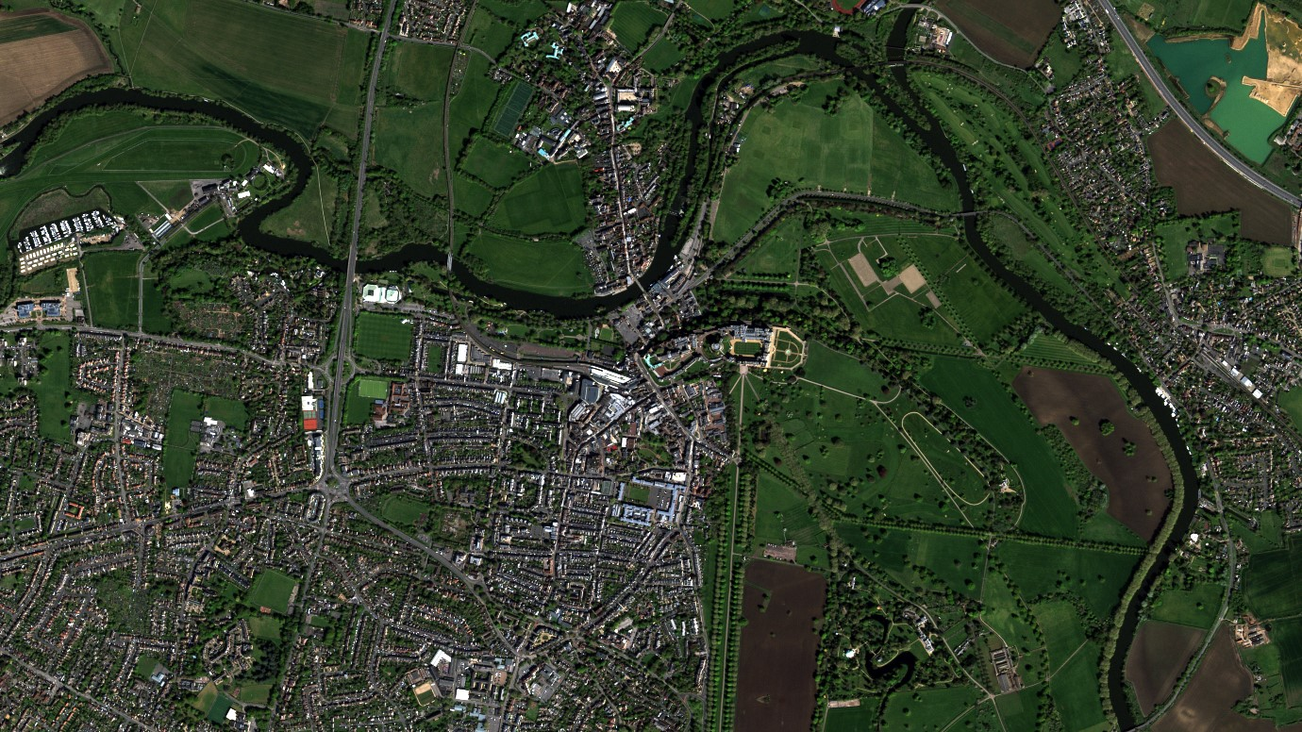

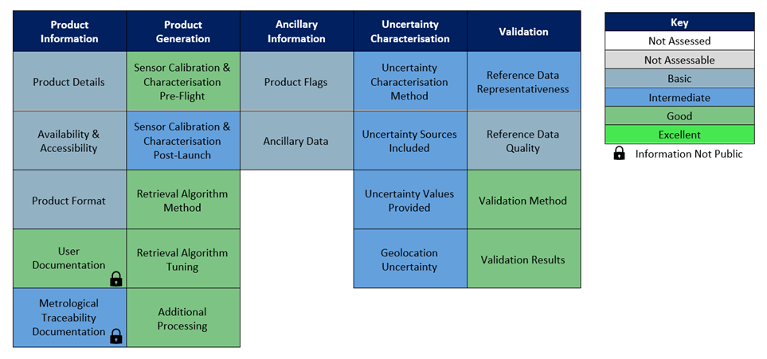

Windsor, UK
Vision-1
Through data buy, ESA assess the quality of commercial EO data
→ ESA data quality stamp
Since few years, ESA increases its activity related
to the assessment of commercial EO data:
A benchmark concept (Product Quality Evaluation Matrix) has been developed and is used to evaluate the quality of commercial mission products
The role of the Sentinel Mission Performance Clusters (MPC) is expanded to support ESA for the assessment of the CCM data quality (mainly for
the emerging data suppliers)
A yearly forum (VH-RODA) organised by ESA addresses the quality of commercial missions (mainly Very High Resolution)
Product Quality Evaluation Matrix
Example with GHGSat-C1 (Iris)
Notes:
To say that there is also a strong similar competition from Chinese EO companies

Slide 9
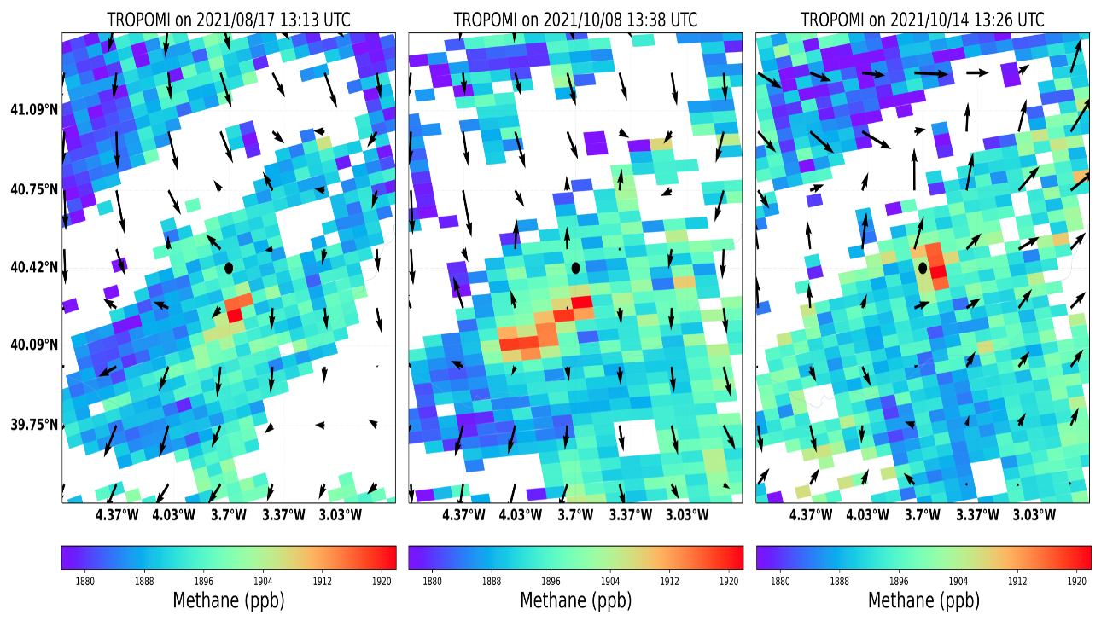
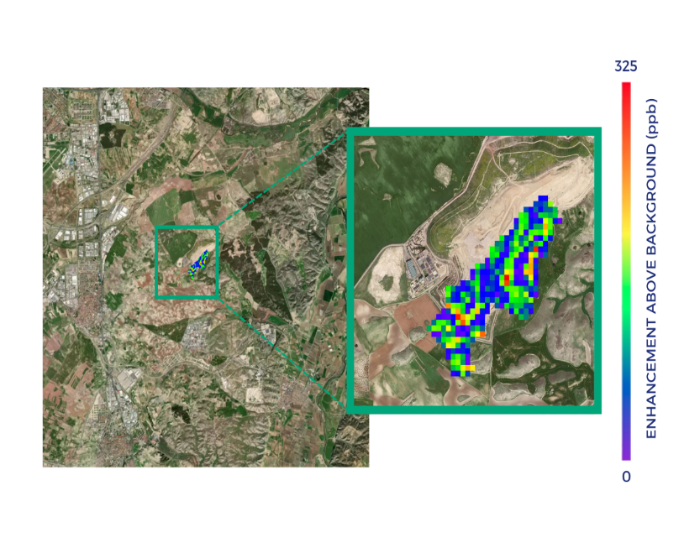
Through data buy, ESA stimulates the synergy
between commercial EO missions and public EO missions
→ Example of synergy between Sentinel-5P and GHGSat (ESA TPM) :
Methane concentration/emissions from landfills close to Madrid
Sentinel-5P
GHGSat
GHGSat methane measurements
(13 Oct. 2021)
Madrid
Copyright GHGSat
Copyright: Contains modified Copernicus Sentinel data (2021) / processed by SRON
https://www.esa.int/Applications/Observing_the_Earth/Satellites_detect_large_methane_emissions_from_Madrid_landfills

