Slide 1
JOIN THE BUSINESS JOURNEY
ESA COMMERCIALISATION GATEWAY
Luca del Monte
Head of Commercialisation Dept

Slide 2
CONTRIBUTIONS IN THE COMPANY’S LIFE-CYCLE
SCALEUP COMPLEMENTS EXISTING PROGRAMMES
ESA Business Incubation Centres
CASH FLOW
ESA R&D Programmes
ScaleUp INVEST
Supporting the development of ScaleUp ventures in new space markets ESA Marketplace
Prepare for Space
Ф-Lab Network
Technology Transfer
Intellectual Property
ScaleUp INNOVATE
Boosting innovation and commercialization in the European space sector
TURN AROUNDS > 10 M€
INSTITUTIONAL INVESTORS
GROWTH CAPITAL > 10 M€
PRIVATE EQUITY/LEVERAGED BUYOUT
VENTURE CAPITAL UP TO 10 M€
10 k€ – 1 M€
INCUBATOR
BUSINESS ANGEL
Technology Readiness Level (TRL) 1
TRL 7
TRL 9
TIME/TRL

Slide 3
Key Commercialisation Services provided by ESA
Enabling access to a pipeline of novel commercial enterprises nurtured within the ESA BIC network.
29 BICs – 200 startups supported annually – 1600+ startups selected overall
Creating a Marketplace for suppliers and customers to secure space services at competitive prices
Currently supporting companies to access c.25Me in funding for IOD/IOV deals
BUSINESS INCUBATION
INVEST
Facilitating integration of innovative commercial solutions via the PhilabNet into ESA missions.
12 Phi-labs target – 4 in development
Building effective partnerships with capital allocators (EIB, EIF), key institutions (EC, EUSPA, EIC), Accelerators (Space Founders, Seraphim, etc.), and Investors (VCs, PE firms)
35 members in the ESA Investor Network – 250+ investors in the community
Φ-LAB NETWORK
ESA Investor Network
Identifying technologies that have spin-off potential and supporting their commercialisation through ESA Spark Funding.
9 Technology Brokers – 400+ technology transfers
Extending the reach of ESA and space-companies into non-space sectors through dedicated in-country support.
Currently 13 ambassadors in 7 member states
TECHNOLOGY BROKERS
Plus patents/IP, biz accelerations, marketplace, etc.
AMBASSADOR NETWORK

Slide 4
ScaleUp INVEST
Mission
How it works
Enabling Aerospace companies
With a vision to scale UP their operations AND become the next Big European Player
On the Global Space Market.
Seller
Buyer
B2B DEAL
€€€ to co-finance B2B deal
BUSINESS & TECHNICAL INSIGHT
What companies can benefit from the program:
🗸 Access to Millions of € for B2B deals
🗸 Up to 80% for co-financing of B2B deal
🗸 Support for up to 5 deals

Slide 5
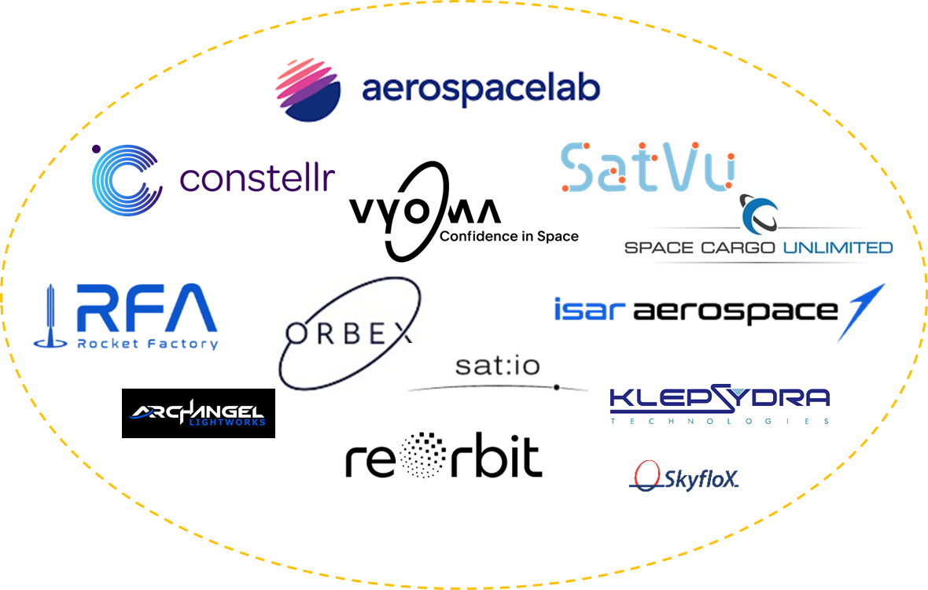
ScaleUp INVEST: Marketplace
The ScaleUp Marketplace​
The future "Amazon" of Space
1st IOD/IOV CAMPAIGN
100+ LEADING COMPANIES ENGAGED
Companies in the marketplace by 26/10

Slide 6
Commercialisation Services for the EO ecosystem
How can we help future EO missions ?
Incubating new companies to support future EO missions and maximising their socio-economic impact
Dedicated brokers and ambassadors' networks to scout spin-in opportunities
Faster cost-effective implementation of EO missions introducing commercial solutions/services: ESA as a CUSTOMER
Harnessing ESA’s patents to deliver better commercial solutions for EO missions
Leveraging a network of investors to support the growth of new industrial players
Bringing innovation rapidly to the market through PhiLabNET ready for use by EO missions

Slide 7
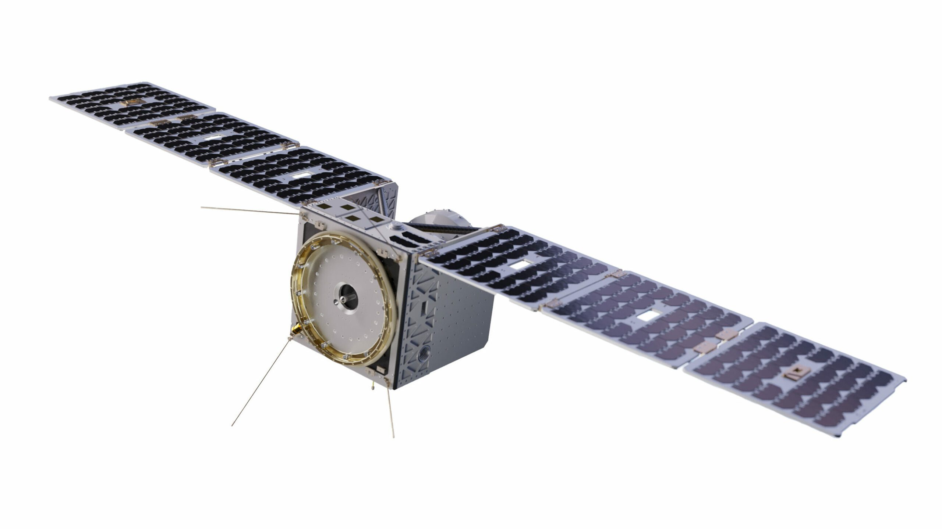
An example: ESA Contribution on ConstellR
Copernicus Contributing Mission 2023
Service Contracts and Anchor Customer Schemes
CASH FLOW
MARKETPLACE 2023
ScaleUp INVEST
INCUBED 2022-2023
ESA pre-commercialization / R&D Programmes
ESA BICs 2020-2022
ScaleUp INNOVATE
Karista 2023
Einstein Industries Ventures 2023
Lakestar 2022
Seraphim space 2021
Technology Readiness Level (TRL) 1
TRL 7
TRL 9
TIME/TRL
ESA INVESTOR NETWORK
Notes:
Key features:
Twin track/element approach – technology/sector agnostic – complementary to other ESA programmes - end-to-end support to avoid gaps in the development & delivery of commercial services/products through companies
ELEMENT 1. INNOVATE – to boost innovation and commercialisation
To identify and translate high-potential strategic R&D into commercial services/products (Phi labs)
To incubate start-up companies through access to critical business development services - funding, access to technical support, brokers, IP (Tech transfer)
To grow space economy at a local, regional, national and European level through innovation networks (BICs)
ELEMENT 2. INVEST - to support development of companies in commercial space markets
To facilitate access to finance for SMEs and midcaps with demonstrated technology and high growth potential
Live call for IOD/IOV demonstration – ends 1 Oct – valid for companies seeking to test payloads aimed at In Orbit ops
Open call on OSIP

Slide 8
TOGETHER WE INVEST AND INNOVATE
YOU SCALE UP!

