Slide 1
The ESA Scout framework
1st EO Commercialisation Forum
Jean-Pascal Lejault (Scout project manager)
SCO-HO-ESA-PM-0054
30th October 2023

Slide 2
Scout framework
New category of research missions in Earth Observation since 2019, inspired by New Space
to prove new disruptive concepts and to timely deliver innovative science
Scout missions are science-driven, not commercially-driven
However, Scout missions may have commercial applications
It can’t just be the dominant factor in the mission selection
Main features
a more pro-active role of industry (service contract with limited oversight from ESA)
a low-cost approach: 30 M€ e.c. 2022 max (use of COTS, lighter model philosophy, strictly tailored ECSS standards, lean reviews)
a rapid development cycle (3 years from start of phase B/C/D/E1 implementation to launch).

Slide 3
Main Scout features
Fully funded End-to-end service contract
The Contractor shall procure, develop, validate, launch, operate and complete the entire system (ground segment, space segment, launch services and operations)
The satellite(s) remain(s) the property of the Contractor
Key Performance Gate Reviews (KPGR) at key stages (e.g. SRR, PDR, CDR, QR) → to raise confidence that the service will be delivered as expected
In case a KPGR fails, ESA has the right to terminate the Contract
Which service?
delivery of innovative science products
specified in the Mission Requirements Document (MRD)
free and open data policy

Slide 4
Process followed for the first Scout cycle
ITT to
collect Scout mission concepts (some 16 concepts were received)
down-select the most promising concepts (4 concepts) → system consolidation studies
Independent scientific assessment of the 4 down-selected concepts
Submission to the Programme Board for Earth Observation (PB-EO) for implementation
For each approved Scout mission
Procurement (dialogue phase, RfQ, proposal writing, evaluation, negotiations)
Implementation
Typical time scales
1.5 years between ITT and ACEO conclusions
1 year between PB-EO approval and phase B/C/D/E1 kick-off

Slide 5
CubeMAP (Scout-1)
A constellation of 3 12U satellites to observe key radiative gases in the atmosphere
H₂O, CO₂, CH₄, O₃, N₂O
Sadly, CubeMAP could no longer be maintained within the Scout framework → contract terminated in Q2 2023
Full Lessons learnt are being collected

Slide 6
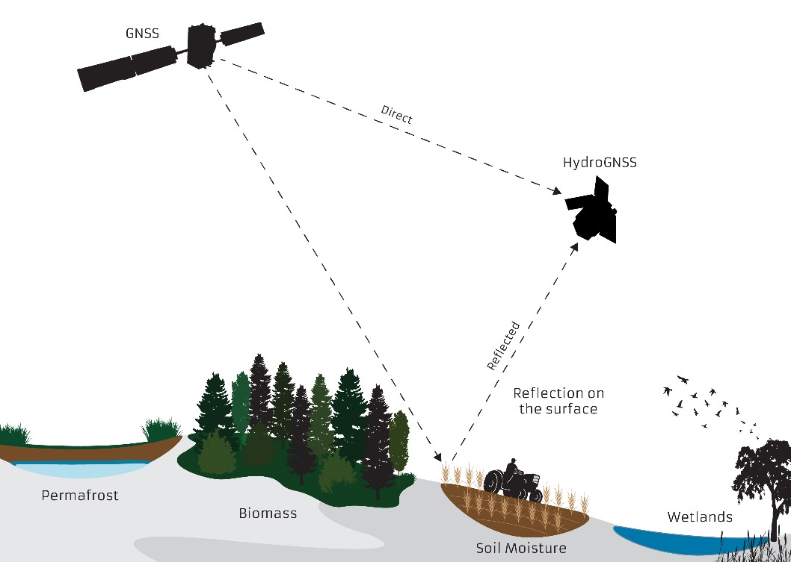
HydroGNSS (Scout-2)
Aim: improve our knowledge of the Earth water cycle.
Technique: GNSS reflectometry (i.e. sense the signals reflected by the Earth surface from GNSS satellites)
Constellation of two small satellites (50 x 50 x 70 cm, 70 kg)
Sun synchronous orbit, 550 km altitude
Launch readiness: Q4 2024
Service (science data) for up to 4.5 years
soil moisture
inundation / wetlands
soil freeze / thaw (notably over permafrost)
above-ground biomass
Potential interest in adding satellites to deliver a commercial service to specific customers (e.g. soil moisture knowledge and prediction for agriculture to adapt irrigation and manage water shortage or over-abundance)

Slide 7
Opportunities for commercialisation
Scaling-up
It is easy to add recurring satellites to a Scout mission at a low-cost (not to be paid by ESA)
to replace satellites nearing end-of-life
to improve the science return once the concept is demonstrated
(e.g. improve coverage or reduce revisit time)
to expand the science products to commercial applications (e.g. Green transition and sustainability regulations)
Commercial applications, though not at the heart of the selection of Scout missions, are relevant
To address commercial needs which can be built on the science service
An incremental approach (Minimum Viable Product) is very suitable:
Start with “basic” commercial service directly derived from the science products
Add one recurring satellite to expand the commercial service
Then add more recurring satellites as the commercial service further grows
→ Financial risks can be minimized

Slide 8
Conclusion
The Scout framework offers key opportunities for Industry in Europe, including commercialisation
Commercial applications
can be incrementally derived from the science products at a low cost
minimise risks as initial development is fully funded and supported by ESA experts
maximise return on investment
Next step for Scout is coming very soon and will be discussed at the PB-EO meeting on 21-22 November 2023
Stay tuned!
Visit https://www.esa.int/Applications/Observing_the_Earth/FutureEO/Scouts_ESA_s_agile_research_missions

Slide 9
Thank you for your attention

Slide 10
Backup slides

Slide 11
Commercial possibilities with HydroGNSS
Agriculture: soil moisture knowledge and prediction is vital for agriculture, especially under changing climate conditions and demographic pressures.
Quantification of water shortage or over-abundance allows for correct irrigation and drainage.
This is important locally (farm planning) and at a larger scale (regionally and nationally).
Water agencies extract from aquifers and natural reservoirs, which have a dependence on rainfall and soil moisture.
Run-off from land into lakes and water courses can cause water treatment facilities to overflow, causing river pollution.
Construction site flooding can cause pollutant discharge (silt, oil, chemicals), as well as halting progress.
Flood planning agencies need to know the saturation levels of soils to predict risks of flooding, something also important to insurance companies
Weather forecast: accurate numerical weather predictions (NWP) depends on soil moisture knowledge
Soil moisture has a significant effect on weather, especially over large land masses.
Insurance industry
interest in the risk of land subsidence caused by cycles in soil moisture, especially in hilly and mountainous regions.
Management of infrastructure
Changes in freeze/thaw cycle and underlying permafrost cause subsidence for some settlements in high latitudes.
Notes:
Silt → limon (en français)

Slide 12
Scout future
360-degree Scout lessons learnt exercise on-going, report due by 3rd Nov 2023
To improve the next Scout cycle based on the experience from the first cycle
e.g. reduce time-to-contract duration, streamline procurement process
To improve the Scout framework to maintain attractiveness (ESA Member States & Industry)
November 2023 PB-EO
Present the outcome of the Scout lessons learnt exercise
Agree with Member States the approach for the next Scout cycle and next steps

Slide 13
Scout specificities
New Space approach
MRD: key document, defining the service to be delivered
produced by the Prime Contractor and delivered as part of the proposal
MRD is co-signed by all parties (ESA, Contractor, SAG chair) at phase B/C/D/E1 kick-off
Other requirements are strictly limited to best fit the Prime Contractor’s processes
ECSS standards are significantly tailored to fit to New Space
No dedicated management requirements, only limited management tasks in the SoW
Product Assurance requirements are tailored
Lean ESA reviews
ESA project-level reviews, no ESA independent teams
Lean ESA team, as ESA relies much more on Industry for Scout missions
Very pragmatic and flexible Scout project team
Dedicated expert support in the areas exposed to the main risks

