Slide 1
EOP as a Partner – InCubed Programme
Michele Castorina
THE 1st EO COMMERCIALISATION FORUM
ESA HQ, Paris
30th October 2023

Slide 2
7 presentations in this session
The session is not exhaustive, i.e. does not address all actions related to EO commercialisation
ESA EOP as a CUSTOMER
ESA EOP as a PARTNER
ESA EOP as an ENABLER
“Traditional” EOP R&D procurement agency role
Funded by ESA and/or
with a third-party partner
Co-funded
(generally with industry)
Fully funded by ESA
Fully funded by ESA
“ New Space approach”
3
FutureEO
Block 4 : Enabling downstream applications
Block 3: Enabling commercialisation with GS & data management
Block 1 : Commercialisation with upstream technology
4
1
2
Scouts
(FutureEO Block 2)
Commercialisation through
EO Data Buy
for science (Earthnet)
& for operations (Copernicus)
InCubed
(Earth Watch)
5
Arctic Weather Satellite
(Earth Watch)
6
7
[D/CIC]
BICs, Scale Up Invest
Business Applications
& Space Solutions (BASS)
[D/TEC]
General Support Technology Programme (GSTP)

Slide 3
7 presentations in this session
The session is not exhaustive, i.e. does not address all actions related to EO commercialisation
ESA EOP as a CUSTOMER
ESA EOP as a PARTNER
ESA EOP as an ENABLER
“Traditional” EOP R&D procurement agency role
Funded by ESA and/or
with a third-party partner
Co-funded
(generally with industry)
Fully funded by ESA
Fully funded by ESA
“ New Space approach”
3
FutureEO
Block 4 : Enabling downstream applications
Block 3: Enabling commercialisation with GS & data management
Block 1 : Commercialisation with upstream technology
4
1
2
Scouts
(FutureEO Block 2)
Commercialisation through
EO Data Buy
for science (Earthnet)
& for operations (Copernicus)
InCubed
(Earth Watch)
5
Arctic Weather Satellite
(Earth Watch)
6
7
[D/CIC]
BICs, Scale Up Invest
Business Applications
& Space Solutions (BASS)
[D/TEC]
General Support Technology Programme (GSTP)

Slide 4





ESA contributions in the EO company life-cycle
ScaleUp INVEST
Data Buy
(CCM/TPM)
InCubed
Future EO
Technology Developments
Business Readiness Level BRL 0 BRL 1 BRL 2-7 BRL 9
TURN AROUNDS
> 10 M€
INSTITUTIONAL INVESTORS
ScaleUp INNOVATE
GROWTH CAPITAL
> 10 M€
PRIVATE EQUITY/LEVERAGED BUYOUT
VENTURE CAPITAL
UP TO 10 M€
BUSINESS
ANGEL
10 k€ – 1 M€
TRL 1. TRL 3
TRL 9
Technology Readiness Level
Company cash-flow

Slide 5




ESA as a Partner – InCubed - Key Characteristics
ESA, Industry and National Delegations are partners
No Statement of Work - Industry idea
A promising business case – road to market
Technology not yet ready – target an MVP

Slide 6



ESA as a Partner – InCubed – What ESA offers
Risk sharing - Equity free co-funding
ESA technical expertise, business development
Strong connection with private investors (through CIC)

Slide 7
InCubed role impact to industry
InCubed is more and more seen as a key tool for company innovation, for:
  Established companies (i.e. LSI and SMEs) to innovate their portfolio with highly competitive product/services
  For start-ups and New Space companies, to establish their business taking advantage from the strong ESA
Significant commercial results of supported companies:
  Major commercial contracts
  Follow-up private investments
€182M
InCubed fund size
124
@64% co-funding rate

Slide 8






InCubed Domains
Space segment
Ground segment
Data segment
Platform
Ground Networks &
Data Distribution
Data Analytics, Insights &
Applications
Payload
Ground Stations &
Mission Management
Data Processing &
Visualization

Slide 9

























































Supported InCubed Downstream Companies

Slide 10









































Supported InCubed Upstream Companies

Slide 11
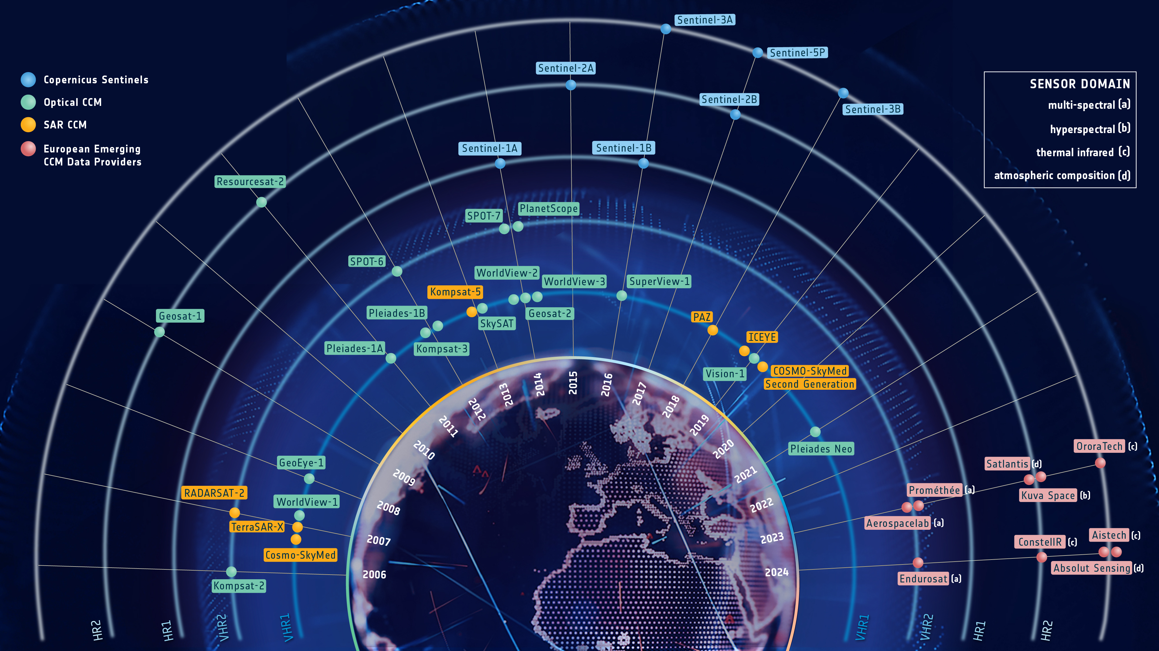
InCubed impacts to the EO commercial industry
InCubed, ScaleUp, and CCM synergetic pipeline
Five InCubed companies have been awarded with a CCM contract providing quality data for operational public needs within the Copernicus framework
Two others (ConstellIR and ReOrbit) have qualified also for ScaleUp Invest step1 for scaling up their service
The success of these InCubed companies is a testament to the value of what small emerging European companies are doing with the support of the different teams at ESA
InCubed supported

Slide 12
Thank you for your attention
Michele.Castorina@esa.int
To know more, visit our website:
https://philab.esa.int
https://incubed.esa.int

